Slide 1


Slide 3

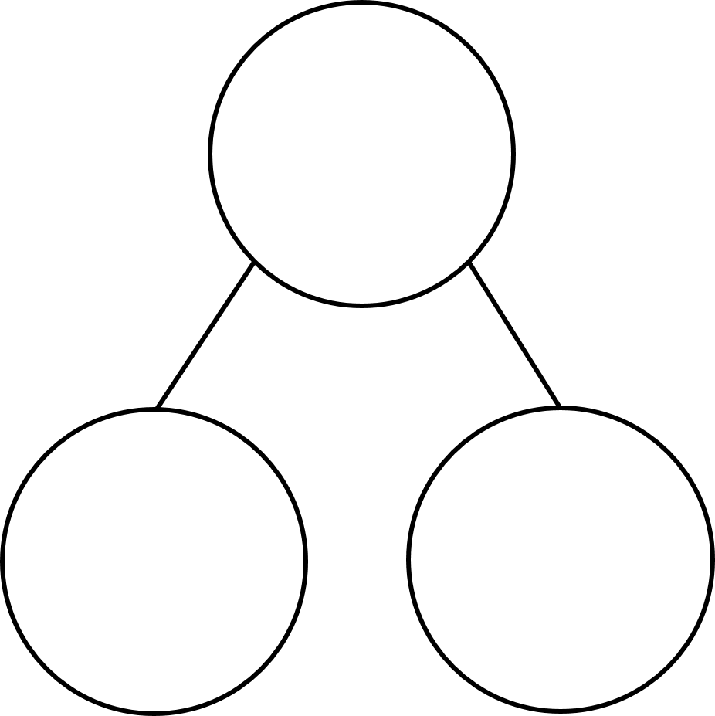

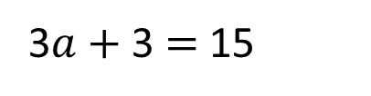
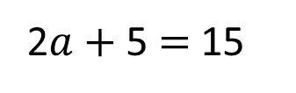
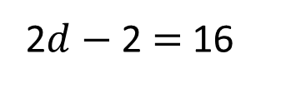
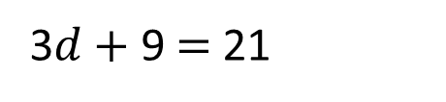
1)Solve the equations to work out the value of
2) Solve the equations.
15
15
2$a+$ 5 $=$ 15
3$a+$ 3 $=$ 15
3$d$ $+$ 9 $=$ 21
2$d−$ 2 $=$ 16

Slide 4
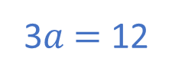
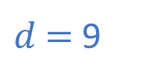
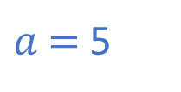
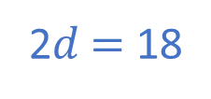
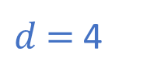
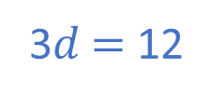
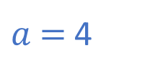
1)Solve the equations to work out the value of
2) Solve the equations.
10
15
15
2$a+$ 5 $=$ 15
3$a+$ 3 $=$ 15
$a$ $=$ 5
3$a$ $=$ 12
$a$ $=$ 4
3$d$ $+$ 9 $=$ 21
2$d−$ 2 $=$ 16
3$d$ $=$ 12
2$d$ $=$ 18
$d$ $=$ 4
$d$ $=$ 9

Slide 6



Have a think
The circle and the square represent positive integers.
$$+$$
$$=$$
5
What numbers could the square and the circle be?
How many different possibilities are there?

Slide 7


The circle and the square represent positive integers.
$$+$$
$$=$$
5
 |  | Total
 |  | 5
 |  | 5
 |  | 5
 |  | 5
4 |  | 5
 |  | 5
 |  | 5
 |  | 5
4 | 1 | 5
 |  | 5
 |  | 5
 |  | 5
4 | 1 | 5
3 | 2 | 5
 |  | 5
 |  | 5
4 | 1 | 5
3 | 2 | 5
2 | 3 | 5
 |  | 5
4 | 1 | 5
3 | 2 | 5
2 | 3 | 5
1 | 4 | 5

Slide 8


Have a think
The circle and the square represent positive integers.
$$×$$
$$=$$
15
What numbers could the square and the circle be?
How many different possibilities are there?

Slide 9
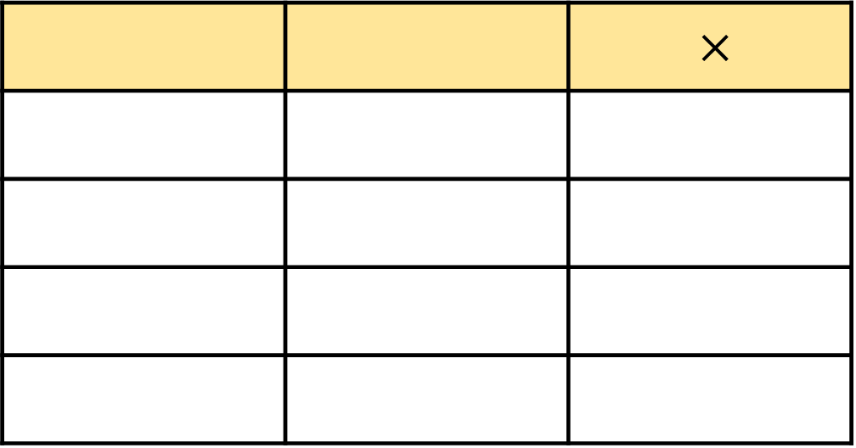

The circle and the square represent positive integers.
$$×$$
$$=$$
15
 |  | $×$
 |  | 15
 |  | 15
 |  | 15
 |  | 15
1 |  | 15
 |  | 15
 |  | 15
 |  | 15
1 | 15 | 15
 |  | 15
 |  | 15
 |  | 15
1 | 15 | 15
2 |  | 15
 |  | 15
 |  | 15
1 | 15 | 15
2 | 7.5 | 15
 |  | 15
 |  | 15
1 | 15 | 15
3 |  | 15
 |  | 15
 |  | 15
1 | 15 | 15
3 | 5 | 15
 |  | 15
 |  | 15
1 | 15 | 15
3 | 5 | 15
5 | 3 | 15
 |  | 15
1 | 15 | 15
3 | 5 | 15
5 | 3 | 15
15 | 1 | 15

Slide 10
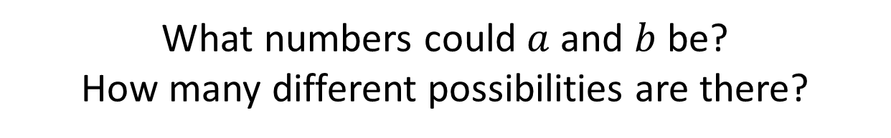
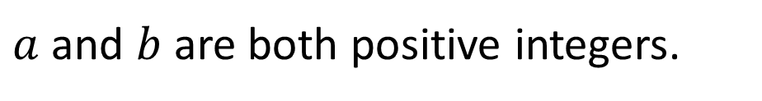
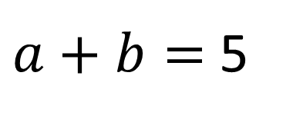
Have a think
$a+b=$ 5
$a$and $b$ are both positive integers.
What numbers could $a$ and $b$be?
How many different possibilities are there?

Slide 11


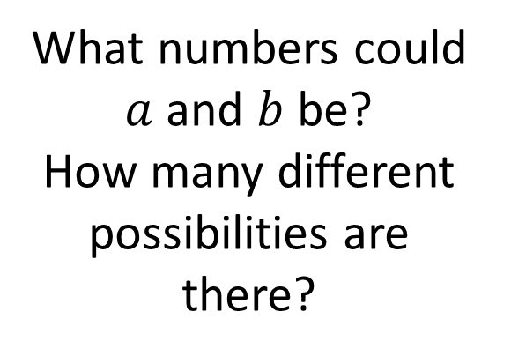
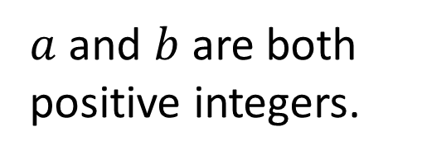
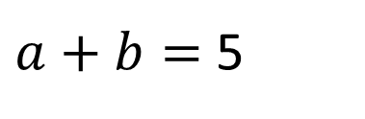
$a+b=$ 5
$$+$$
$$=$$
5
$a$and $b$ are both positive integers.
The circle and the square represent positive integers.
What numbers could $a$ and $b$be?
How many different possibilities are there?
What numbers could the square and the circle be?
How many different possibilities are there?

Slide 12
Have a go at questions
1 - 3 on the worksheet

Slide 13

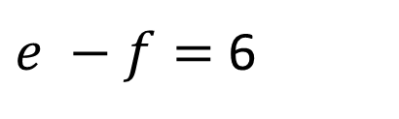


Have a think
$e −f=$ 6
List 3 possible values for $e$ and $f$.
85
$$e$$
20
7
$$f$$
79
6
14
1

Slide 14
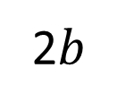
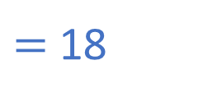
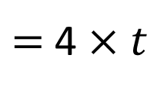


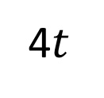

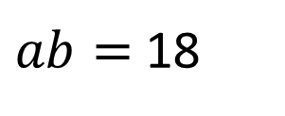


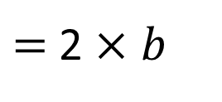
Have a think
$a$ and $b$ are integers.
$ab=$ 18
$a$ $×$ $b$
$=$ 18
List all the possible values for $a$ and $b$.
4$t$
$=$4 $×$ $t$
2$b$
$=$ 2 $×$ $b$
What do you notice?
$$ab$$
$=$ $a$ $×$ $b$

Slide 15



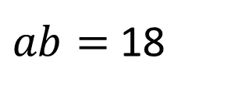

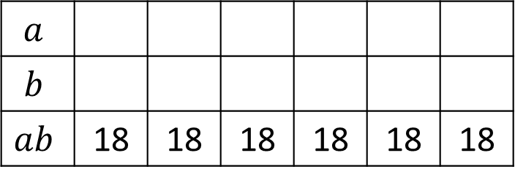
$a$ and $b$ are integers.
$ab=$ 18
$a$ $×$ $b$
$=$ 18
List all the possible values for $a$ and $b$.
1 and 18
18
3 and 6
2 and 9
1
2
18
9
3
6
$$a$$
$$b$$
$$ab$$ | 18 | 18 | 18 | 18 | 18 | 18
6
3
18
1
9
2

Slide 16
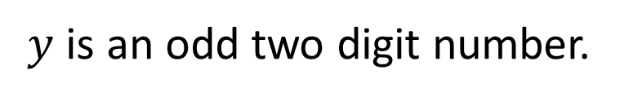
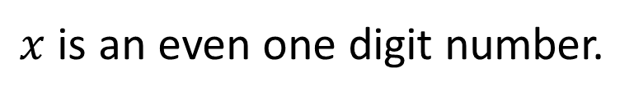
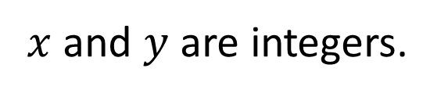
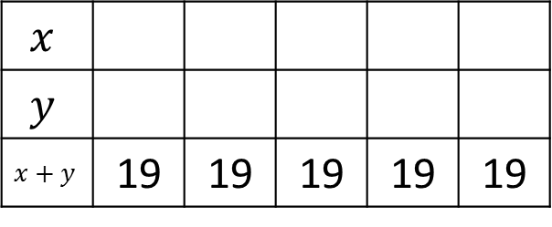

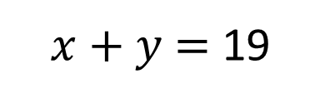
$x$ and $y$ are integers.
$x$ is an even one digit number.
$y$ is an odd two digit number.
$x+y$ $=$ 19
Find all the possible values of $x$ and $y$.
$$x$$
$$y$$
$$x+y$$ | 19 | 19 | 19 | 19 | 19
0
2
4
6
8
19
17
15
13
11
Have a think

Slide 17
Have a go at the rest of the questions on the worksheet

