Slide 1


Slide 3
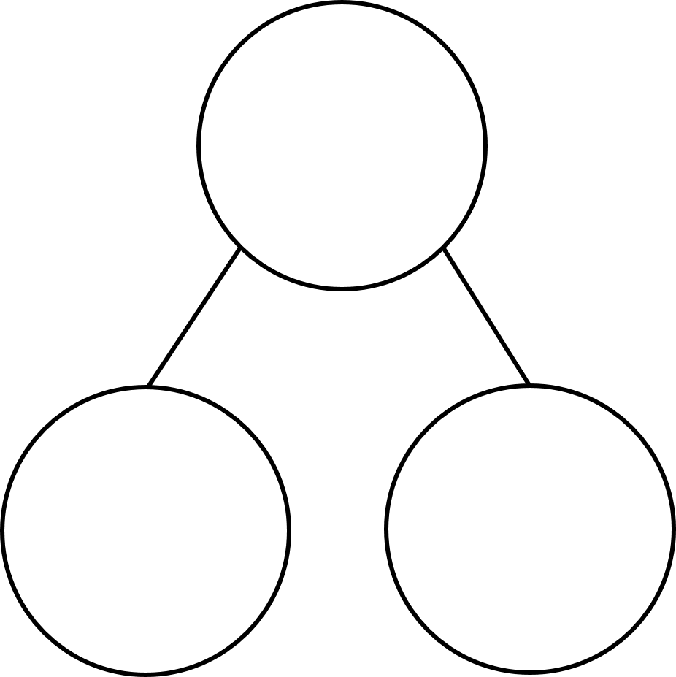
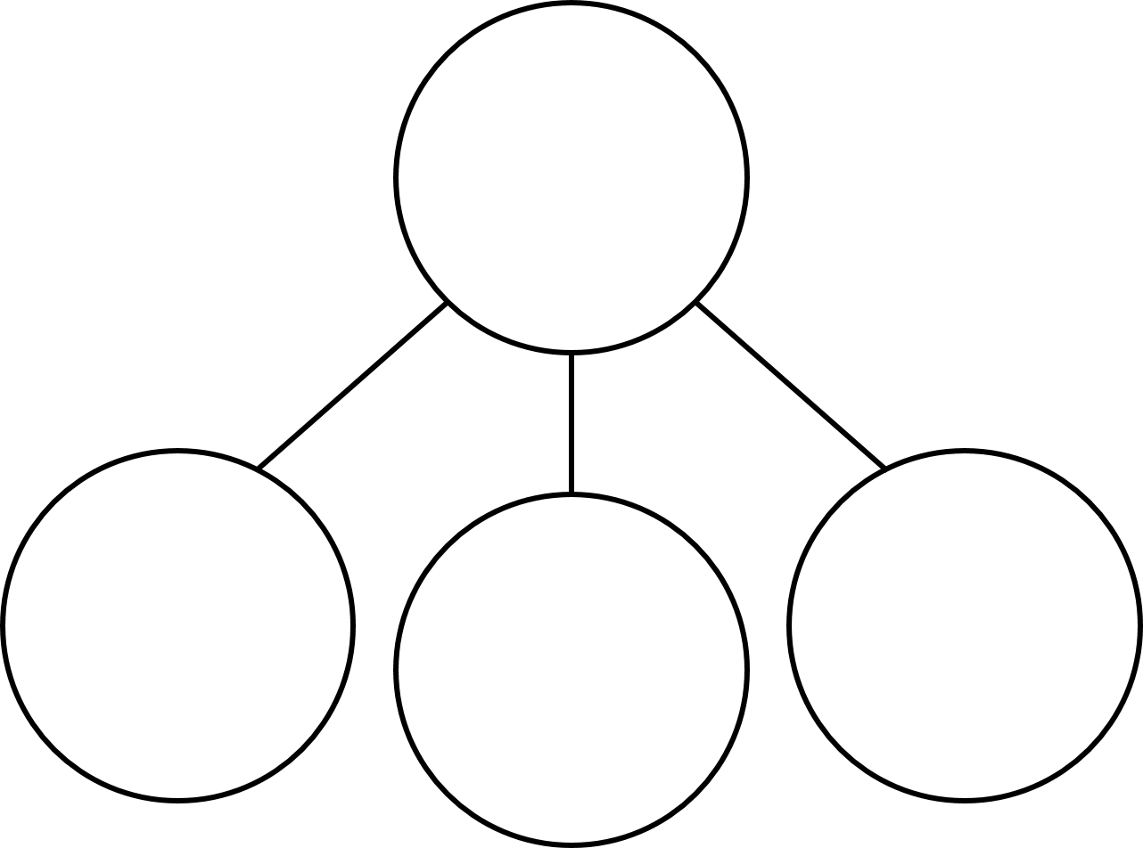


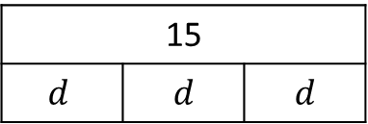
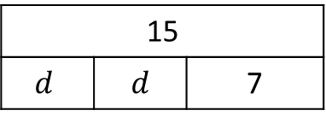
1) Form an equation to represent the part-whole models.
2) Form equations to represent the bar models.
20
30
12
15
$$d$$ | $$d$$ | $$d$$
15
$$d$$ | $$d$$ | 7

Slide 4
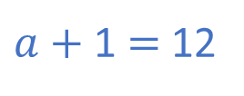
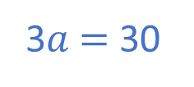
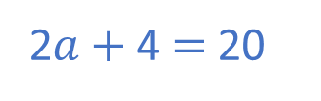
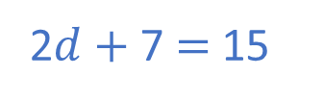
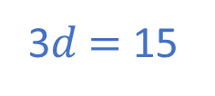
1) Form an equation to represent the part-whole models.
2) Form equations to represent the bar models.
20
30
12
2$a+$ 4 $=$ 20
3$a$ $=$ 30
$a+$ 1 $=$ 12
15
$$d$$ | $$d$$ | $$d$$
15
$$d$$ | $$d$$ | 7
3$d$ $=$ 15
2$d+$ 7 $=$ 15

Slide 6



Alex and Jack have the same number of sweets.
This is all of Alex’s sweets
This is some of Jack’s sweets.
The rest are in his pocket.
How many sweets are in Jack’s pocket?

Slide 7
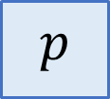
Alex and Jack have the same number of sweets.
$p$

Slide 8
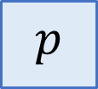
Alex and Jack have the same number of sweets.
$p$

Slide 9
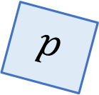
Alex and Jack have the same number of sweets.
$p$

Slide 10
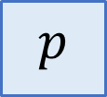
Alex and Jack have the same number of sweets.
$p$

Slide 11


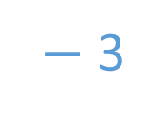

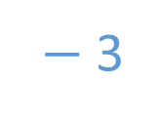
Alex
Jack
$$p$$
3 $+$ $p=$5
$−$ 3
$−$ 3
$p=$ 2

Slide 12




What is the value of ?
$$+$$
$$+$$
$$=$$
9
Have a think

Slide 13




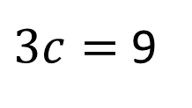
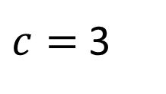



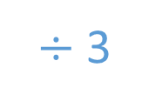







$$c$$
$$+$$
$$c$$
$$+$$
$$c$$
$$=$$
9
9
$3c=$ 9
$÷$ 3
$÷$ 3
$$c$$
$$c$$
$$c$$
$c=$ 3
$$c$$
$$c$$
$$c$$
3 | 3 | 3
$$9$$

Slide 14
4f = 12
3y = 15
7s = 42

Slide 15
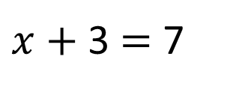
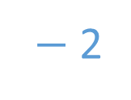

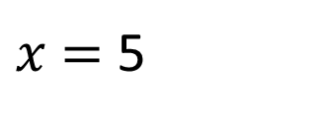

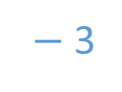

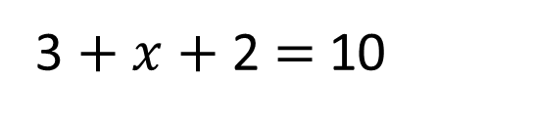
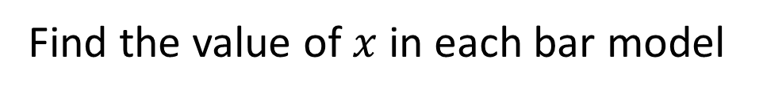

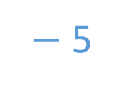
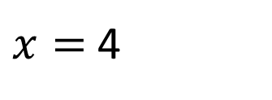
Find the value of $x$in each bar model
7
10
$$x$$
3
3
$$x$$
2
$x+$ 3 $=$ 7
3 $+ x+$ 2 $=$ 10
$−$ 3
$−$ 3
$−$ 3
$−$ 2
$−$ 5
$x=$ 4
$x$ $=$ 5
Have a think

Slide 16



16
$$x$$
7
22
$$x$$
9
9
$$x$$
2

Slide 17
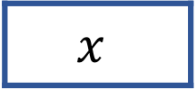
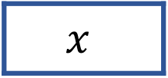
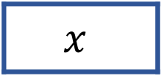
40
15
$$x$$
10
26
6
$$x$$
6
100
30
$$x$$
20

Slide 18

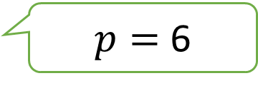
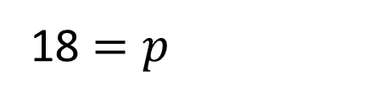
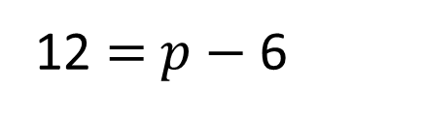
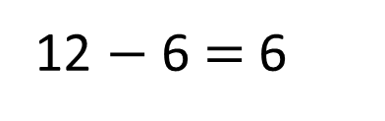

12 $=$ $p$ $−$ 6
18 $=p$
12
$$p$$
6
12 $−$ 6 $=$ 6
$p=$ 6
Have a think

Slide 19

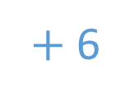

12 $=$ $p$ $−$ 6
$+$ 6
$+$ 6
18 $=p$
$$p$$
6
12

Slide 20
18 = h – 10
25 = d – 15
40 = s – 60

Slide 21
Have a go at questions
1 - 4 on the worksheet

Slide 22

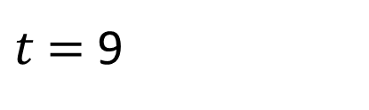


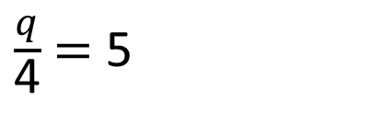
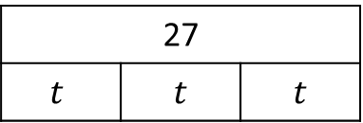
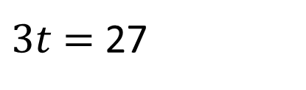
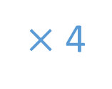
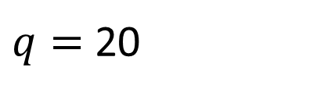
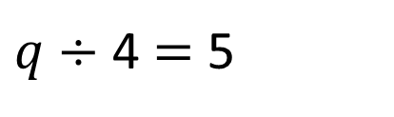
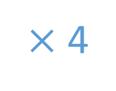
Solve the equations
Have a think
$$q$$
27
$$t$$ | $$t$$ | $$t$$
5
5
5
5
$\frac{q}{\text{4}}$ $=$ 5
$3t$ $=$ 27
$q÷$ 4 $=$ 5
$÷$ 3
$÷$ 3
$×$ 4
$×$ 4
$t$ $=$ 9
$q=$ 20

Slide 23
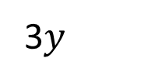
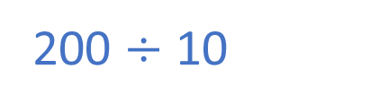
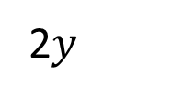
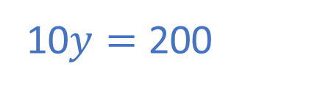
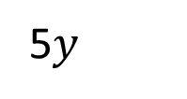
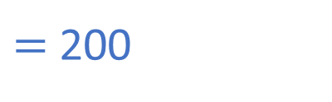
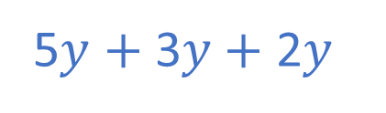
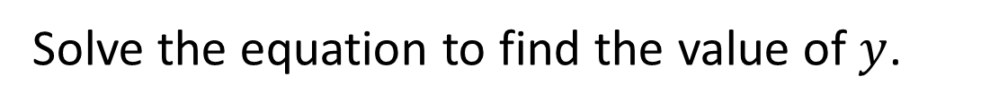

The perimeter of the triangle is 200 cm
Not to scale.
3$y$
Have a think
60 cm
5$y$
100 cm
2$y$
40 cm
Form an equation to show this information.
5$y$ $+$ 3$y+$2$y$
$=$ 200
10$y=$ 200
Solve the equation to find the value of $y$.
200 $÷$ 10
$y=$ 20
Work out the lengths of the sides of the triangle.

Slide 24
Have a go at the rest of the questions on the worksheet

