Slide 1
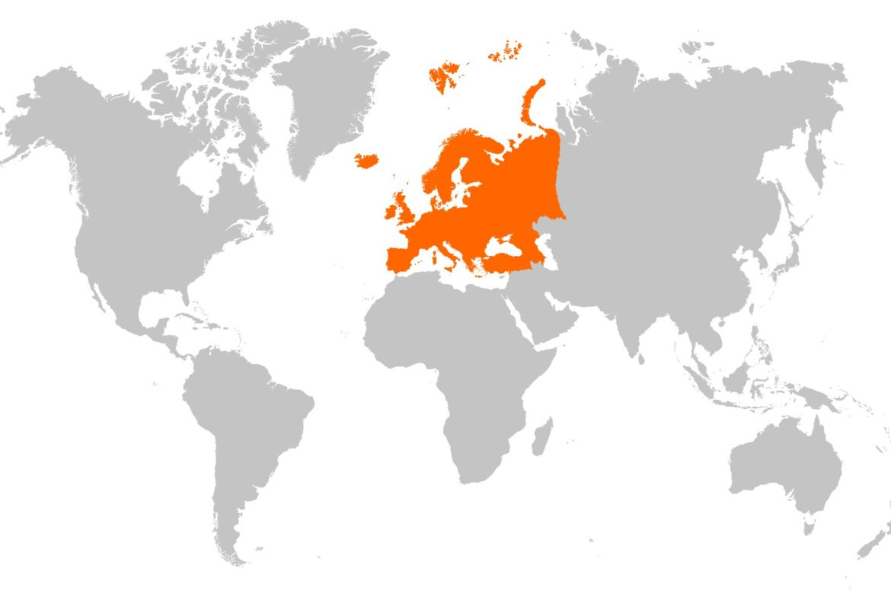
Europe
By Percy Booker

Slide 2
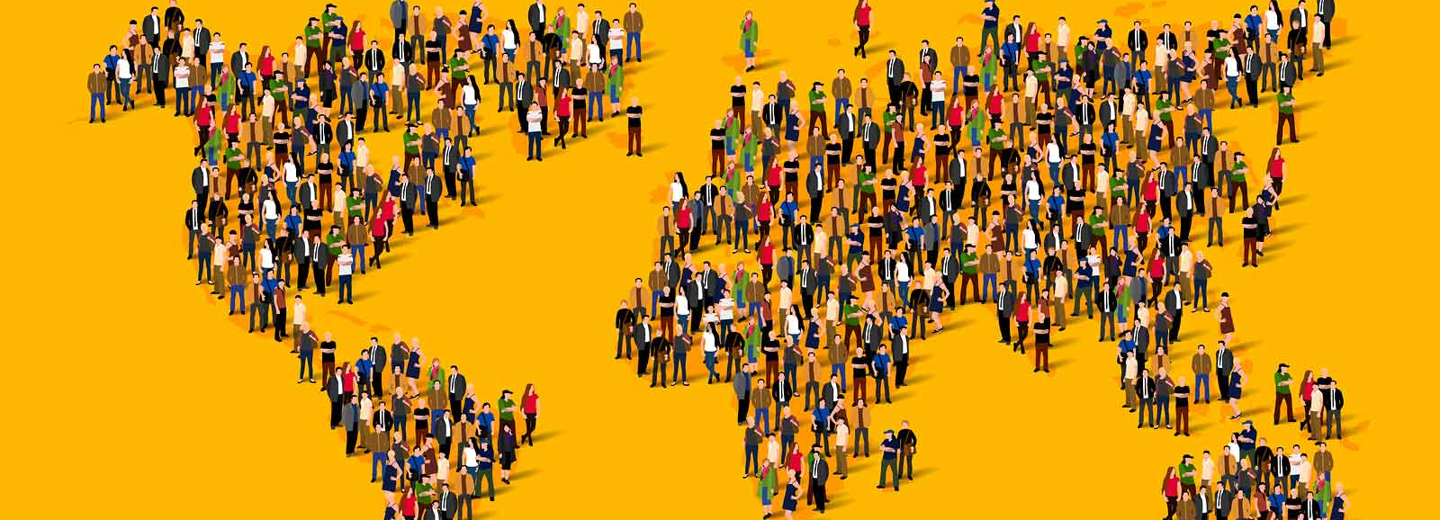
Around 10% of the world’s population lives in Europe.

Slide 3
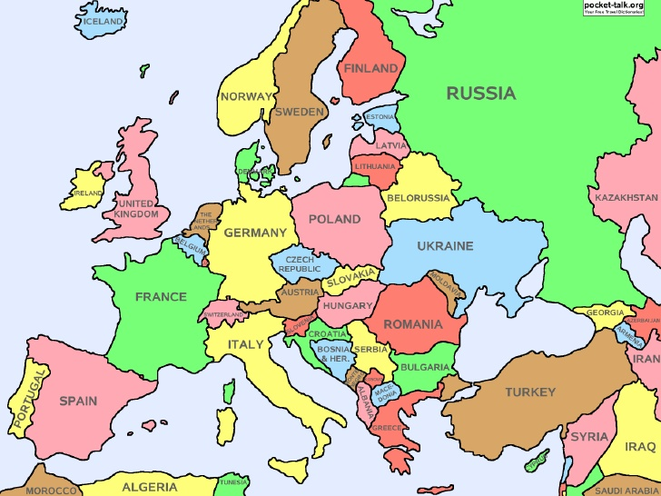
There are 44 countries in Europe.
Russia is the biggest country in Europe but not just in Europe but across the whole world.

Slide 4

People in Europe speak 23 languages.

Slide 5
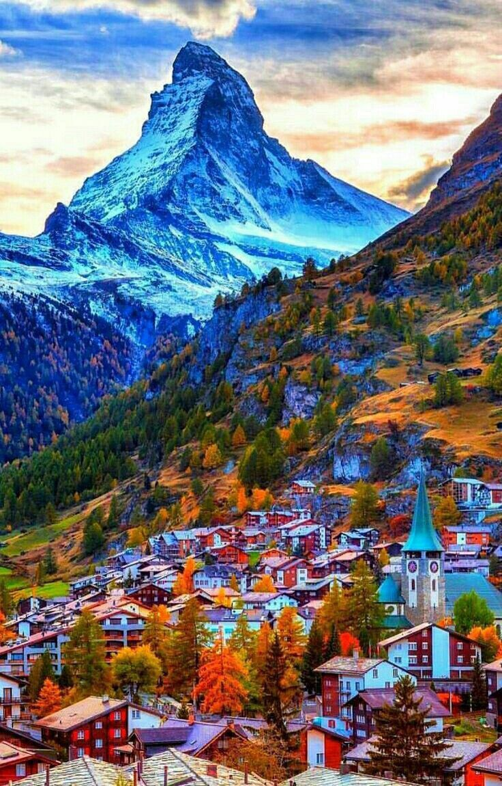
The matterhorn
The mountain is in Switzerland and Italy, and is the height of 1,000 double decker buses on top of each other.

Slide 6
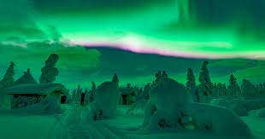
The northern lights
The green lights in the night sky look like a nature firework display.
A good place to see the northern lights is Finland.

Slide 7
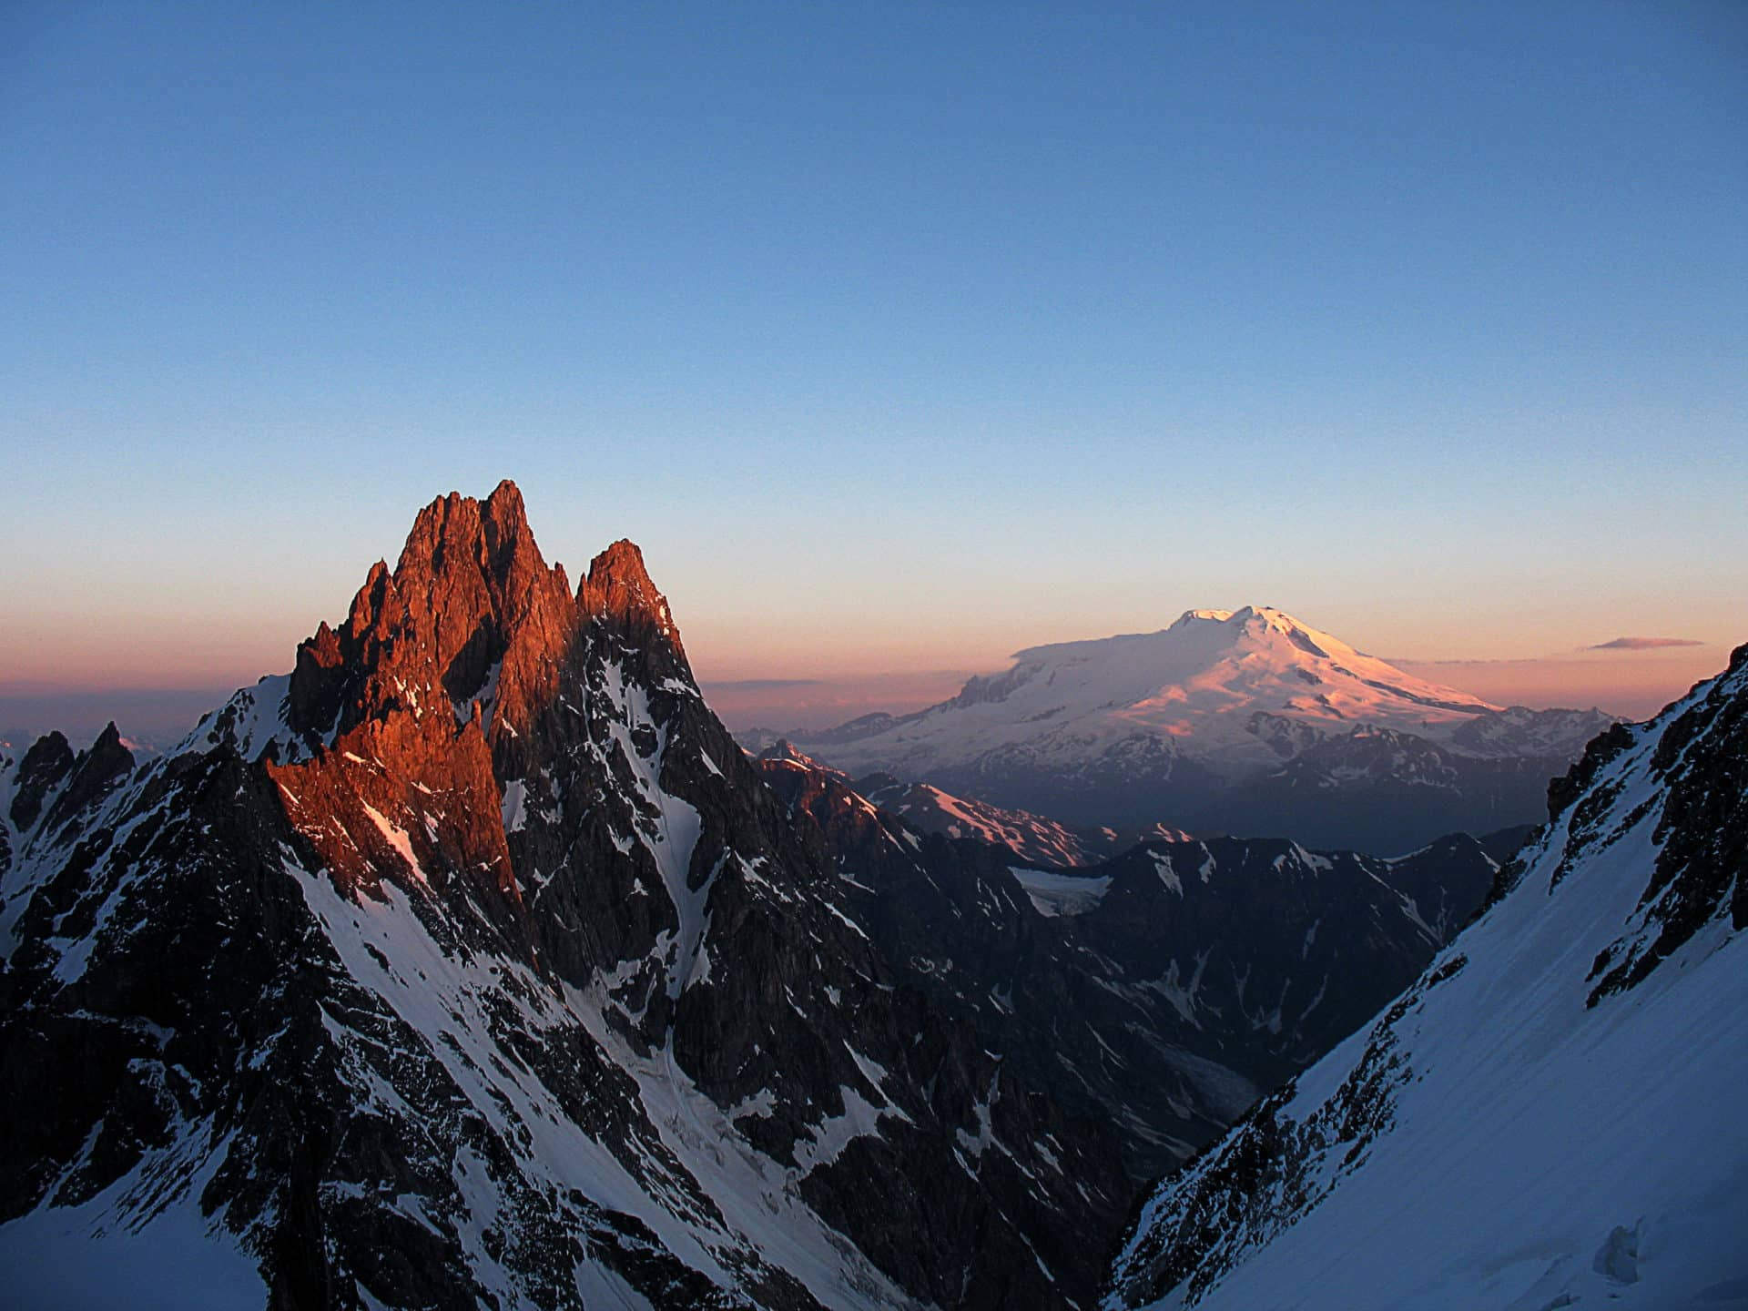
Mount elbrus
Mount Elbrus is in Russia and is 5,643 meters above sea level.

Slide 8
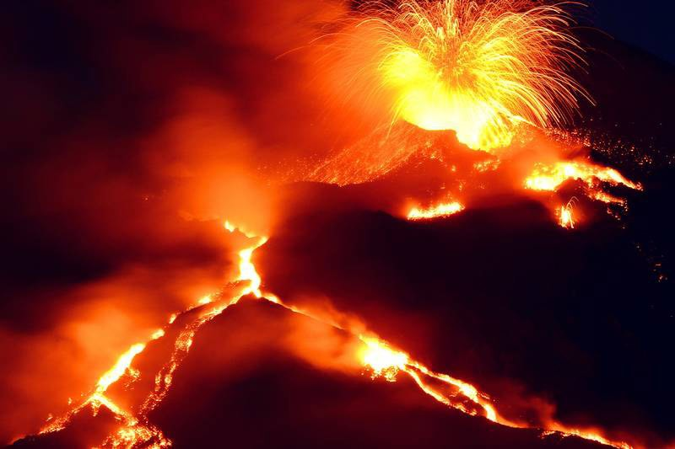
Mount etna
Mount Etna is a volcano in Sicily and its smoke helps trees to grow.

Slide 9
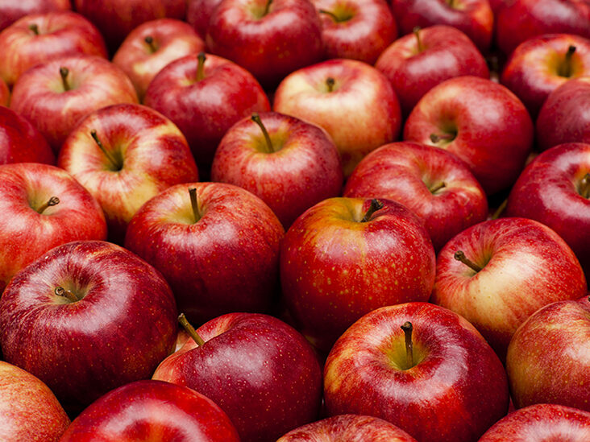
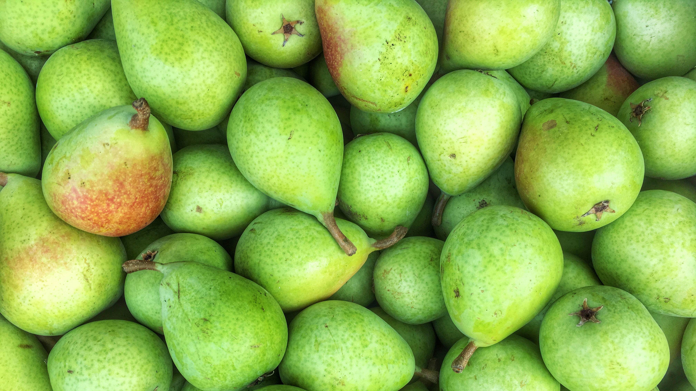
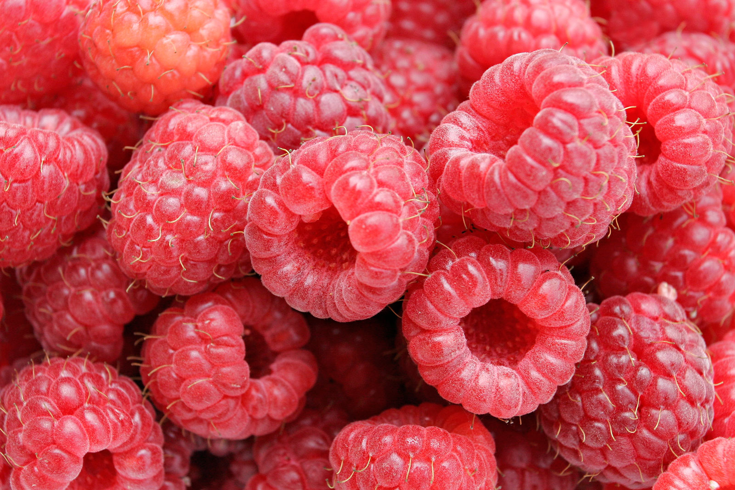
fruit
Apples, pears and raspberries come from Europe.

