Slide 1
ASIA
BY AMELIA ISHFAQ – 2W

Slide 2

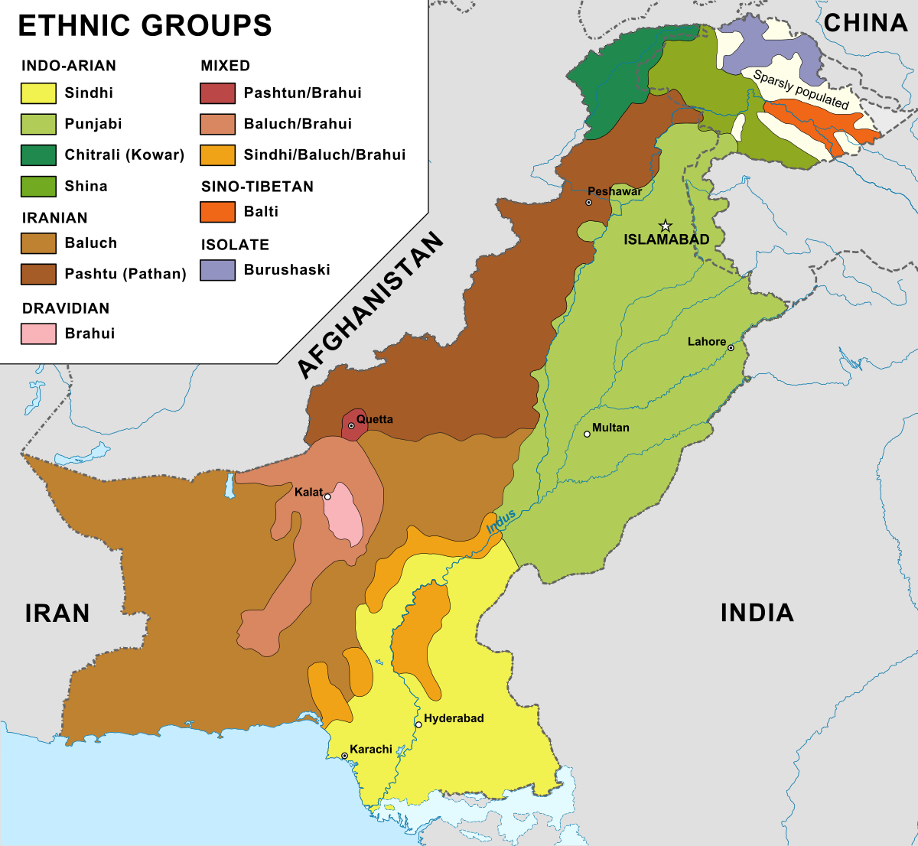
ASIA HAS LOTS OF DIFFERENT COUNTRIES IN IT LIKE PAKISTAN
AND TURKEY

Slide 3
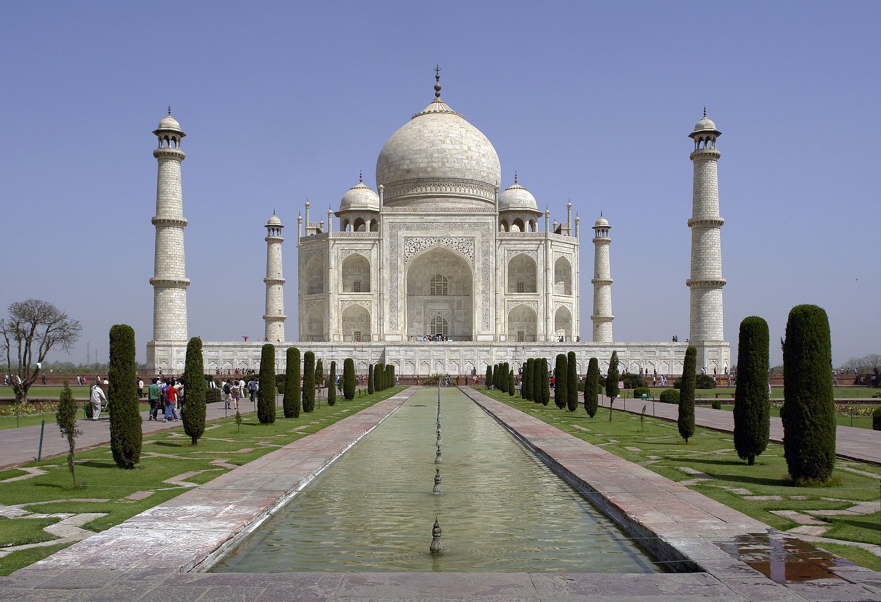
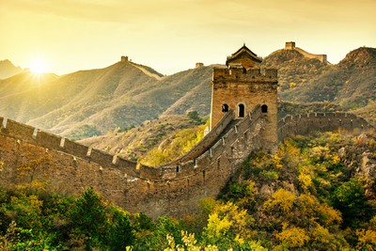
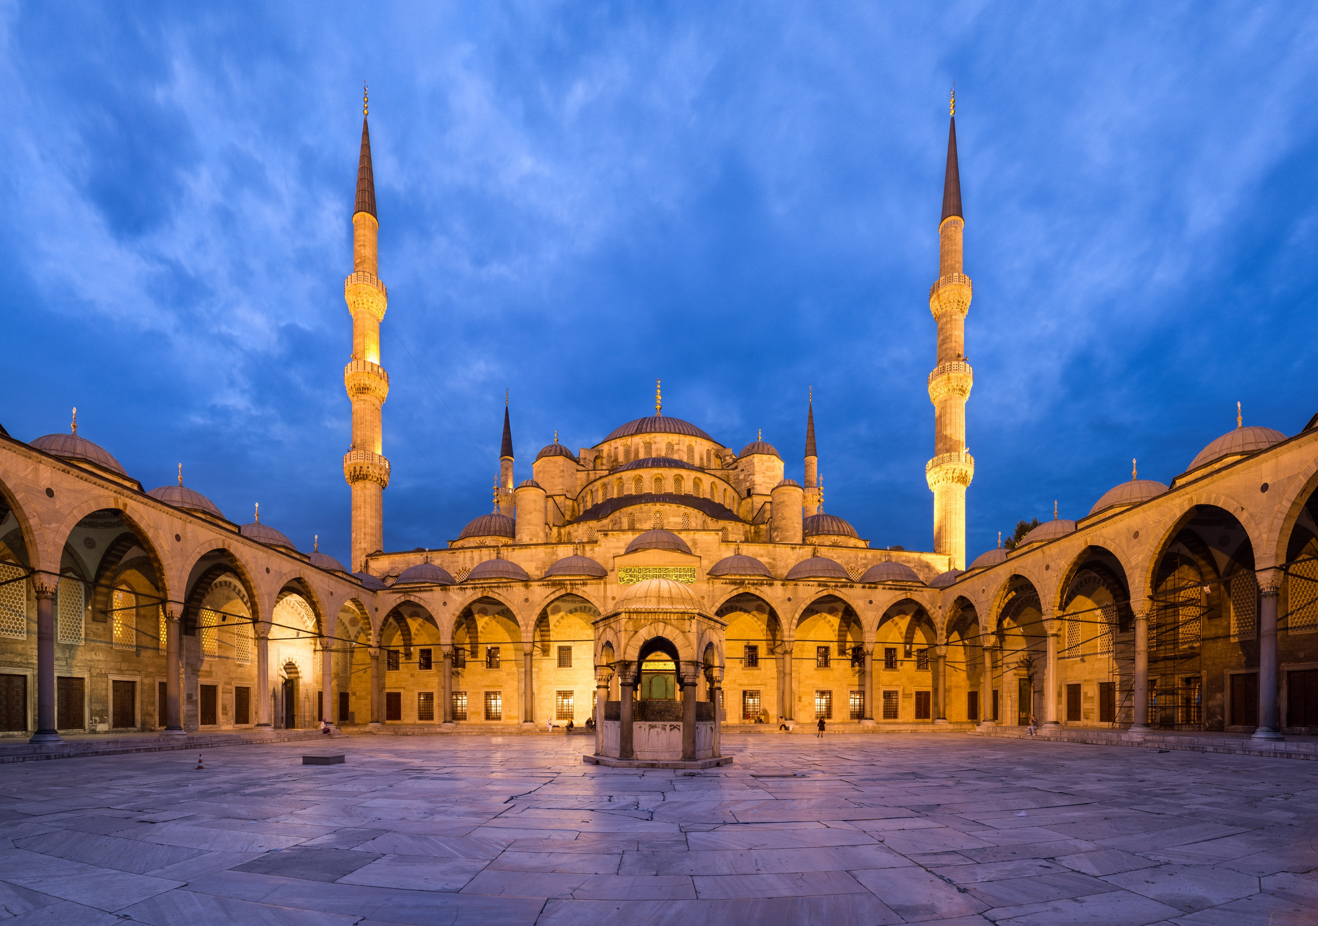
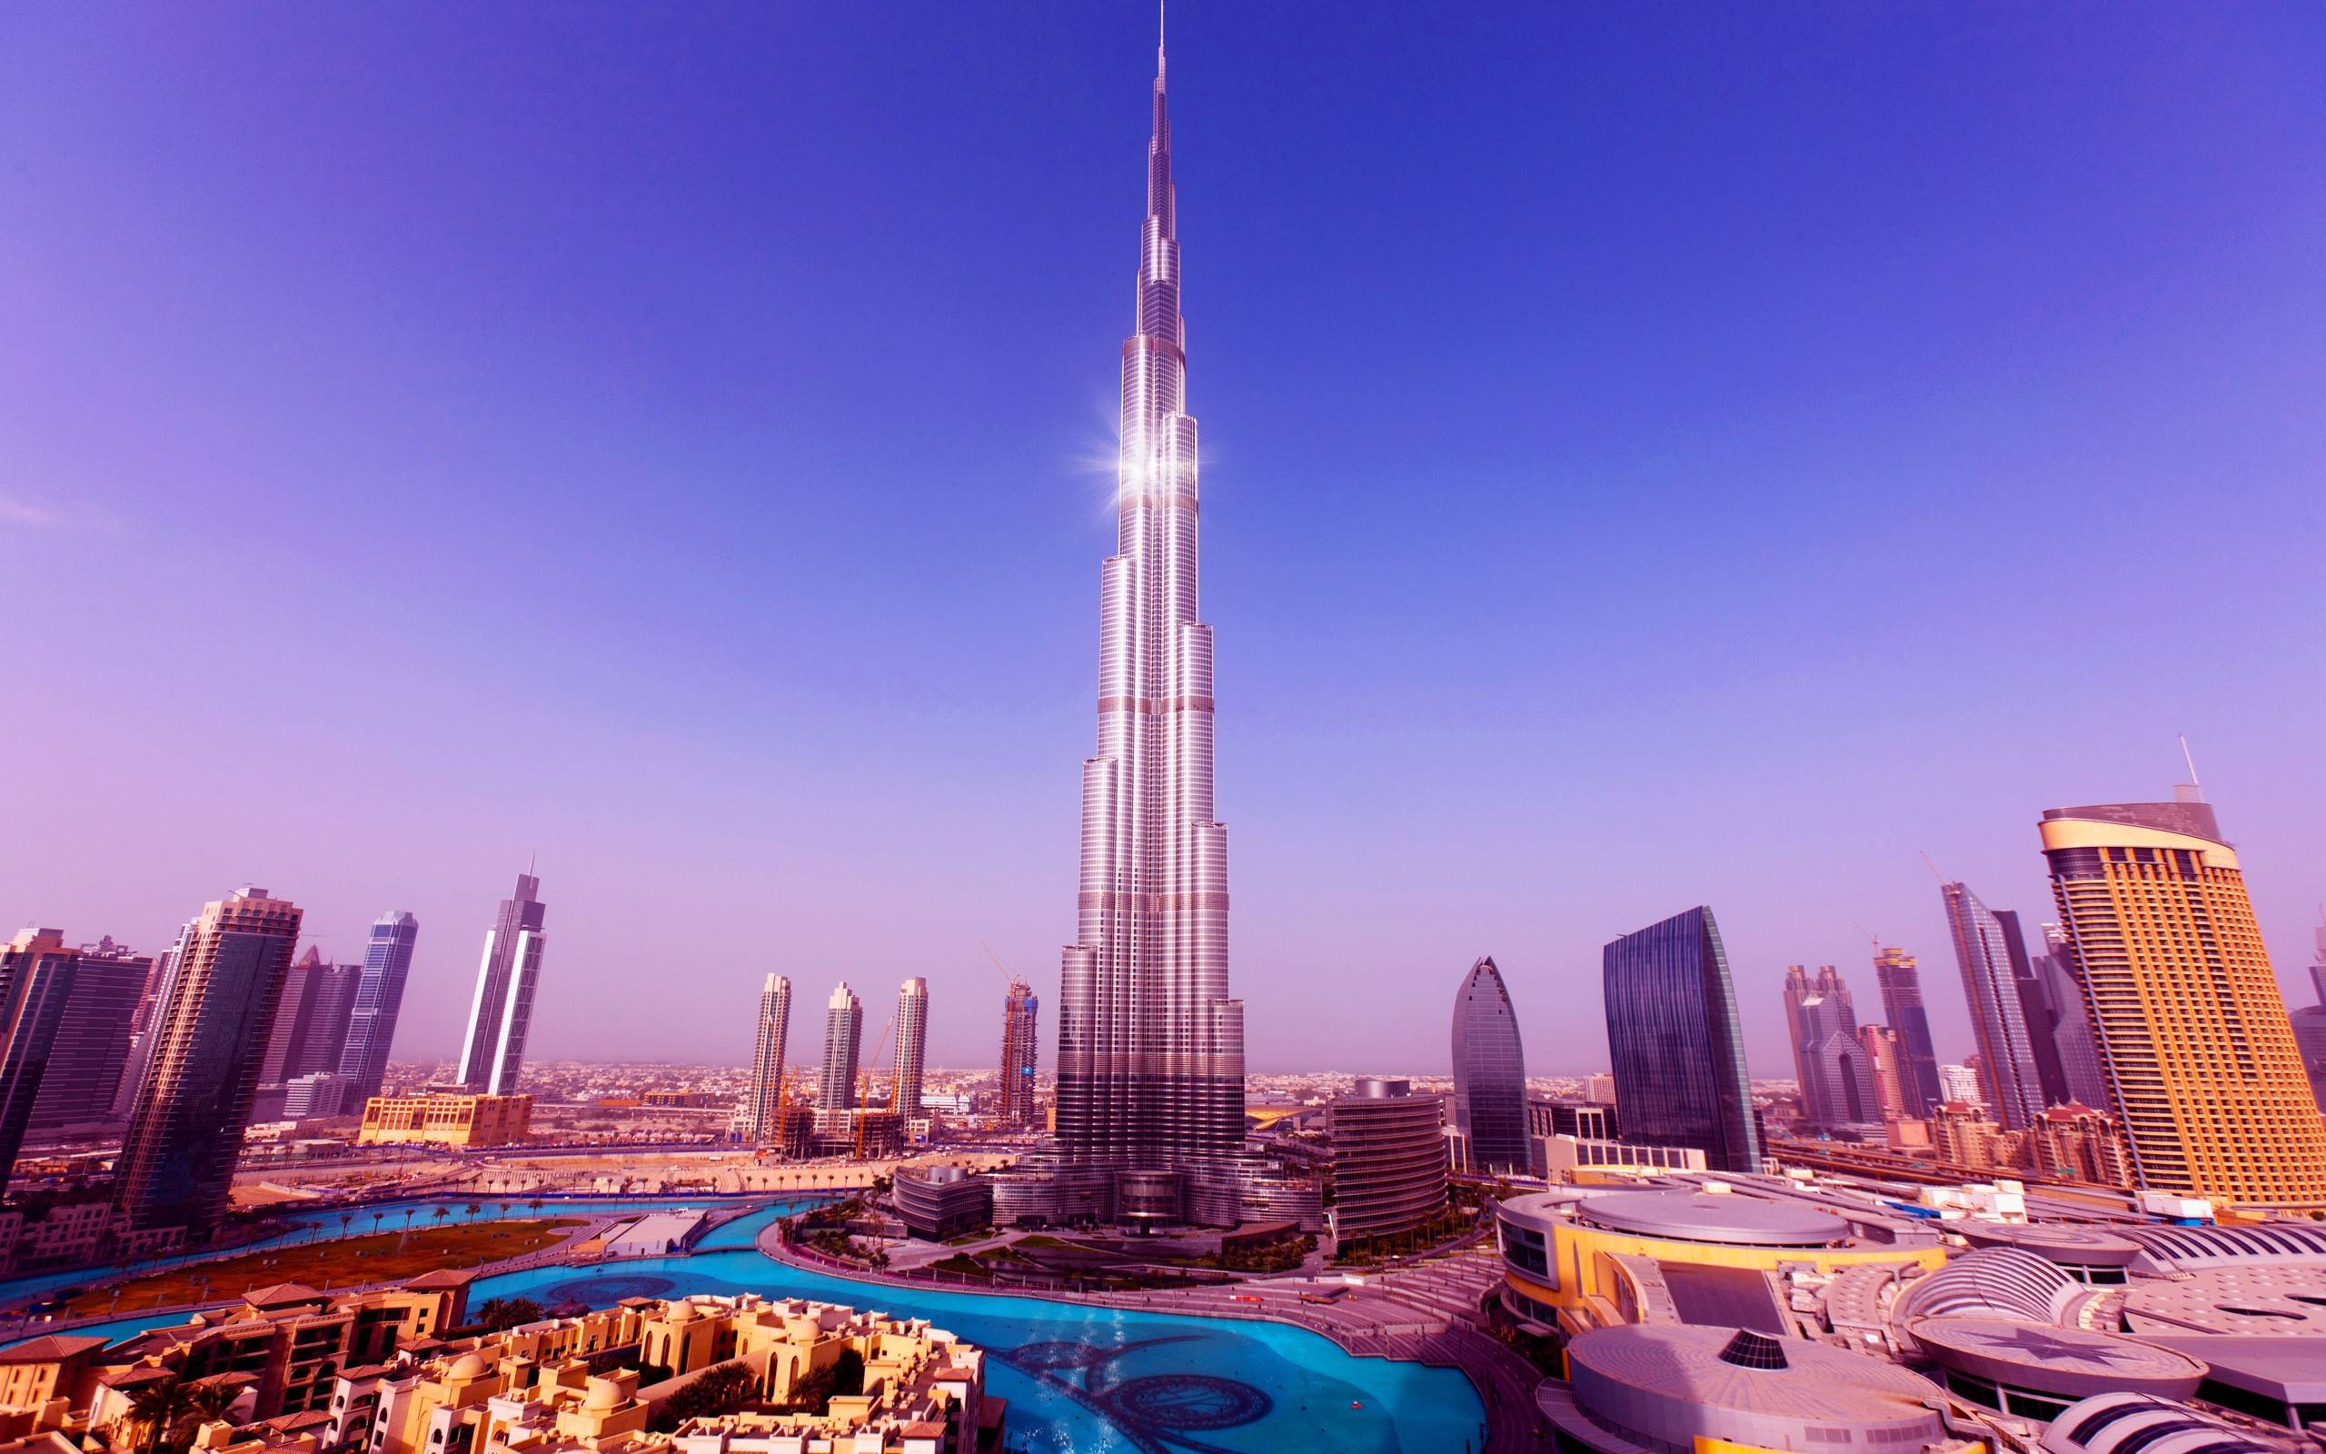
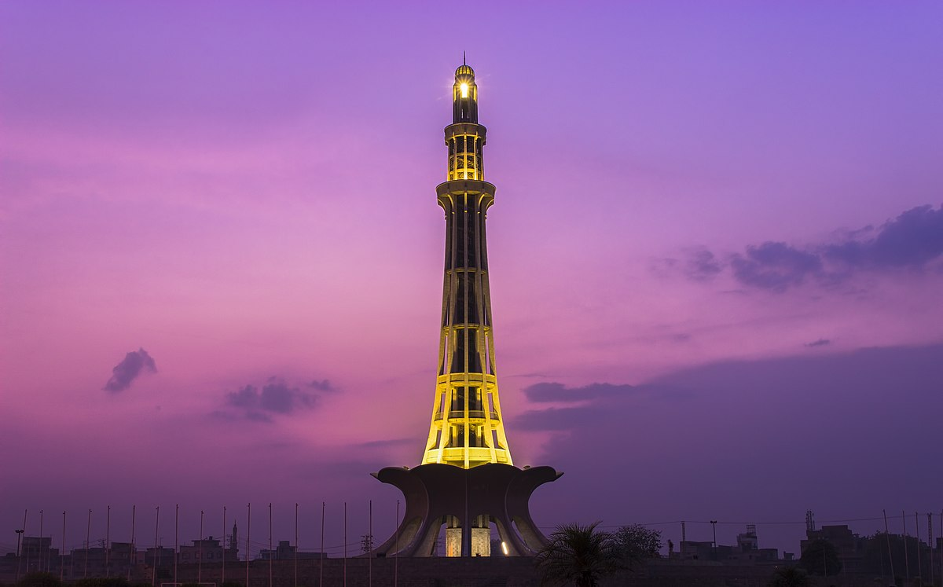
ASIA HAS LOTS OF FAMOUS LANDMARKS
This Photo by Unknown Author is licensed under CC BY-SA
This Photo by Unknown Author is licensed under CC BY-SA

Slide 4
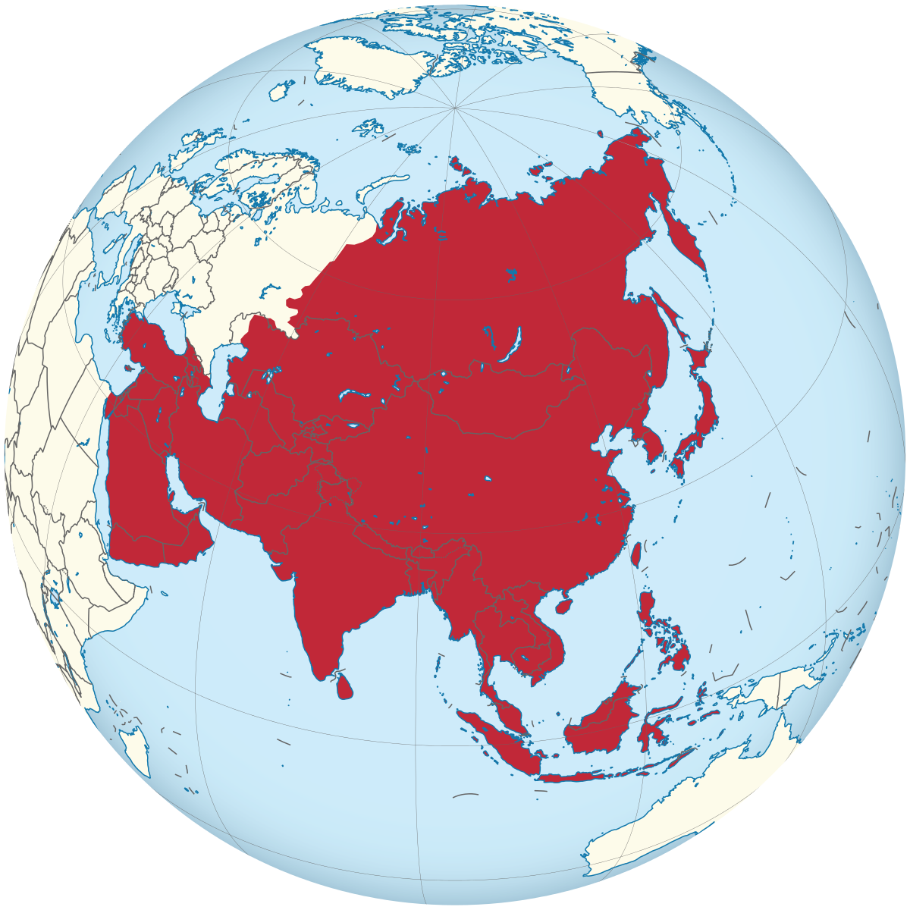
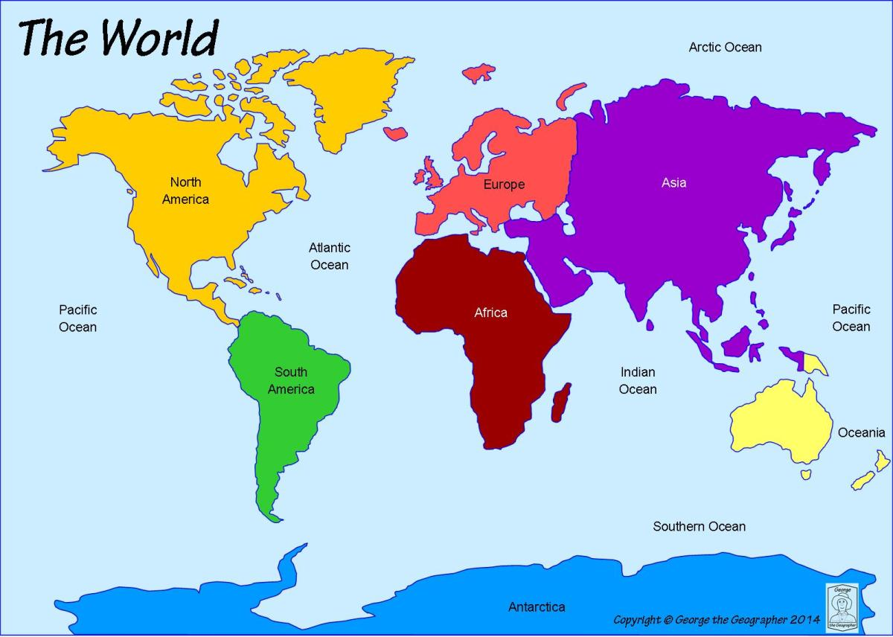

ASIA IS THE LARGEST CONTINENT IN THE WORLD!!!

Slide 5
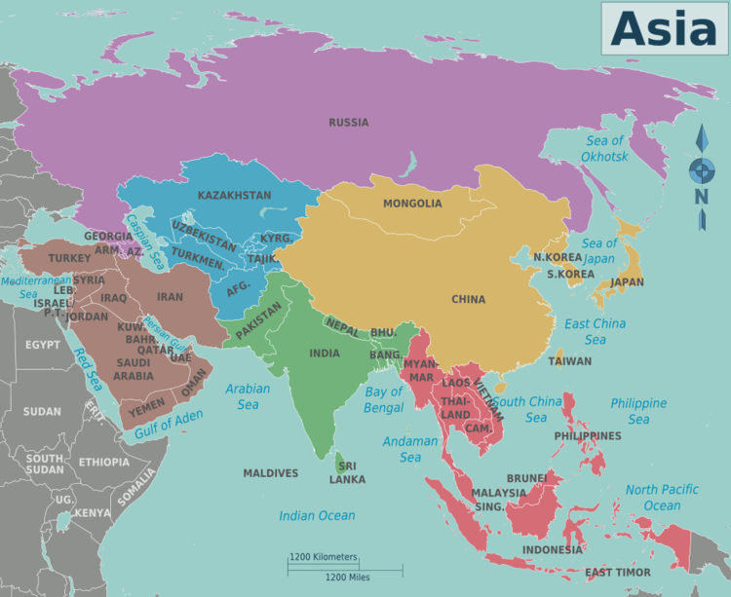
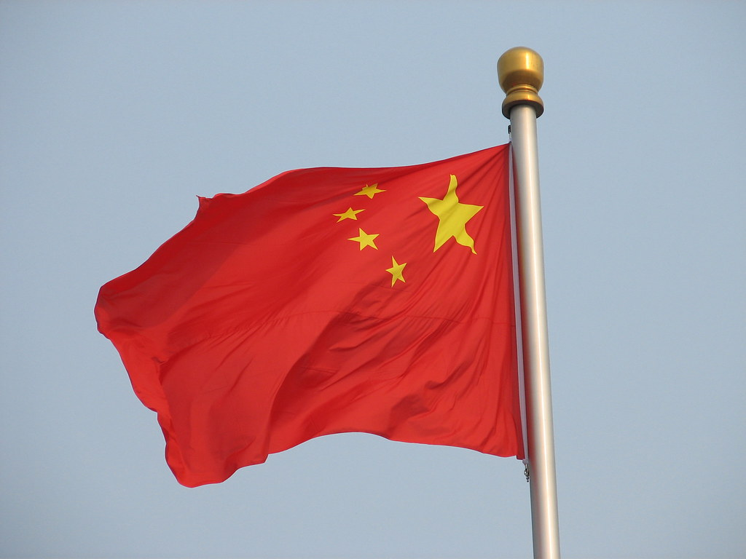



DID YOU KNOW ASIA HAS 48 COUNTRIES IN IT!
This Photo by Unknown Author is licensed under CC BY-SA
This Photo by Unknown Author is licensed under CC BY-SA
This Photo by Unknown Author is licensed under CC BY

Slide 6
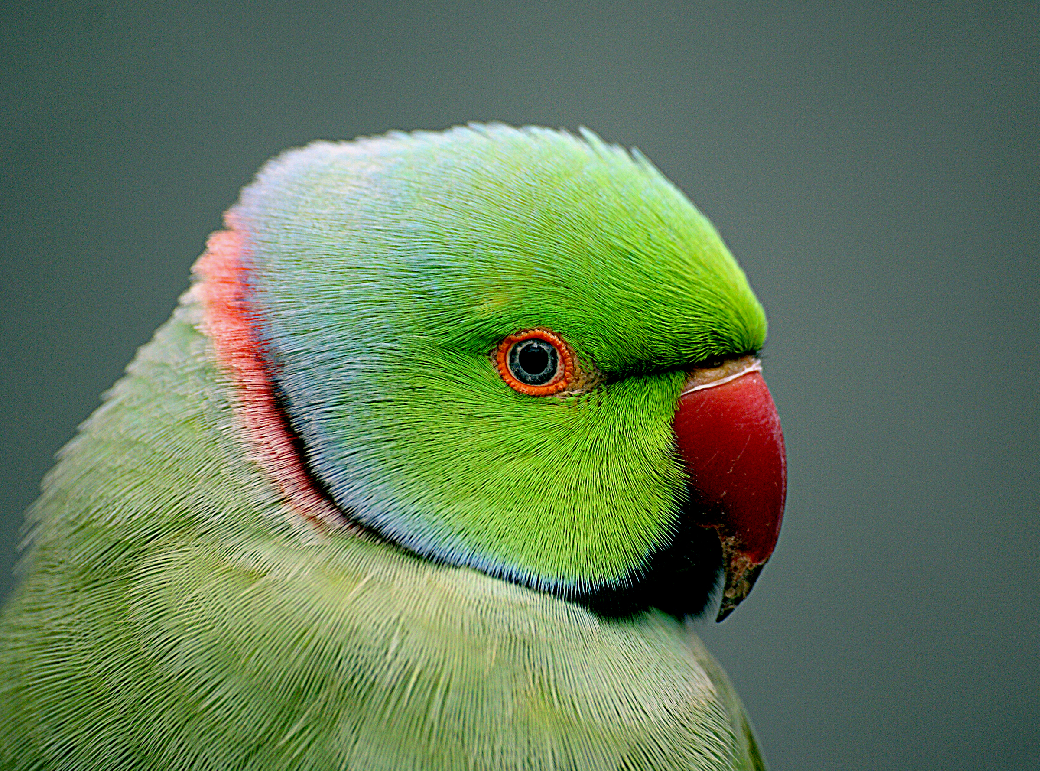
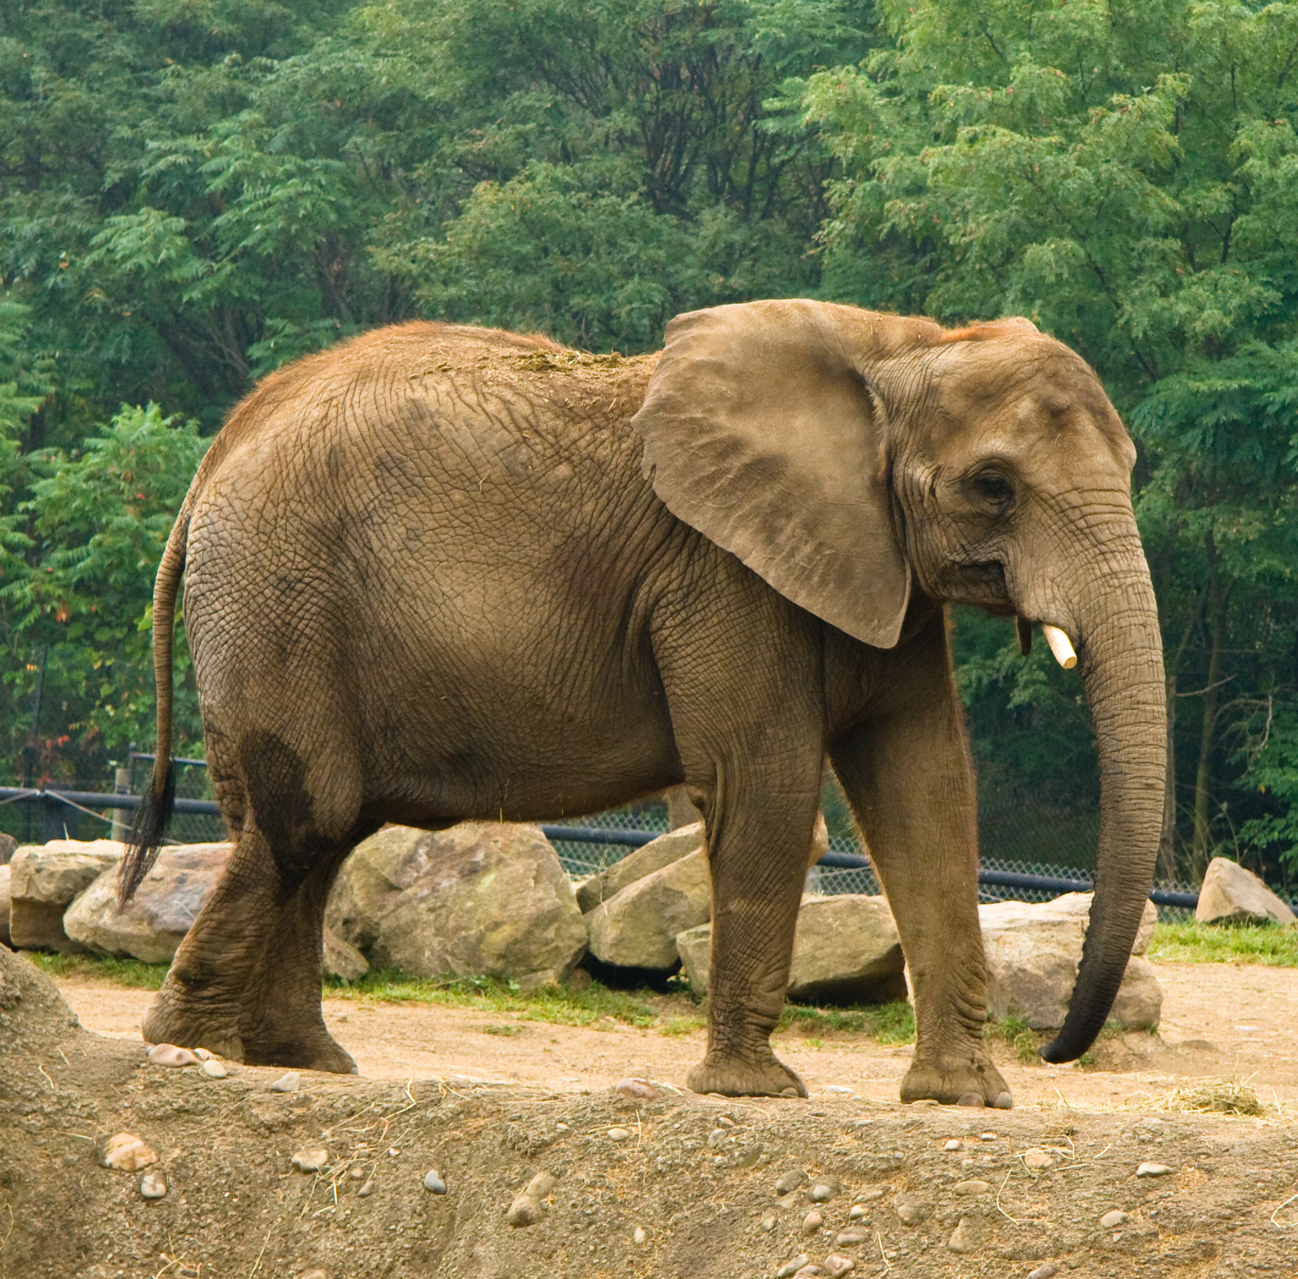
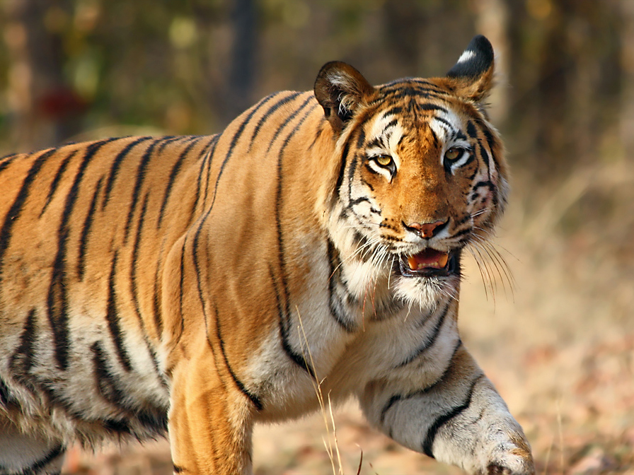
ASIA IS HOME TO LOTS OF DIFFERENT ANIMALS LIKE TIGERS,BIRDS,ELEPHANTS AND MANY MORE!

Slide 7
THANK YOU FOR LISTENING EVERYONE!

