Slide 1
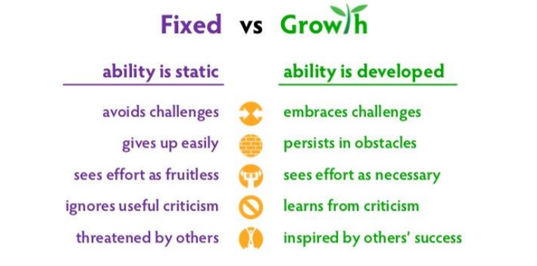
What is your Mindset?

Slide 2
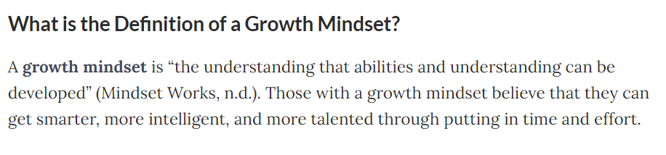
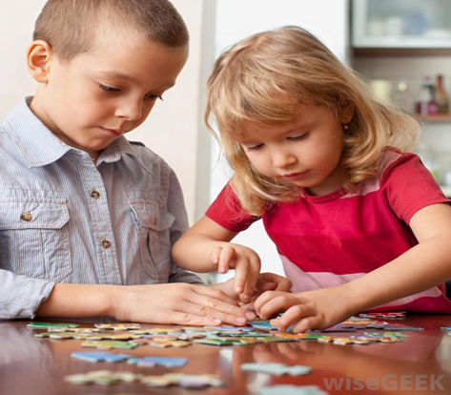
Growth Mindset
make sure you reward effort and progress not just the outcome. (eg Reward the time and effort put into learning spellings and times tables, not just the result in a test).
use the language of growth mindset
YET!

Slide 3
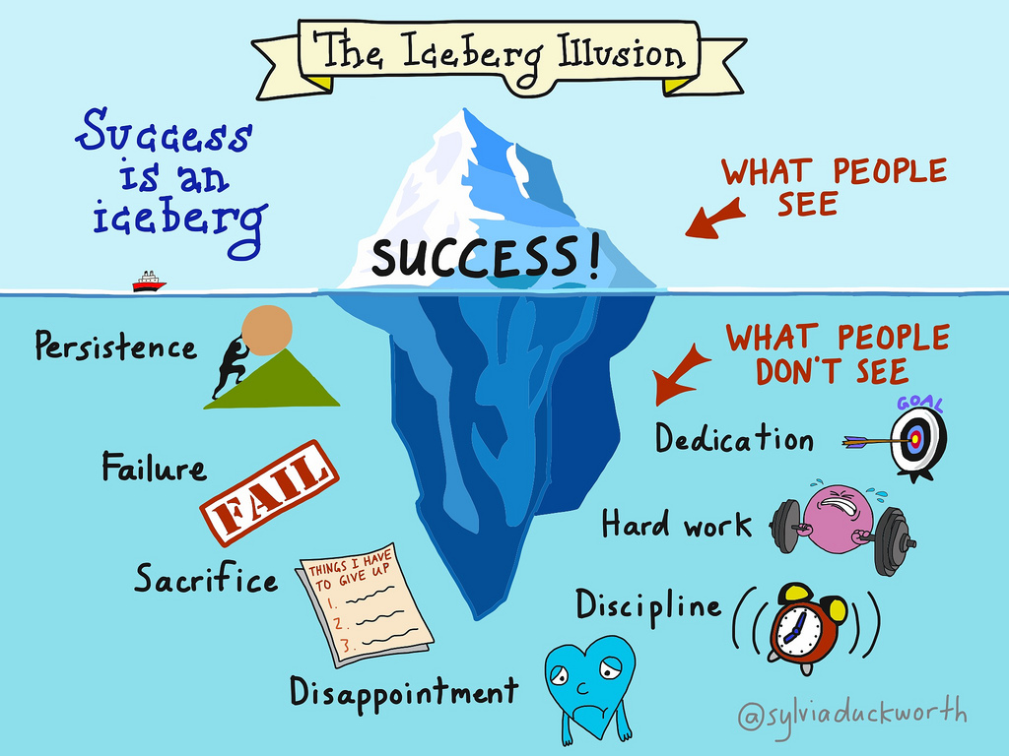

Slide 4
With a growth mindset, individuals may achieve more than others because they are worrying less about seeming smart or talented and putting more of their energy into learning
Students with a growth mindset may display behaviours like:
Asking the teacher to demonstrate a new way to do a maths problem
Volunteering answers in class even when unsure
Asking a question even if it might seem basic or “stupid”
Seeking out problems that will push them instead of problems that keep them safely within their comfort zone

Slide 5

How you can support a Growth Mindset
Praise wisely – praise effort to learn, rather than talent and achievement, this will build resilience with challenges
Use the language of yet and not yet as this will build confidence and perseverance.
Teach your child that every time they challenge themselves and push out of their comfort zone, the neurons in their brain form new connections and over time, they can become smarter.

