Slide 1


Tips to Help Your Child At Home
Mrs Horsley Class 5

Slide 2
As you know, your child is in year 5, upper KS2.
The children have settled well into year 5, and now it is time for us to prepare them for the challenges ahead.
I am working hard to ensure that any gaps are addressed as well as reinforcing the importance of both physical and mental health. Now is the best time to ensure your child is putting as much effort as possible into their learning. This will hopefully lead to a love of learning and prepare them for both year 6 and for a smooth transition to High School.
It is a busy curriculum so any support you can give with gaps in learning is really beneficial and appreciated.

Slide 3
Sooner than you think!
In the summer term of 2027, most children will sit year 6 SATs papers. The SATs for English and maths which, reflect the new national curriculum, are challenging.
The majority of new content and concepts are being taught in year 5 and in the first term of year 6.
Support that you give now in developing good learning habits will be extremely beneficial for both year 6 and for secondary school.

Slide 4

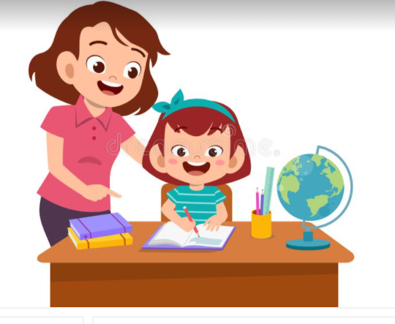
How can you help?
Growth Mindset
English
Oracy
Reading
Writing and Handwriting
Spelling, punctuation and grammar
Mathematics
Home Learning

