Slide 1


Mathematics
Home-School Link Diary pages 100-110
Times Tables (End of year 4)
Knowing the times tables supports so many different topics in maths. Please support your child in practising regularly.
Times Tables Rock Stars
Topmarks Timestables

Slide 2
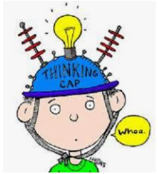
Mental Mathematics
Practising mental maths by playing games is a brilliant way to support written maths work.
Number Bonds to 10, 100, 1000
Adding single digits
Doubles and near doubles
Counting in 50s and 25s
Adding two-digit numbers mentally
Subtracting two-digit numbers mentally
Mental calculations with large numbers using place value 12 462-2300
Topmarks mental mathematics games

Slide 3
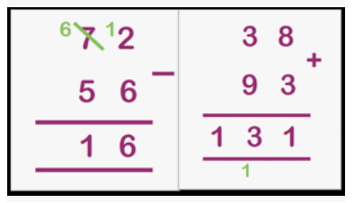

Arithmetic
Formal written methods: In year 5, we will work hard
To make sure the formal methods can be used accurately.
Addition
Subtraction
Multiplication and long multiplication
Division.
(Home-School Link Diary pages 102-103)
Remember to use Mathletics to practise.
Worksheets for practising

Slide 4
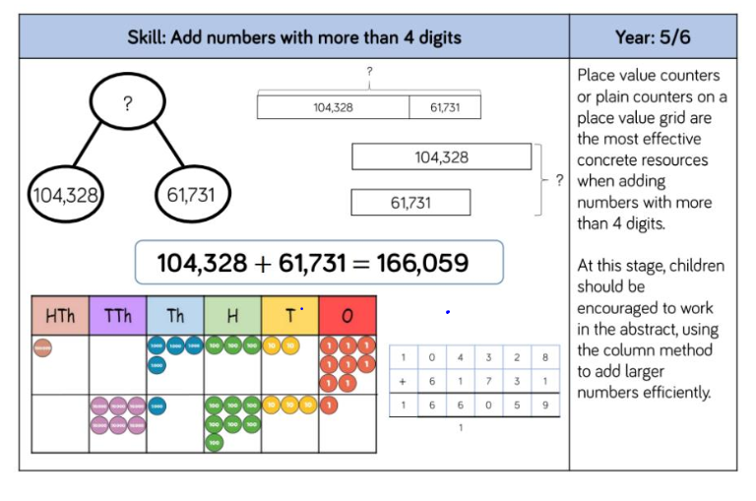
Children use manipulatives and models to support their understanding of formal methods.

Slide 5
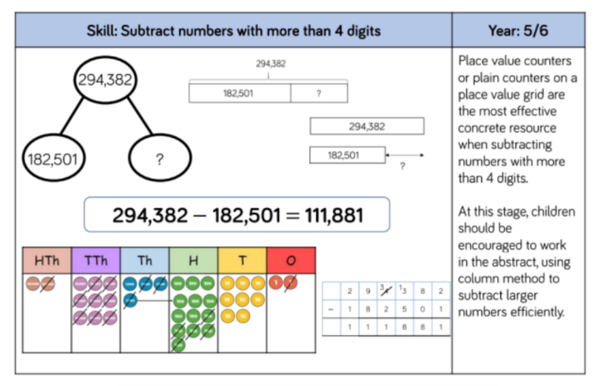

Slide 6
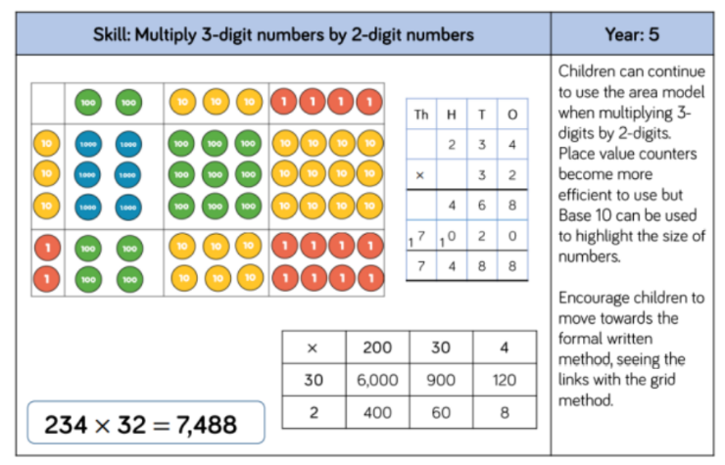

Slide 7
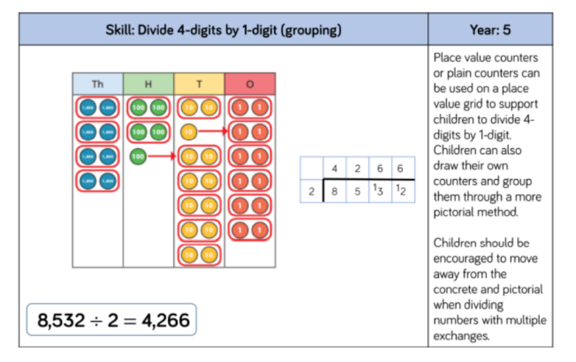

Slide 8
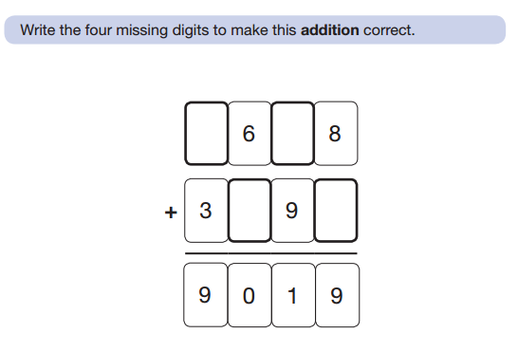
Mathematics – Reasoning (an example)

Slide 9
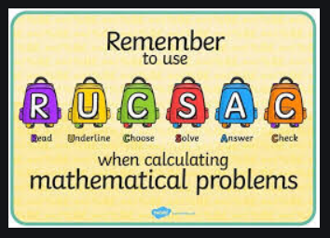
Problem Solving and Reasoning
Understanding Mathematical Vocabulary is essential for problem solving.
Practise the vocabulary in the Home-School Link Diary page 104.
At school, I use RUCSAC as a hook:
Read, Understand, Choose, Solve, Answer
and Check
To solve, use a formal method or a bar model

Slide 10
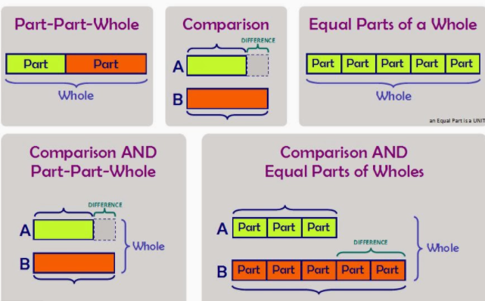
Solving Problems with Bar Modelling

Slide 11
White Rose
At school, we use White Rose Mathematics. The work sheets allow the children to practise number and mathematical skills.
The last questions on the worksheets require problem solving and reasoning. To do these questions, the children must have a good understanding of the topic and apply this to the questions.

Slide 12
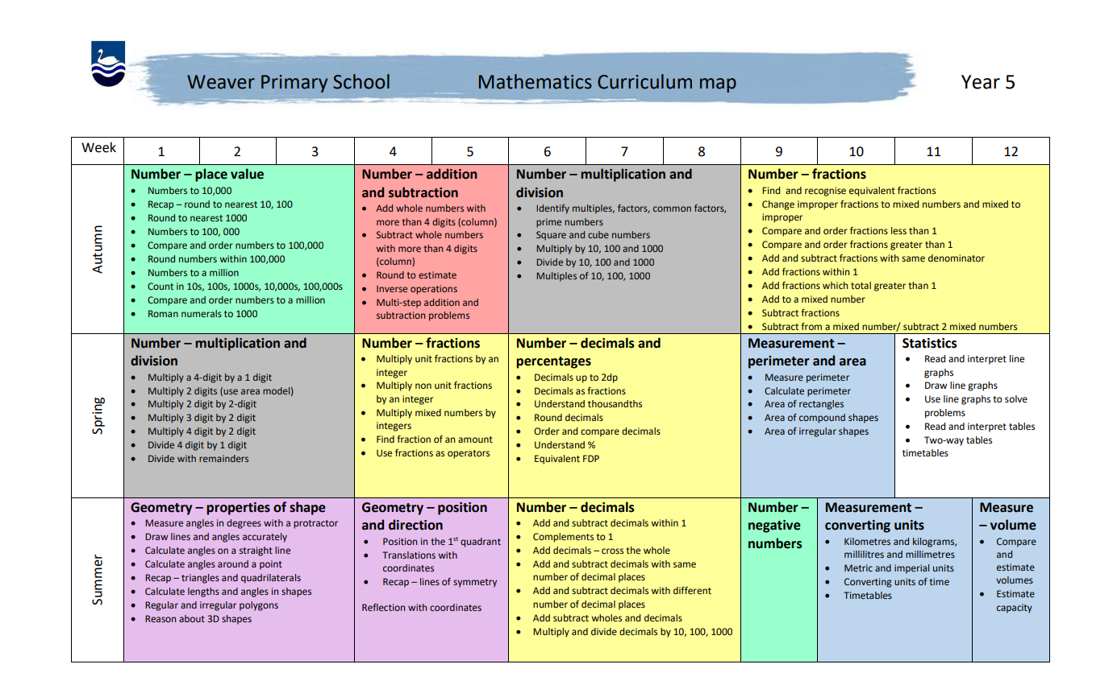

Slide 13
That has been a lot of information.
Learning will happen best when we all work as a team. Encourage your child to put in the effort both at home and at school and support them in developing self motivation.
Priorities:
Talking together
Praising effort and building resilience
Listening to your child read daily (please sign the diary)
Practising spelling (Spelling Frame)
IDL daily (if applicable)
Practising times tables (mental mathematics)
Supporting home learning.
Helping your child to learn organisational skills

Slide 14
Please remember that learning does not only happen in school between 8.45 and 3.15, learning can happen anywhere at any time.
Have fun, be creative and create memories and a love of challenges and learning.
Thank You
If you have any questions please do e-mail me:
ahorsley@weaver.cheshire.sch.uk

