Slide 1

English Home-School Link Diary- pages 90-99
There are so many different things for children to think about in this subject.
Try to help your child to see the links between all the areas of the English curriculum.
Oracy
Reading
Writing
Handwriting
Spelling
Punctuation
Grammar

Slide 2
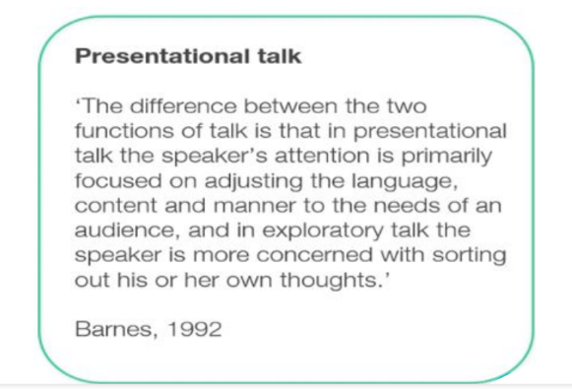
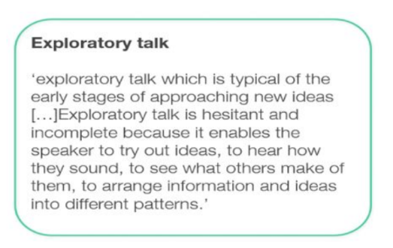
Oracy
Oracy is a main focus at Weaver this year.
We are teaching children to be confident speakers and respectful listeners by using talk strategies.
Here are the two types of talk:
Notes:
2

Slide 3
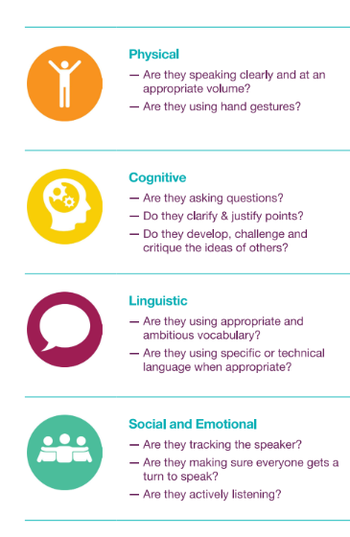
Oracy Continued
Good oracy involves the four areas explained here.

Slide 4
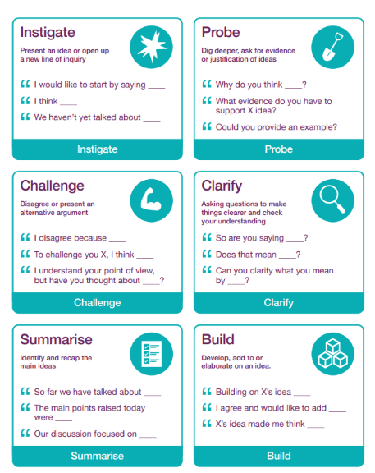
Oracy Continued
Here are the talk tactics we are learning to use to develop good oracy skills.

Slide 5
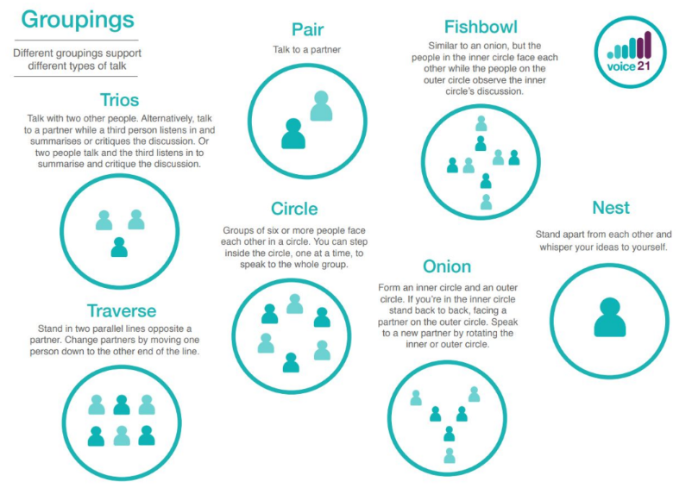
Oracy Continued
Children will practise oracy skills in different groupings in all curriculum areas.
We will be introducing these over time.

Slide 6
What Can You do?
Talk to your child and encourage them to speak in sentences
Ask them about their day and expect some detail
Ask for their opinion on things and reasons
Ask open ended questions
Encourage good listening and to show good listening
Any Questions?

Slide 7


READING
Our main aim is for children to read for enjoyment.
We want our children to choose to pick up a book for sheer pleasure or to learn something new.
How can you help?
Encourage your child to read their Big Cat Banded book with an adult at least three times each week.
Also encourage reading independently.
Reading out loud and reading independently
require different skills which is why all children need to practise both. They need to be active readers – think, feel and imagine.

Slide 8
Reading out loud will help with new vocabulary
Read and talk about new words with your child on a daily basis.
Explaining the choice of author’s words in context.
Aim to learn 6 new words a day – children will remember 3 of them. If your child is presently below the expected standards, you must aim to discuss 12 new words a day in order to narrow the gap.
How can you help your child to choose books?
Visit the library or look at books online.
Here are websites for finding books:
BookTrust – Book Finder
Book Trust – 100 Best Books
The School Reading List
The Reader Teacher

Slide 9

Comprehension
Encourage active reading – think, feel and imagine
Discuss the story in depth
Words chosen by the author in context
Retrieval questions (Dog and Bone)
Inference questions with evidence (Magnifying glass)
PLEASE READ WITH YOUR CHILD ON A DAILY BASIS, TALK ABOUT THE BOOK AND REMEMBER TO SIGN THEIR DIARY
Literacy Counts Ideas 1 and Ideas 2

Slide 10
READING Continued
When children read independently, we need to aim for it to be both sustained and active.
Active Reading and Building Stamina
Independent reading for 15 minutes each day to build stamina.
think, imagine and feel to gain a deeper understanding of characters and plots.
In the SATs paper, they have three passages to read up to a maximum of 2300 words. It requires concentration to actively read so by encouraging daily reading now, your child is gradually building good reading habits and reading stamina. This will set them up for learning any subject in the future.

Slide 11
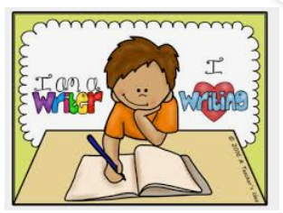
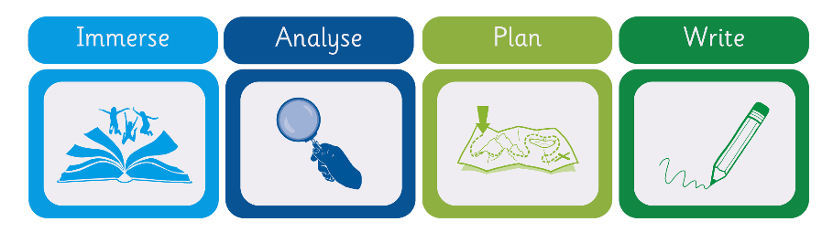
Writing
Read as a writer and write with the reader in mind.
Encourage your child to try to think like a writer when they are reading.
Encourage them to question the decisions the author has made.
At school, we use Ready, Steady Write, by Literacy Counts which always uses the same structure. The children are immersed in a vehicle text. We then analyse a model text before the children plan and write their own piece based on the model text.

Slide 12
Writing
Encourage your child to do some writing at home such as keeping a journal, writing a shopping list, writing verses on cards etc
When doing home learning, have high expectations of the content but also, the presentation, spelling and grammar.
Use the year 4 writing standards and begin to use the year 5 standards as a guide to the expectations and requirements. These can be found on the Writing Expectations tab on the website.

Slide 13
Handwriting
At Weaver, we teach Nelson Handwriting.
By year 5, children should be using a consistent, joined style.
Unfortunately, if children have developed bad habits with grip and letter formation, it is very tricky to break the habit at this stage.
When doing home learning, encourage the use of pen for writing and a joined style.

Slide 14

Spelling
At School:
Monday – Test Day
Words to practise are in the back of the book. Test is in the front of the spelling book.
Investigations of spelling patterns throughout the week
Use of a writing and spelling journal (A5 book)
Why Learn Spelling? To use in writing. (Not just to achieve 10 out of 10 in a spelling test). The rule needs to go into the long-term memory which takes time. It is important that children understand the words they learn and can use them in context.
Notes:
14

Slide 15
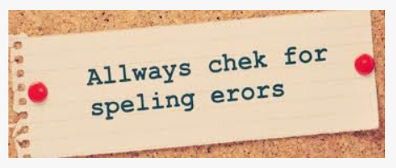
Spelling Continued
At Home:
Practise a few spellings for a short amount of time on a daily basis.
Look for spelling patterns when reading with your child.
Use Spellingframe Please make sure your child logs on so I can see their progress.
IDL – (International Dyslexia Learning)
If your child has been asked to use IDL, please encourage them to do 10 minutes every day as this is how it works best, by building up the skills. (26 hours use can narrow gaps by 11 months).
Home-School Link Diary
Spelling lists on page 97 and 99 of the reading Diary
These are examples of the types of words your children are expected to be able to spell and use in their own writing. All these words can be practised on Spelling Frame.
Home Learning – have high expectations of quality
Ask your child to proofread and edit work upon completion
Please support your child in correcting home learning.

Slide 16
Grammar
Help your child to learn the grammar terms by having a grammar focus during reading.
Support your child with home learning and re-visit work to ensure it has been retained.
If your child is speaking incorrectly, try to repeat back the words using the correct grammar.
Here is a grammar and punctuation overview for each year group.
Topmarks Spelling and Grammar Games

