Slide 1
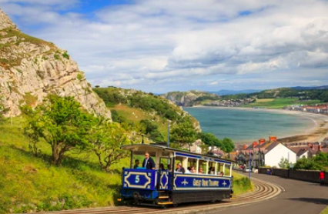
Llandudno 2025

Slide 2
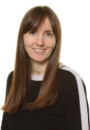
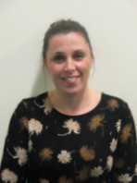



Who is going?
Mrs Johnson
Mrs Cope
Miss Warhurst
Mrs Ackerley
Mrs Jones

Slide 3
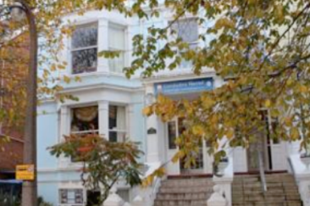
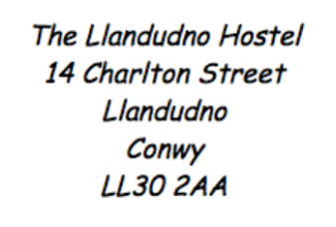
Where are we staying?

Slide 4
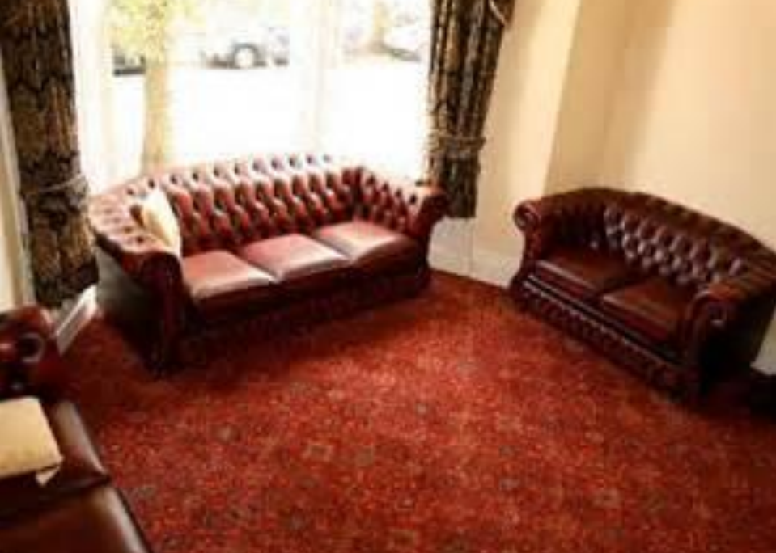
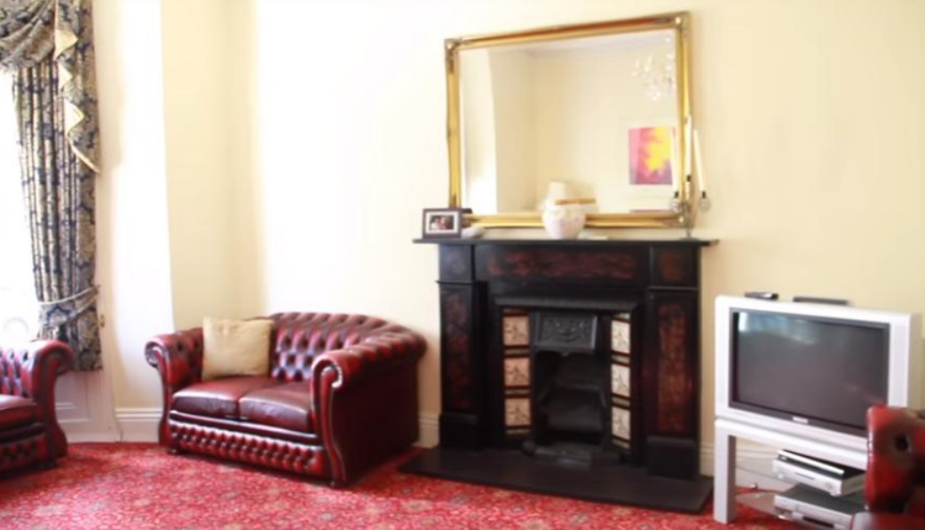
Lounge

Slide 5
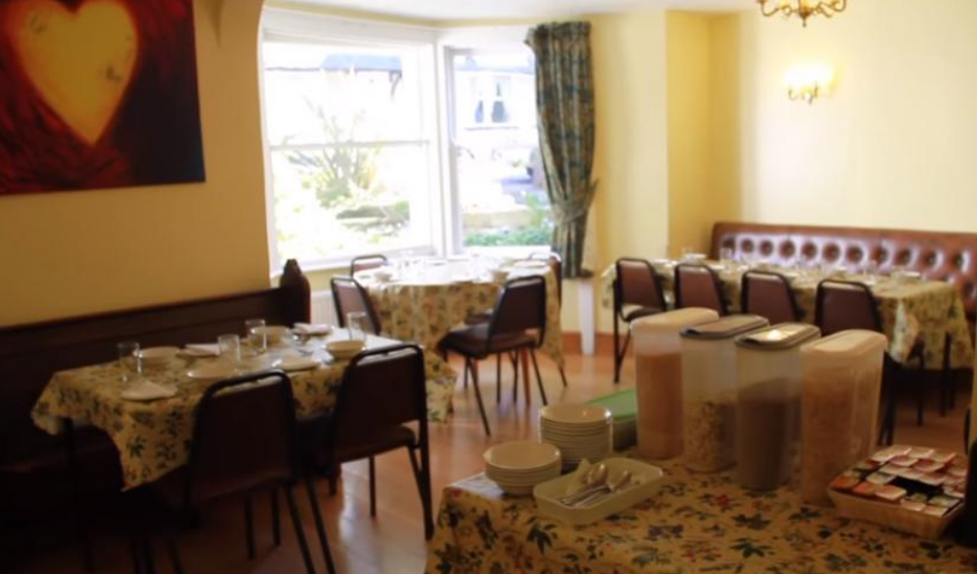
Dining Area

Slide 6
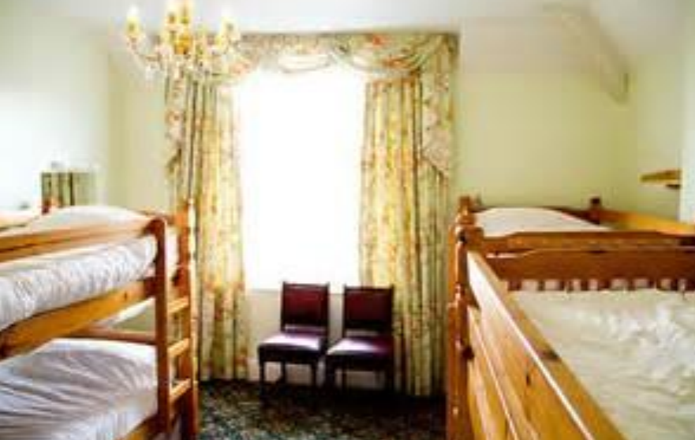
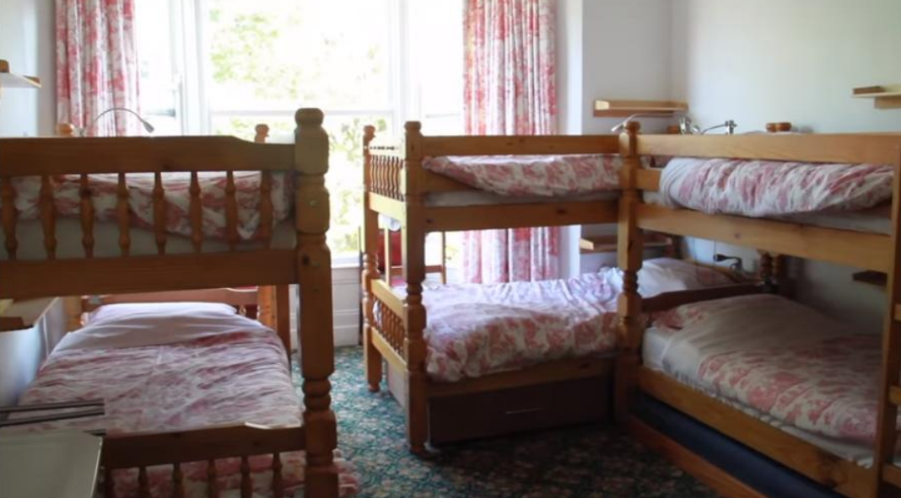
Bedrooms

Slide 7
Wednesday 25th June 2025
8.45 am - Arrive at Weaver school – Go to the school hall via the school car park
9.00 am - Parents give hugs and say goodbye!
9.15 am - Leave BLS – Parents can wave from BLS
10.30 am – Arrive at Welsh Mountain Zoo. Suitcases stay on the coach
3.00 pm – Arrive at Llandudno Hostel. Safety talk and unpack
Leave Welsh Mountain Zoo
5.30 pm – Dinner
6.30 pm - Beach

Slide 8
Thursday 26th June 2025
8:30 am – Breakfast, pack small rucksacks
10:45 am – Tram to the Copper mines, lunch
3:00 pm – Punch and Judy
5:30 pm – Dinner
6:30 pm – Showers and pack!
7:30 pm – PJ party

Slide 9
Friday 27th June 2025
8.00am – Breakfast, pack small rucksacks
9.30am – Coach
10.00am – RNLI
12.00pm – Lunch
3.00pm – Arrive at Weaver School
3.15pm – Parents pick up at the hall. Use the door near the car park.

Slide 10
What do I need to pack?
SMALL suitcase with wheels
A rucksack for every day. This will hold their lunch, water bottle, hat, sun cream
An outfit for every day in a carrier bag. This means all the clothes for each day are in a bag and then they can put their dirty clothes in it at night. Please put in an extra carrier bags for dirty clothes.
For example:
Trousers/leggings/shorts
T-shirt
Jumper
Knickers/pants
socks

Slide 11
What do I need to pack?
Comfy shoes for walking – trainers are perfect. If it looks like rain pack a spare pair too!
Indoor shoes such as slippers. All outdoor shoes are left at the front door. Slippers/indoor shoes are worn in the hostel. Please can they be sensible slippers so they can walk up and down the stairs.
Waterproof coat
Small rucksack
Water bottle (refillable strong bottle)
Towel
Toothbrush and toothpaste
Small shower gel or soap in a wash bag
Pyjamas/night clothes x 2 in case of accidents
Extra underwear
Toilet requirements
Teddy (small)
Book and small game (card games are great)
Hairbrush / bobbles
Sun hat
Sun cream (labelled)
Bucket and spade (labelled and in a carrier bag tied to the suitcase if it won’t fit inside. Please use a strong carrier bag. For example a bag for life)

Slide 12
Wednesday Morning
Your child will meet in the hall with:
Small suitcase
Bucket and spade securely tied to the suitcase if it won’t fit inside the suitcase
Wearing their waterproof coat
Small rucksack with lunch, water bottle, sun cream and hat inside
DO NOT PACK THE LUNCH IN THE SUITCASE
All suitcases will be put under the coach. When we arrive at the Welsh Mountain Zoo we only carry the rucksacks with our lunch.
Any medication handed to Miss Warhurst in the school hall on Wednesday morning. This MUST be labelled with the dosage.

Slide 13
Things they won’t need
Mobile phones
IPADs
Cameras (We take lots of photos)
Any electronics
I phone watches

Slide 14
Additional Information
Insurance can be viewed at the office on request
Medical forms and contact lists (Yellow form)– Please complete and return ASAP
On the yellow form please make it clear if your child can have Calpol or Nurofen.
Please inform us of any medical needs/medicines to be taken BEFORE the trip including travel sickness tablets (White form from the office will need to be completed before the trip)
Rooms – children will choose three children and they will be with at least one of their friends. They will find out when we get to Llandudno.
Night issues – please let us know
Any food allergies – please tell us
Please send a stamp into school (It’s a secret!)
We will contact you if there is an emergency

Slide 15
Twitter
We will keep you updated with many photos on Twitter. Please join before we go to Llandudno.
@Class2Weaver

