Slide 1
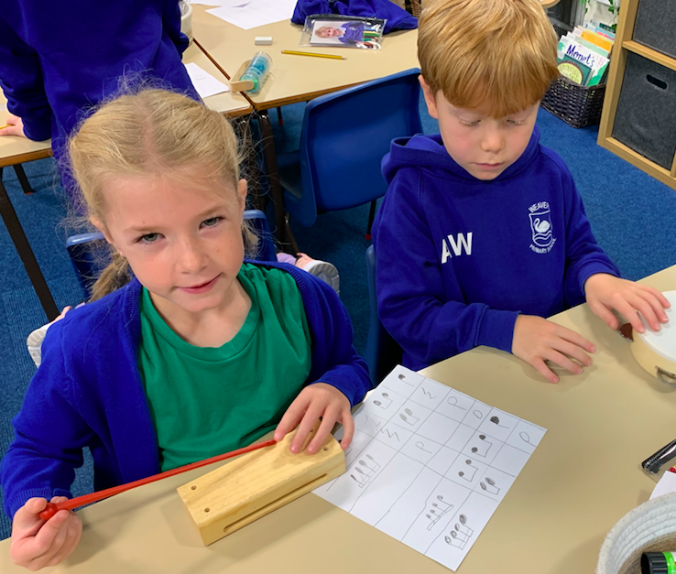
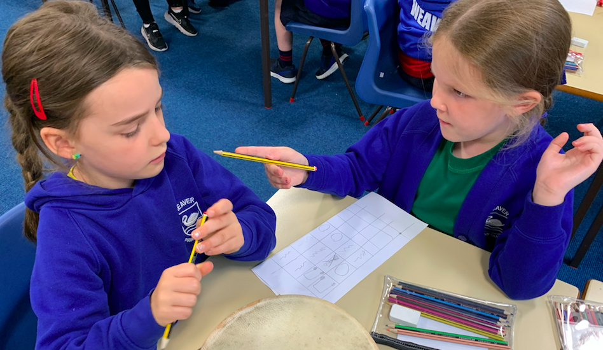
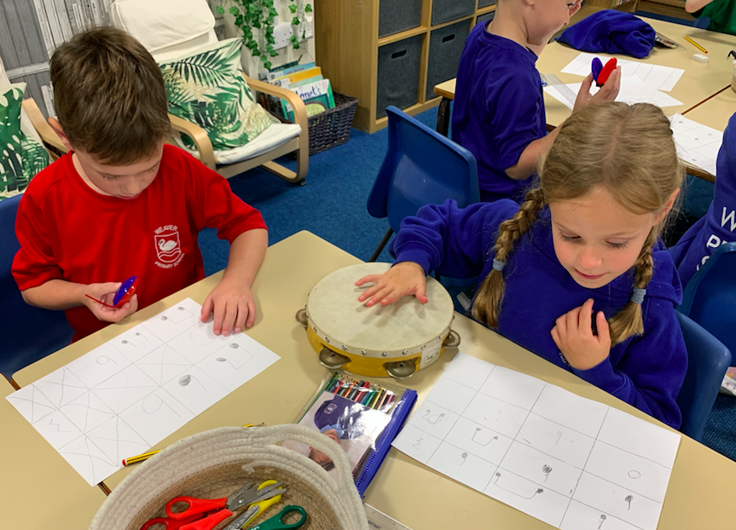
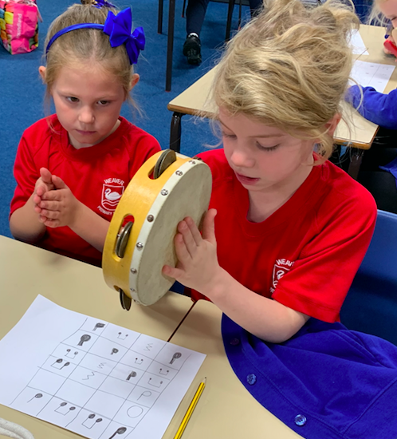
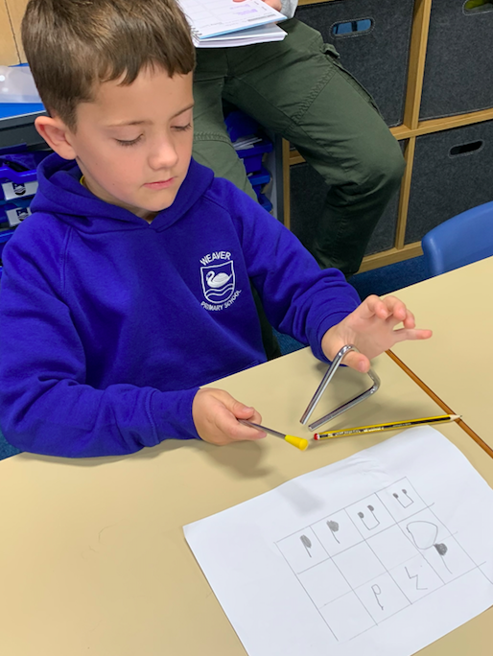
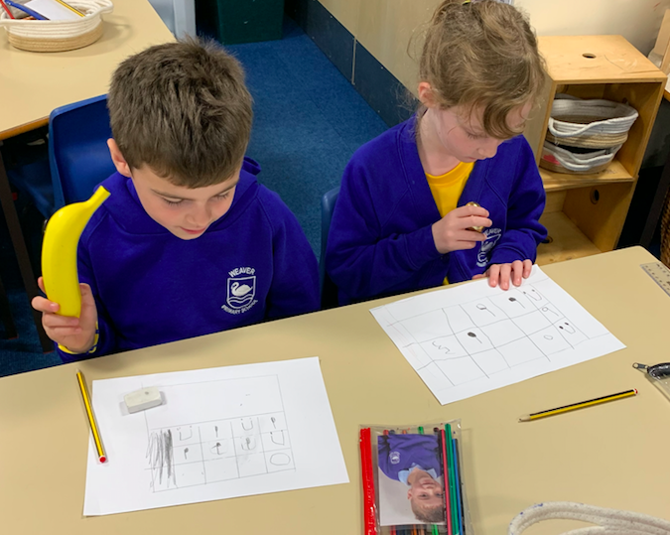
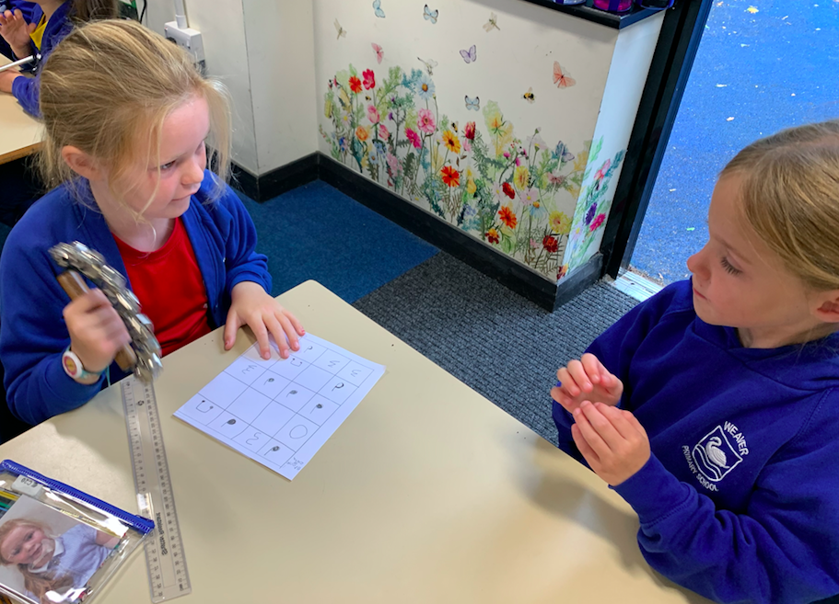
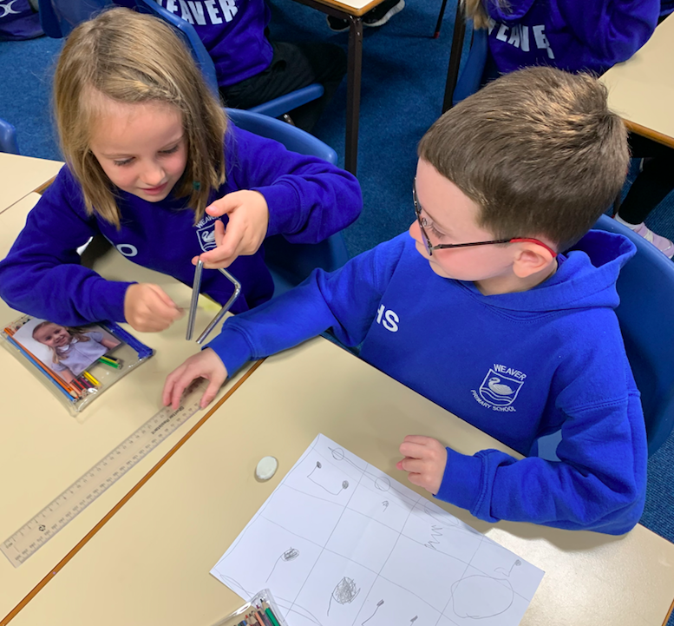
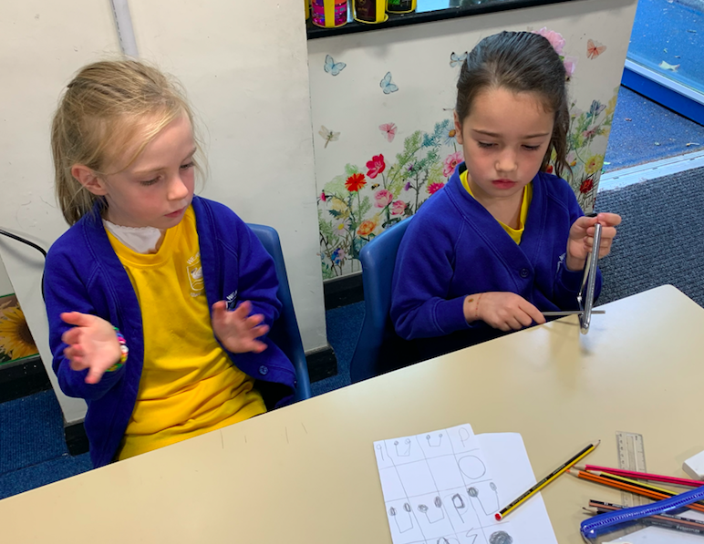
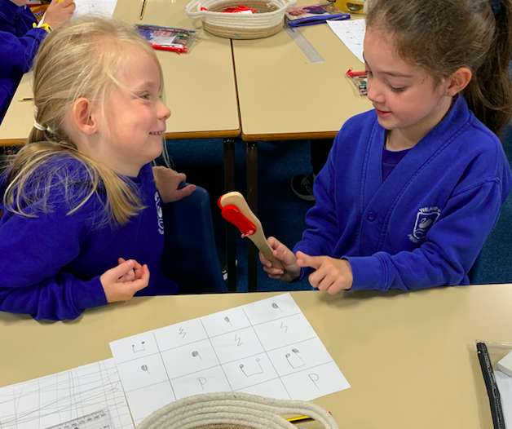
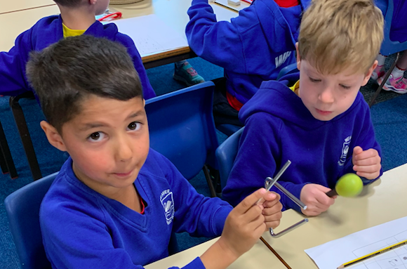
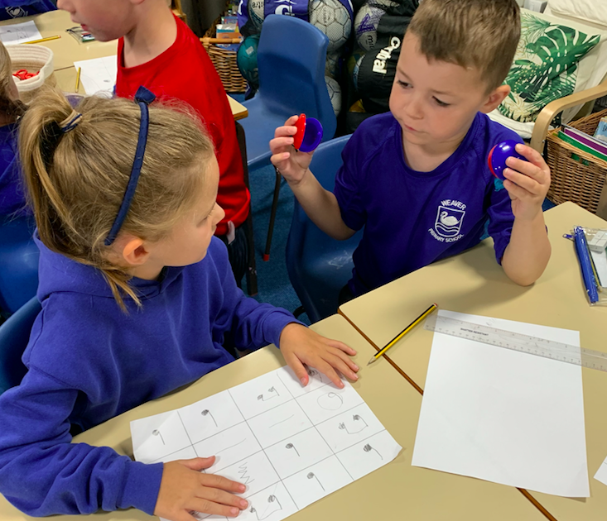
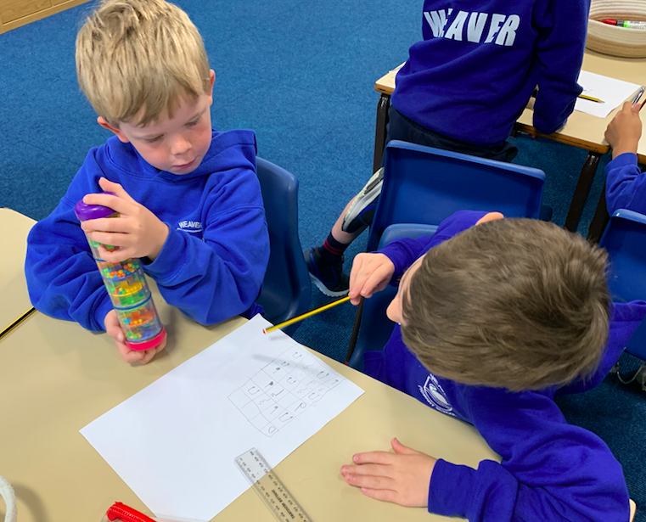
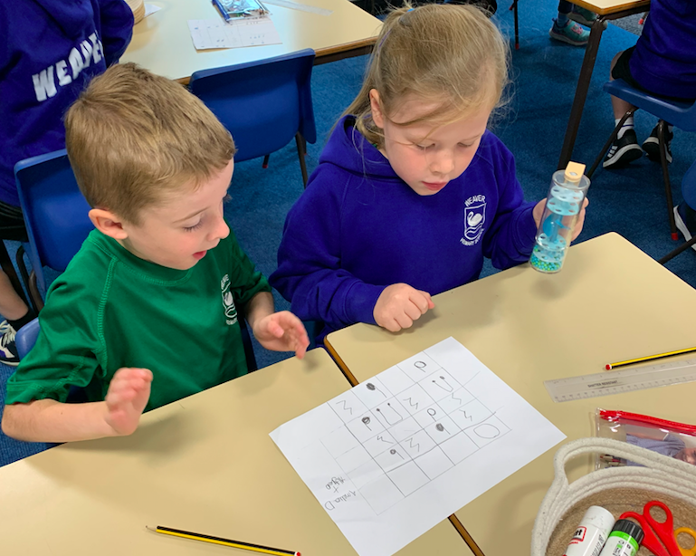
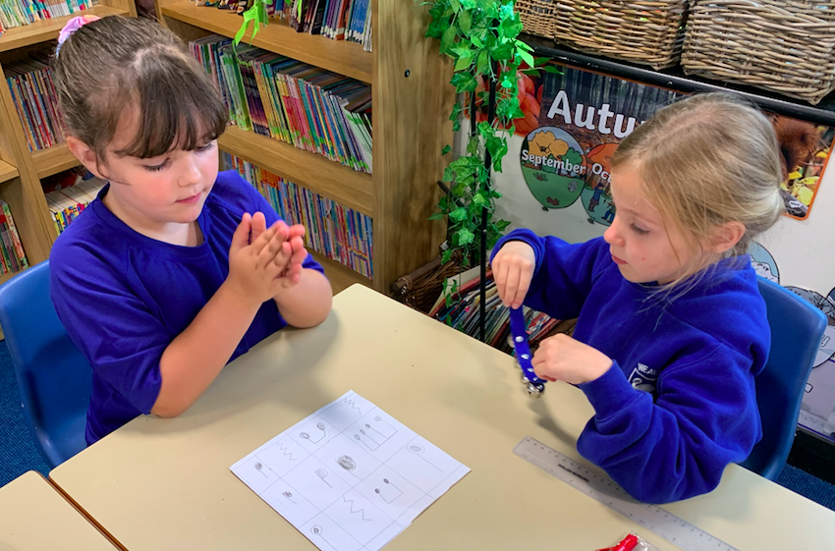

Year 2
2024-2025

Slide 2
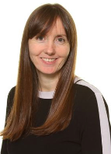
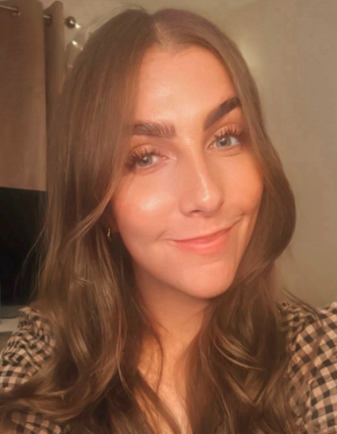
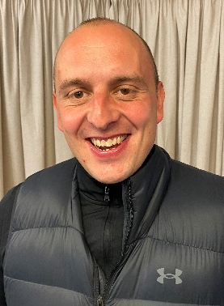
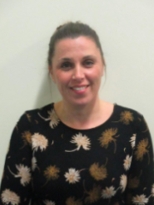
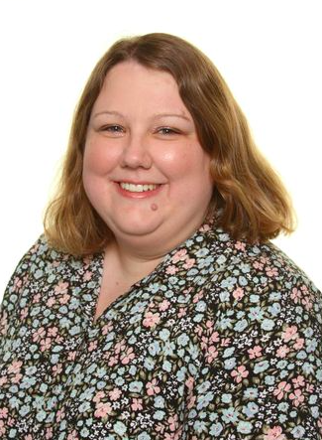


Year 2 – Who’s who ….
Mrs Johnson
Miss Street
Mr Gibbons
Mrs Cope
Miss Warhurst
Mr Dean

Slide 3
Year 2 Daily Timetable
8.45 -9.00am | Morning activities and registers. (Common Exception Words, maths flashback, grammar, punctutation, mindfulness)
9.00-9.40am | RWI Phonics, spelling, reading
9.40-10.40am | English
11.00-12.00pm | Maths Maths Fluency
 | Lunch
1.00-3.15pm (includes playtime) | History, Geography, Science, PE, IT, Art, DT, PSHE, RE
2.45-3.10pm | Assembly (Monday/Tuesday)
3.15pm | Home time

Slide 4



Curriculum
Significant Individuals
Australia
Seasides

Slide 5

PE
PE is on a Tuesday and a Thursday. Mr Gibbons teaches the Thursday session.
Children are allowed to come to school wearing their school PE kit.
During colder months the children must wear warm clothing for outdoor PE sessions.
Please label all clothing, especially jumpers!
We encourage the children to wear trainers and not the the black pumps.
Earrings – Tape is needed to cover earrings or please don’t wear them.

Slide 6

Reading in Year 2
Reading diaries are checked daily.
RWI books are changed every three days.
Book banded books can be changed when they have completed them.
We focus on fluency and understanding. The children should be 95% fluent with the text and be able to answer questions about the text confidently.
In Year 2 we focus on fluency and comprehension skills.
RWI assessments every half term. Book Banded assessments termly.
Try and read most nights, little and often helps to accelerate their reading.

Slide 7


Spellings in Year 2
RWI – Bookmarks
Book banded books – Weekly spelling challenge
Spelling Frame games.
Everyone to learn Common Exception Words

Slide 8





Home Learning
Numbots
TT Rockstars
Mathletics
Spelling Frame
All login and passwords are in the children’s diaries.
Seesaw – All home learning to be uploaded and sent via Seesaw. Homework sheets will be sent home every Friday so no printing is required at home.

Slide 9
Communication
Reading diaries
Email - cjohnson@weaver.cheshire.sch.uk
Weekly letter
Twitter - @Class2Weaver
Seesaw – Homework only
School office (Please notify the school office if your child is poorly) admin@weaver.cheshire.sch.uk

Slide 10
SATs
Standard Assessment Tests
This year the KS1 SATs are NOT compulsory.
No data will be sent to the Local Authority.
End of Year 2 standards are the same.
Reading papers will be used as part of lessons to develop reading and comprehension.

Slide 11
Supporting your child with Reading and Writing
Sound out words.
Re-read to check it makes sense.
Use pictures for clues.
Re- read for fluency.
Ask questions about the book.
Tracking – use a bookmark or lollipop stick. Encourage pointing to the words when reading.
Adults to read and share books.
Retell stories.
Audio books.
Any opportunity ask them to write. Christmas cards, invitations, cards, shopping list etc.
Common Exception Words (CEW) Learn to read and spell.
Handwriting – Copy sentences from reading books.

Slide 12
Supporting your child with Maths
Time – o’clock, half past, quarter past, quarter to and 5 minute intervals. Analogue not digital. A clock for the bedroom!
Months of the year - Calendars and diaries.
Money – play games with money, pocket money, shopping with money.
Play games such as snakes and ladders as this helps with counting forwards and backwards to 100.
Measurements (g/kg, CM/M, ml/l) Cooking is great for measuring g/kg.
Number lines for addition and subtraction. See example.
Mathletics

Slide 13
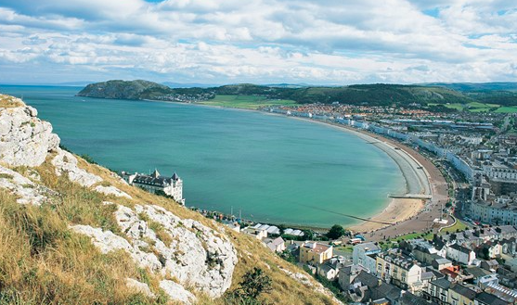
Llandudno 2025
------------

Slide 14
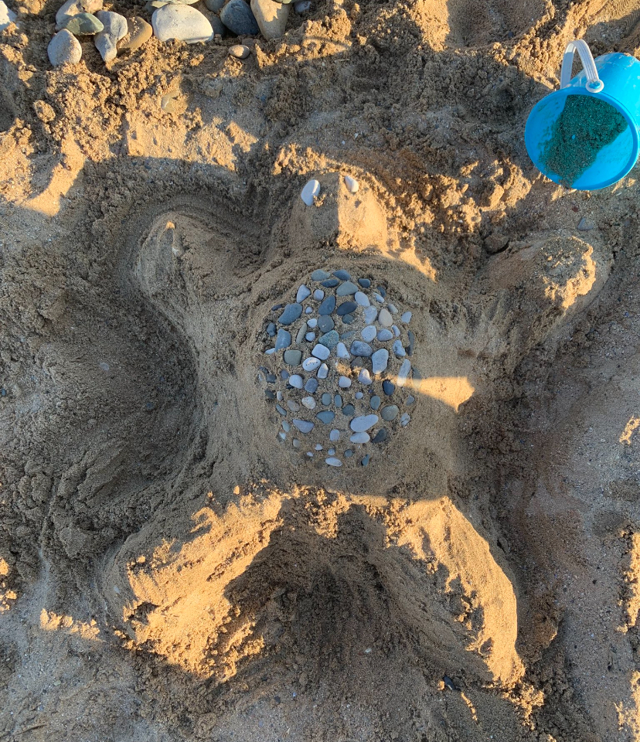
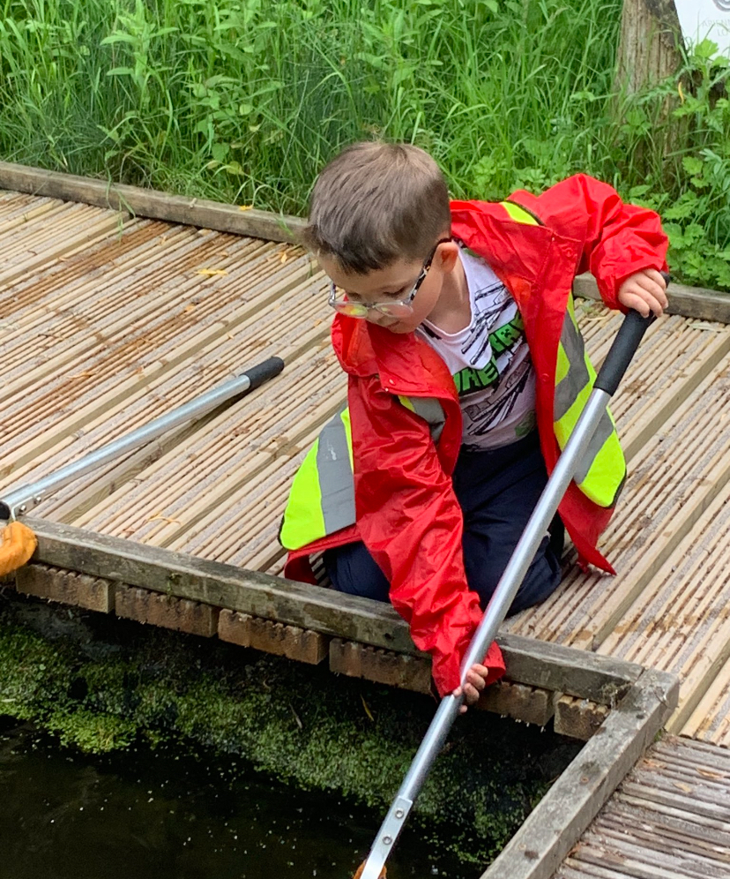
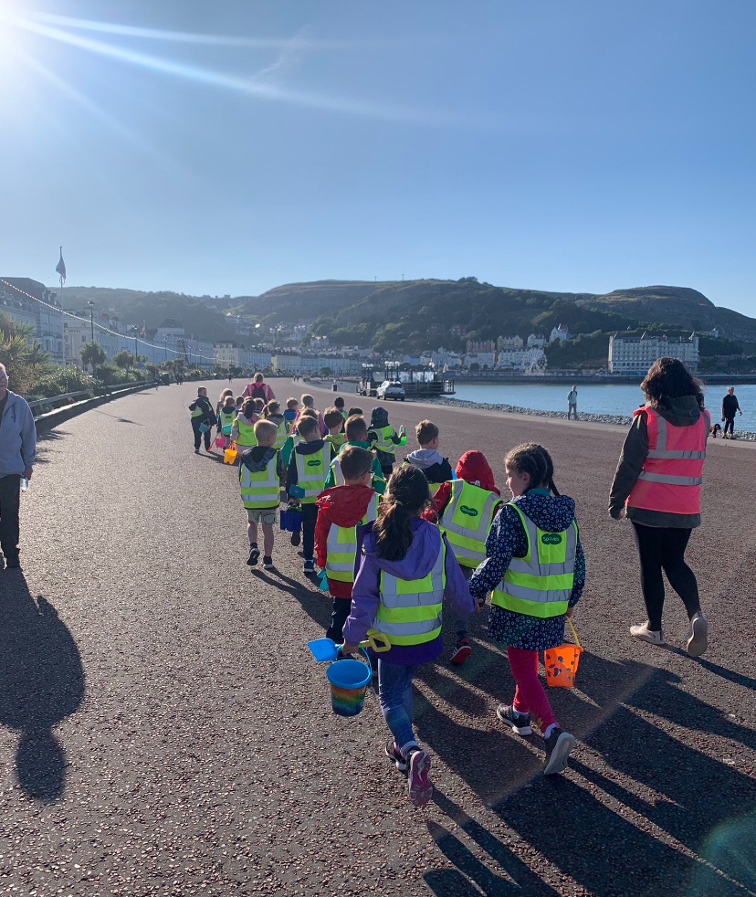
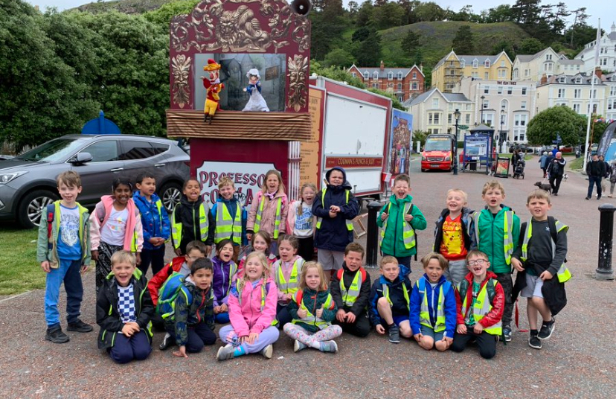
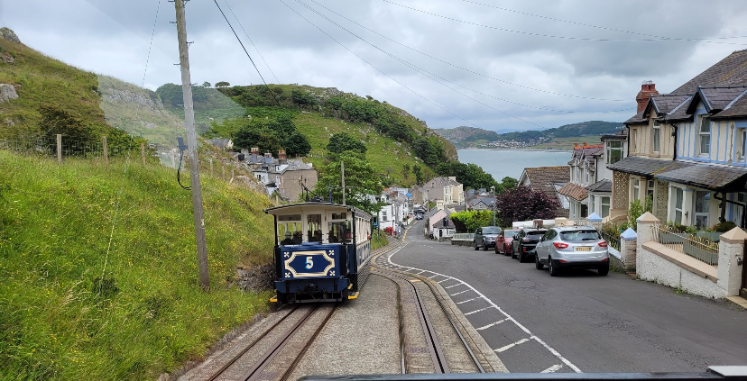
Llandudno
Wednesday 25th June – Friday 27th June 2025
A meeting will be organised before the residential.
Sleepovers
Getting dressed independently

Slide 15
Top Tips for Year 2
Label ALL uniform.
Encourage your child to be independent.
Develop organisational skills.
Scissor skills.

Slide 16
Questions
???

