Slide 1


Year 2
2025-2026

Slide 2
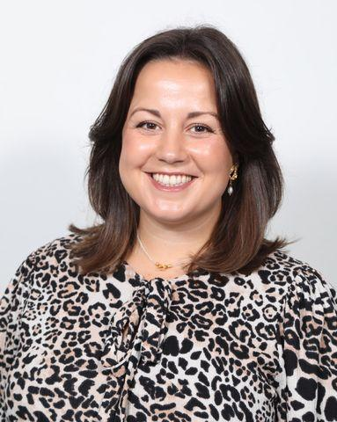
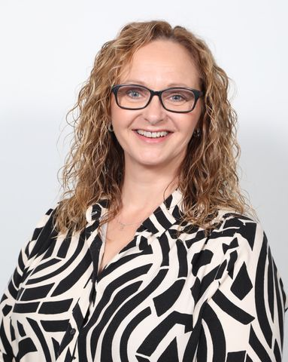
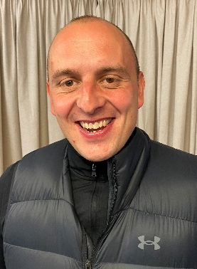

Year 2 – Who’s who ….
Mrs Waters
Mrs Ackerley
Mr Gibbons

Slide 3
Year 2 Daily Timetable
8.45 -9.00am | Morning activities and registers. (Common Exception Words, maths flashback, grammar etc)
9.00-9.40am | RWI Phonics, spelling, reading
9.40-10.40am | English
11.00-12.00pm | Maths
 | Lunch
1.00-3.15pm (includes playtime) | Foundation subjects: History, Geography, Science, PE, IT, Art, DT, PSHE, RE Maths Fluency Handwriting
2.45-3.10pm | Assembly (Monday/Tuesday)
3.15pm | Home time

Slide 4
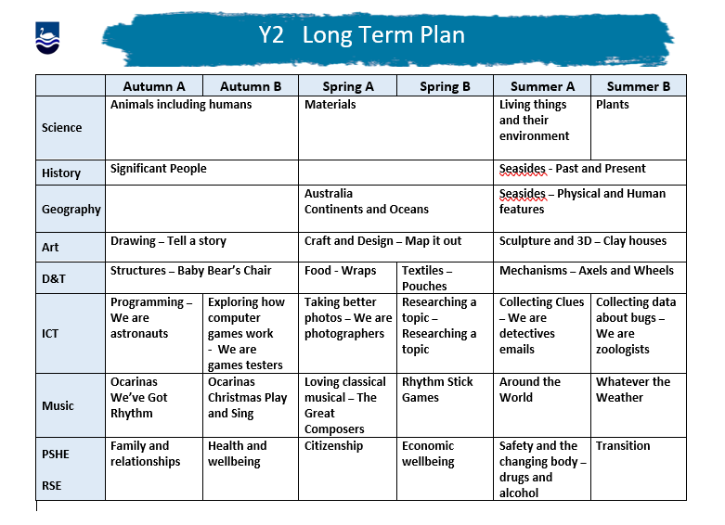
Curriculum

Slide 5
PE
PE is on a Tuesday and a Thursday. Mr Gibbons teaches the Thursday session.
Children are allowed to come to school wearing their school PE kit.
During colder months, the children must wear warm clothing for outdoor PE sessions.
Please label all clothing, especially jumpers!
We encourage the children to wear trainers and not the the black pumps.
Earrings – Tape is needed to cover earrings or please don’t wear them.

Slide 6

Reading in Year 2
Reading is an essential skill for accessing the entire curriculum. Please try to read daily with your child as it will help them immeasurably. Numerous studies show significant correlations between reading fluency and academic success.
Praise them! Confidence is key when reading. Children can easily worry they are disappointing you by not reading fluently enough. It’s important to keep reminding them what a great job they are doing and how proud you are of them. If they get stuck, use positive language to encourage them to have another go. It’s important they associate reading with positive feelings.
When reading with your child, model strategies such as chunking (breaking down) words. Encourage them to use their hands to cover parts of words etc. It’s amazing how many children will try to do everything in their heads!
Encourage them to recognise punctuation as this will help to develop their understanding of sentence structure, thus helping their writing.
Model good use expression to convey meaning. Children can demonstrate their comprehension of a text through their ‘storytelling voice’.
Pause to discuss the text – ask questions etc. Children need to be ‘active readers’ (thinking as they read) to help comprehension. Also, check their understanding of vocabulary you think might be tricky.
Foster a love of reading – trips to the library, reading stories to them. Don’t be afraid to read the same book over and over again as this can actually help develop their vocabulary.

Slide 7
Writing in Year 2
There are two main elements to writing – composition (their ideas, the content of what they choose to write) and transcription (the technical part – correct grammar, spelling, punctuation and handwriting)
To help with their composition, give them exposure to quality texts, encourage them to write for fun e.g. diaries, shopping lists, homemade story books etc.
To help with transcription, practise spellings with them (I have sent home the list of common exception words that all children are expected to spell by the end of Y2. These are words that don’t follow typical spelling patterns and therefore need to be memorised) and encourage good letter formation (watch out for letters a, d, b, p, g and y as these are often formed incorrectly)
Spellingframe is a great app to help children improve spellings, too. Log-ins will be in diaries soon!
Again, be positive and congratulate your child. When writing, we are asking them to use such a wide range of skills and, as adults, we often forget the cognitive load children can face when putting pen to paper.
Writing should be purposeful – children should feel compelled to write for best outcomes. I have had lots of training in narrative immersion (bringing texts to life through drama etc) and will be using these strategies to make writing meaningful in Year 2.

Slide 8

Maths in Year 2
In Year 2, maths will be taught through the NCETM Curriculum Prioritisation. This scheme of provides the following:
Promotes mastery of number
Deeper understanding of numerical structures to aid mastery
Slower pace but favours conceptual knowledge over procedural.
Stem sentences – mathematical vocabulary (addend etc)
Deepens understanding of order of operations
Promotes mathematical thinking e.g. pattern spotting, making connections ‘if I know that, then I also know…’ , working systematically and efficiently.
All of the resources are free to use and the curriculum map for Year 2, as well as information on the strategies taught etc, can be found here:
Year 2 curriculum map | NCETM

Slide 9

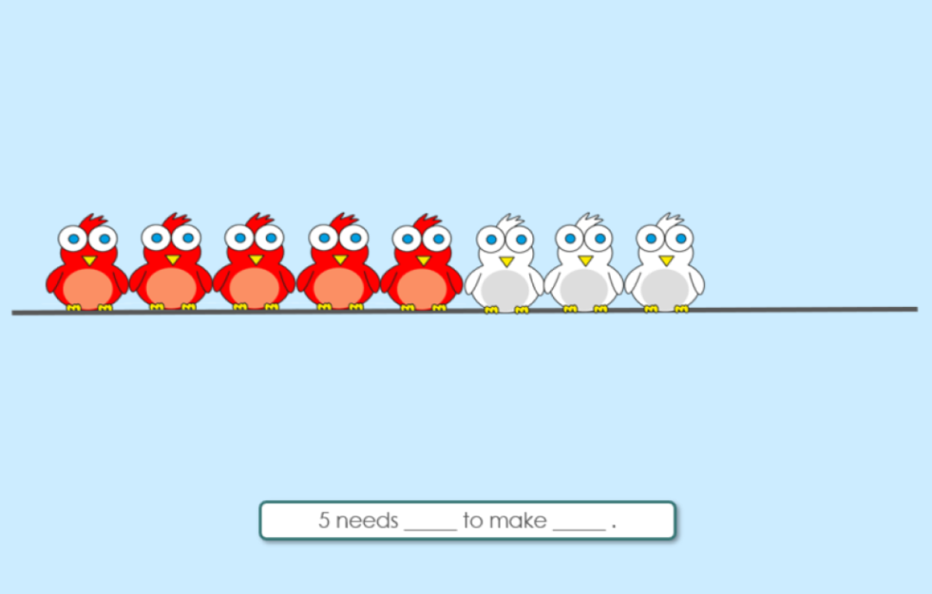
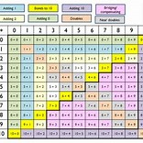
Maths Fluency in Year 2
As part of teaching for mastery, we will be having daily 10 minute maths fluency sessions (also part of the NCETM). This is to secure the many number bonds children need to be able to recall fluently.
Daily fluency practise of key number facts
Highlights importance of commutativity and inverse e.g. helping children realise that if they know 6 + 1 = 7, then they also know:
1 + 6 = 7
7 - 1 = 6
7 - 6 = 1
Fluency in these facts can be applied to a whole range of mathematical relationships e.g.
60 + 10 = 70
16 + 1 = 17

Slide 10


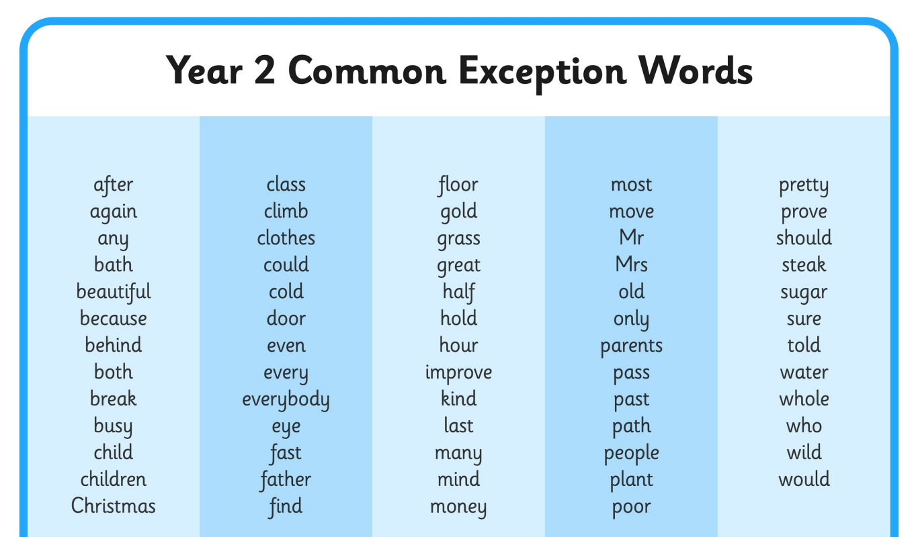
Spellings in Year 2
Children who have completed the RWI phonics scheme will have a weekly spelling test – mixture of spelling rules and ‘red’ words.
Top tips: Clap for syllables, use phonics, encourage use of letter names over phonemes (letter sounds)
These are the common exception words mentioned on the writing slide.
Every child has had a copy sent home with them ☺

Slide 11




Home Learning
Numbots – great for number bonds/fluency
TT Rockstars – more important later in the year
Mathletics
Spelling Frame
All login and passwords will be in the children’s diaries.
Seesaw – Homework will vary – thank you for your patience!

Slide 12
Communication
Reading diaries
Email - mwaters@weaver.cheshire.sch.uk
Monthly newsletter
Seesaw – Homework mainly but more than happy to message on there, too. I will keep ‘office hours’ with communication as much as possible, so you may not always receive a response on the same day ☺
School office (Please notify the school office if your child is poorly) admin@weaver.cheshire.sch.uk

Slide 13
SATs
Standard Assessment Tests
This year the KS1 SATs are NOT compulsory.
No data will be sent to the Local Authority.
End of Year 2 standards are the same.
Reading papers will be used as part of lessons to develop reading and comprehension.

Slide 14

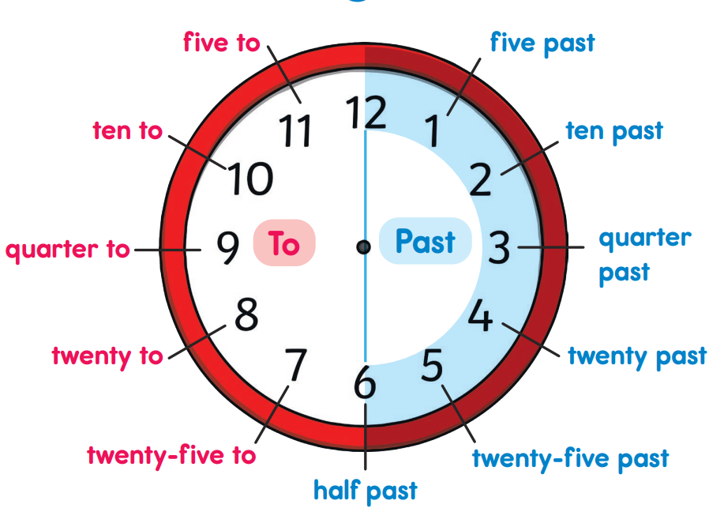

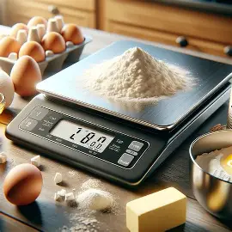

Supporting your child with Maths
Here are some ideas for how you can help your child use maths in everyday life. I would also strongly encourage giving them pocket money in cash, as this will provide a great foundation for when we study this in the summer term. It also helps their rounding, addition and subtraction skills.

Slide 15
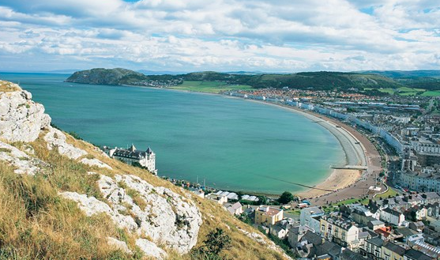
Llandudno 2026
------------

Slide 16
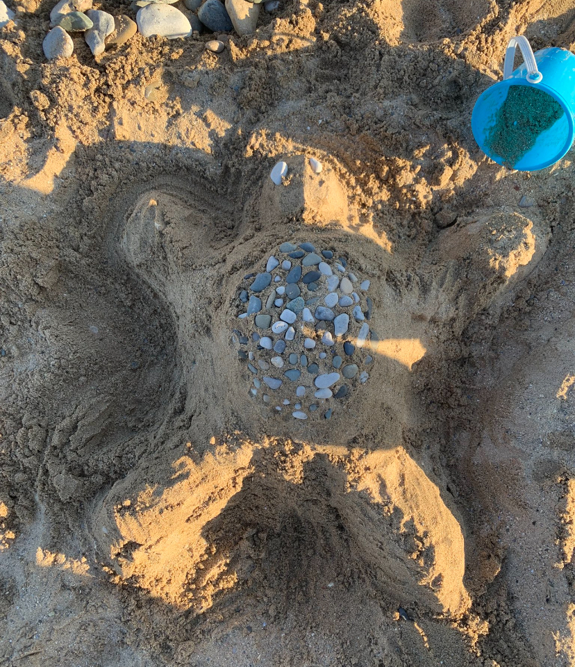
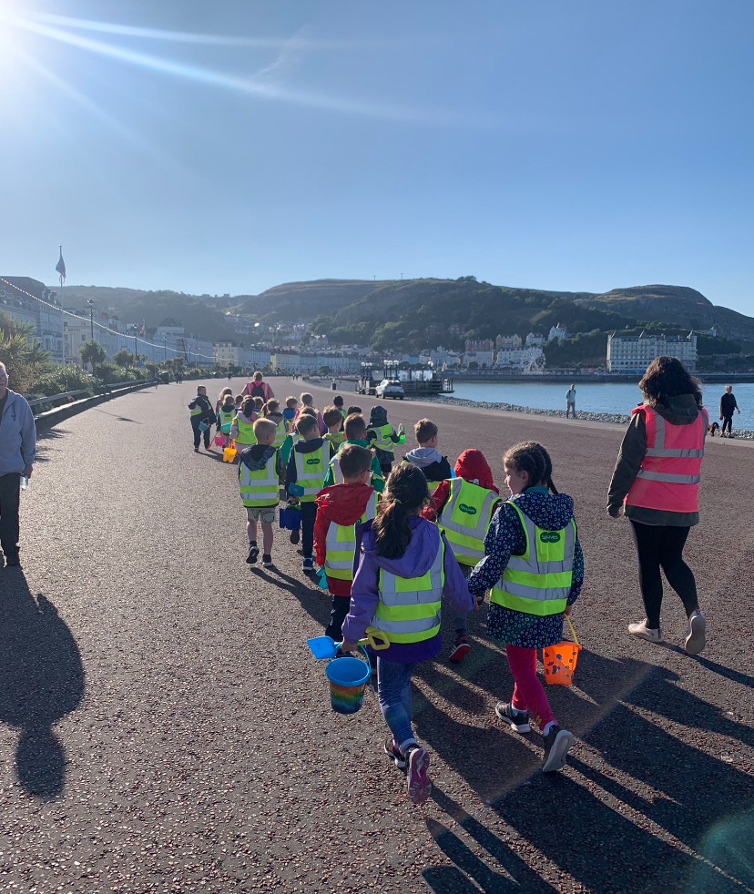
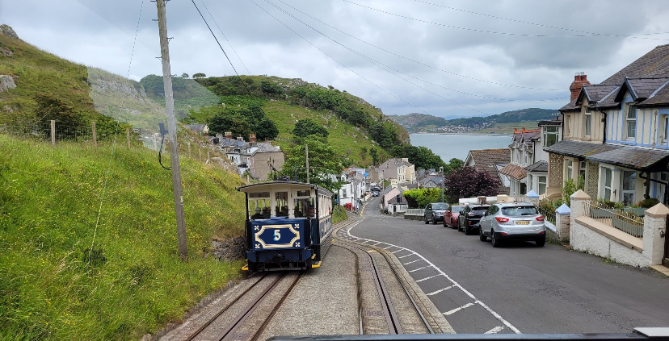
Llandudno
Date: Wednesday 24th – Friday 26th June
A meeting will be organised before the residential.
Sleepovers are a great way to prepare your child and build their confidence.
It’s a good idea to get them to practise getting dressed independently.

Slide 17
Top Tips for Year 2
Label ALL uniform.
Encourage your child to be independent.
Develop organisational skills.
Scissor skills.

Slide 18
Any Questions?

Slide 19
Thank you for coming! ☺

