Slide 1






Mossley School Council
Assembly

Slide 2
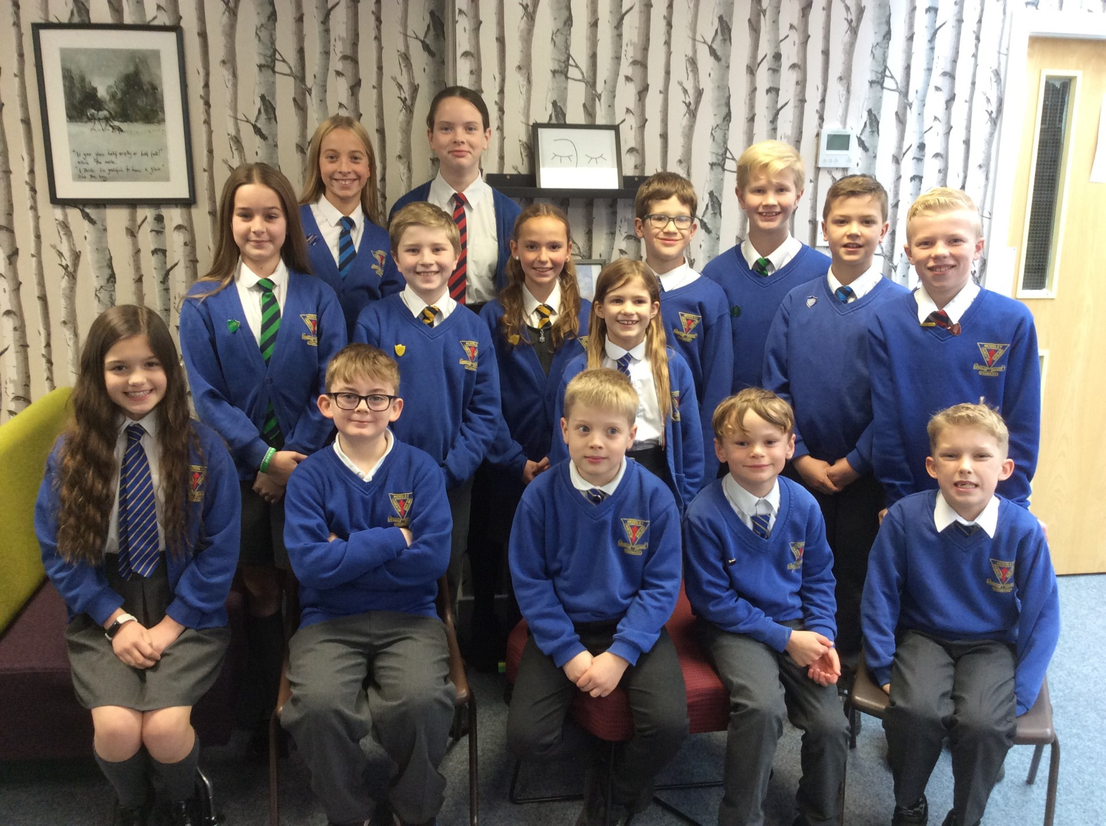


We are the ‘pupil voice’ for the children attending this school.
We look at how children are kept safe at this school.
We will be fundraising.
Making improvements
Why do we have a school council?
Notes:
Leah and Lexi

Slide 3
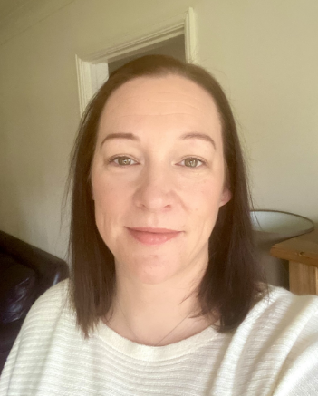
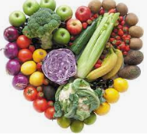


Our priorities:
Making improvements & fundraising
Keeping us all safe….
Having a healthy school
Jo Graham
Notes:
Jonah and Theo

Slide 4



MOSSLEY CE PRIMARY
SCHOOL
COUNCIL
One of our tasks, as members of the School Council, is to act as representatives for our classmates in discussing the views of Mossley pupils with the headteacher and staff.
But how do we do this?
Notes:
Matilda and Isla

Slide 5
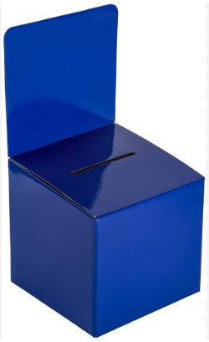
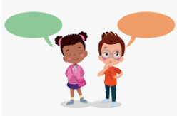
We are your voice….
How can you suggest improvements?
Speak to your year group representative.
Use our suggestion boxes.
Notes:
Edward and Sofia

Slide 6
Suggestion Examples
We don’t want:
We need a swimming pool.
Can we have McDonalds everyday.
They need to be:
Useful
Achievable
Sensible
Safety
Improvements
Being Healthy
The benches in the quiet area are broken! Can they be fixed?
We saw a stranger on site! Are all people signing in?
Could we have house flags for sports day?
Could each class go in the woods once a week?
Improving table manners.
Have a treat day on a Friday.
Mile a day running.
Notes:
Leah and Mikey

Slide 7


The End
Thank you for listening!
Please come and see us.

