Slide 1
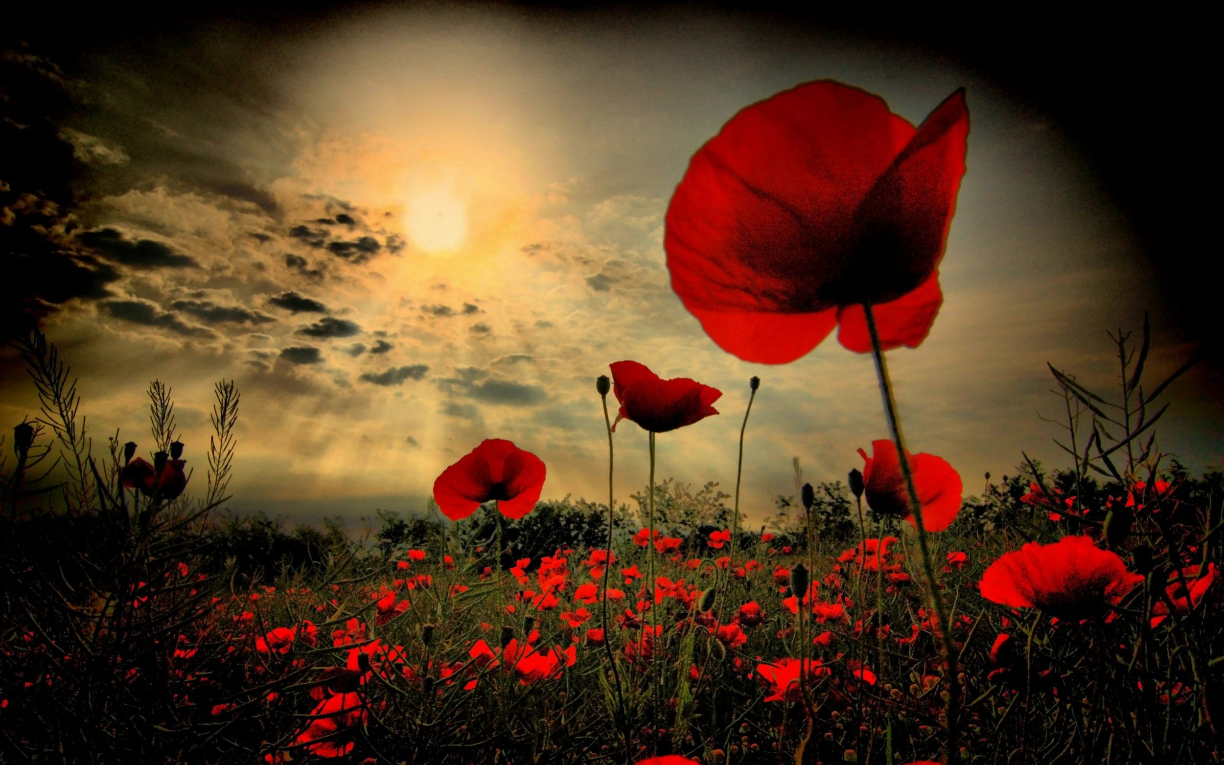
Remembrance Worship
Wednesday 11th November 2020

Slide 2
What is Remembrance day?
Why is it important?

Slide 3
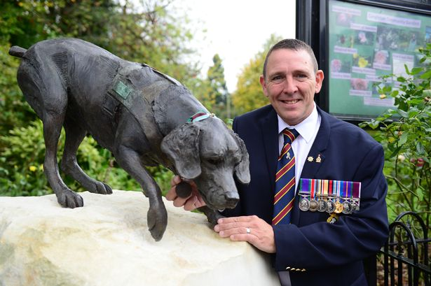
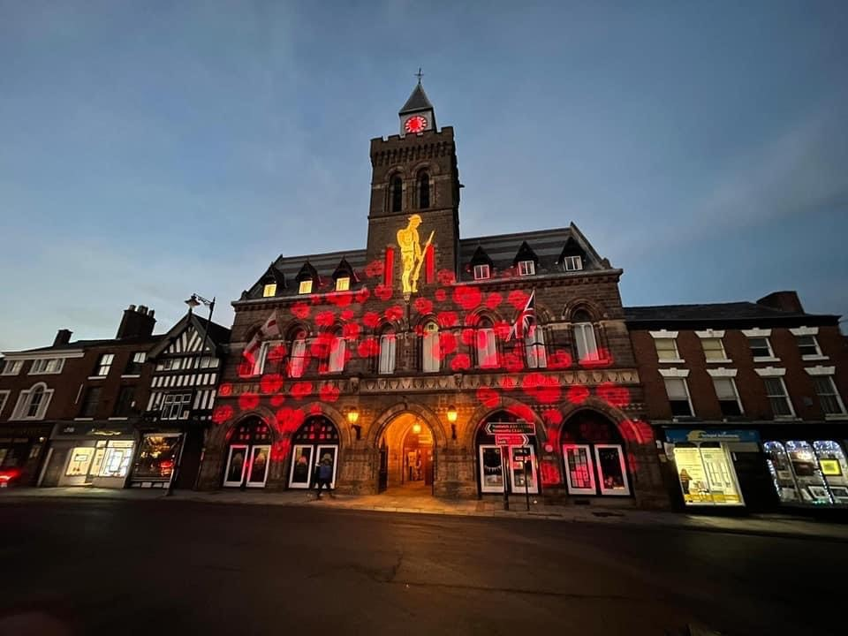
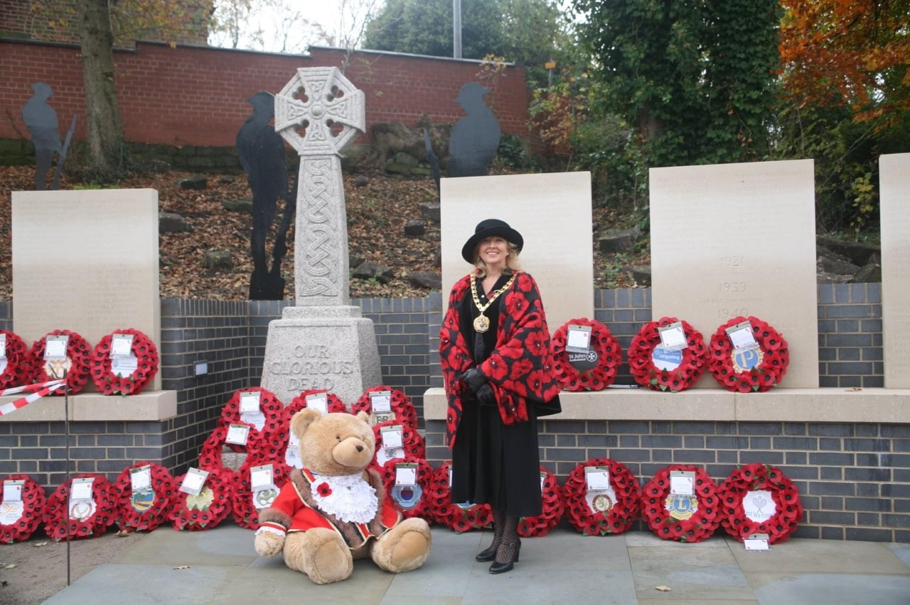
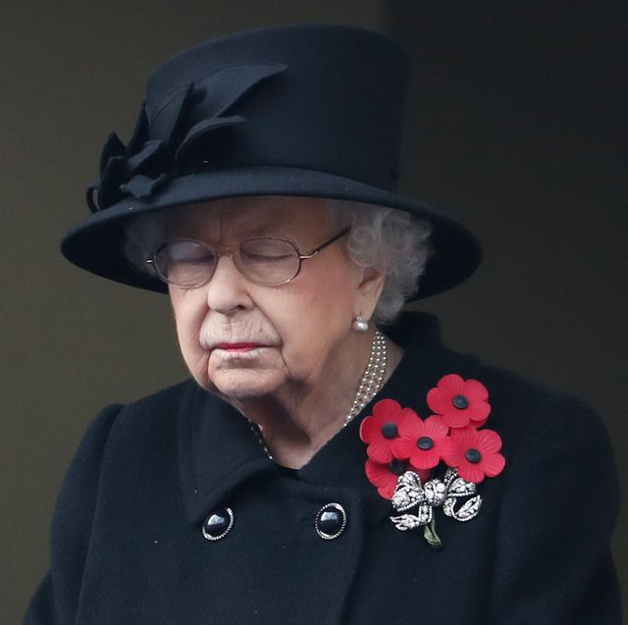
On Sunday…

Slide 4
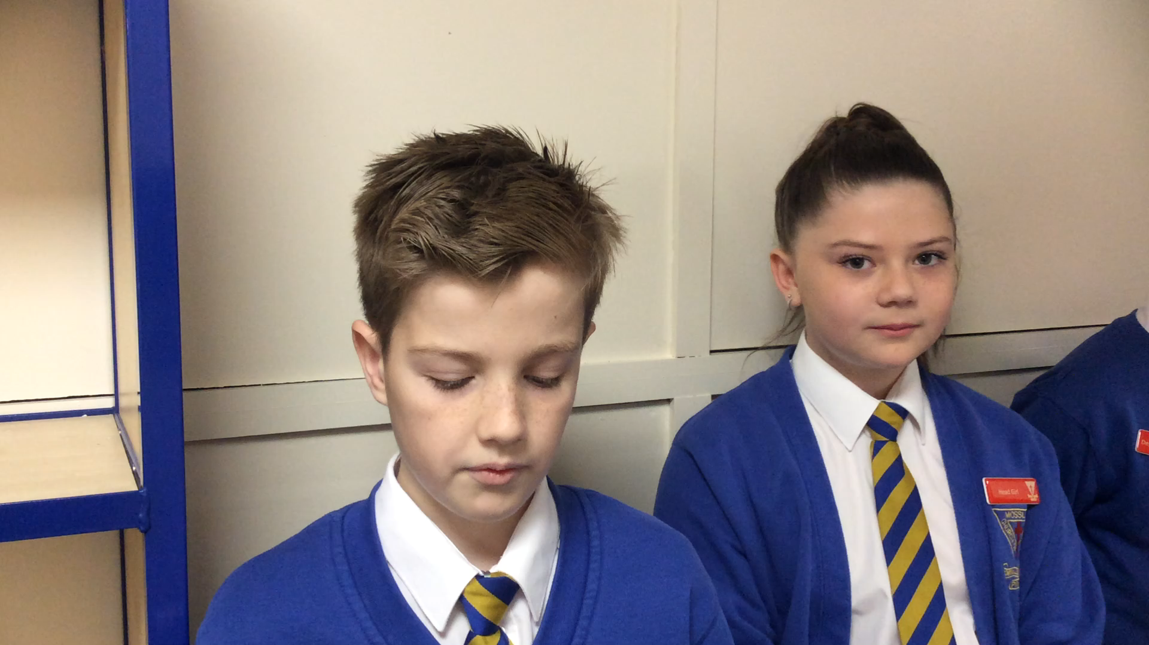
Our Year Six, school parliament (Head boys, girls and prefects) have read ‘In Flanders Fields’

Slide 5
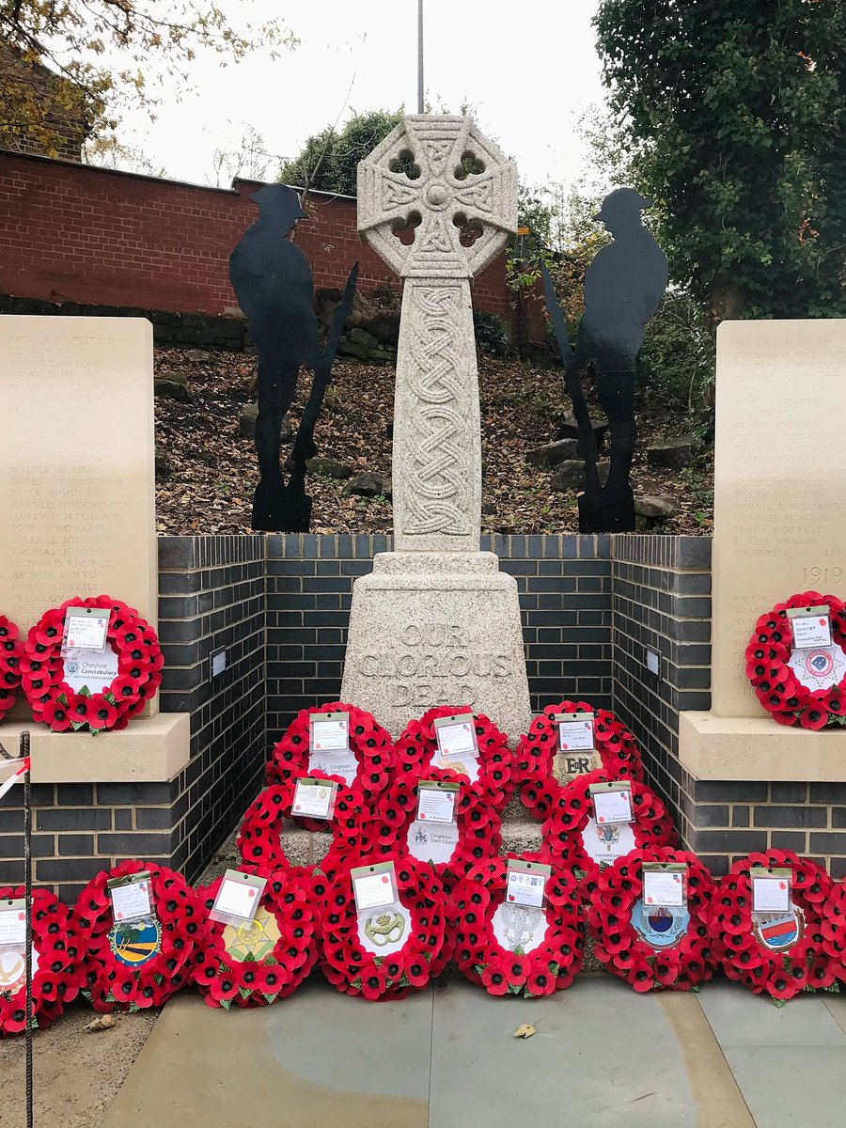
Make yourselves still for our 2 minute silence.

