Slide 1
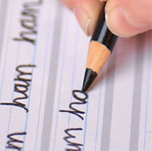
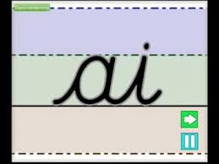

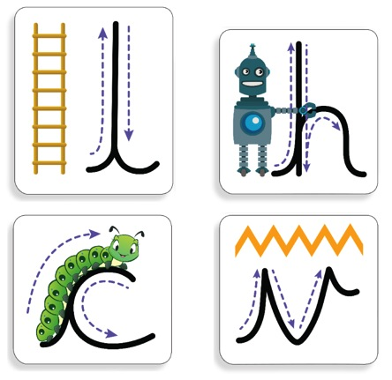
Handwriting Presentation
Wednesday 1st November 2017

Slide 2
Handwriting Policy
Here at Mossley Primary School we are very proud of our pupil’s handwriting and take particular care in our cursive/joined-up handwriting style. We use Mossley Cursive as the basis of our handwriting policy that covers all the requirements of the 2014 National Curriculum.
Handwriting is a basic skill that influences the quality of work throughout the curriculum. At the end of Key Stage 2 all pupils should have the ability to produce fluent, legible and, eventually, speedy joined-up handwriting, and to understand the different forms of handwriting used for different purposes.
We aim to make handwriting an automatic process that does not interfere with creative and mental thinking.
As a catalyst to speedy handwriting we encourage parents and carers to use our Mossley cursive resources at home to help their children to practise their handwriting.

Slide 3
School aims
We aim for our pupils to develop a neat, legible, speedy handwriting style using continuous cursive letters that leads to producing letters and words automatically in independent writing.
By the end of Year 6 pupils will understand the importance of neat presentation and the need for different letterforms (cursive, printed or capital letters) to help communicate meaning clearly.

Slide 4
Why cursive?
It would be desirable for children to be able to join their handwriting by the end of KS1. Starting a joined form of handwriting in year one will help them to do this.
Reduces the chances of children reversing letters and putting capitals in the middle of words because they all start from the same place on the line.
Helps them to see a word as a whole unit and shape which helps with spelling patterns.
Although it can be hard to learn at first the end result is worth it and once the children are writing fluently they can then concentrate on the content of their writing.

Slide 5
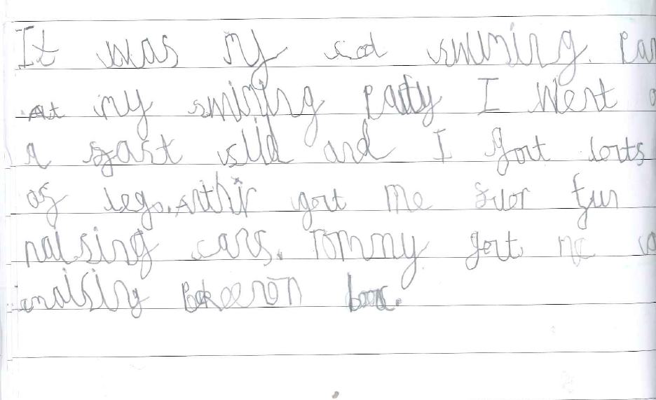
Examples of children’s writing

Slide 6
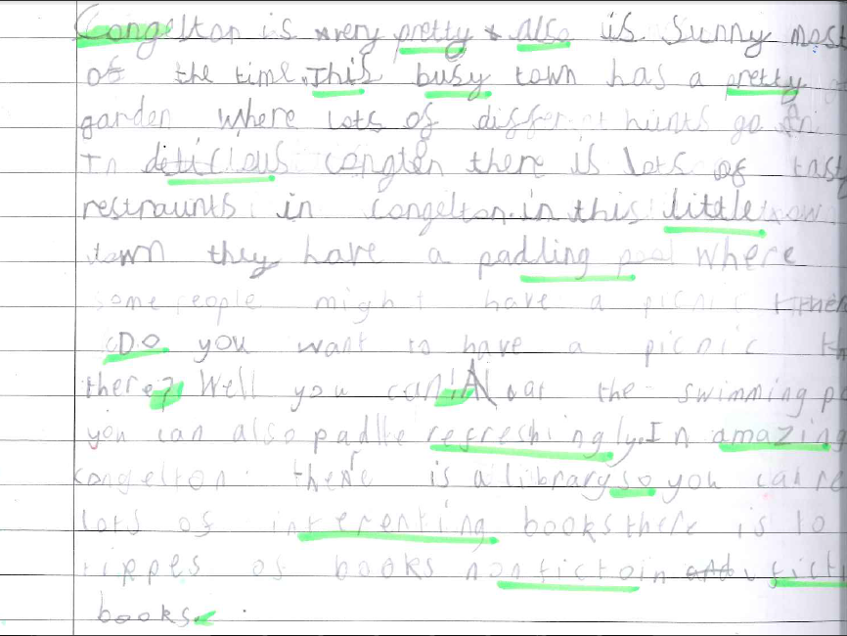
Examples of children’s writing

Slide 7
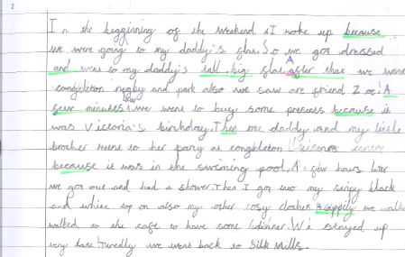
Examples of children’s writing

Slide 8
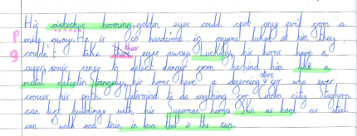
Examples of children’s writing

Slide 9
HANDWRITING FREQUENCY.
Handwriting is a cross-curriculum task and will be taken into consideration during all lessons. Formal teaching of handwriting is to be carried out regularly and systematically to ensure Key Stage targets are met.
Reception:
For our youngest pupils we aim daily sessions totalling 15 minutes a day that will include the following;
Movements to enhance gross motor skills such as air-writing, pattern making, dancing.
Exercises to develop fine motor skills such as making marks on paper, whiteboards, blackboards, sand trays, iPads and tablets.
Letter learning to familiarise letter shapes, formation and vocabulary.
Years 1 to 3:
Tuition will continue as daily sessions totalling 15 minutes a day covering:
Gross and fine motor skills exercises.
Cursive handwriting reinforcement, learning and practice.
Numerals, capitals and printed letters: where and when to use, learning and practice.
Years 4 to 6:
More advanced handwriting techniques will be taught during two or three weekly sessions totalling 20 to 30 minutes teaching:
Cursive handwriting re-enforcement.
Form-filling/labelling using printed and capital letters.
Dictation exercises to teach the need for quick notes and speedy handwriting writing.

Slide 10
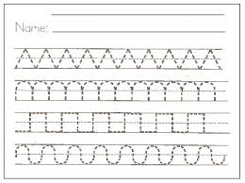
Reception
Sit in the correct position and hold a pencil correctly to allow fluid movement of the nib.
Improve fine and gross motor skills by enjoying drawing pre-cursive patterns in a variety of writing materials such as modelling clay, air writing, sand trays, felt pens, crayons, pencils, IWB, iPads/tablets.
Understand the language need to describe pencil movements in preparation of letter formation.
Hold a pencil in an effective manner for writing and be encouraged to correct any errors in grip or stature.
Have an understanding of writing their own name.
Understanding different shaped letter families and form letters from these families.
Begin to be introduced to cursive writing during phonics sessions and teacher modelling.

Slide 11
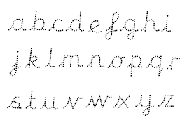
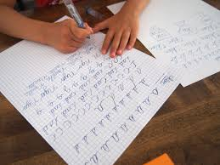
Key Stage 1
Write legibly using upper and lower case letters with correct joins.
Understanding different shaped letter families for cursive letters and form letters from these families
Form all letters in a cursive style and once they know the whole alphabet begin to join words.
Ensure that letters sit on the base line and are consistent in size with ascenders and descenders that are the correct length and formation.
Leave the correct space between words.
Form capital letters and use where appropriate.
Form numerals that are consistent in size and sit on the base line.
Begin to form printed letters and understand when they are to be used.
Improve the speed of writing and begin to write automatically so promoting creativity in independent writing.

Slide 12
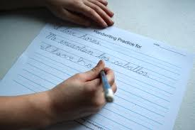
Key Stage 2
Improve quality, speed and stamina of handwriting.
Quality: Ensure letters are consistently sized with equal word spacing and that ascenders and descenders are parallel and do not touch words on the lines above and below.
Speed: Improve speed of handwriting to allow creative writing to take precedence over the task of handwriting and be able to take ‘quick notes’ at a faster pace.
Stamina: Have the strength and mobility to be able to write for longer periods of time without fatigue.
Have full knowledge and ability of the different forms of handwriting for different purposes:
Neat, joined, cursive letters for writing passages and large amounts of text, lists and letters.
Printed or capital letters for posters, notices, headings, labelling, and form filling.
Speedy handwriting for note-taking and dictation where neatness is not as important and shortcuts, such as + instead of ‘and’, can be used.

Slide 13
Letter Formation
Hand outs to be given out
https://www.youtube.com/watch?v=cVf-LnFmt-U

Slide 14
How to help your child at home
Practise at home.
THE TRIPOD PENCIL GRIP
Both right and left handed children should be encouraged to use the tripod grip which allows the pen/pencil to be held securely whilst allowing controlled movements of the pen/pencil nib.
Sit with a straight back, not leaning over the
The table reaches to below elbow
Sit right back in the seat
Keep feet flat on the floor
Pull the chair close in to the table

Slide 15

Useful APPs and websites…
APPs:
Singalong Cursive Handwriting
Cursive writing wizard
On the school website, there is a link to a youtube video, guiding children through each cursive join.

