Slide 1
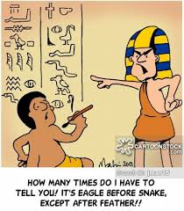

Spelling Workshop
“Anyone who can only think of one way to spell a word obviously lacks imagination.”
― Mark Twain

Slide 2
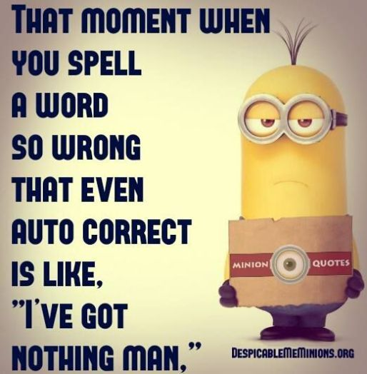
Phonemes, graphemes, phonics, syllables, vowels, consonants??!!
So what is it all about?
Words in the English language are formed by blending sequences of sound into meaningful wholes. By manipulating the 26 letters 44 sounds are produced. But there are 100 ways of spelling those 44 sounds.

Slide 3
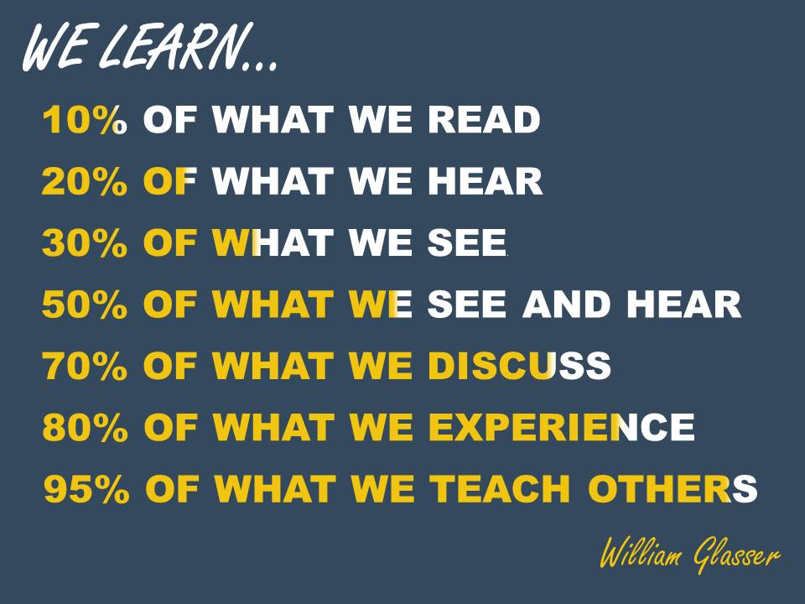
Multisensory is a MUST
Reading and writing are neurological functions. Ears, eyes, mouth and hand movement need to be integrated to develop literary skills. When you use all 4 then the connections between left and right brain and more secure and memory is better enabled.

Slide 4
What are the most effective ways?
SOS – simultaneous oral spelling.
1. Print the word for the pupil to read said
2. Pupil reads the word.
3. Pupil writes over the word naming each letter aloud as he forms it in a joined style.
4. Stage 3 is repeated as many times as necessary.
5. The word is covered. The pupil says the word and writes it naming the letters aloud as before.
6. Pupil checks his attempt carefully with the original model.

Slide 5
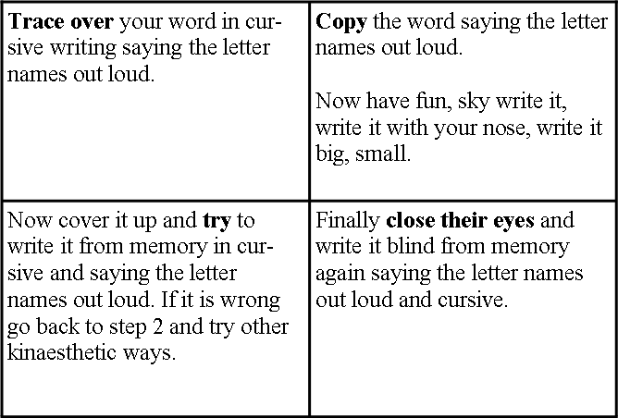
Quarter grid method

Slide 6
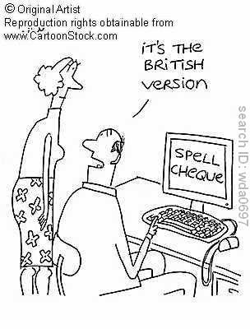
Everyday tips
Teach word names and sounds – sounds are only helpful when spelling cvc words.
When writing out needs to be cursive handwriting to allow the 2 sides of your brain to connect.
Use visualisation w hen w hat
Find words within words – together to get her
Use syllables, clap them out to help chunk the word.
Mnemonics – big elephants can always use smaller elephants.

Slide 7
Remember
If GH can stand for P as in Hiccough
If OUGH stands for O as in Dough
If PHTH stands for T as in Phthisis
If EIGH stands for A as in Neighbour
If TTE stands for T as in Gazette
If EAU stands for O as in Plateau
The right way to spell POTATO should be: GHOUGHPHTHEIGHTTEEAU!
Attributed to Oscar Wilde

