Slide 1


Meet The Teacher
July 2026
Year 2

Slide 2
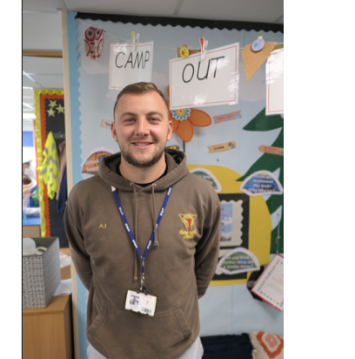
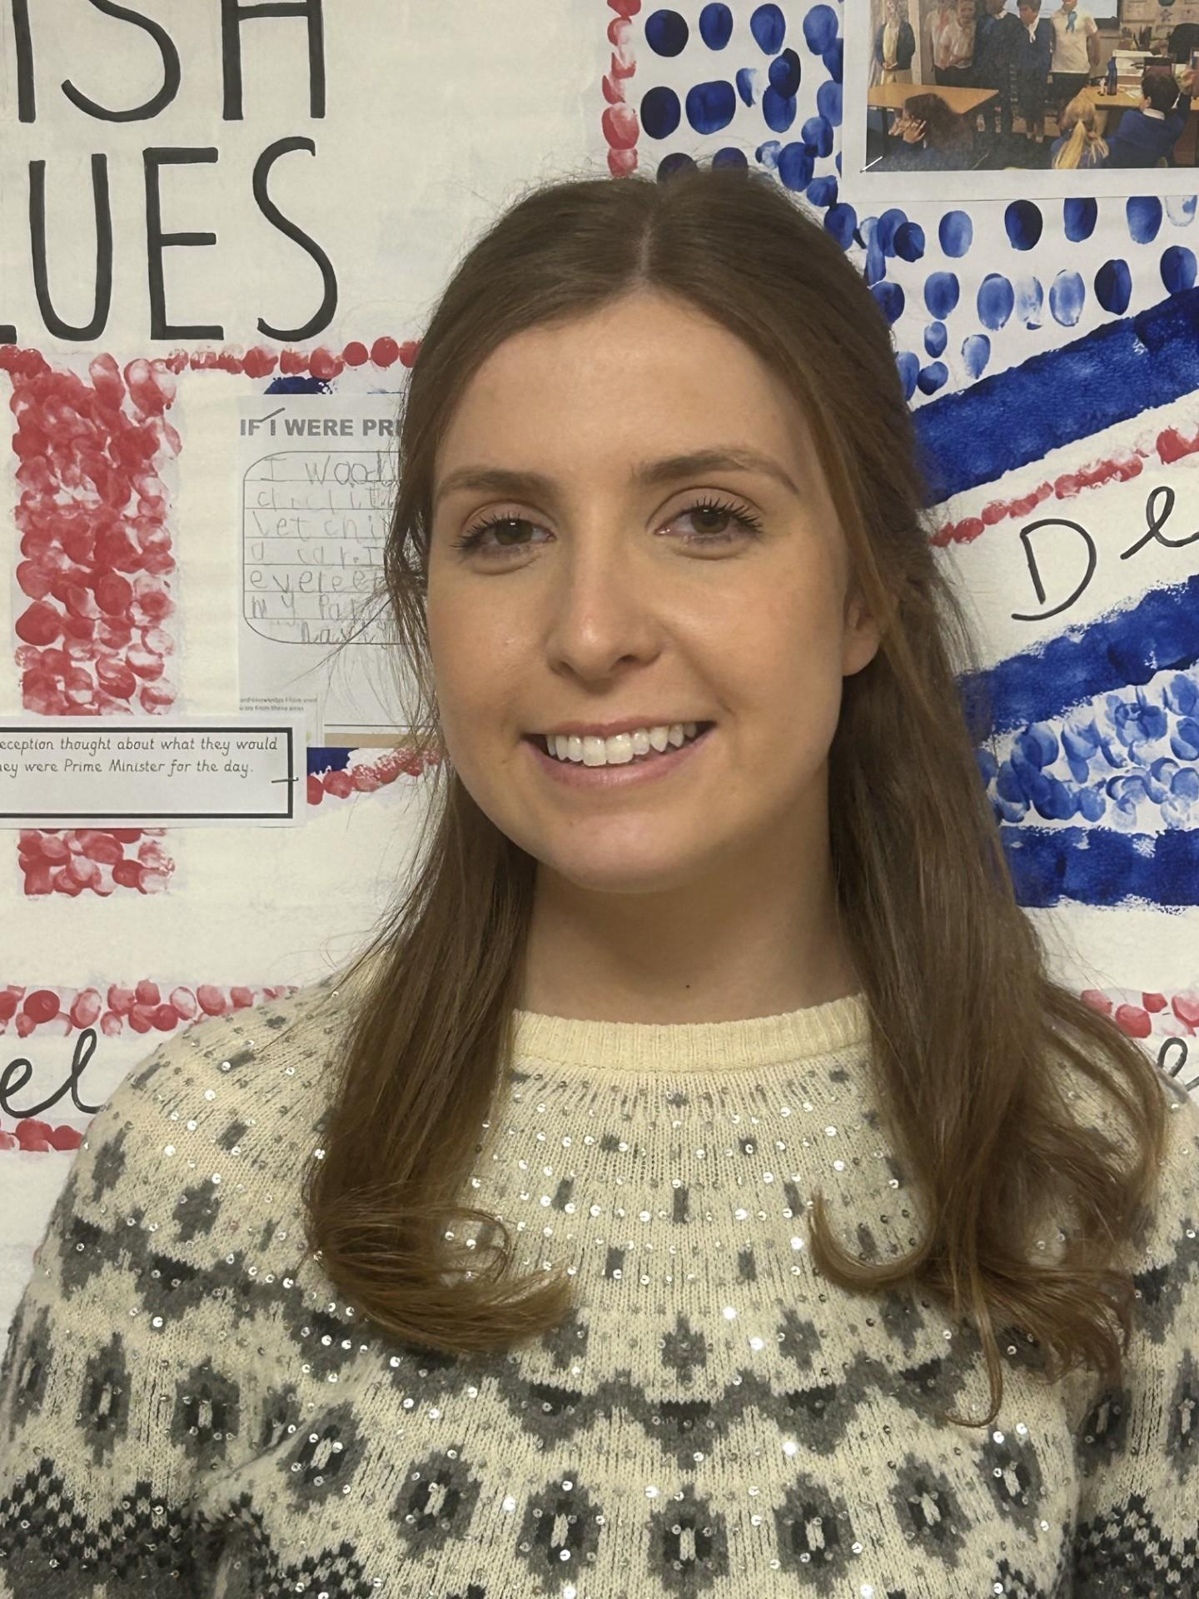
Welcome and Introductions
Names, roles and photos of staff
Teachers
  Miss McCarty
  Mr Johnson
  Learning Assistants
  Mrs Watson
  Miss Worrall

Slide 3
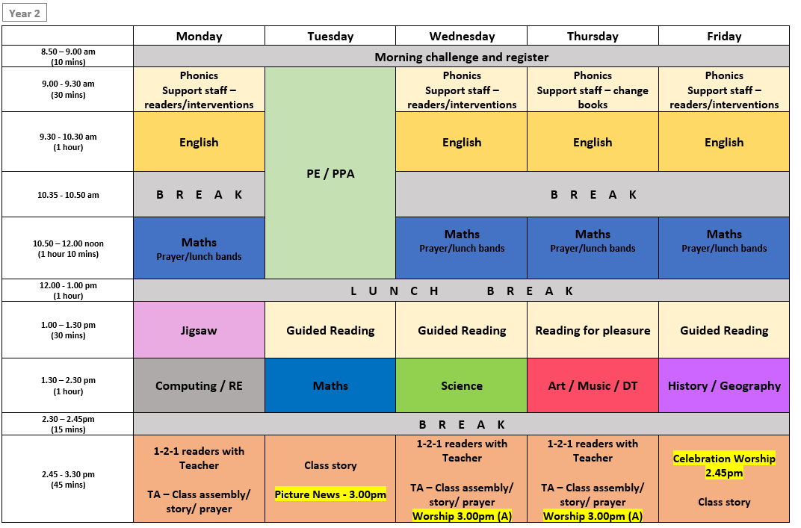
Timetable

Slide 4

P.E Day
Year 2 PE Tuesday
Children required to come to school wearing their PE kit (Blue top and shorts).
Mr Dodds and Miss Smith to lead PE lessons.

Slide 5



Main English lesson each day taught through Pathways to Write Scheme and PKC Scheme.
All units are linked to high-quality texts to ensure engaging and purposeful lessons.
Units of work aim to develop vocabulary, reading and writing skills through the mastery approach and include strategies to develop Greater Depth writers.
English
5

Slide 6
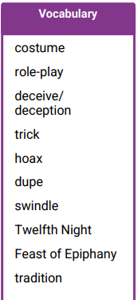
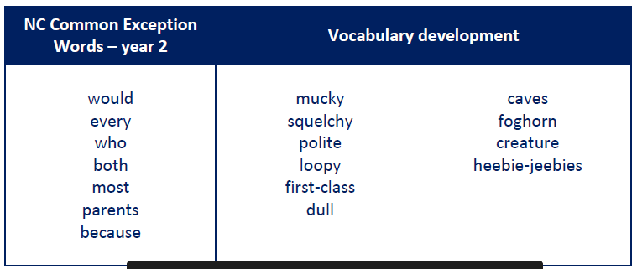
Vocabulary
We teach vocabulary through each English sessions.
We explore the definitions and how we can use these words in sentences, encouraging children to apply them in their writing.
English
6

Slide 7


Phonics / Spelling
English
Phonics will continue in Year 2 through the FFT programme, revisiting previously taught sounds.
In year 2, we begin exploring new spellings, and introducing specific spelling patterns.
Continue practising high-frequency and common exception words at home – these will be provided at the beginning of the academic year.
Children resitting the phonics screening check will receive targeted support in small groups. The screening usually takes place in June.

Slide 8
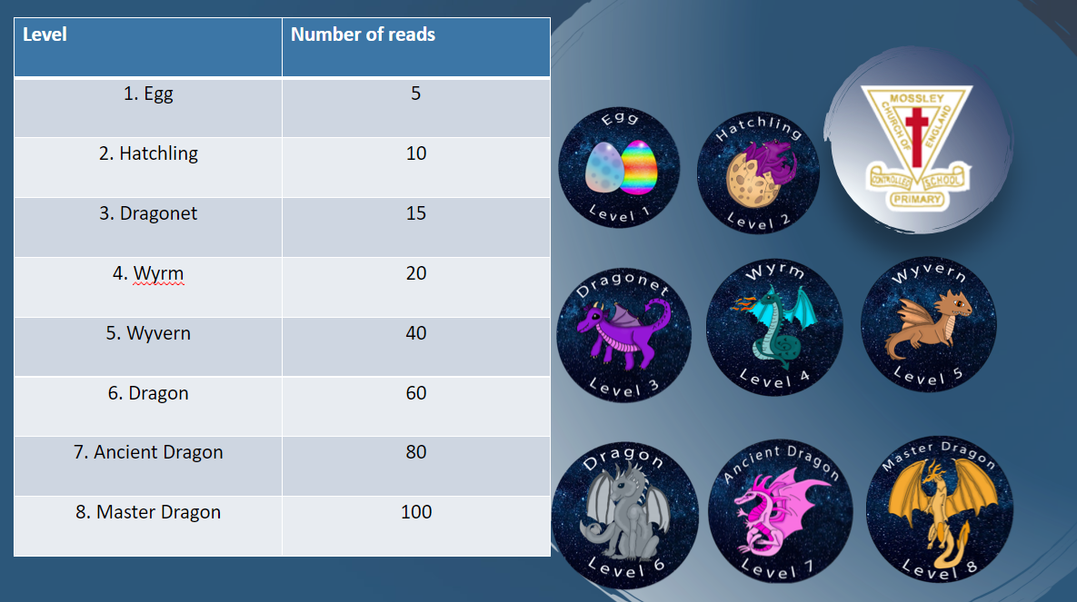

Reading
Reading packs will be sent home with reading books and a reading record each week. As in Year 1, the reading books are in line with the phonics programme so children will continue through these phases from Year 1 into 2 and we will continue to monitor this.
When you hear your child read, please record it in their reading records and number each one.
Continuing with the whole school reading reward
scheme to motivate readers, building up to 100 reads, so please continue to sign the reading record after each read.
VIPER questions can be used to question your child on what they have read to develop understanding. (Website).
Daily guided reading sessions to practise key reading skills in school.

Slide 9

Maths
We are using the Oak Academy maths scheme as it gives our children a clear, consistent and well-sequenced maths curriculum. It helps pupils build confidence, fluency and understanding step by step, while ensuring strong progression from one year group to the next. The scheme supports high-quality teaching and allows us to adapt learning to meet the needs of all children.
This curriculum develops pupils’ understanding of mathematics over time creating competent and confident mathematicians.
The scheme will develop their ability to select the most suitable tools to solve problems across a range of topics and real-world scenarios.
The curriculum is intentionally designed to facilitate high-quality teaching as a powerful lever to support all children.

Slide 10
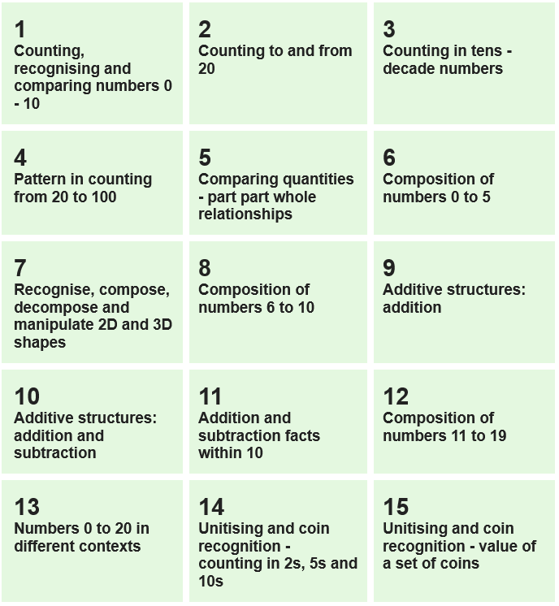
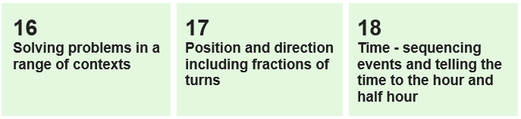
Maths overview

Slide 11

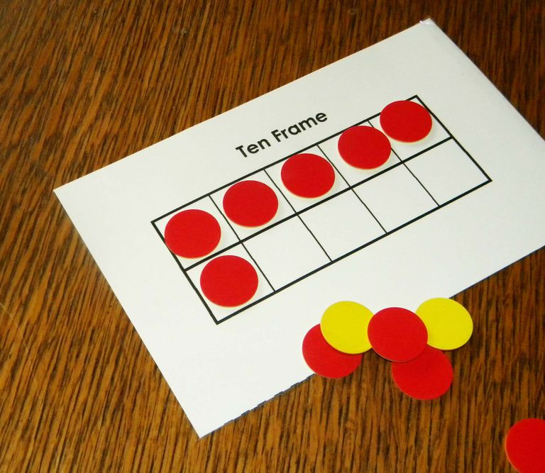
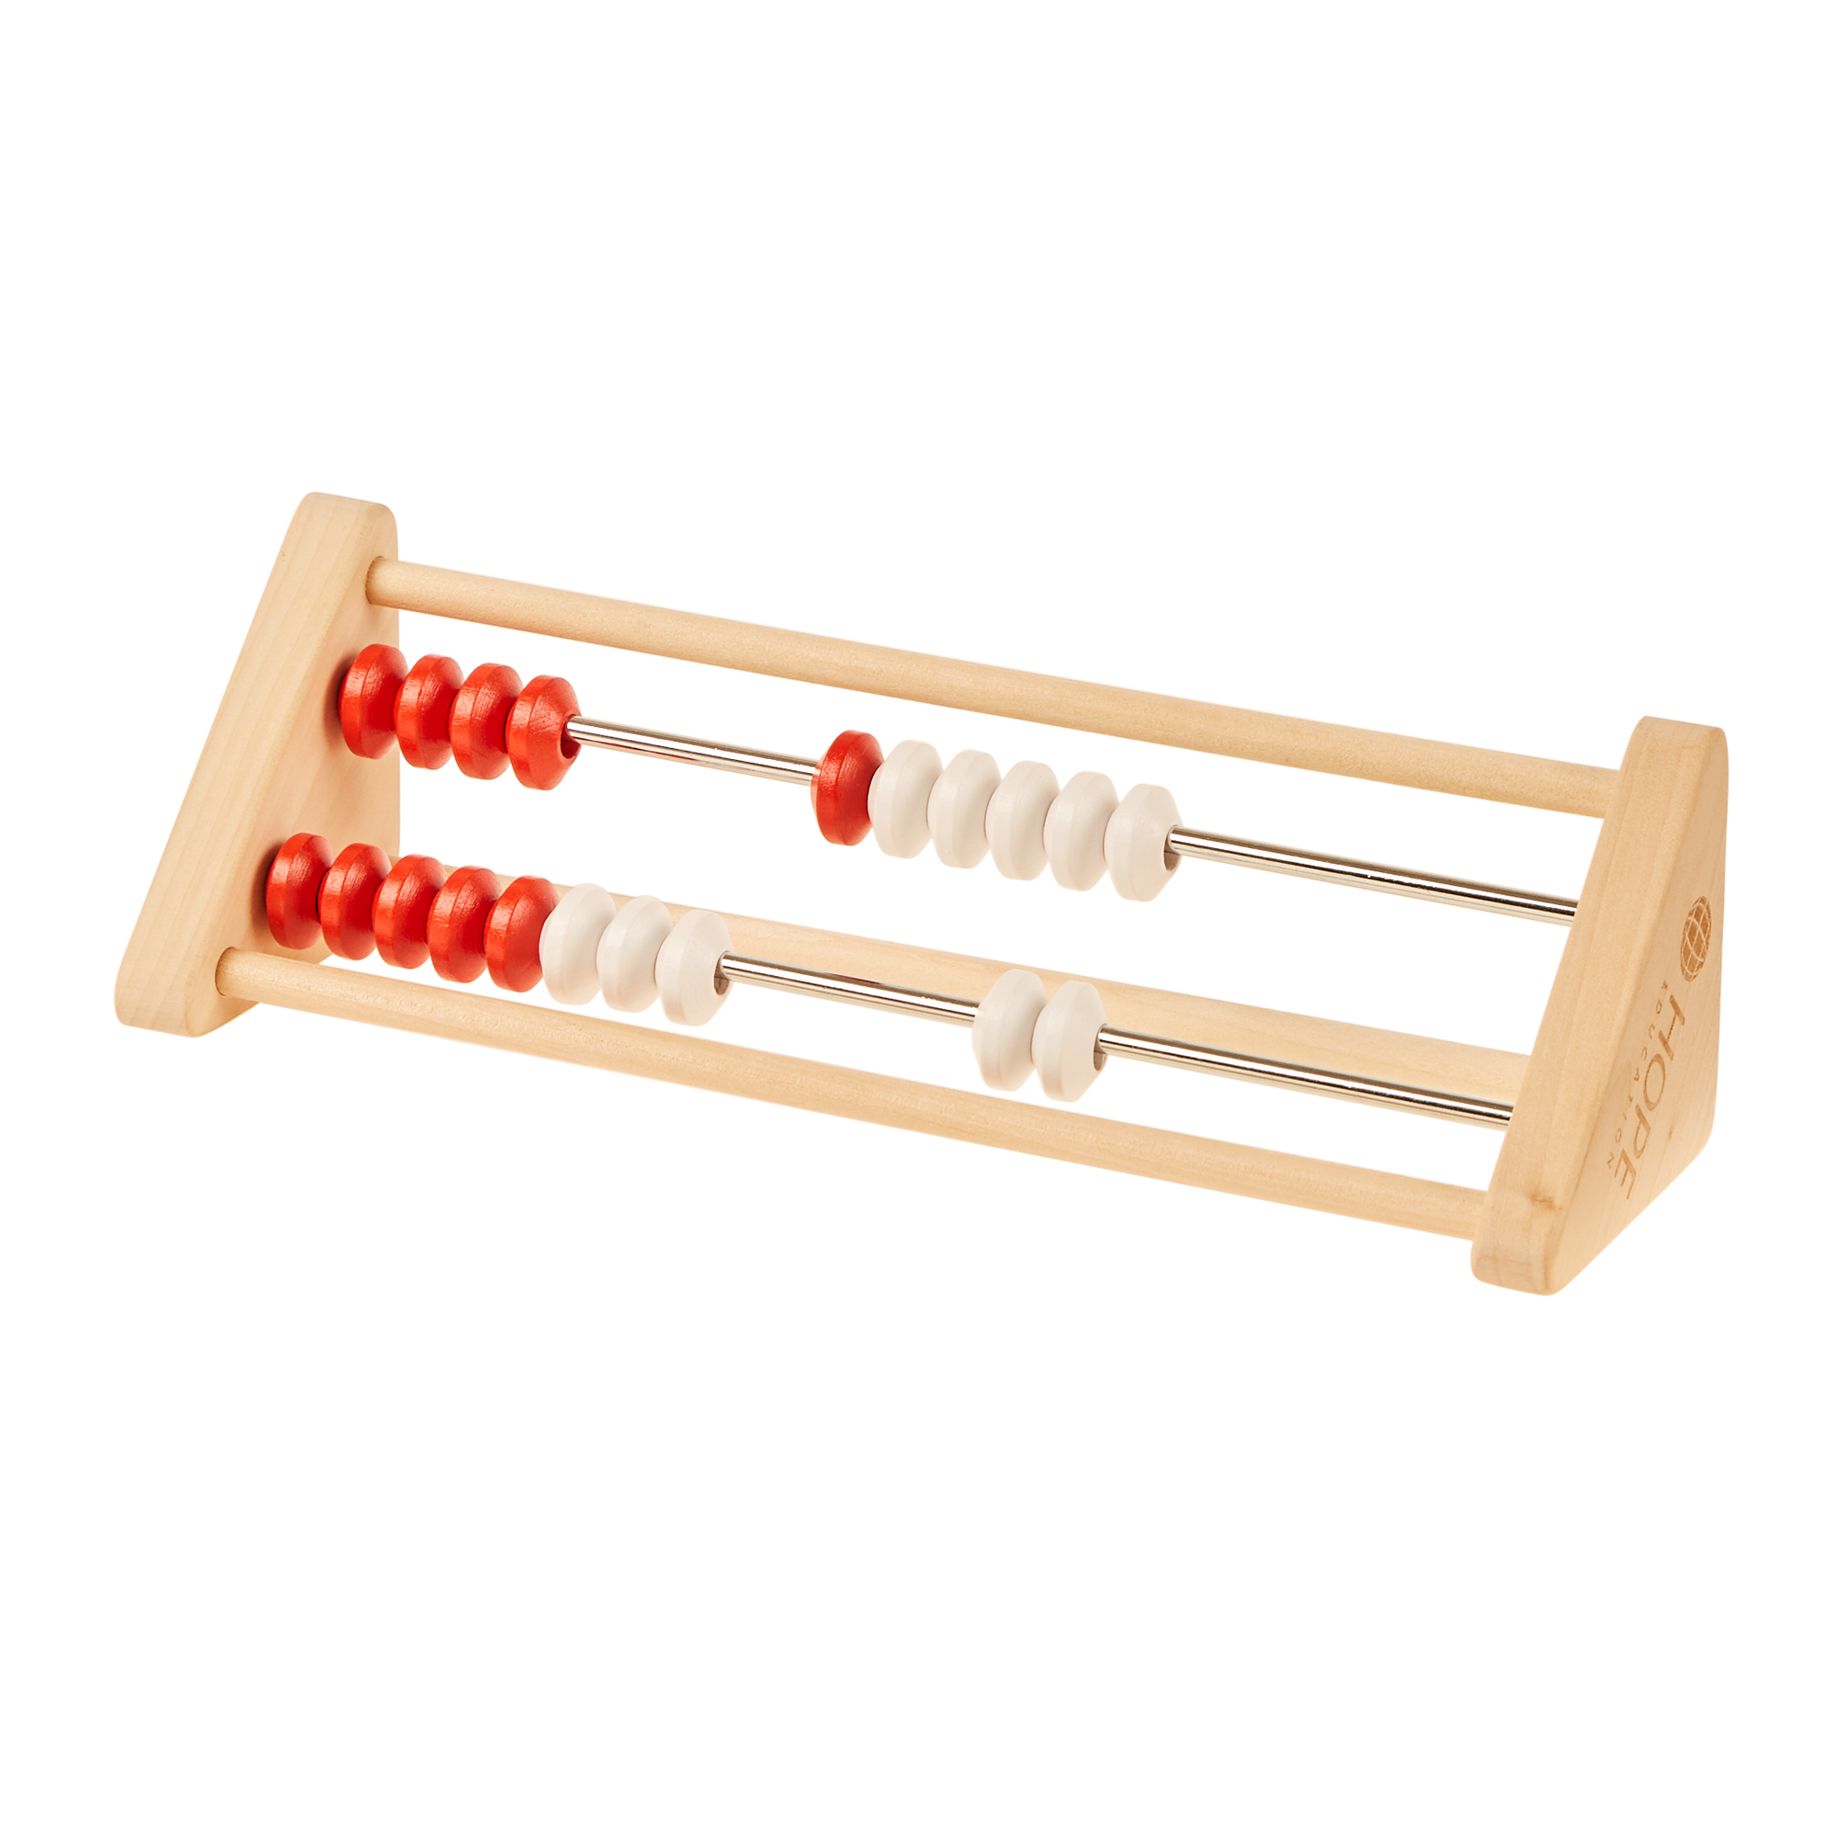
Mastering Number
We are using Mastering Number to strengthen children’s understanding of number and improve their fluency. Through short, regular sessions, taught 4 times a week for 5-10 minutes and is in addition to maths lessons.
Children practice key number facts and build confidence, accuracy and a deeper understanding of how numbers work. This gives them a strong foundation for success in maths.

Slide 12


Foundation Subjects
You will find half termly information on Science, History, Geography, Art and D&T on our webpage.
You will be able to read the knowledge organisers for each subject that we are doing for that half term.

Slide 13





What can you do to help?
Homework
Weekly maths and spelling activities will be set on a Friday and collected the following Friday.
Maths activities are either linked to our current learning in lessons or times tables.
Spelling activities will mirror our spelling rule for the week. The children will have 10 words to practise each week and be tested on 5 each Friday.
Read regularly with your child—anything from school books to newspapers—and ask questions about what they've read. We ask that as you should be reading at least 3 times a week.
Practise phonics by revisiting familiar sounds in books to build fluency and confidence.
13

Slide 14

Assessment
We have assessment points at the end of each of three terms (Reading fluency, reading comprehension, maths arithmetic and reasoning/problem solving and SPaG).
These will be kept low key as part of everyday activities, alongside continual teacher assessment.
These assessments are used to support teacher assessments, supporting the tracking of progress and end of the year assessments.
If your child is resitting the Phonics screening check, it usually takes place in June.

Slide 15
The Mossley Way
Underpinned by the behaviour principles and our Christian values.
Will offer consistency for all children.
Support children in feeling proud to be a part of the Mossley family.
Lifelong learning and preparation for the wider world.
Maximise learning time.
Our Behaviour Principles
Be kind and considerate
Be respectful
Be resilient
Be honest
Be helpful

Slide 16
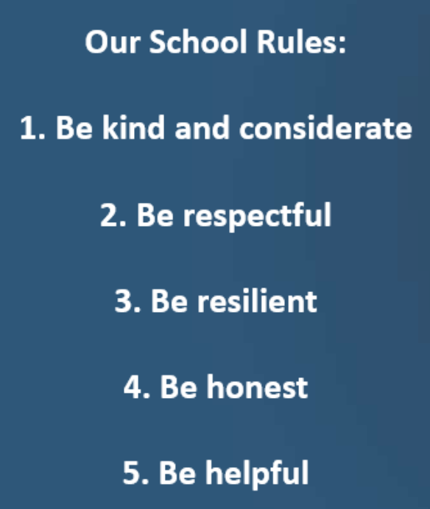
Behaviour
Children are involved in making class rules to ensure that everyone understands how we behave at Mossley.
If any issues arise that we need to discuss with you then you will be contacted. The behaviour policy is on the website.
Expectations
All clothing and belongings to be clearly named eg lunchbox, snack boxes, water bottles, caps.
Children to come into school in the correct uniform eg only trainers on PE days. Jewellery should not be worn, apart from small stud earrings, but please remove on PE days or tape over if can’t be taken out. Hair to be tied up if longer than shoulder length.

Slide 17

Mossley Missions
Will continue to run on ClassDojo under the portfolio section – please submit any photos as a Mossley Missions portfolio.
Whole school initiative to encourage personal development for all children.
Includes activities linking to Personal Development.
Activities to be completed at home with either a drawing, photo or video of the activity.
Some activities (EG camping out) will be able to be covered at school.
This will replace our ‘show and tell’.

Slide 18
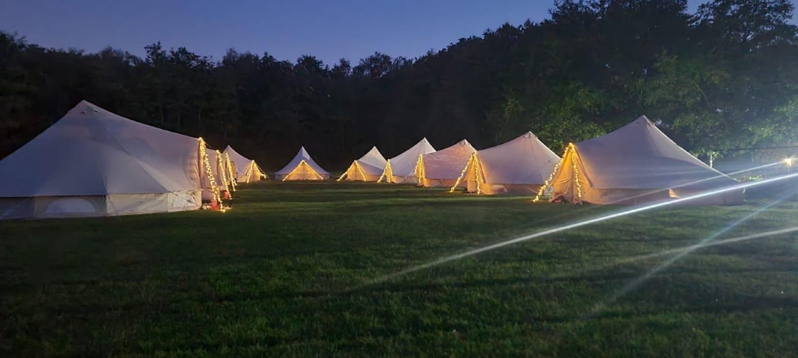

Residential (MossFest)
Year 2 residential – 1st – 2nd July
On site activities provided
The cost will be around £50 on parent pay and payments can be made little and often from now until the end of the school year. We will let you know when the payment is live.
We will provide another meeting closer to the time with further details. Any questions about payment please contact the school office.
18

Slide 19
Other visits/trips
Whole school visit to the Pantomime. More details to follow about this closer to the time.
The cost is £23.50 and is live on parent pay now to begin paying off the balance.
Class educational trips.
19

Slide 20
Collection and drop off policy
A policy is on the website and will be sent out clarifying arrangements for Collection and drop off.
Pupils in Foundation Stage or KS1
Our agreed school policy is that no pupil in Foundation Stage or Key Stage 1 should walk to or from school on their own or be left on their own on the school premises either before or after school. In addition we will only hand over pupils to named adults or older siblings provided they are 14 years old or above.
Pupils will not be handed over to other adults unless the school has been informed by the parent that they have made this arrangement.
We also ask that you keep us informed of any changes in arrangements, preferably by email/dojo or by contacting the school office. If no one turns up to collect a child in these year groups they will be kept in school and parents contacted. We will not allow older brothers or sisters in school to collect younger siblings.
If it’s a last minute change to collection arrangements please contact the school office as we may not pick up a dojo/email within the same school day before the children are collected.
Start time is 8.50am, if you are running late and the door is closed you will need to go through the school office.

Slide 21

If your child is absent please call school in the morning and leave a message
.
Children are not to return to school until 48 hours after last bout of sickness and diarrhoea
Absence and attendance

Slide 22
Everything Else
Allergies and medicines – up to date forms
signed at office.
Children in KS1 are not required to have a pencil case.
Please leave toys at home!
Parent helpers! If you would like to be involved on a regular or ad hoc basis please register your interest with Mrs Harrison by emailing head@mossleyce.cheshire.sch.uk
22

Slide 23
Contact
Email addresses are on the website
amccarty@mossleyce.cheshire.sch.uk
a.johnson@mossleyce.cheshire.sch.uk
Class Dojo
Phone call
Parents’ evenings
Open door policy

Slide 24
Questions?

