Slide 1



Meet The Teacher
July 2026
Reception
Early Years Foundation Stage

Slide 2
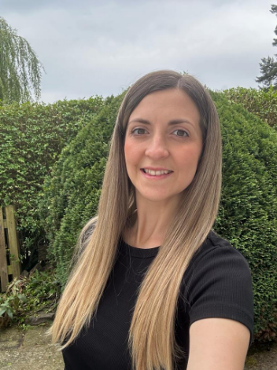

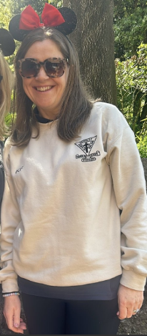
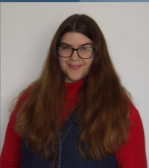
Welcome and Introductions
The Team
Mrs Arnold EYFS Teacher/Phonics Lead
Mrs Swift EYFS Lead/ Teacher & Assistant Head
Mrs Fox EYFS Higher Level Learning Assistant
Miss Battle-Teaching Assistant

Slide 3
A ‘Typical’ Day in EYFS
Morning Session
8.50 – 9.00am Registration/wake and shake
9.05am- Phonics
9.30am- PLAY- time indoors and outdoors with adult directed groups.
10.15 Snack/ Playtime outside
10.45am- PLAY- time indoors and outdoors with adult directed groups.
11.30-Story/rhyme time & handwashing
11.45am-Lunchtime
P.E will take place on Thursday mornings.
It will be taught by Miss Smith & Mr Dodds
Afternoon Session
1pm- Registration/story
1.15pm- Maths
1.30pm- PLAY- time indoors and outdoors with adult directed groups.
2.45pm- Milk, fruit / Play-time
3.00pm Collective worship/story time
3.30pm Home-time

Slide 4

The EYFS Curriculum
The Prime areas of learning
Communication and Language •Listening, Attention and Understanding •Speaking | Physical Development •Gross Motor Skills •Fine Motor Skills | Personal, Social and Emotional Development •Self-Regulation •Managing Self •Building Relationships
The Specific area of learning
Literacy •Comprehension •Word Reading •Writing | Mathematics •Number •Numerical Patterns | Expressive Arts and Design •Creating with Materials •Being Imaginative and Expressive | Understanding the World •Past and Present •People, Culture and Communities •The Natural World

Slide 5


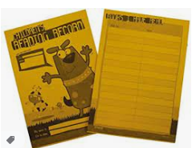
Phonics/Reading
Phonics
The children will take part in a whole class phonics session for 25 minutes each day.
We use a phonics scheme called FFT: Success for All in phonics.
There will be 2 adults in the session and then any children that need further support/challenge can have this during the session/at another time during a planned intervention.
Reading
The children will be reading every phonics session.
They will also participate in a whole class reading sessions/individual reading.
You will have access to e-readers/reading books/choosing book.
Please read with and to your child at home every day.
Let your child see you reading.
Please take them to the library.
When your child reads please record it in their yellow reading diary!
Reading books will be changed every Tuesday. All books must be returned in their plastic reading packet that we provide.

Slide 6

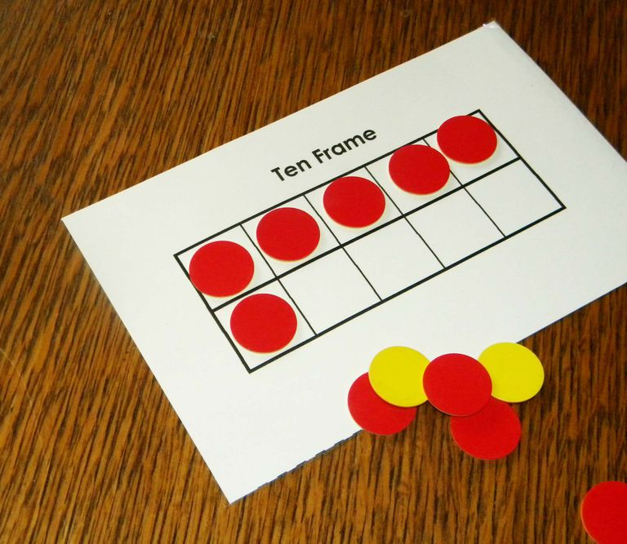
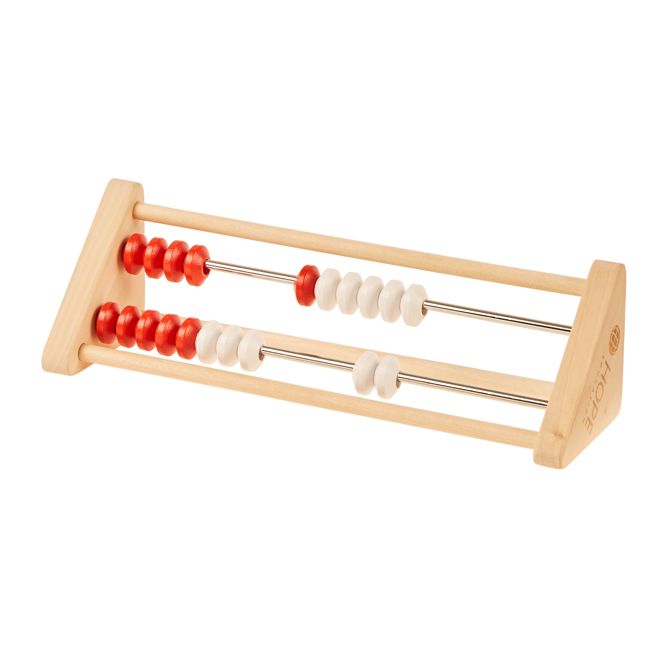
Mastering Number
In Reception through to year 3, we are using Mastering Number to strengthen children’s understanding of number and improve their fluency.
This is delivered through short, regular sessions, taught 4 times a week for 5-10 minutes and is in addition to maths lessons.
Children practice key number facts and build confidence, accuracy and a deeper understanding of how numbers work. This gives them a strong foundation for success in maths.

Slide 7

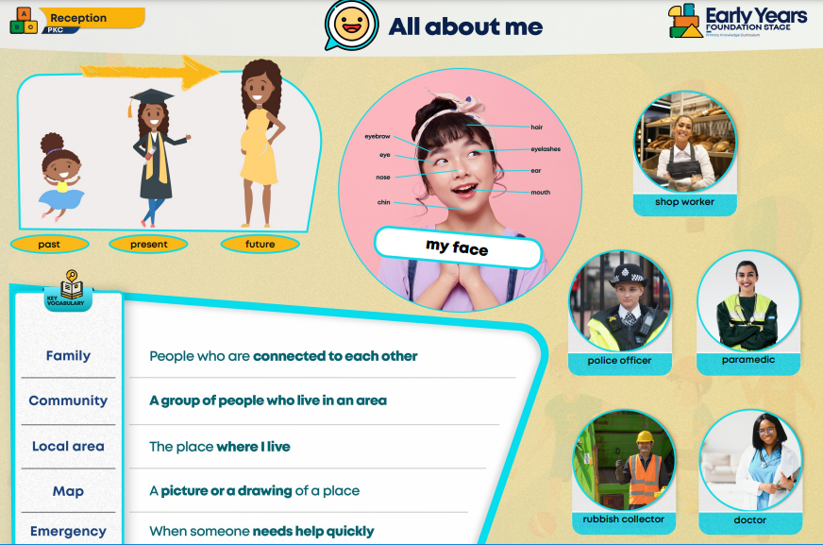
Primary Knowledge Curriculum
We use PKC to guide our curriculum
Our 6 broad themes for the year are:
Autumn
All About Me
Transport
Spring
Space
Growing and Changing
Summer
Kings and Queens
Stories from the Past
Enriching our curriculum
Visit to the library -£2.50
Pantomime-£23.50
Summer term trip- TBC
Church-free
Knowledge Organiser

Slide 8
Learning at home
READING, READING, READING
We expect the children to read and be read to regularly! It is so important.
Once a week (Tuesday) your child will also receive phonics and reading activities to do at home.
They don’t need to be returned to school.
When we have completed a phonics assessment with your child we will ask that you support your child with learning sounds/red words that they may have found difficult.

Slide 9
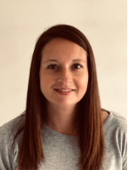
Barriers to learning in EYFS
Thank you for completing our starting school document and for your honesty.
This information is used to help us to support children in the best way that we can.
If you have ANY concerns about the development of your child (including behaviours you see at home) then it is really important that we know this could include:
Sensory seeking/avoiding
Difficulties sharing/taking turns
Outbursts/emotional/tantrums
Difficulty following simple instructions (an earlier hearing and sight check may be needed).
Sleeping/eating/toileting issues
On the go all the time/like a whirlwind
If we have any ‘first concerns’ we will contact you and we will take advice from our SENCO-Mrs Gemma Utteridge.

Slide 10

Our Christian Values
They shall have life, life in all its fullness’ (John 10:10)
Compassion
Hope
Endurance
Self-control
Kindness
Respect
We say 2 prayers a day-lunchtime and home time.

Slide 11
The Mossley Way
Underpinned by the behaviour principles and our Christian values.
Will offer consistency for all children.
Support children in feeling proud to be a part of the Mossley family.
Lifelong learning and preparation for the wider world.
Maximise learning time.
Our Behaviour Principles
Be kind and considerate
Be respectful
Be resilient
Be honest
Be helpful

Slide 12


Keeping in Touch
We have an ‘open door’ policy as long as the timing is appropriate.
Class Dojo for messages and portfolios ( further details to follow).
Yellow reading diary
Phone calls
Parent’s Evenings-November, March and July and any additional meetings.
Report
Emails us:
Mrs Swift: assistanthead@mossleyce.cheshire.sch.uk
Mrs Arnold: rarnold@mossleyce.cheshire.sch.uk

Slide 13

Class Dojo
Class Dojo is a secure cloud based site/app.
We will use office hours of 8am-5.00pm however
please be mindful that we are teaching in the day. We
may sometimes reply out of hours but that depends.
It is going to be used as a way to send messages both ways- Jimmy is going home with Betty or please remember to bring in wellies.
We are also going to use Class Stories and Portfolios. Class stories will have group photos of what they have been doing/special events. Portfolios will be specific to your child for their Mossley Missions.
Please add pictures/videos of your child’s achievements in learning at home onto their portfolio. Lots of videos on you tube to help you.
You need to inform us if you don’t want your child to appear in group photos on class stories.
We may not reply to every message and we won’t communicate about behaviour or other issues that may not be appropriate.

Slide 14

Mossley Missions
These run on ClassDojo under the portfolio section – please submit any photos as a Mossley Missions portfolio.
Whole school initiative to encourage personal development for all children.
Includes activities linking to Personal Development.
Activities to be completed at home with either a drawing, photo or video of the activity.
Some activities (EG camping out) will be able to be covered at school.

Slide 15


Houses
Designed by the Pupil Leadership Team
House Points-allocated for following rules.
Sports Day
Organising the children-useful for them to know which House they are in.

Slide 16


Assessment
We will be completing the Government Reception Baseline assessment (please see website)
We plan using the revised Foundation Stage Curriculum and Development Matters.
There are 17 Early Learning Goals that your child is assessed against. More details throughout the year.
We do both informal and formal assessments. We will be completing the Government baseline assessment.
In June we complete the Early Years Foundation Stage Profile.
Each child will have a Class Dojo portfolio that we will add ‘WOW’ moments to.
We would also like you to contribute to your child’s learning journey by adding ‘WOW’ moments to their Class Dojo portfolio. We will send info about how to do this (You Tube)

Slide 17
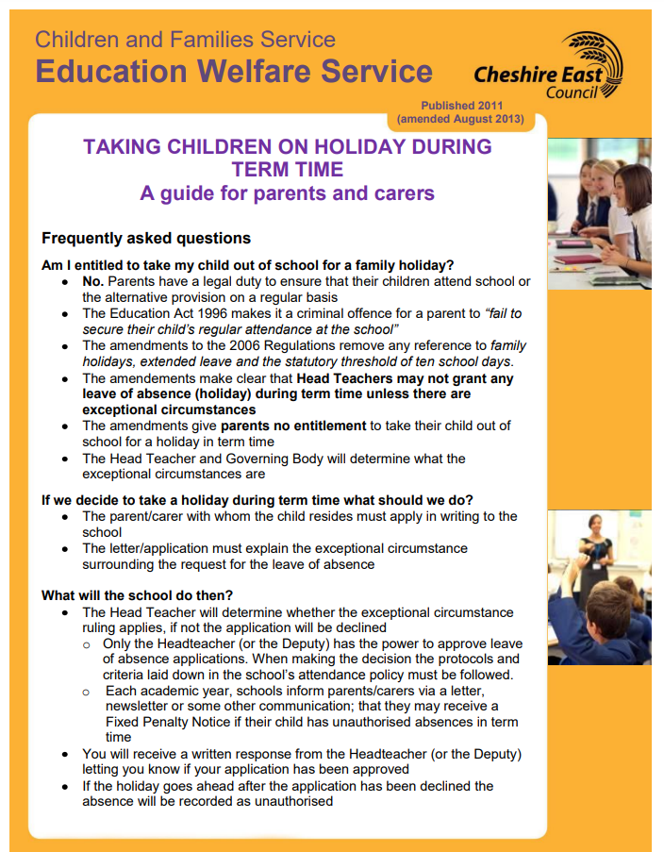
Absence and attendance

Slide 18
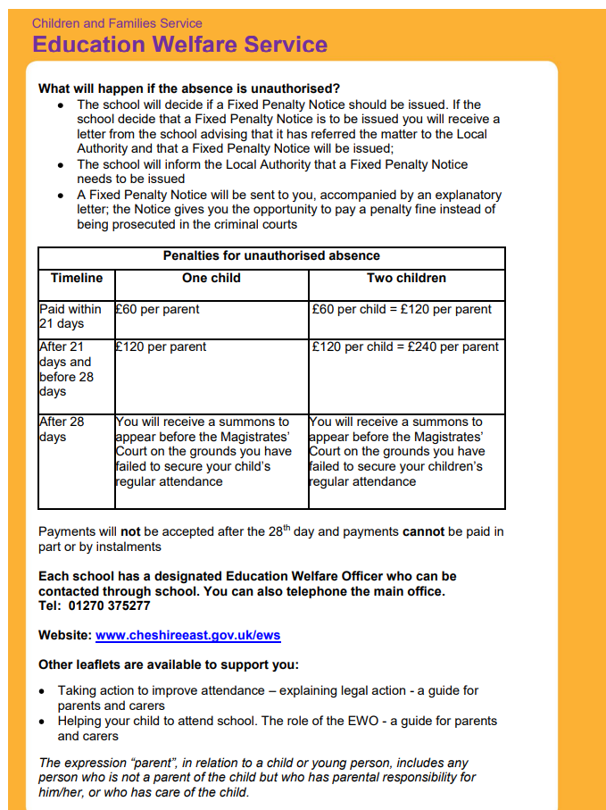
If your child is absent please call school in the morning and leave a message!
Children are not to return to school until
48 hours after last bout of sickness and diarrhoea.

Slide 19
Please help…
The blue book bags are ideal for them.
Please pop a small keyring on their bag so that they can recognise their own bag easily.
Label snack with their name.
Be patient with us at home-time as your child’s safety is so important to us!
Who is picking your child up? Please tell us on Class Dojo/email what the general pattern of the week will be for your child for the year. We MUST know if there is a change. (See drop off/collection policy)
We must know if there is anybody your child should not go home with.
If you or the person collecting your child can stand in a similar spot it would really help.

Slide 20

Wellies
Label clothes- everything!
Please can we have a bag of spare clothes in school.
Any medical concerns-inhalers
Food allergies
Please cut grapes up or anything else that can act as a plug.
If there are any difficulties with food we will get in touch.
Avoid all nuts
Let us know if you treat your child for nits/worms.
Parent pay – please complete lunch selections with your child
Snacks-one a day-free fruit and milk (age of 5)
Water bottles
Any changes at home
Please leave toys at home unless agreed with staff.
We are looking for parent volunteers (helping and enriching our curriculum).
FABs
Bits and Bobs

Slide 21

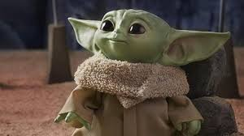

Slide 22

Questions

