Slide 1
Year 6 – English – Modal Verbs
Click this link to the watch the following lesson about modal verbs.
https://www.youtube.com/watch?v=hbDzdtDXRdQ
Then, answer the questions from the following slide.

Slide 2
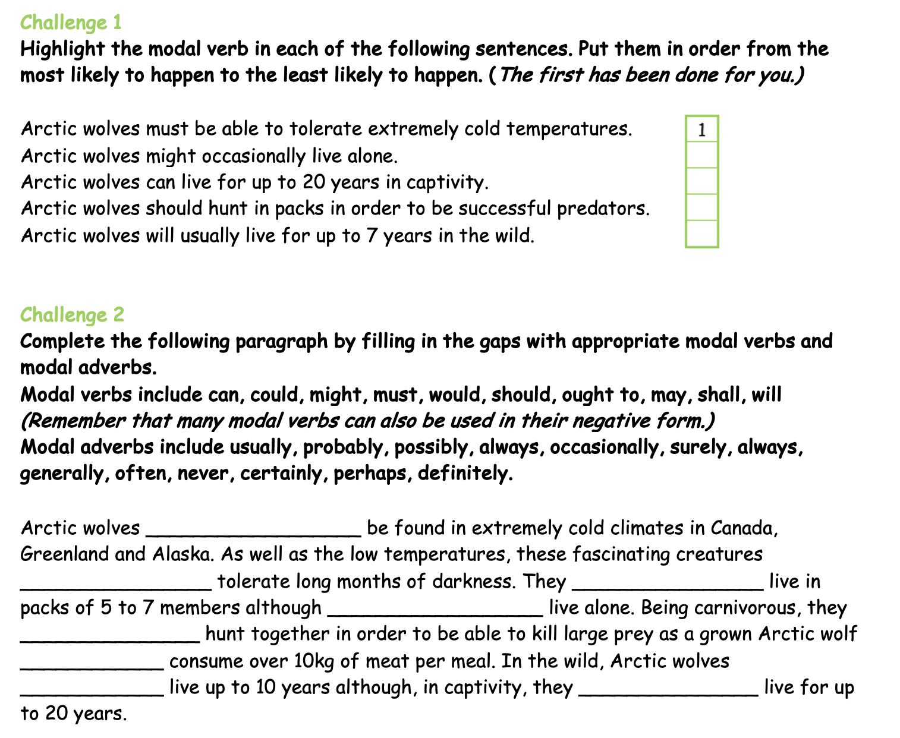

Slide 3
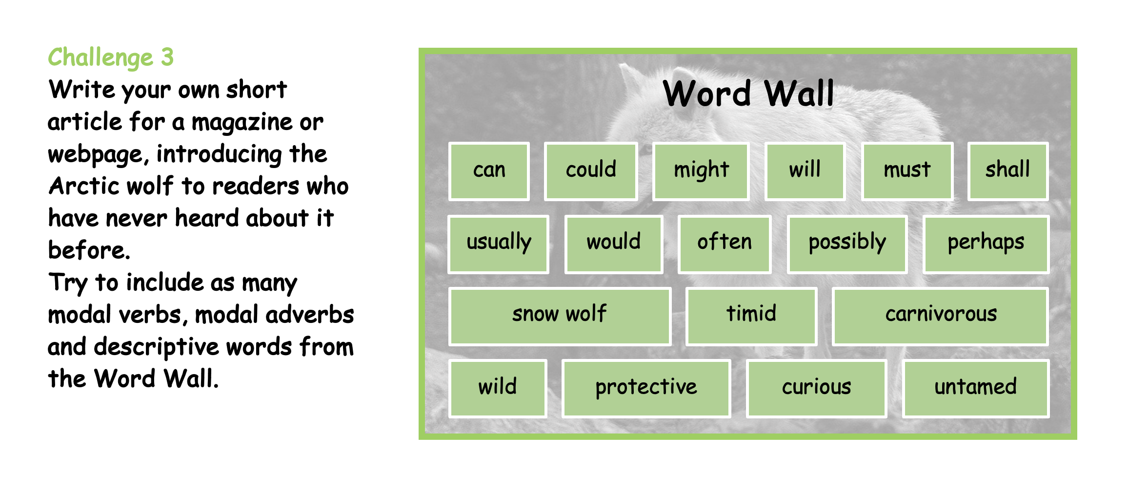

Slide 4
Year 6 Maths – Mixed Questions with Fractions
Use the TopMarks Daily 10 website to practise your arithmetic.
https://www.topmarks.co.uk/maths-games/daily10
Watch the video on the next slide which talks you through today's lesson.
Then, have a go at today's questions.

Slide 5

https://vimeo.com/731807776

Slide 6
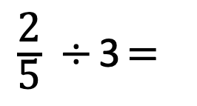

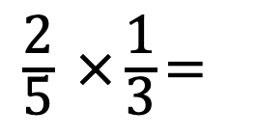

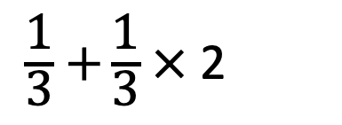
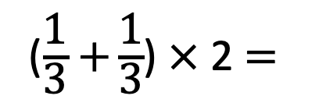
1)
2)
3)
4)
$\frac{\text{2}}{\text{5}} ×\frac{\text{1}}{\text{3}}$ $=$
$\frac{\text{2}}{\text{5}} ÷$ 3 $=$
($\frac{\text{1}}{\text{3}}+$ $\frac{\text{1}}{\text{3}}$) $×$ 2 $=$
brackets
Powers
$\frac{\text{1}}{\text{3}}+$ $\frac{\text{1}}{\text{3}}$ $×$ 2
$÷$ $×$
$+$ $−$

Slide 7
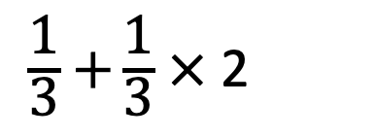


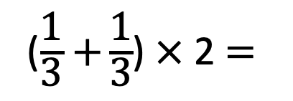
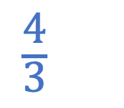

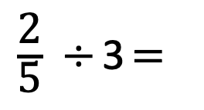
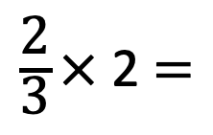
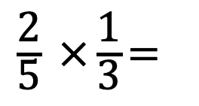

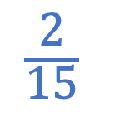
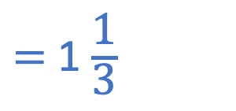
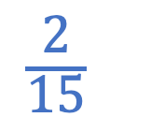

1)
2)
3)
4)
$\frac{\text{2}}{\text{5}} ×\frac{\text{1}}{\text{3}}$ $=$
$\frac{\text{2}}{\text{15}}$
$\frac{\text{2}}{\text{5}} ÷$ 3 $=$
$\frac{\text{2}}{\text{15}}$
($\frac{\text{1}}{\text{3}}+$ $\frac{\text{1}}{\text{3}}$) $×$ 2 $=$
$\frac{\text{2}}{\text{3}}$ $×$ 2 $=$
$=$ 1 $\frac{\text{1}}{\text{3}}$
$\frac{\text{4}}{\text{3}}$
brackets
Powers
$\frac{\text{1}}{\text{3}}+$ $\frac{\text{1}}{\text{3}}$ $×$ 2
$\frac{\text{1}}{\text{3}}$ $×$ 2
$\frac{\text{1}}{\text{3}}$ $+$ $\frac{\text{2}}{\text{3}}=$
1
$÷$ $×$
$+$ $−$

Slide 9

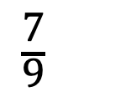



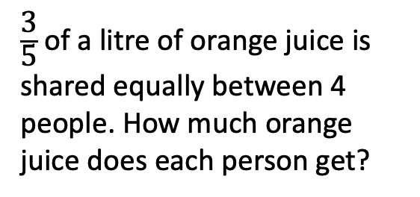
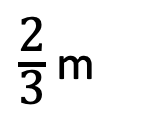
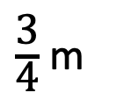
Work out the perimeter of the rectangle.
Work out the area of the rectangle.
$\frac{\text{3}}{\text{4}}$ m
3$\frac{\text{1}}{\text{4}}$ m
$\frac{\text{2}}{\text{3}}$ m
1$\frac{\text{1}}{\text{6}}$ m
$\frac{\text{3}}{\text{5}}$ of a litre of orange juice is shared equally between 4 people. How much orange juice does each person get?
Work out the missing number.
2$\frac{\text{2}}{\text{3}}$
$\frac{\text{7}}{\text{9}}$
?
Have a think

Slide 10
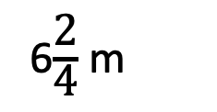
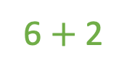
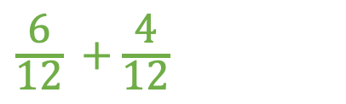
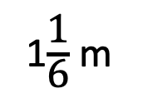
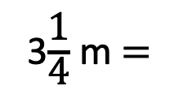
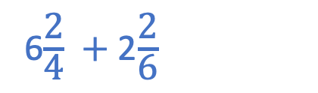

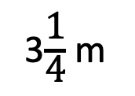

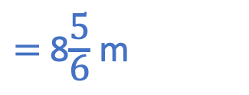
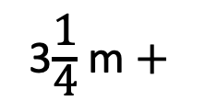
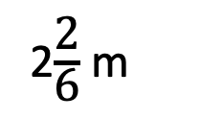
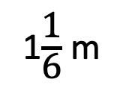
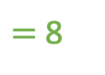
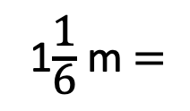
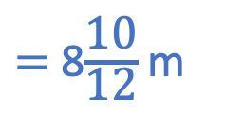
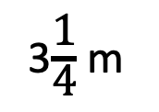
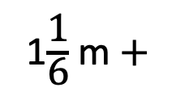
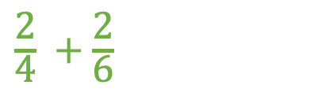
Work out the perimeter of the rectangle.
Did anyone use a different method?
3$\frac{\text{1}}{\text{4}}$ m
1$\frac{\text{1}}{\text{6}}$ m
1$\frac{\text{1}}{\text{6}}$ m
6$\frac{\text{2}}{\text{4}}$ $+$ 2$\frac{\text{2}}{\text{6}}$
$=$ 8$\frac{\text{10}}{\text{12}}$ m
3$\frac{\text{1}}{\text{4}}$ m
$=$ 8$\frac{\text{5}}{\text{6}}$ m
6 $+$ 2
$=$ 8
$\frac{\text{2}}{\text{4}}$ $+$ $\frac{\text{2}}{\text{6}}$
3$\frac{\text{1}}{\text{4}}$ m $+$
3$\frac{\text{1}}{\text{4}}$ m $=$
6$\frac{\text{2}}{\text{4}}$ m
$×$3
$×$2
$\frac{\text{6}}{\text{12}}$ $+$ $\frac{\text{4}}{\text{12}}$
1$\frac{\text{1}}{\text{6}}$ m $+$
1$\frac{\text{1}}{\text{6}}$ m $=$
2$\frac{\text{2}}{\text{6}}$ m

Slide 11
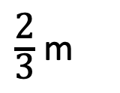
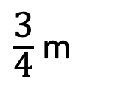
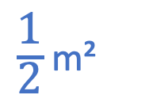
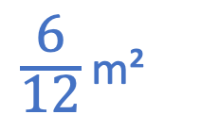
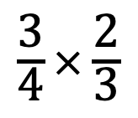
Work out the area of the rectangle.
$\frac{\text{6}}{\text{12}}$ m²
$\frac{\text{1}}{\text{2}}$ m²
$\frac{\text{3}}{\text{4}}$ m
$\frac{\text{2}}{\text{3}}$ m
1 m
1 m
$\frac{\text{3}}{\text{4}}$ $×$ $\frac{\text{2}}{\text{3}}$

Slide 12
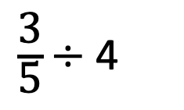
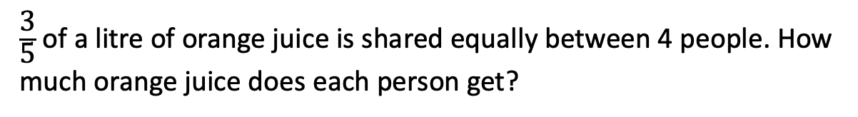
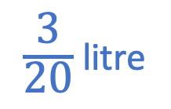
$\frac{\text{3}}{\text{5}}$ of a litre of orange juice is shared equally between 4 people. How much orange juice does each person get?
$\frac{\text{3}}{\text{5}}$ $÷$ 4
$\frac{\text{3}}{\text{20}}$ litre

Slide 13

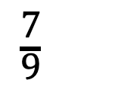






Work out the missing number.
2$\frac{\text{6}}{\text{9}}$
2$\frac{\text{2}}{\text{3}}$
$\frac{\text{7}}{\text{9}}$
1$\frac{\text{8}}{\text{9}}$
?
$+ \frac{\text{2}}{\text{9}}$
$+ \text{1}\frac{\text{6}}{\text{9}}$
1
$\frac{\text{7}}{\text{9}}$
2$\frac{\text{6}}{\text{9}}$
Did anyone use a different method?

Slide 14







$\frac{\text{3}}{\text{4}}$ $×$ $\frac{\text{3}}{\text{4}}$
$=$ $\frac{\text{9}}{\text{16}}$ m²
2 $×$
$=$ $\frac{\text{9}}{\text{16}}$ m²
$\frac{\text{9}}{\text{16}}$ $÷$ 2
$=$ $\frac{\text{9}}{\text{32}}$ m

Slide 15






$\frac{\text{1}}{\text{6}}$ $×$ $\frac{\text{2}}{\text{3}}$
$=$ $\frac{\text{2}}{\text{18}}$
Boys
$=$ $\frac{\text{1}}{\text{9}}$
Girls
$\frac{\text{1}}{\text{4}}$ $×$ $\frac{\text{1}}{\text{3}}$
$=$ $\frac{\text{1}}{\text{12}}$

Slide 16





More boys wear glasses.
$\frac{\text{1}}{\text{9}}$of the boys wear glasses.
$\frac{\text{1}}{\text{12}}$of the girls wear glasses.
$\frac{\text{1}}{\text{9}}$
$\frac{\text{1}}{\text{12}}$
$$>$$
When the numerators are the same, the smaller the denominator, the greater the fraction.

Slide 17


Slide 18


Slide 19



Indoor/Outdoor Activities
Log in to your Purple Mash account to complete the 2Dos set for you.
Alternatively... head outside and enjoy the snowy weather!
Can you make a snow sculpture?

