Slide 1



Routines, Phonics and Reading
A Meeting for Parents

Slide 2
Routines
PE is on a Tuesday morning taught by Mrs Braham – they only need an indoor kit in school please.
Message books are checked everyday but the children must now get their own message book out.
2 baskets – 1 for messages / 1 for messages and a book change.
We suggest you only read 1 book a night but focus on discussion and predicting skills. Re-reading books or sentences helps their fluency and expression.
This allows more time to focus on playing phonics games, reading books from the library, using an educational app, learning how to spell or read the 100HFWs/statutory words etc.

Slide 3

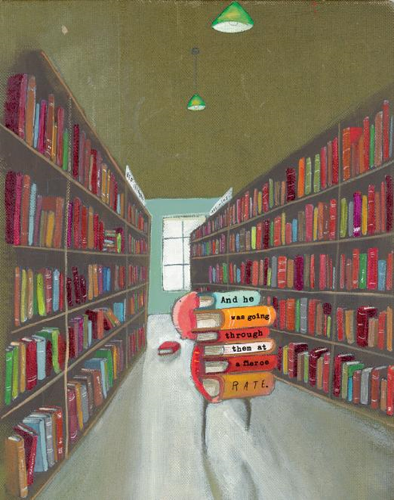
What is important?
Hearing stories
Sharing books
Looking at range of books
Hearing interesting words and phrases
Playing with words and phrases
Singing rhymes and songs
Playing with rhyming words

Slide 4


Slide 5
Desire to Read ~ a love of books!
Directionality ~ Front to back/left to right/ top to bottom/line to line/word to word.
Knowledge of letters ~ can recognise letters in all their forms and in all fonts.
Knowledge of phonemes ~ need to recognise and represent sounds in all their forms.
Knowledge of graphemes ~ need to recognise and represent letters in a variety of combinations to create phonemes.
Knowledge of punctuation ~ can recognise punctuation marks and how they should be ‘read.’
One to one correspondence ~ that groups of letters make a word and that each printed word should match what they read.
Sight recognition ~ can recognise a word in any or every context.
Self-correcting behaviours ~ they monitor their own reading for meaning, to check it makes sense.
Understanding meaning ~ gain understanding from the texts that they read.
Knowledge of ‘book language’ ~ phrases that are not usually found in patterns of speech.
Fluency ~ the speed with which a child can read, pace and expression.

Slide 6

Why teach phonics?
The ability to read and write well is a vital skill.
Reading and writing are like a code: phonics is teaching your child to crack the code.
Phonics helps children to develop good reading and spelling skills.
We use a synthetic scheme called ‘Read Write Inc’ as our main teaching resource.

Slide 7
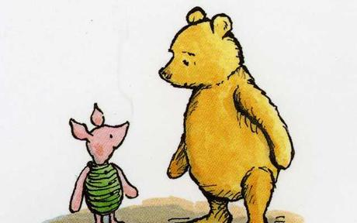
Why synthetic phonics?
“Synthetic phonics offers the vast majority of young children the best and most direct route to becoming skilled readers and writers.”
Sir Jim Rose, Rose Review of Reading 2006
Synthetic phonics is simply the ability to convert a letter or letter group into sounds that are then blended together into a word.

Slide 8

Phonics consists of:
Identifying sounds in spoken words.
Recognising the common spellings of each sound.
Blending sounds into words for reading.
Segmenting words into sounds for spelling.

Slide 9

Phonics lesson structure
Revise: The children will revise previous learning.
Teach: New phonemes or high frequency or tricky words will be taught.
Practice: The children will practise the new learning by reading and/or writing the words.
Apply: The children will apply their new learning by reading or writing sentences.

Slide 10
Saying the sounds correctly
Saying the sounds correctly with your child is extremely important.
The way we say sounds at school now may well be different from when you were at school.
We say the shortest form of the sounds.
https://www.youtube.com/watch?v=RlpsmpWOUFY

Slide 11
Blending & Segmenting
Blending is the ability to recognise the letter sounds in a written word, for example
c-u-p
and merging or ‘blending’ them in the order in which they are written to pronounce the word
‘cup’
Segmenting is identifying the individual sounds in a spoken word (e.g. p-a-n , ch-o-p) and writing down letters for each sound (phoneme) to form the word pan and chop.

Slide 12
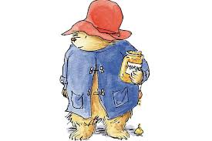
Activity
Using ‘sound buttons’ can you say how many phonemes are in each word?
shelf
dress
sprint
string

Slide 13
Answers
shelf = sh – e – l – f = 4 phonemes
dress = d - r - e – ss = 4 phonemes
sprint = s – p – r – i – n – t = 6 phonemes
string = s – t – r – i – ng = 5 phonemes

Slide 14
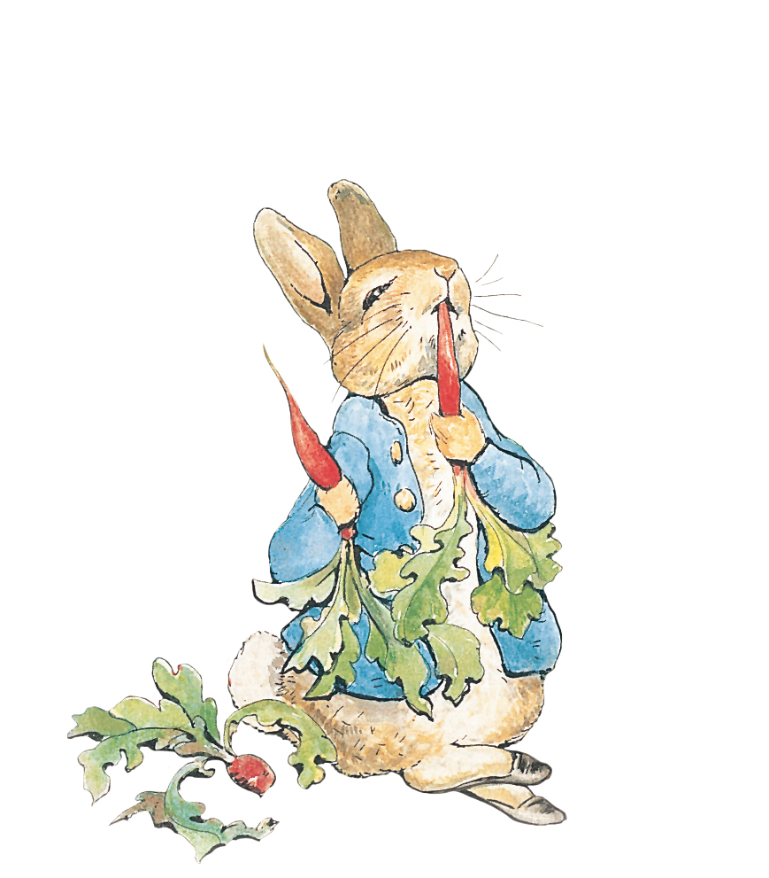
How can I help with phonics?
Sing an alphabet song together
Play ‘I spy’
Have a sound hunt
Play sound bingo
Try to teach your child 3-4 words a day that can be blended, little and often
Play with magnetic letters, When you've blended a word together, mix it up, say the word and ask your child to put the sounds back in the same order (if they find it tricky say the sounds in the word strongly and slowly). When they've put it back together re-blend to check it makes sense
Praise your child for trying out words
Look at and practise reading tricky words - ESPECIALLY FOR Y2s
Play phonic games online

Slide 15
When to use sounds and when to spell correctly?
When your child is writing let them use their knowledge of sounding out. This is a really important skill to learn.
HOWEVER … if you spot your child spelling any of the 100 HFWs words wrong it is worth correcting these – all children should spell these correctly ESPECIALLY Year 2 children. Statutory words should always be spelt correctly.
BUT … for all other words sounding out is super, praise these efforts.
EG: The big bighsicul was righding down the road.

Slide 16
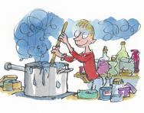
Useful websites
www.letters-and-sounds.com
www.phonicsplay.com
www.mrthorne.com
http://www.bbc.co.uk/bitesize/ks1/literacy/phonics/play/
www.oxfordowls.co.uk
http://www.kenttrustweb.org.uk/kentict/content/games/literacy_menu.html
http://www.ictgames.com/literacy.html
http://www.crickweb.co.uk/ks1literacy.html
http://www.starfall.com/n/level-a/learn-to-read/load.htm?f

Slide 17
Reading at home
Make a Regular Time Together
Find a time of the day that best suits you and your child. 10 minutes a day is ideal.
Create a ‘special time’ to read together and give them your undivided attention.
Listen with your eyes as well as your ears.
Take it in turns to read parts of a story.
A story at bedtime is an invaluable part of your child’s bedtime routine.
Tell them about a book you enjoyed as a child and read together.
Make up stories together or tell them about things that happened to you when you were younger – remember you don’t always need a book to tell a story!
Find the Right Level
Every child develops at their own speed so try to be patient. Let your child choose which book they want to read. Read harder books to them if they want to hear more complex stories, letting them read the easier bits.

Slide 18
Reading at home
Strike a Balance Between Perfection and Correction
As your child begins to grow in confidence they’re still bound to make mistakes. Get into the habit of praising them for all the words they get right – don’t just focus on the ones they are struggling with.
Don’t jump in too soon – give them time to process and think for themselves.
Make a note of any words your child really struggles with and put them on the fridge.
Talk About What You’ve Read
Doing this helps to boost your child’s imagination.
Discuss new words. Do they know what they mean?
Challenge your child to think of questions they can ask you to test if you’ve been listening.
As your child becomes a more fluent reader focus more on comprehension (3-5 questions after each read).

Slide 19
Reading at home
Enjoy Reading Everything, Everywhere
Read everywhere! Carry a book or comic when out and about.
Encourage them to read traffic signs, adverts, cereal packets and DVD covers.
Join your local library.
Let them see you reading.
Have Fun!
Read adventure stories in the dark or under the covers with a torch.
Use funny accents when reading.
Share the character parts so you take it in turns to read.
Act out stories with their toys or puppets.
Make up a treasure hunt around your home with a clue in every room for your child to find and read.

Slide 20

Reading at home
If Your Child Gets Stuck
Try to encourage your child to use these strategies:
Carry on past the word. Think about what word would make sense in the story or sentence.
Sound the word out.
Can you think of a word that looks similar?
Look for parts of the word that are familiar.
Check the pictures for clues.
Go back and read again.
Ask for help.

Slide 21
Remember
Create a calm environment
Look positive
Sound positive
Sit next to the reader so that you can read exactly what they are reading.
Talk about the book before, during and after they read it.
Be a good role model Handle books carefully ~ Let your child see you reading for pleasure.
Praise ~ well done, I like how you sound that out, good expression.
Pause ~ don’t just offer an answer, let them think about it for a while.
Prompt ~ encourage your child to use one of the strategies
YOU ARE DOING A GREAT JOB!

