Slide 1


Accelerated Reader: The Dingle Primary School – Sept 22

Slide 2

Accelerated Reader: A Guide for Parents
All students from year 3-6 take part in the Accelerated Reader programme, which is designed to do the following things:
Find books that are the right ability for each child
Encourage children to read more
Improve children’s reading ability.

Slide 3
How it works…
At the start of the year every student will take a Star Test, which is a computer-based test that measures a student’s reading ability through a series of 34 questions.
Every test for every student is different, and the computer selects different questions for each student dependent on how well they answer the previous questions. Essentially, the computer adapts the test to suit each child.
Once the student has completed the test, they are then given a ZPD score by their teacher.
Notes:
https://ukhosted62.renlearn.co.uk/1892677/default.aspx If they can’t find it

Slide 4
How STAR tests work
The student must take their time. It is recommended that each child should spend at least 20 minutes on their tests. Students are used to working quickly in timed conditions, but during a STAR test it is about concentration, focus and careful reading.
Students should not guess answers to questions. Instead, they should wait for the question to time out. This is to ensure the computer is not given a false impression of the student’s reading ability.
Tests are done in exam conditions without any help from other students or the teacher.

Slide 5
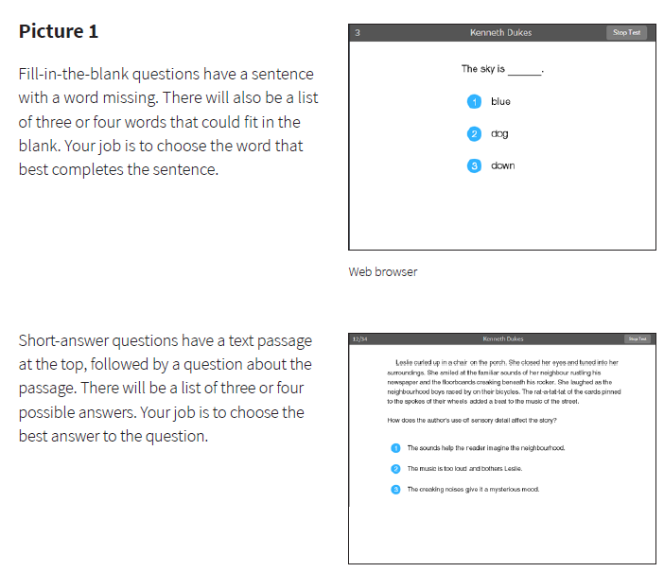

Slide 6

A ZPD score is given to your child after completing the STAR test
3.2 – 4.6
ZPD is two numbers that the student uses to choose their next reading book.
The lowest number is the lowest level of book the student should be choosing.
The highest number is the highest level of book the student should be choosing.
Students keep a record of all their ZPDs in their planners or exercise books.
A new STAR test takes place every half term, so students can see improvements in their reading ability, but also choose more challenging books.
Lowest number
Highest number

Slide 7

All the AR books in the junior area are levelled according to their ZPD
<2.5 | 4.5-4.9
2.5-2.9 | 5.0-5.4
3.0-3.4 | 5.5-5.9
3.5-3.9 | 6.0-6.4
4.0-4.4 | >6.5
Students should only choose books within their numbers and the boxes make it easier for them to choose the right book.
Books are boxed according to their levels.

Slide 8
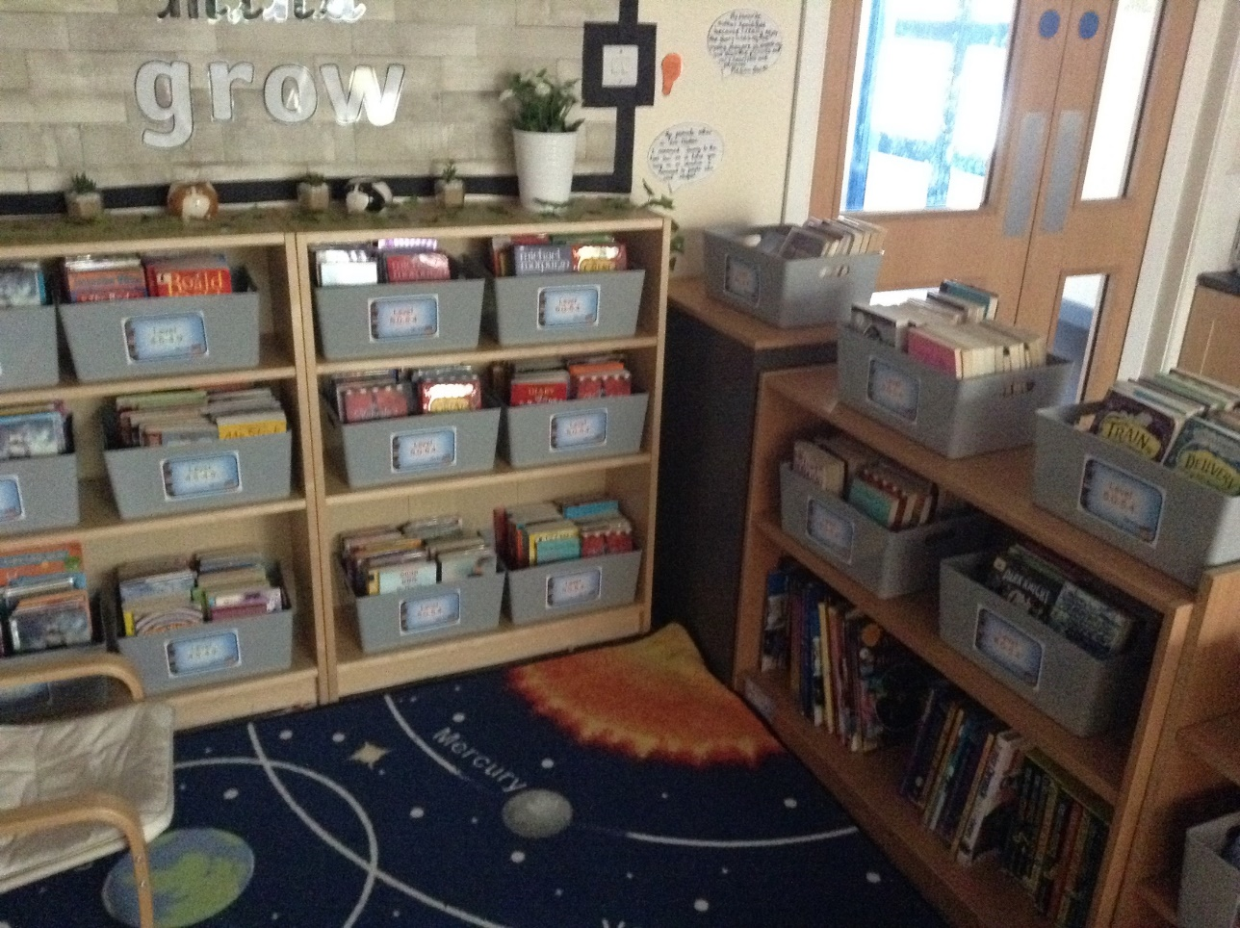
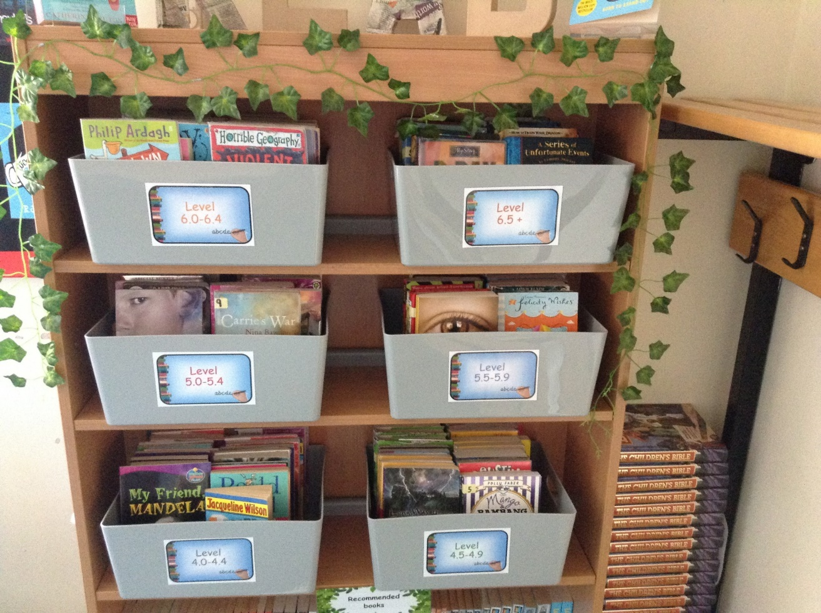
There are lots of boxes in the communal junior areas.
There are approx. 6-8 boxes in each classroom based around each year group level. These can be swapped between classes.

Slide 9

Reading in school
We allocate the first 20 minutes of the school day to reading time as a minimum. Children should come in and independently read their chosen book. Teachers use this time to support the children through listening to individual or groups read or comprehension and quiz activities.
Children can also take AR quizzes during this allocated reading time.
Children can also complete AR quizzes at home. These should be independently.

Slide 10
AR Quizzes
A quiz is different to a STAR test because students only take a quiz after they have finished a book.
There are between 5-20 questions on the book that has been read. At the end of the quiz the students are given a percentage to show them how well they have done.
There are some important rules for taking quizzes:
The book the child is quizzed on should be a book they have read in the last two weeks. AR is not a memory test but rather measuring reading ability.
A student cannot take a quiz until they have read the entire text.
Quizzes must be done individually, not with anyone’s help.

Slide 11
AR Quizzes
A children can do a quiz on a book they have previously read as long as they feel that they know it well enough. Children can also take quizzes on books that have been read to them but they must disclose this.
It is important to note that children only collect points and words if they pass the quiz.
The pass level for the quizzes is around 60% and children are not able to retake a quiz once they have done it.

Slide 12
ARBookFind.co.uk
It’s not just books from school that students can read, they can read books from home and take quizzes on them!
You can use ARBookFind.co.uk to check whether a child’s current book is on Accelerated Reader.
A child, parent or teacher can also request a book is added to AR by emailed on the website.

Slide 13

Do we still teach reading?
YES!!!
The accelerated reader programme is all about the children reading their books for pleasure and it will improve their understanding and comprehension. However, this does not replace any of the whole class reading sessions or small guided sessions that we already do.
It won’t take away from teachers’ reading high quality stories to the class – children can add them as quizzes.
We are still promoting books on the reading spine. These books can be quizzed on AR

Slide 14
Can a child who is not a strong reader still use Accelerated Reader?
Accelerated Reader helps all children become better readers from pupil, regardless of initial ability.
When children read books at their appropriate level, they experience success.
Furthermore, teachers work with children to set appropriate targets based on each child’s reading level.

Slide 15
Any Questions ?

