Slide 1
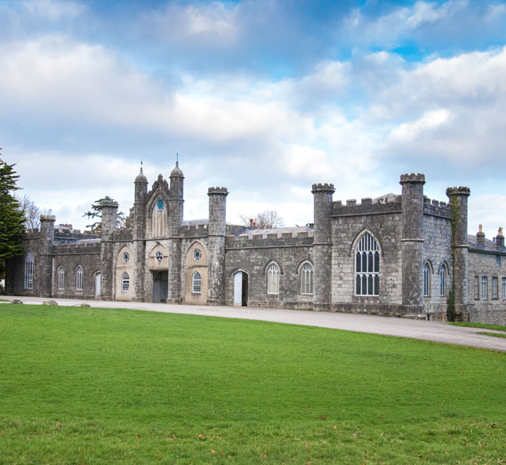
CONWAY CENTRE Residential Information Meeting 19/4/2022 – 21/4/2022

Slide 2
AIMS :
To promote teamwork and teambuilding skills.
To challenge and push yourself with new activities.
To learn new skills.
To promote independence.

Slide 3
Where is the Conway centre?
It is located in North Wales on the island of Angelsey.
The centre is situated adjacent to the Menai Strait within 169 acres of National Trust parkland, it is ideally placed for children to enjoy all that the wild outdoors has to offer.

Slide 4
INFORMATION THAT YOU WILL RECEIVE:
Cheshire East Council consent/medical form.
Copy of information slides.
Kit list.

Slide 5
Departure and return times:
Please be at school for 7:30 a.m.
Luggage will be taken into the Hall.
Coach leaves at 8.00 a.m.
Expected time of arrival back at school is 3:15 p.m. Please collect any medication from Mrs Charlton before you leave.

Slide 6
Covid-19
The school has completed a risk assessment relating to Covid-19. A copy of this is available upon request.
We need parents to consent to children taking an LFT if they display symptoms of Covid. You must agree to come and collect them as soon as possible if they test positive, in order to minimize contact with other children and staff.

Slide 7
Organisation:
Staff- Mr Griffiths, Mrs Done, Mrs O’Donnell, Mrs Hayes and Mrs Leavy.
Rooms will accommodate 6-10 pupils. Teachers’ rooms are next to children’s rooms.
Children will have an opportunity to nominate one friend they would like to share a room with.
We have our own building and social area, which no other school has access to.

Slide 8
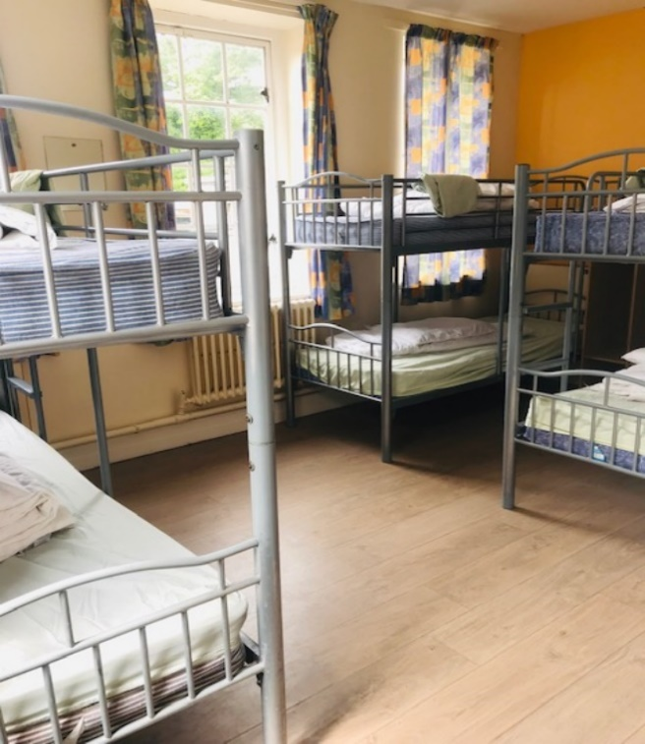
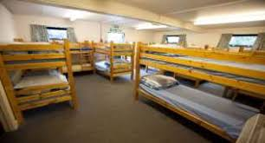
DORMITORIES

Slide 9
A typical day:
A.M. Children will be woken up. They will be told when they need to be ready for breakfast according to the centre’s rota. They will be expected to get washed, dressed and make their bed. Eat breakfast. Get ready for and then take part in morning activities. Prepare for lunch.
P. M. Prepare for and take part in afternoon activities. Possible period of free time before dinner, when children will be in social room or outside with staff. Have dinner at our allocated time.
Evening. Take part in the evening activity. Get ready to go to sleep. Lights out at around 9:30pm.

Slide 10
Meals:
Children will need to bring a packed lunch for the first day.
They will have an evening meal on Tuesday and Wednesday. There will be a choice of hot food in a canteen.
They will have a cooked breakfast on each morning with the option of cereal, toast, juices etc.
Children will get a packed lunch style lunch on Wednesday and Thursday before setting off home.
Please ensure any food allergies are highlighted on medical forms.

Slide 11
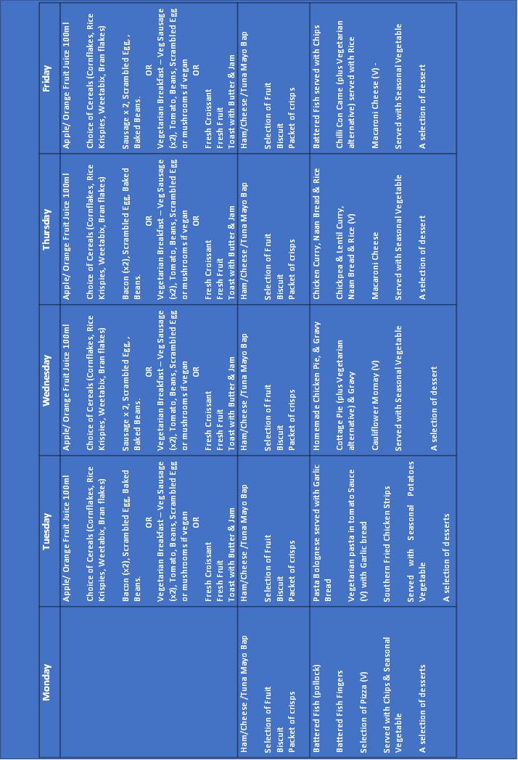

Slide 12
Activities:
Split into 4 activity groups – approx. 11 per group.
Qualified instructors throughout.
Each activity will be lead by a member of the Conway team. There will be a member of The Dingle staff with each group. In the evenings, The Dingle staff will look after the children and run an evening activity.
Trial by Choice – encouragement not force.

Slide 13
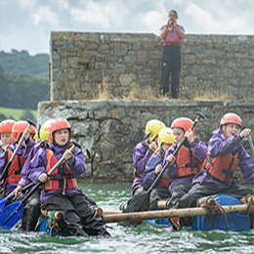
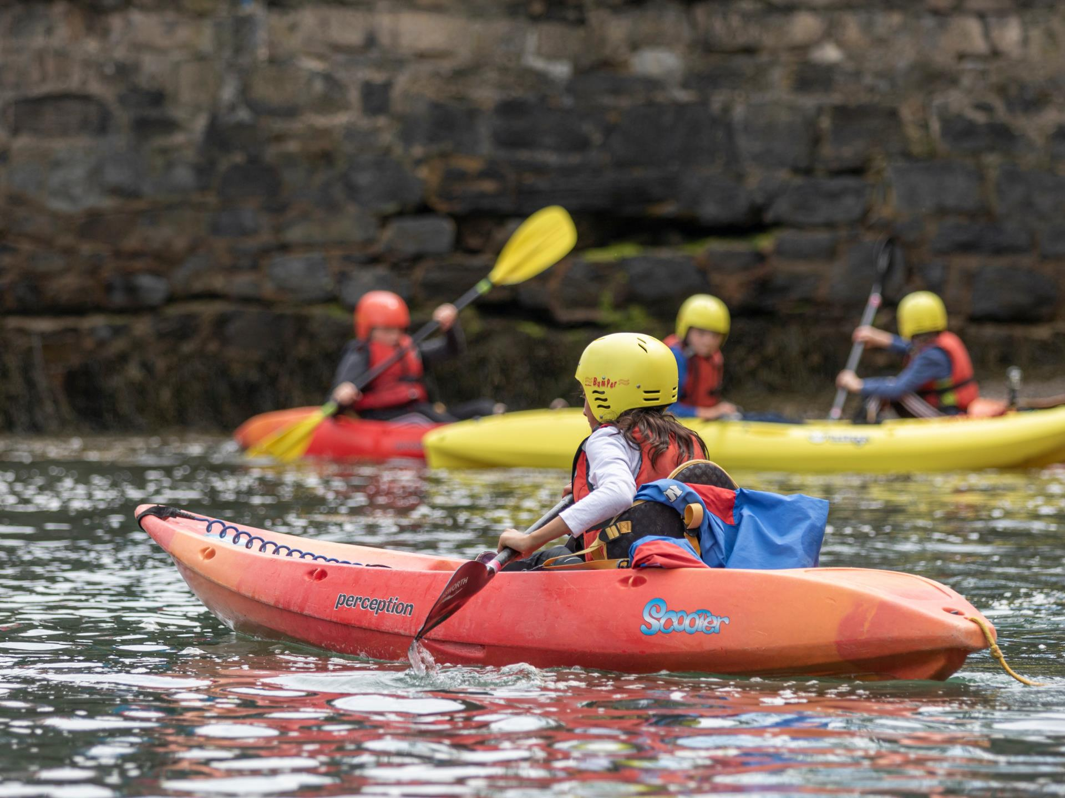
KAYAKING AND RAFT BUILDING

Slide 14
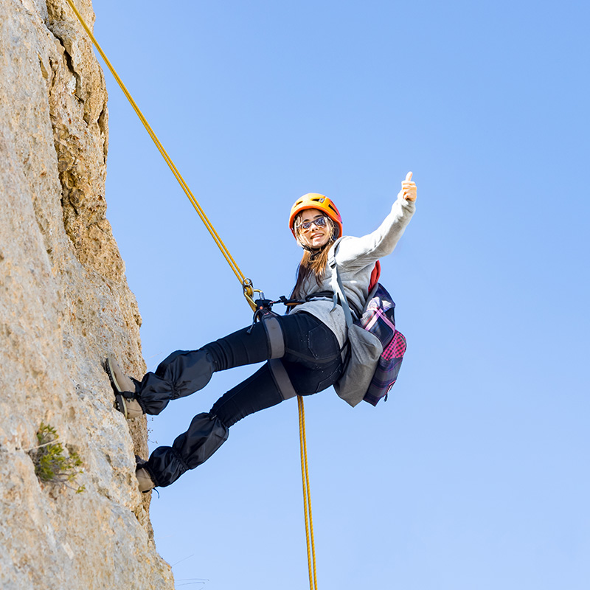
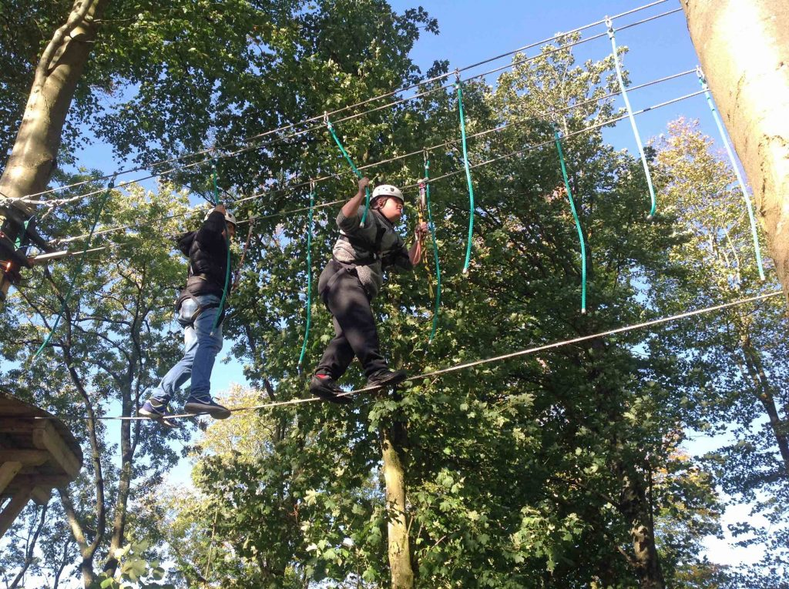
LOW AND HIGH ROPES
CLIMBING AND ABSEILING

Slide 15
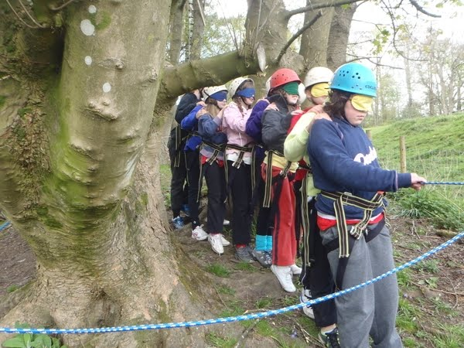

NIGHT LINE
DISCO

Slide 16
Clothing:
Lots of layers. It could be cold!
Old clothes rather than new.
No jeans – they are cold and stay wet!
Waterproof jacket – not good quality coats e.g white ski jackets.
Child’s name and school in EVERYTHING.
Your child must be able to lift their own suitcase/ bag.

Slide 17
Other items:
Small puzzle/ books and magazines
Paper and pen
Card games e.g. Uno, Top Trumps
Diary
Teddy
Some sweets and snacks
£5 spending money for shop

Slide 18
Do not bring:
Electronic games of any kind
I-pad
Mobile phones
Jewellery and make up
Items of value
Creams, medication etc. that we are not aware of
Expensive clothing
Midnight feasts
Electrical appliances of any kind
Aerosols

Slide 19
medication
Please ensure :
Medication is in a named container with dosage clearly labelled.
Please inform Mrs Charlton and give it to her on Wednesday morning or before if possible.
If your child suffers from Asthma, please provide two inhalers; one for them to have with them and one spare.
No child should have any creams, tablets etc in their baggage.
We will take Calpol. If your child is allergic to Calpol, please let Mrs Charlton know.

Slide 20
faqS
My child has never stayed away from home. How will they be supported?
My child has special dietary requirements. Who should I speak to?
Can my child contact home during the week?
My child has night terrors /sleep walks. What should I do?
My child sometimes wets the bed. What should I do?
My child struggles to organise themselves in the morning. What should I do?
Can my child take any spending money with them?

Slide 21
In case of emergencies:
Please telephone the school during school hours (Tel: 01270 918988).
At night call The Conway Centre and ask for The Dingle Tel 01248 714501
Daily updates will be provided to school.
We will phone you in an emergency. Mrs Robinson will hold pupils’ contact information with her 24 hrs/day.

