Slide 1

Number Formation Rhymes
Numbers 0-9
Activity ©Bev Evans, 2012 www.communication4all.co.uk

Slide 2










Click on a number
You can also use action buttons
to click through in order

Slide 3
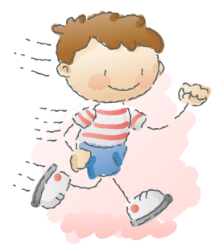


Around and round and round we go,
When we get home we have a zero.
Click for the pencil
Click green for go!

Slide 4

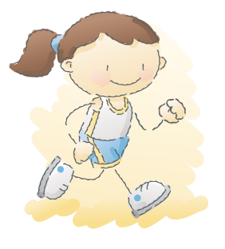
Start at the top and down we run,
That’s the way to make a one.
Click for the pencil
Click green for go!

Slide 5

Around and back on a railway track,
Two, two, two!
Click for the pencil
Click green for go!

Slide 6

Around the tree and around the tree,
That’s the way we make a three.
Click for the pencil
Click green for go!

Slide 7

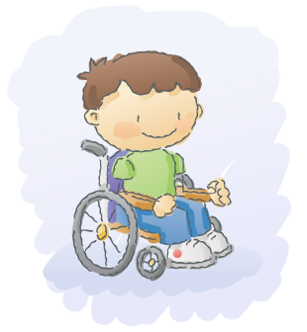
Down and over, down some more,
That’s the way we make a four.
Click for the pencil
Click green for go!

Slide 8


Down and around then a flag on high,
That’s the way to make a five.
Click for the pencil
Click green for go!

Slide 9
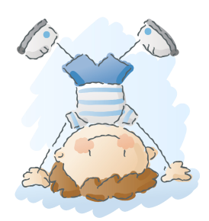
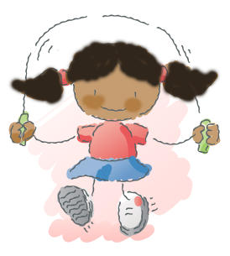
Down we go and make a loop,
Number six makes a hoop.
Click for the pencil
Click green for go!

Slide 10

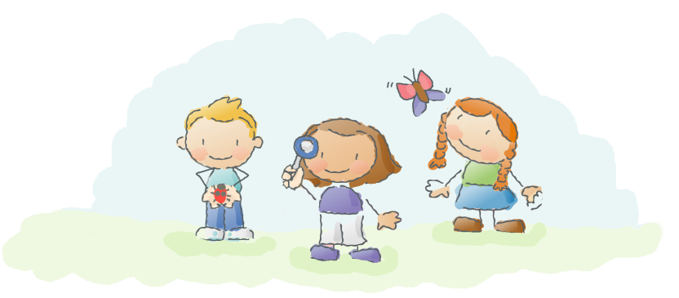
Across the sky and down from heaven,
That’s the way we make a seven.
Click for the pencil
Click green for go!

Slide 11

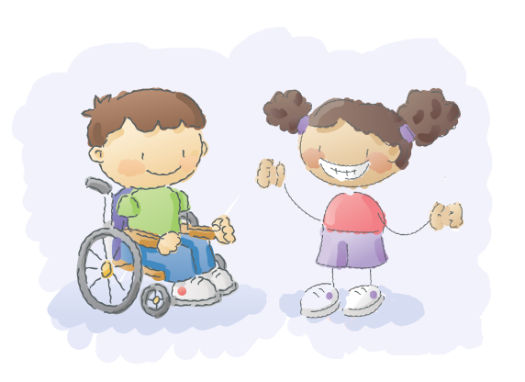
Make an ‘s’ and do not wait!
When it’s joined up you have an eight.
Click for the pencil
Click green for go!

Slide 12
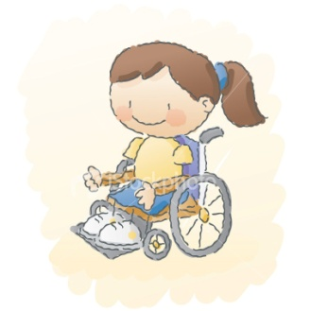

Make a loop and then a line,
That’s the way to make a nine.
Click for the pencil
Click green for go!
Quit

