Slide 1
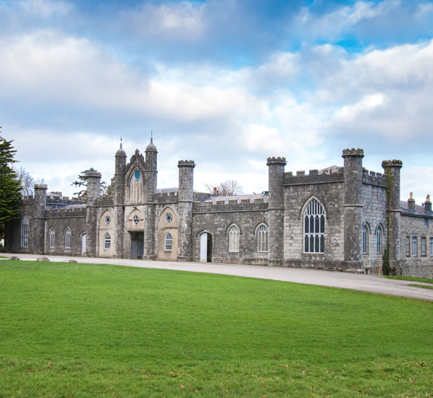
CONWAY CENTRE Residential Information Meeting 20/4/2026 – 22/4/2026

Slide 2
AIMS :
To promote teamwork and teambuilding skills.
To challenge and push yourself with new activities.
To learn new skills.
To promote independence.

Slide 3
Where is the Conway centre?
It is located in North Wales on the island of Anglesey.
The centre is situated adjacent to the Menai Strait within 169 acres of National Trust parkland, it is ideally placed for children to enjoy all that the wild outdoors has to offer.

Slide 4
When is it and cost:
We will leave at 7:30am on Monday 20th April and return for 3:30pm on Wednesday 22nd April.
We anticipate the cost to be around £265.

Slide 5
Organisation:
Staff- At least 5 members of staff.
Rooms will accommodate 6-10 pupils. Teachers’ rooms are next to children’s rooms.
Children will have an opportunity to nominate one friend they would like to share a room with.
We have our own building and social area, which no other school has access to.

Slide 6
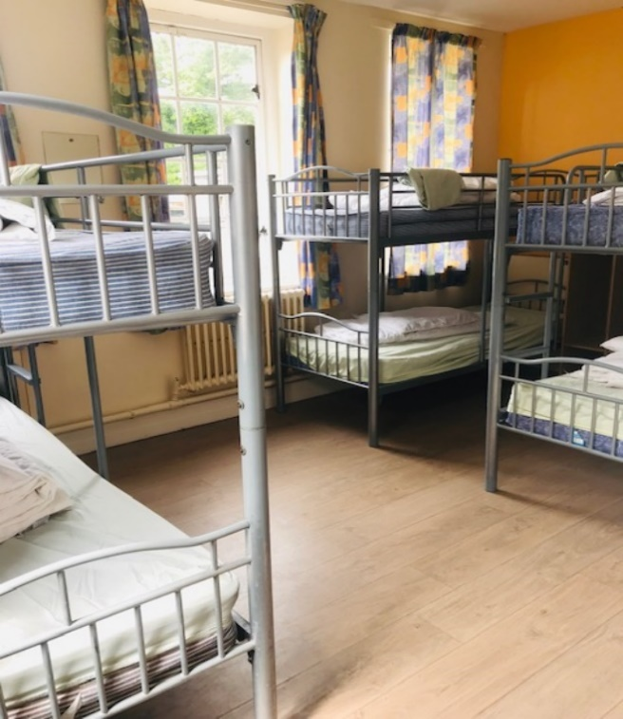
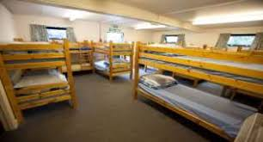
DORMITORIES

Slide 7
A typical day:
A.M. Children will be woken up. They will be told when they need to be ready for breakfast according to the centre’s rota. They will be expected to get washed, dressed and make their bed. Eat breakfast. Get ready for and then take part in morning activities. Prepare for lunch.
P. M. Prepare for and take part in afternoon activities. Possible period of free time before dinner, when children will be in social room or outside with staff. Have dinner at our allocated time.
Evening. Take part in the evening activity. Get ready to go to sleep. Lights out at around 9:30pm.

Slide 8
Meals:
Children will need to bring a packed lunch for the first day.
They will have an evening meal on Monday and Tuesday. There will be a choice of hot food in a canteen.
They will have a cooked breakfast on each morning with the option of cereal, toast, juices etc.
Children will get choice of hot or cold lunch on Tuesday and Wednesday before setting off home.
Please ensure any food allergies are highlighted on medical forms.

Slide 9
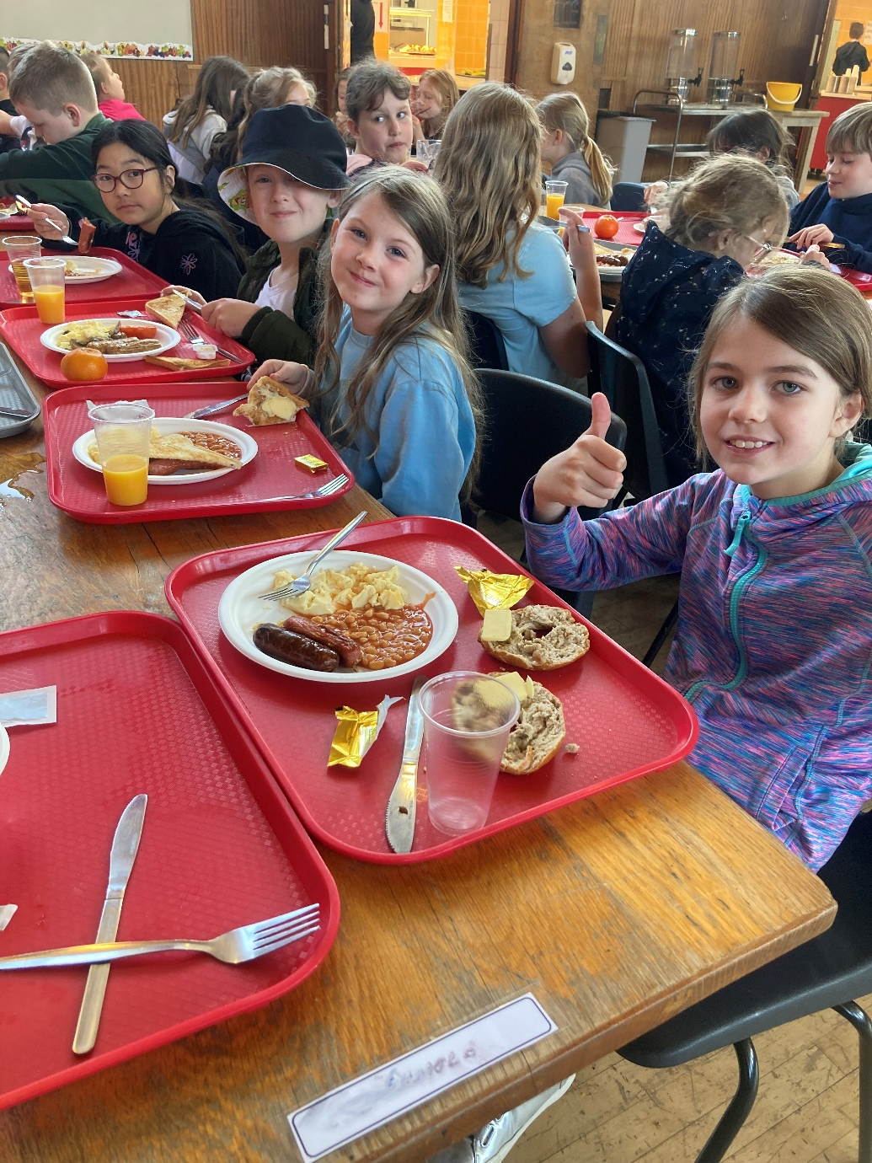
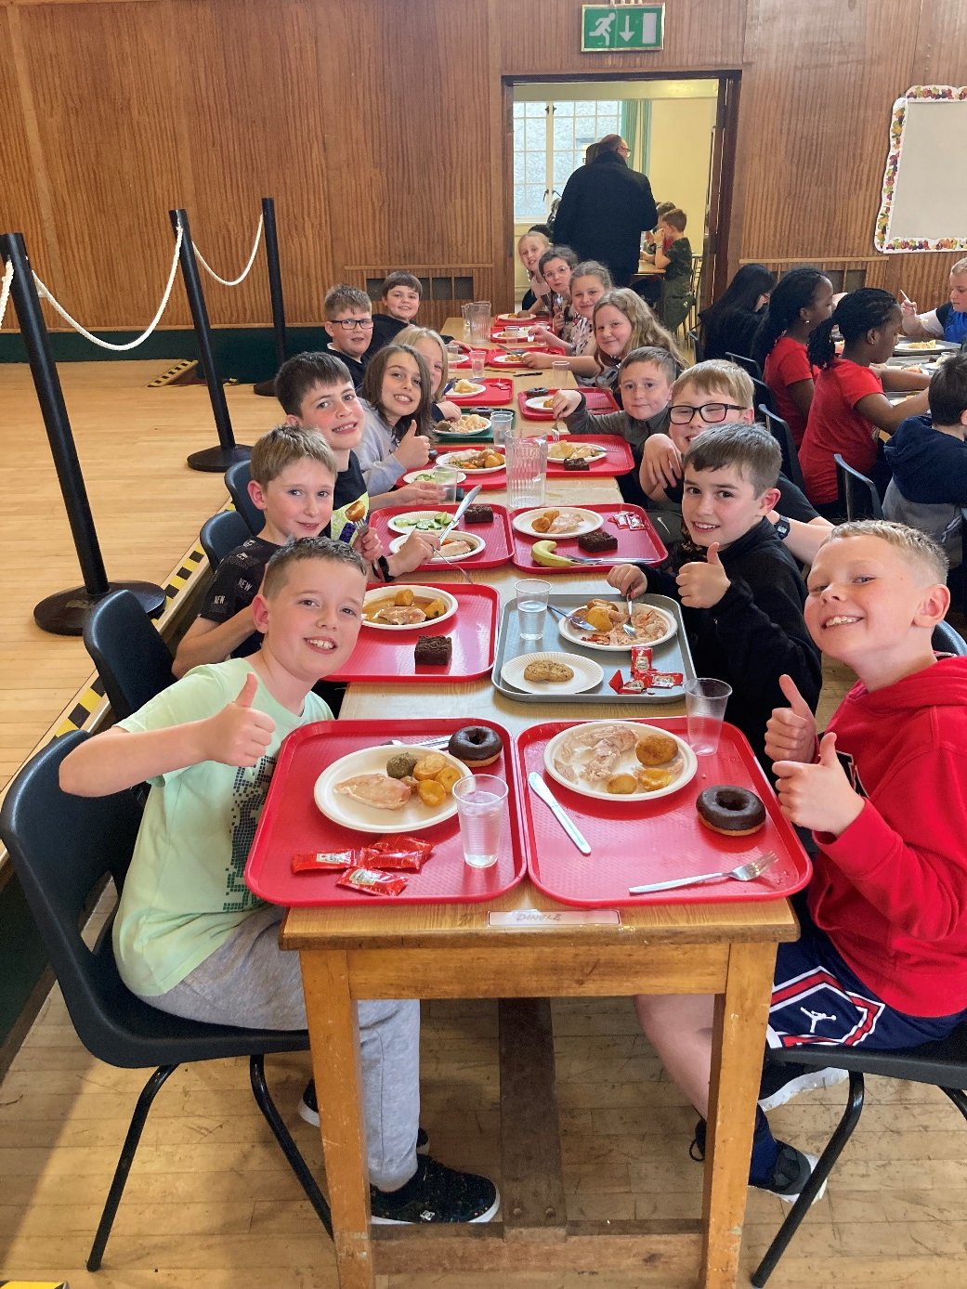

Slide 10
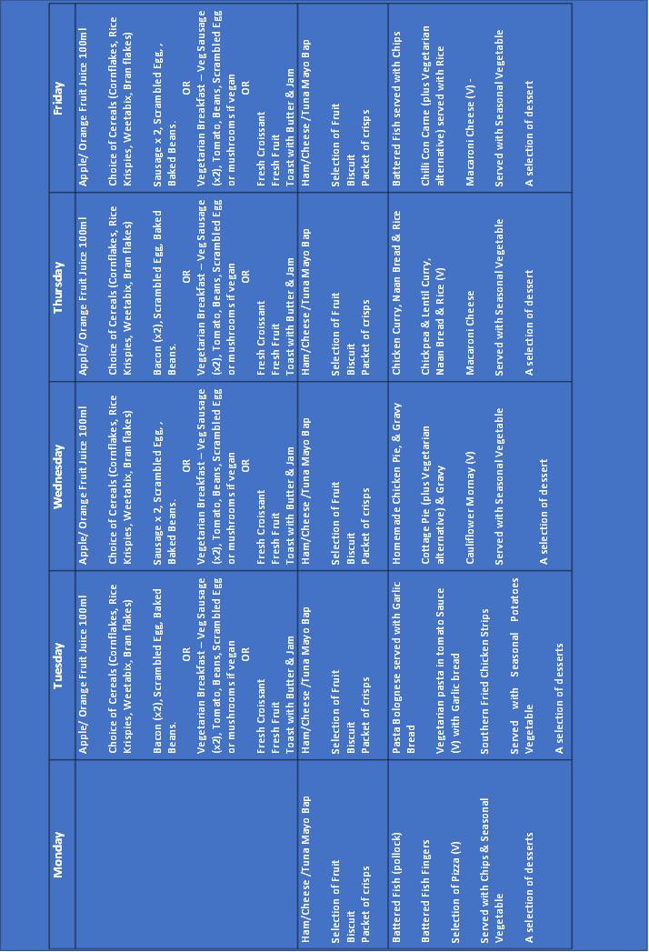

Slide 11
Activities:
Split into 5/6 activity groups – approx. 10-12 per group.
Qualified instructors throughout.
Each activity will be led by a member of the Conway team. There will be a member of The Dingle staff with each group. In the evenings, The Dingle staff will look after the children and run an evening activity.
Trial by Choice – encouragement not force.

Slide 12
 | B’fast | Morning Session Usually 9.30am-12.30am | Lunch | Afternoon Session Usually 1.30pm-4.30pm | Evening Meal | Evening Session For hygiene reasons please ensure all beds are made
Wednesday |  | Estimated Arrival - 11.30am Please ensure all arrive dressed ready for the afternoon session | Own Packed Lunch | Group 1 + 2 - Kayaking Group 3 - Low - High ropes Group 4 - Low - High ropes | 5.45pm | Nightline
Thursday | 8.00am | Group 1 - Low - High ropes Group 2 - Low - high ropes Group 3 4 - Abseiling | Packed Lunch | Group 1 - Abseiling Group 2 - Abseiling Group 3- Kayaking Group 4 - Kayaking | 5.45pm | Shop 5pm Disco
Friday | 8.00am | Groups 1 2 - Raft building Group 3 + 4 - Raft building | Packed Lunch

Slide 13
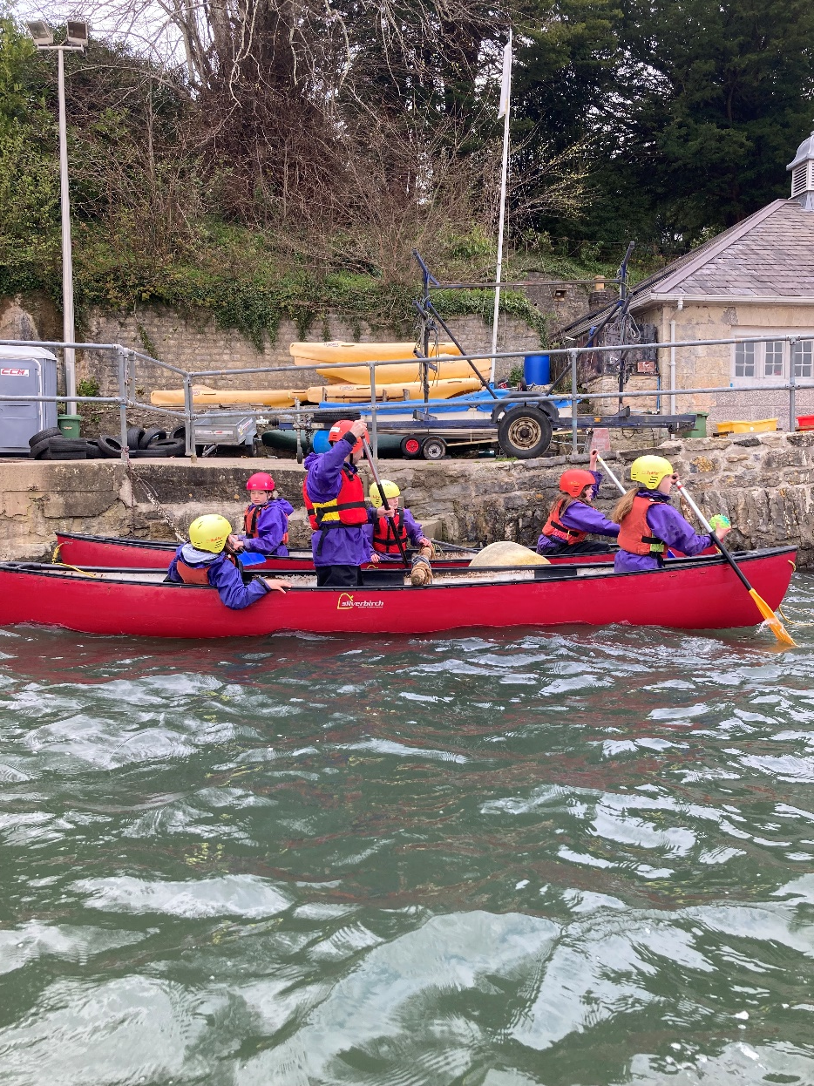
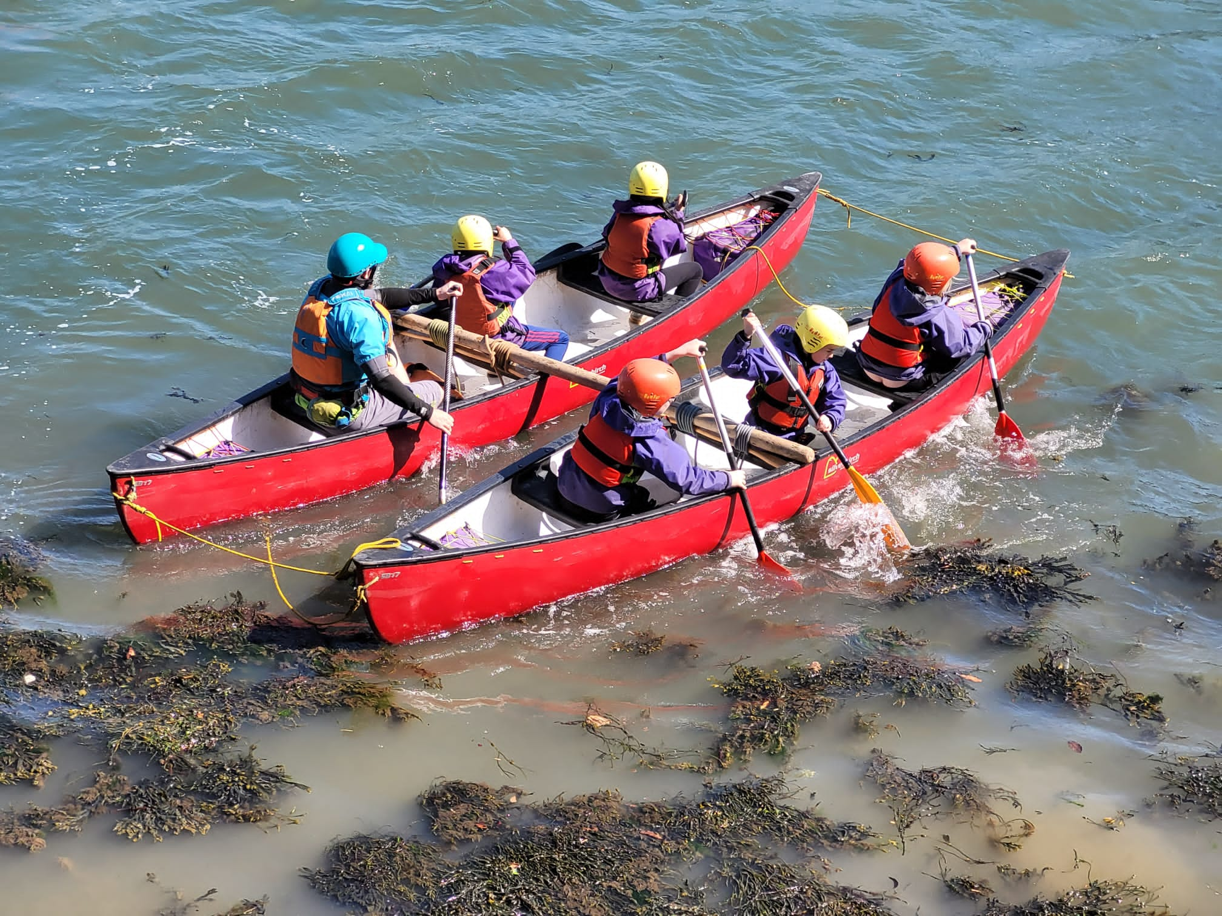
KAYAKING AND RAFT BUILDING

Slide 14
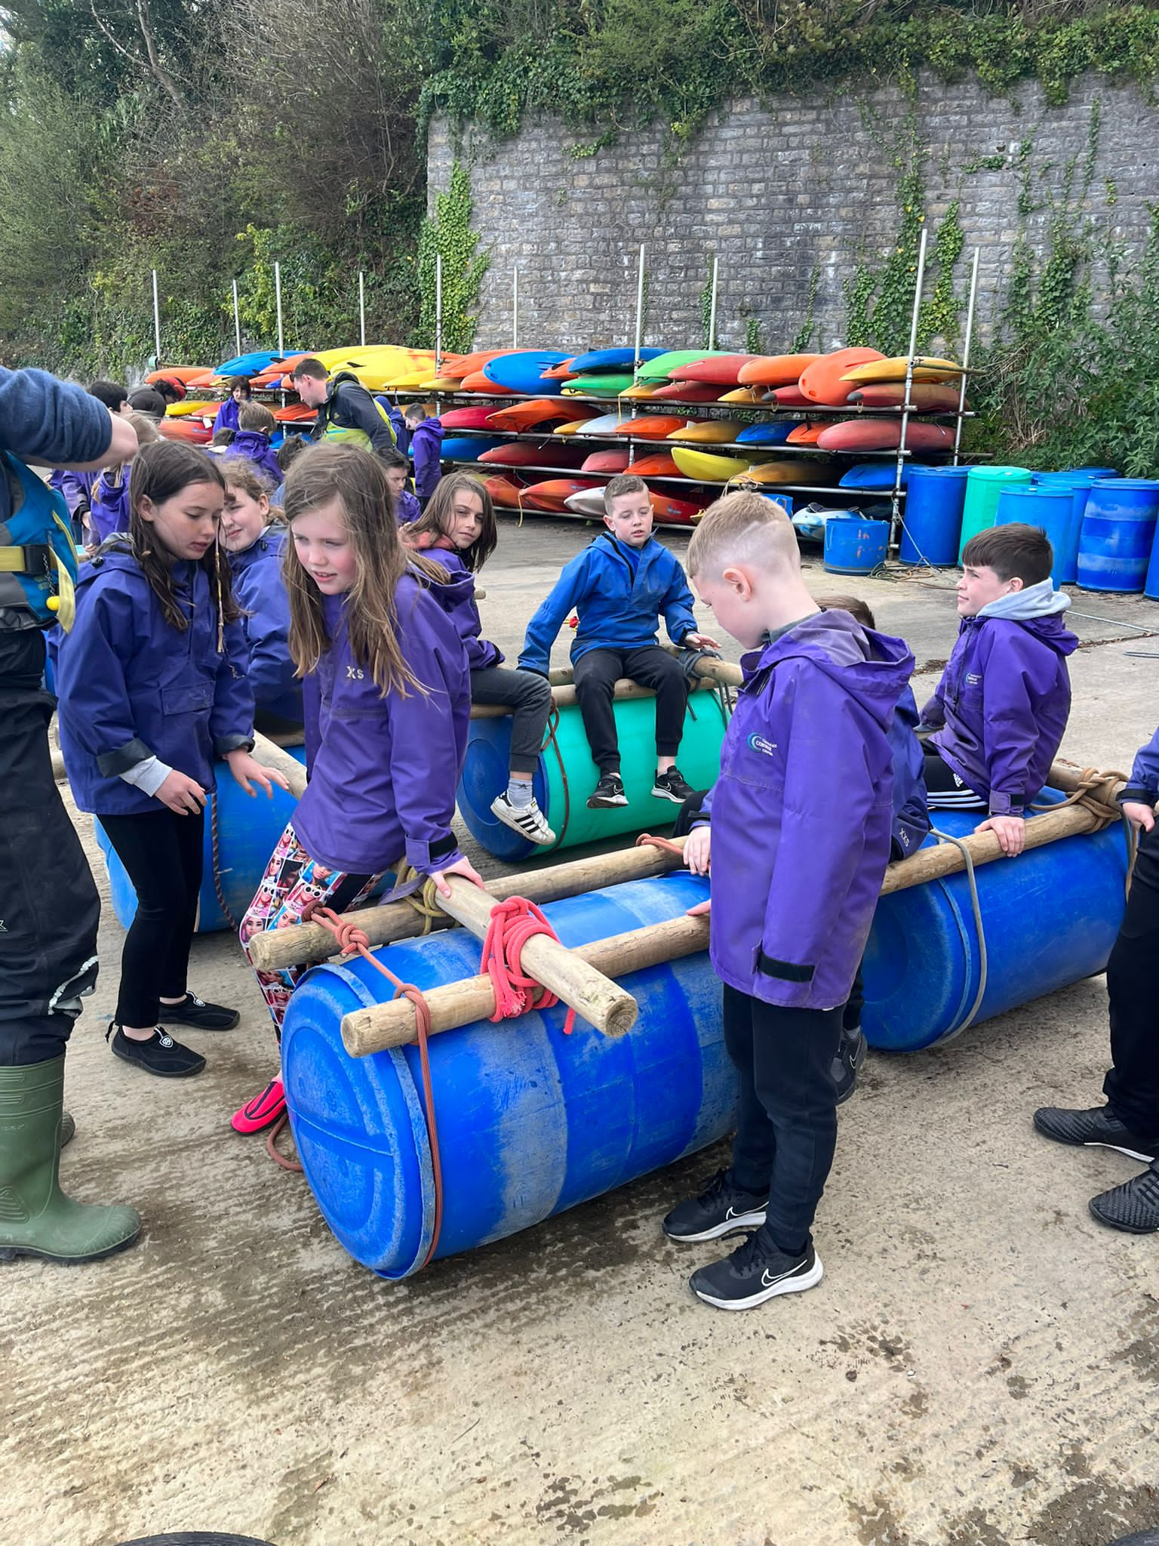
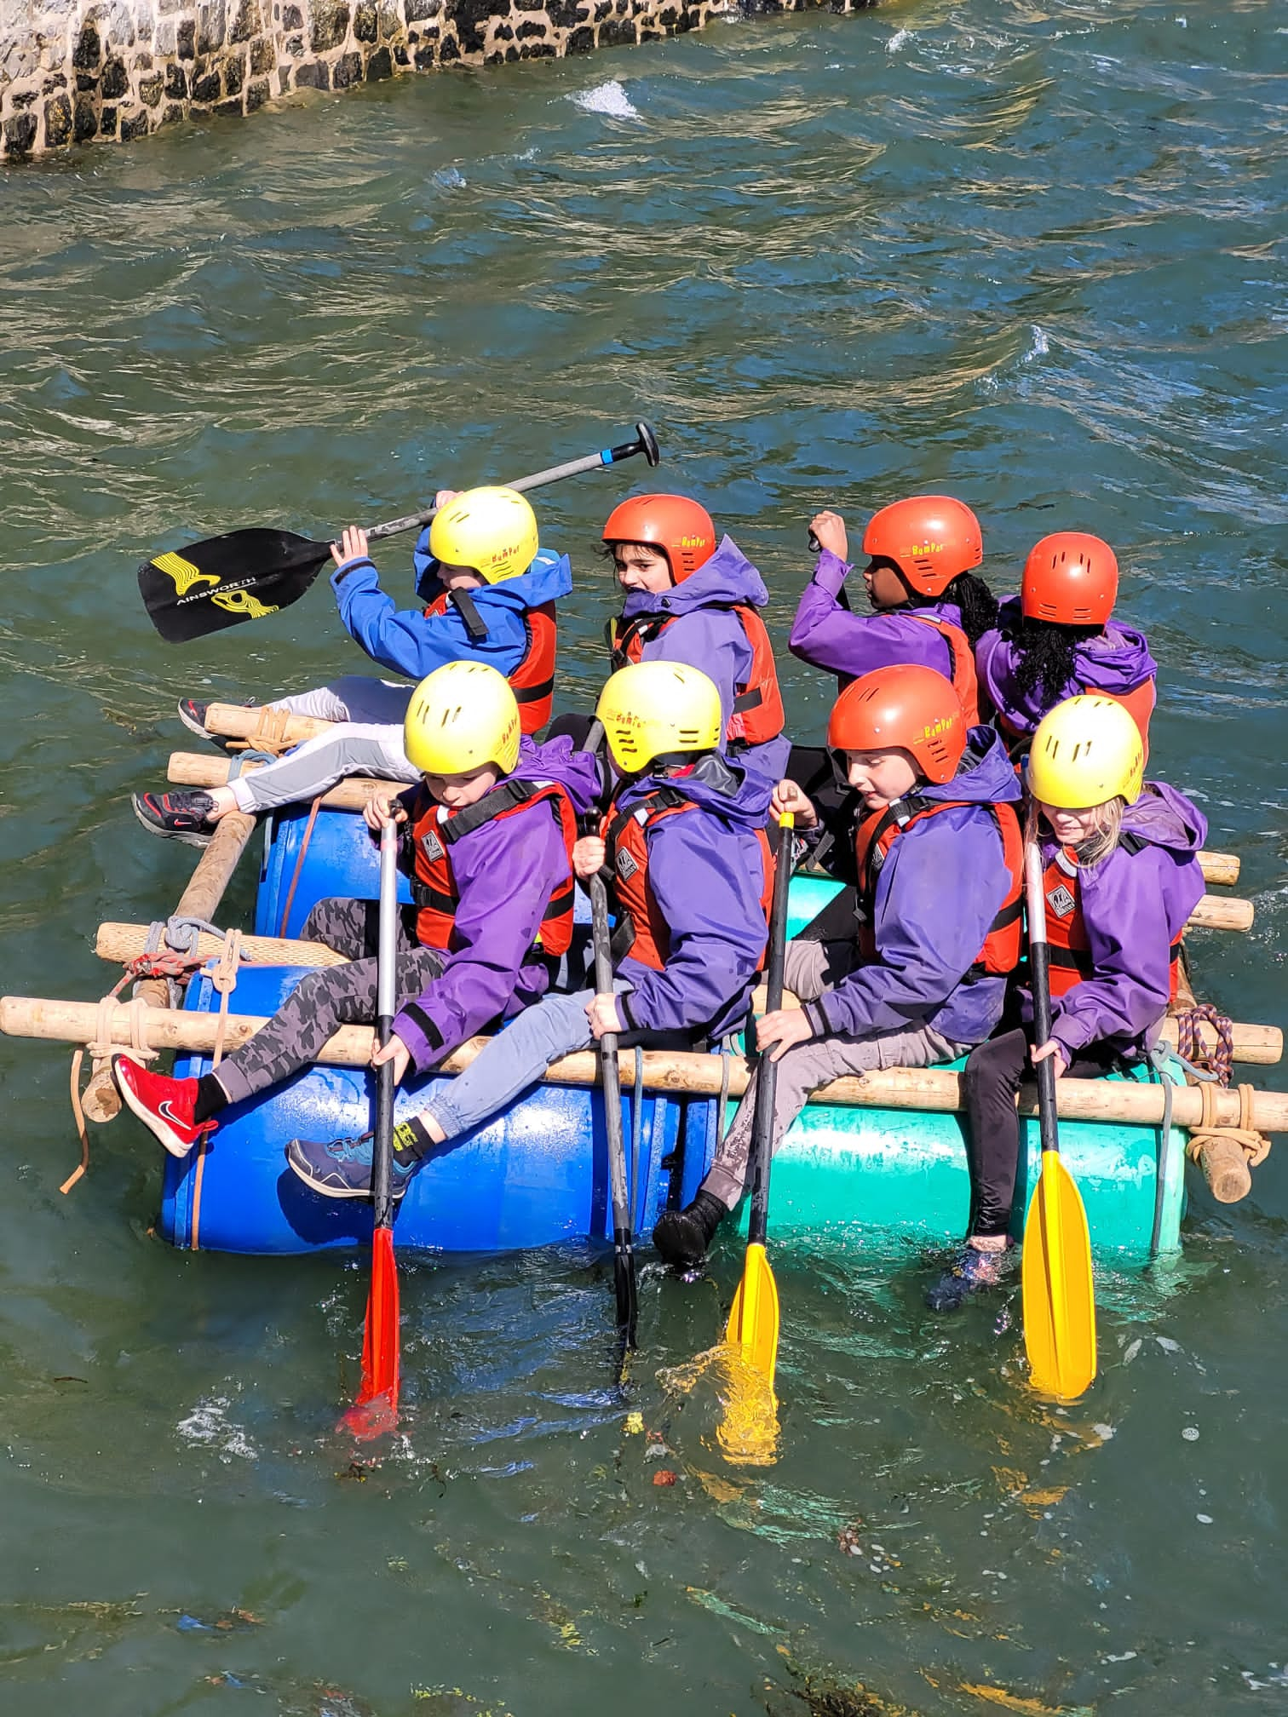

Slide 15
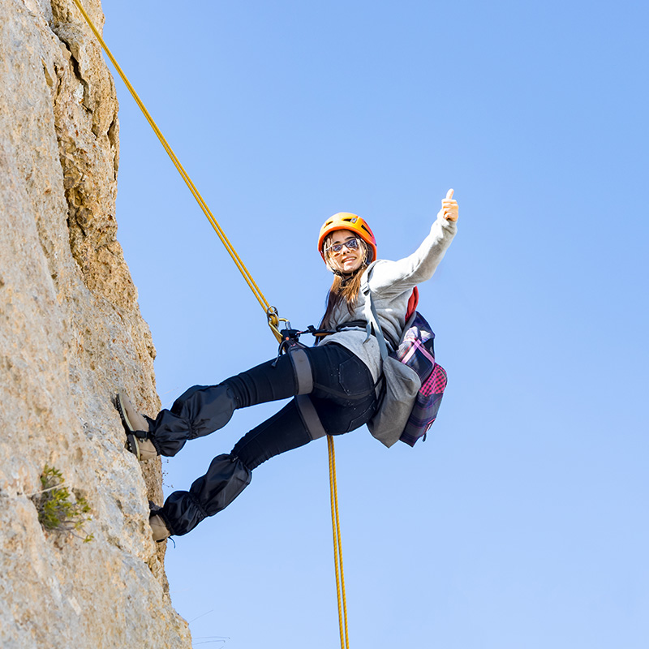
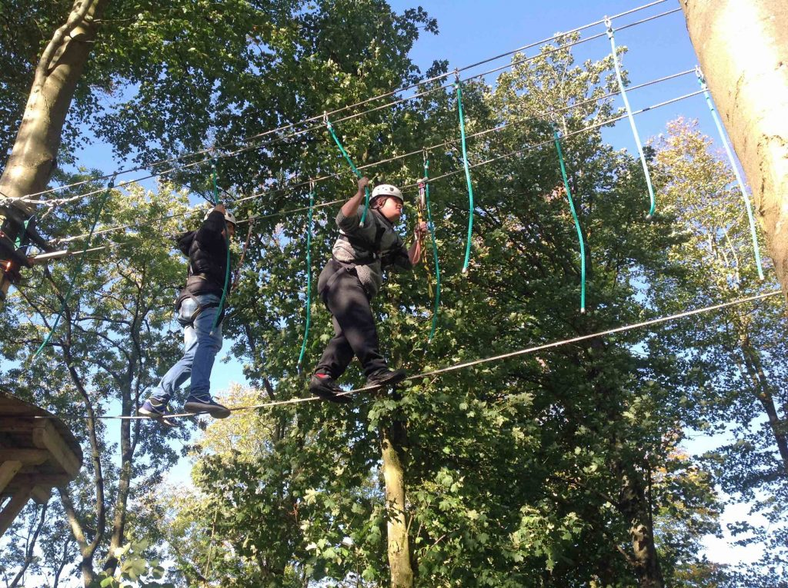
LOW AND HIGH ROPES
CLIMBING AND ABSEILING

Slide 16
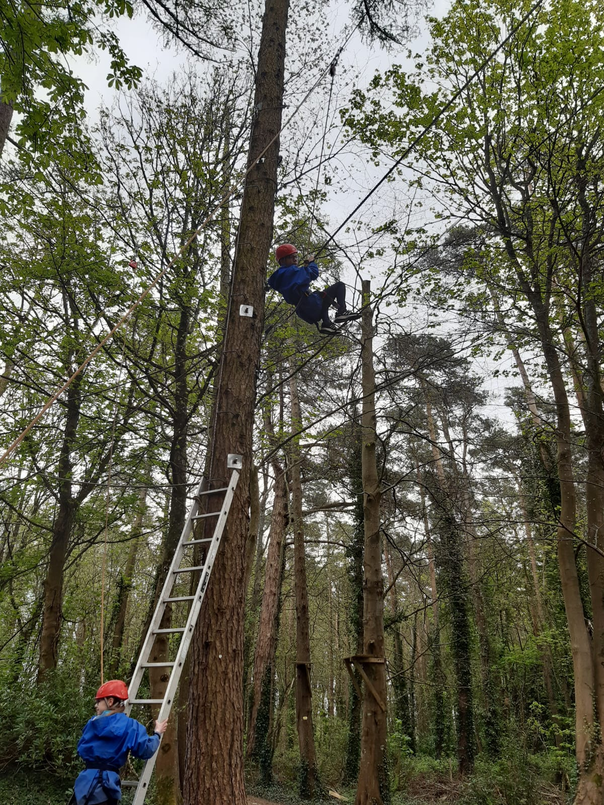
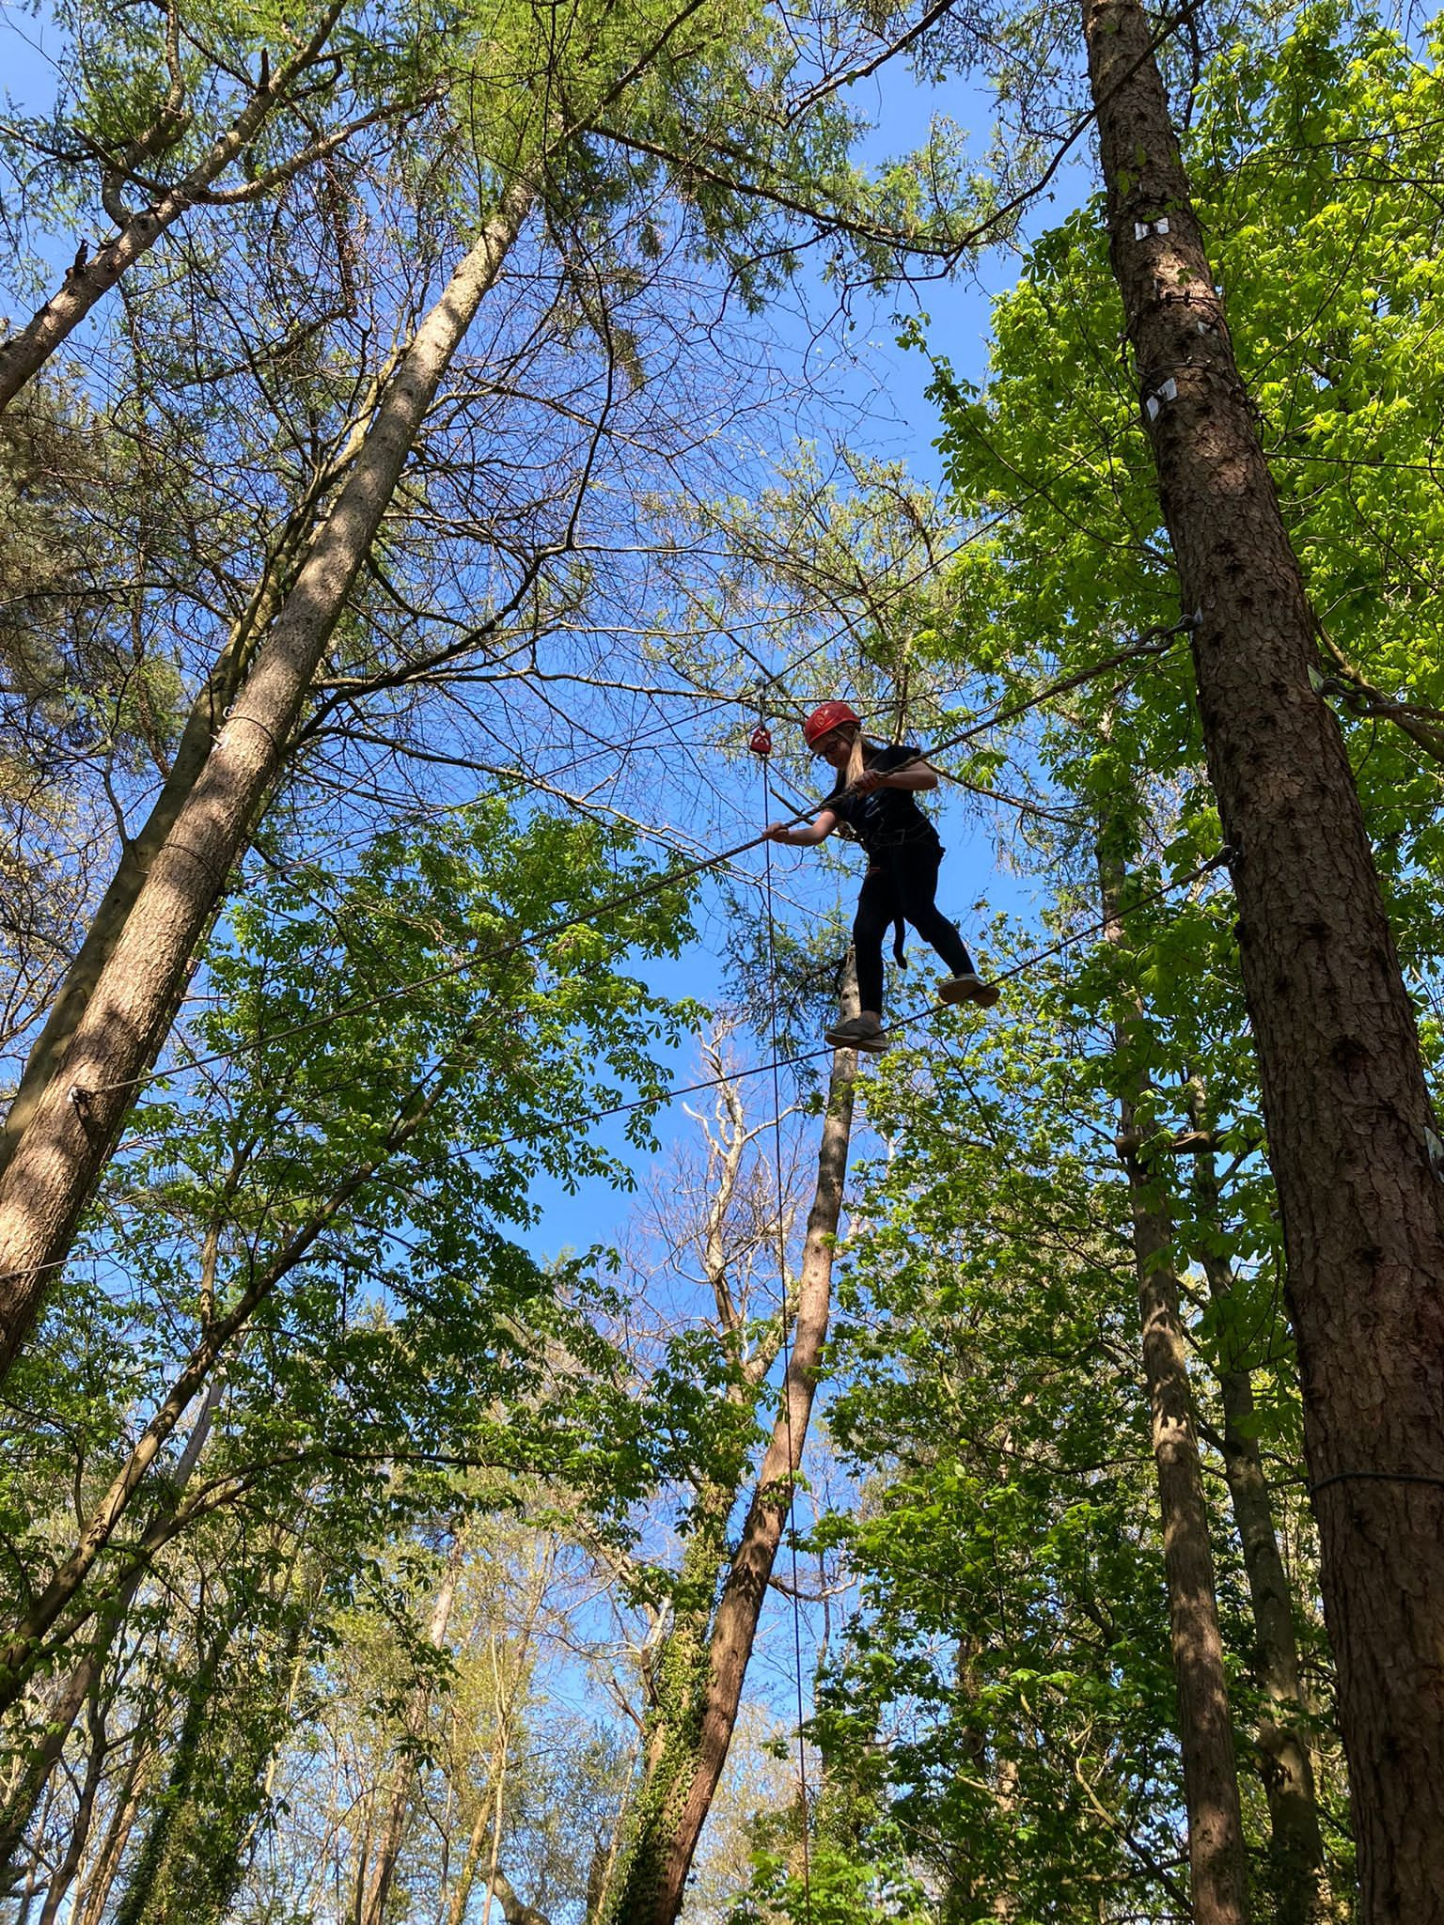

Slide 17
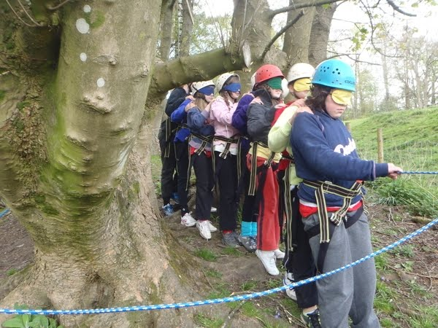
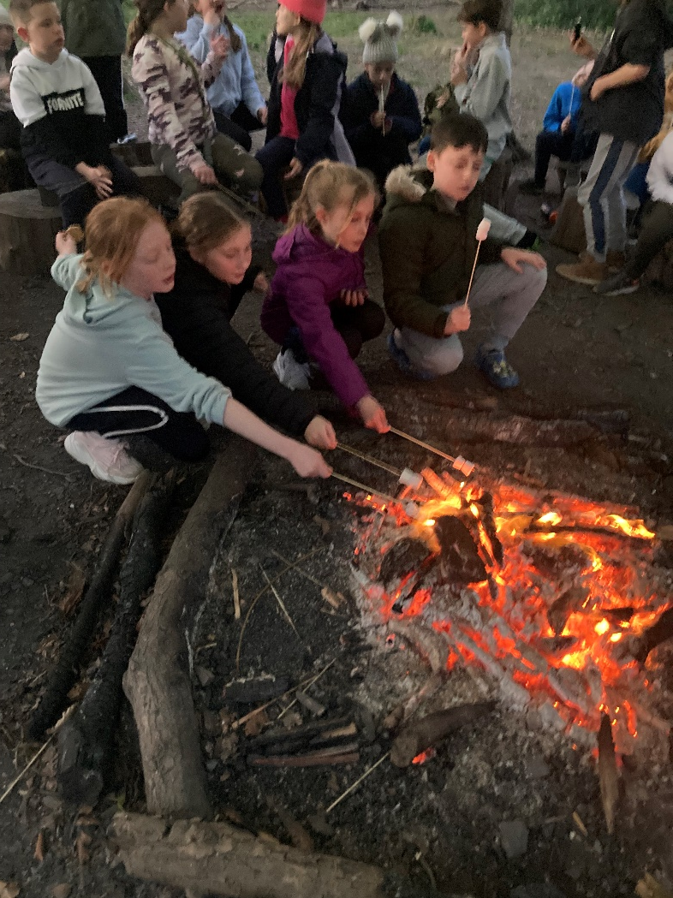
NIGHT LINE
CAMPFIRE

Slide 18
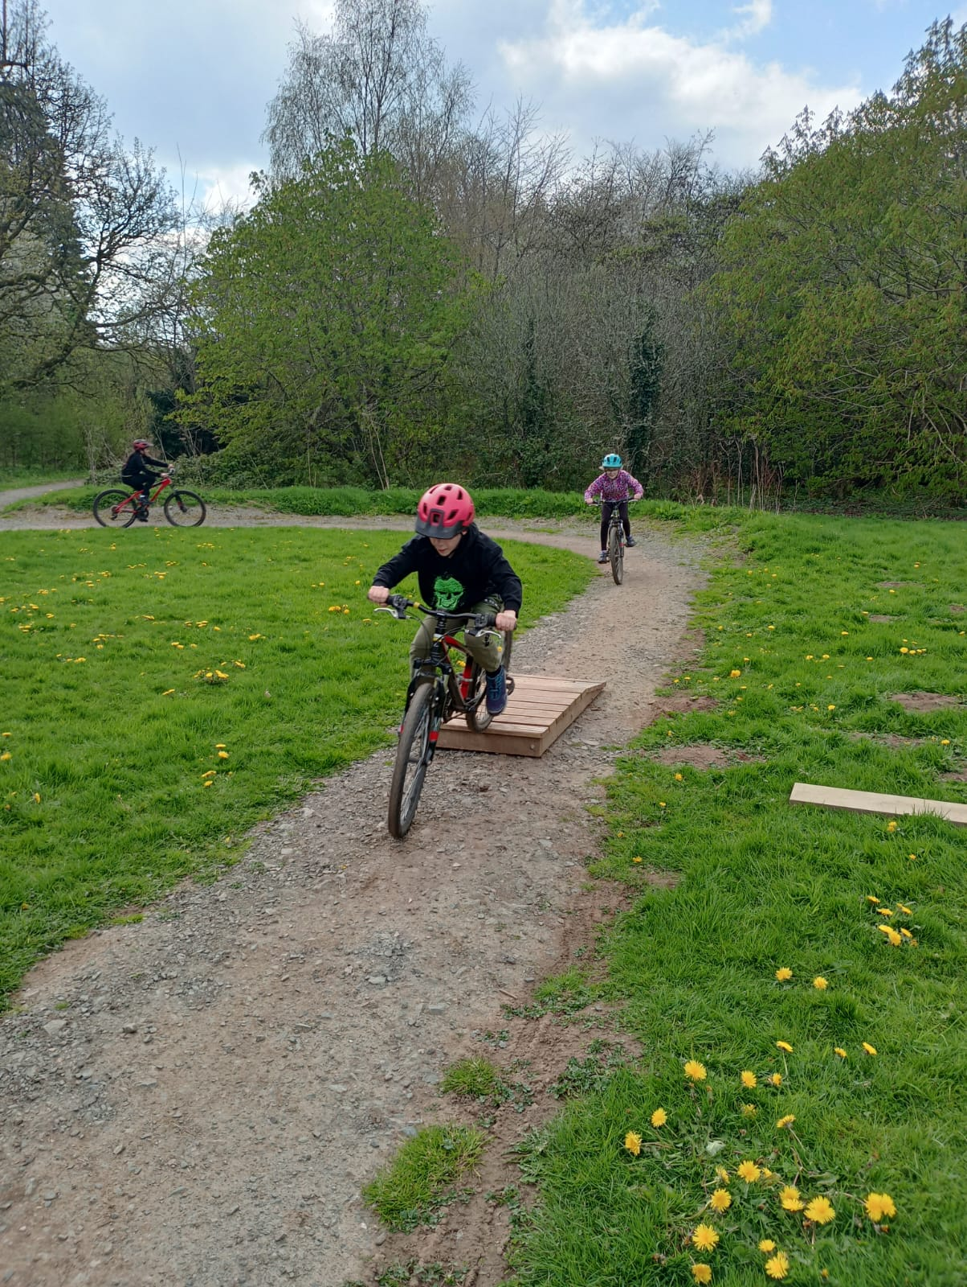
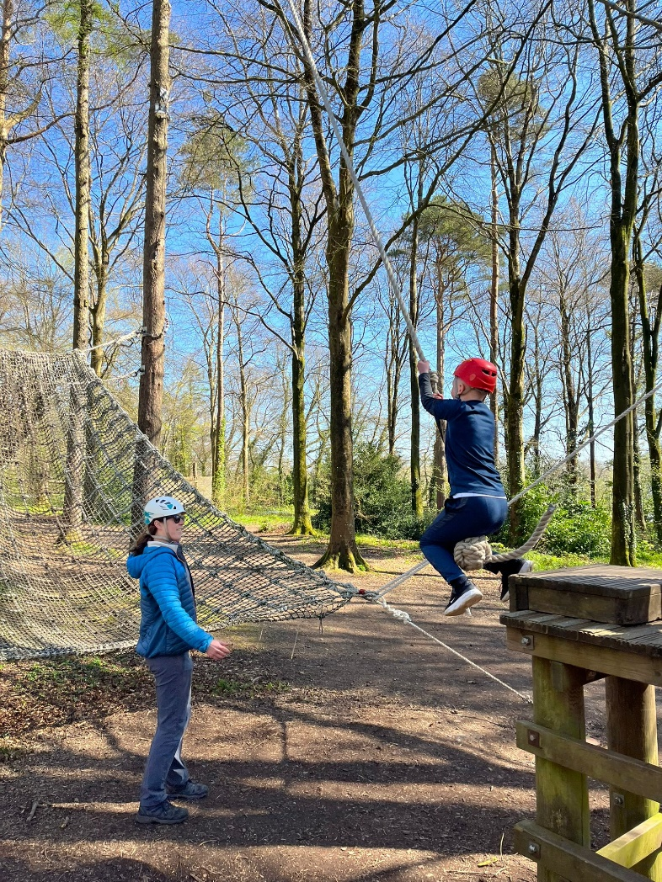
MOUNTAIN BIKING
CHALLENGES

Slide 19
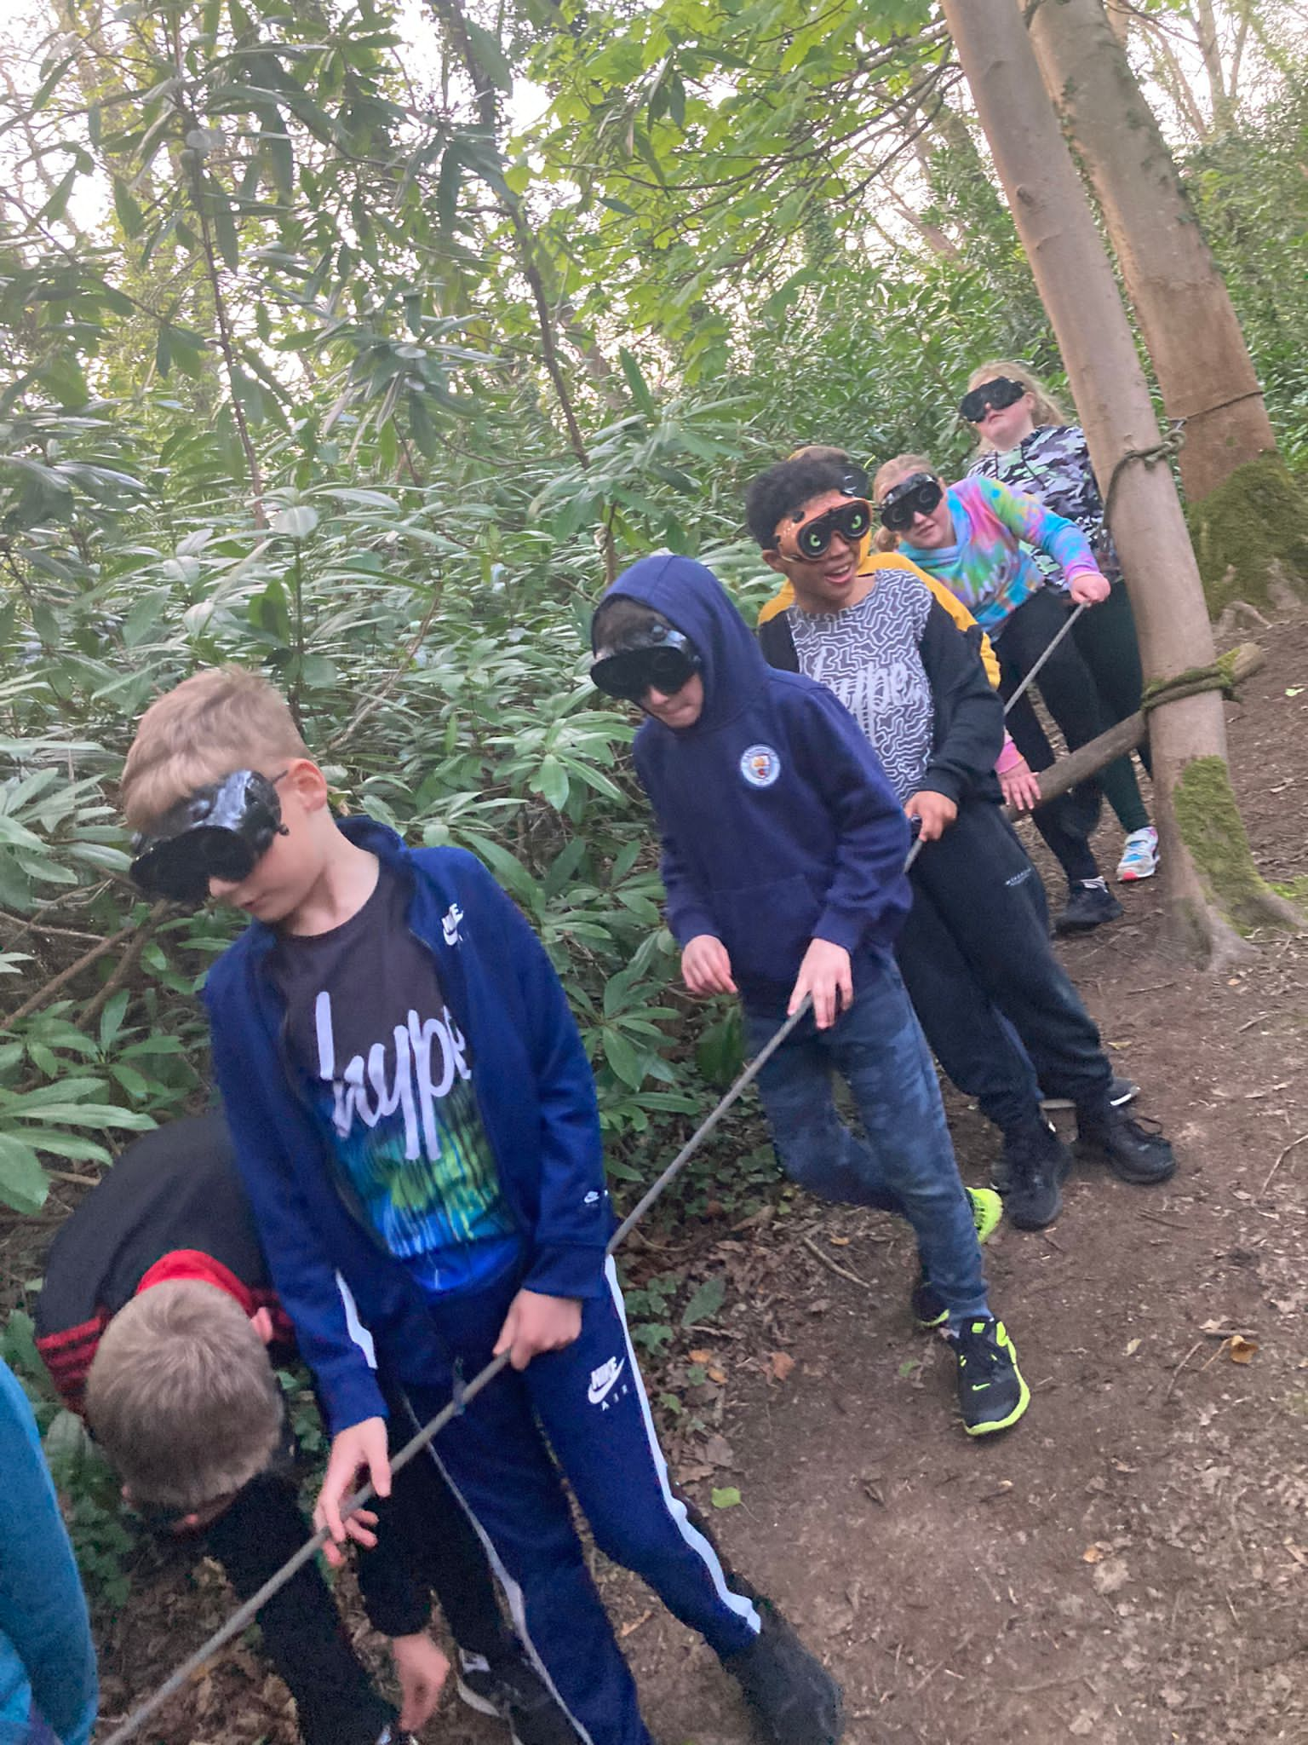

Slide 20
Clothing:
Lots of layers. It could be cold!
Shoes/trainers for wet activities.
Old clothes rather than new.
No jeans – they are cold and stay wet!
Waterproof jacket – not good quality coats e.g white ski jackets.
Child’s name and school in EVERYTHING.
Your child must be able to lift their own suitcase/ bag.

Slide 21
Other items:
Small puzzle/ books and magazines
Paper and pen
Card games e.g. Uno, Top Trumps
Diary
Teddy
£5 spending money for shop

Slide 22
Do not bring:
Electronic games of any kind
I-pad
Mobile phones
Jewellery and make up
Items of value
Creams, medication etc. that we are not aware of
Expensive clothing
Midnight feasts
Electrical appliances of any kind
Aerosols

Slide 23
Medication
Please ensure :
Medication is in a named container with dosage clearly labelled.
Please inform School office and hand it in on Wednesday morning or before if possible.
If your child suffers from Asthma, please provide two inhalers; one for them to have with them and one spare.
No child should have any creams, tablets etc in their baggage.
We will take Calpol. If your child is allergic to Calpol, please let school know.

Slide 24
FAQ’s
My child has never stayed away from home. How will they be supported?
My child has special dietary requirements. Who should I speak to?
Can my child contact home during the week?
My child has night terrors /sleep walks. What should I do?
My child sometimes wets the bed. What should I do?
My child struggles to organise themselves in the morning. What should I do?
Can my child take any spending money with them?

Slide 25
In case of emergencies:
Please telephone the school during school hours (Tel: 01270 918988).
At night call The Conway Centre and ask for The Dingle Tel 01248 714501
Daily updates will be provided to school.
We will phone you in an emergency. Miss Clark will hold pupils’ contact information with her 24 hrs/day.

Slide 26
WHAT HAPPENS NEXT?
If you would like your child to take part in the visit we will require a £60 deposit in November and the rest can be paid in instalments or in one payment via Arbor.
If you require any further information then please contact myself at school or via email on deputy@dingle.Cheshire.sch.uk

