Slide 1
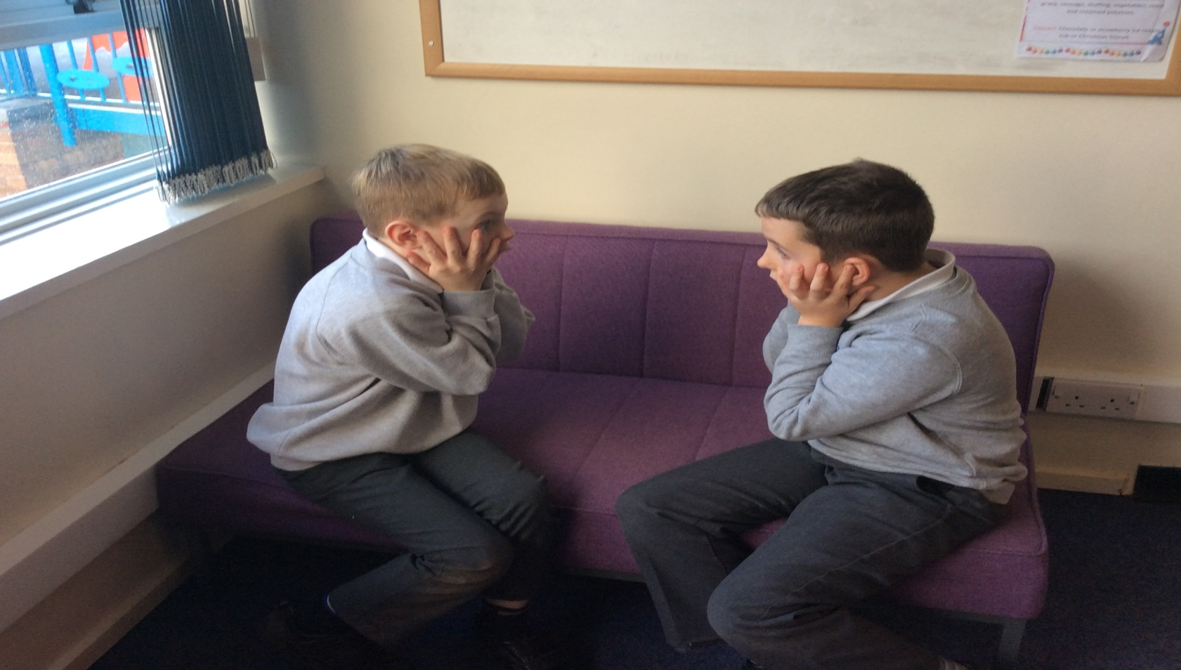
‘Twas the days before Christmas,
And all through the school,
The teachers were trying
To keep their cool.

Slide 2
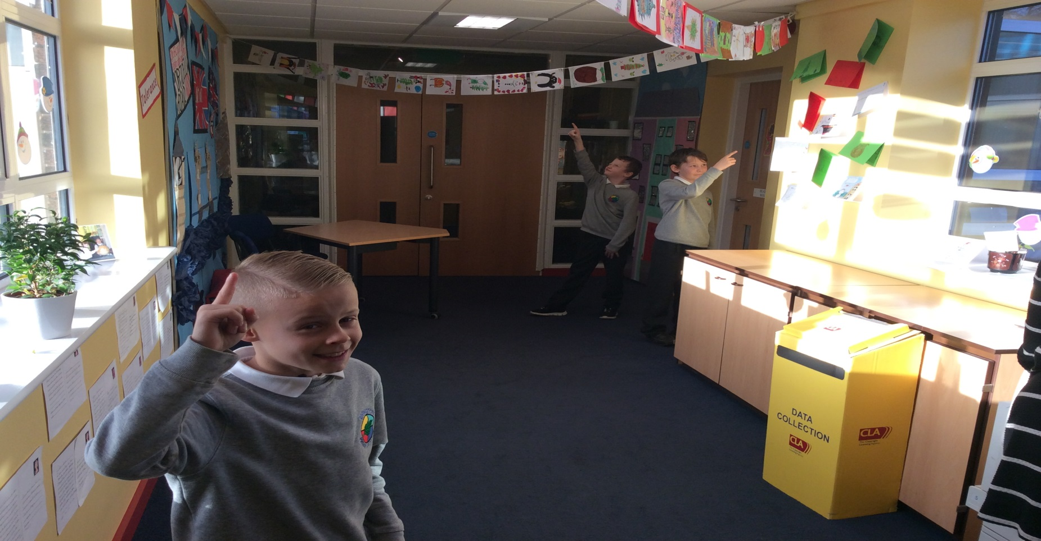
The hallways were hung,
With Christmas art
(Some made in November to get a head start!)

Slide 3
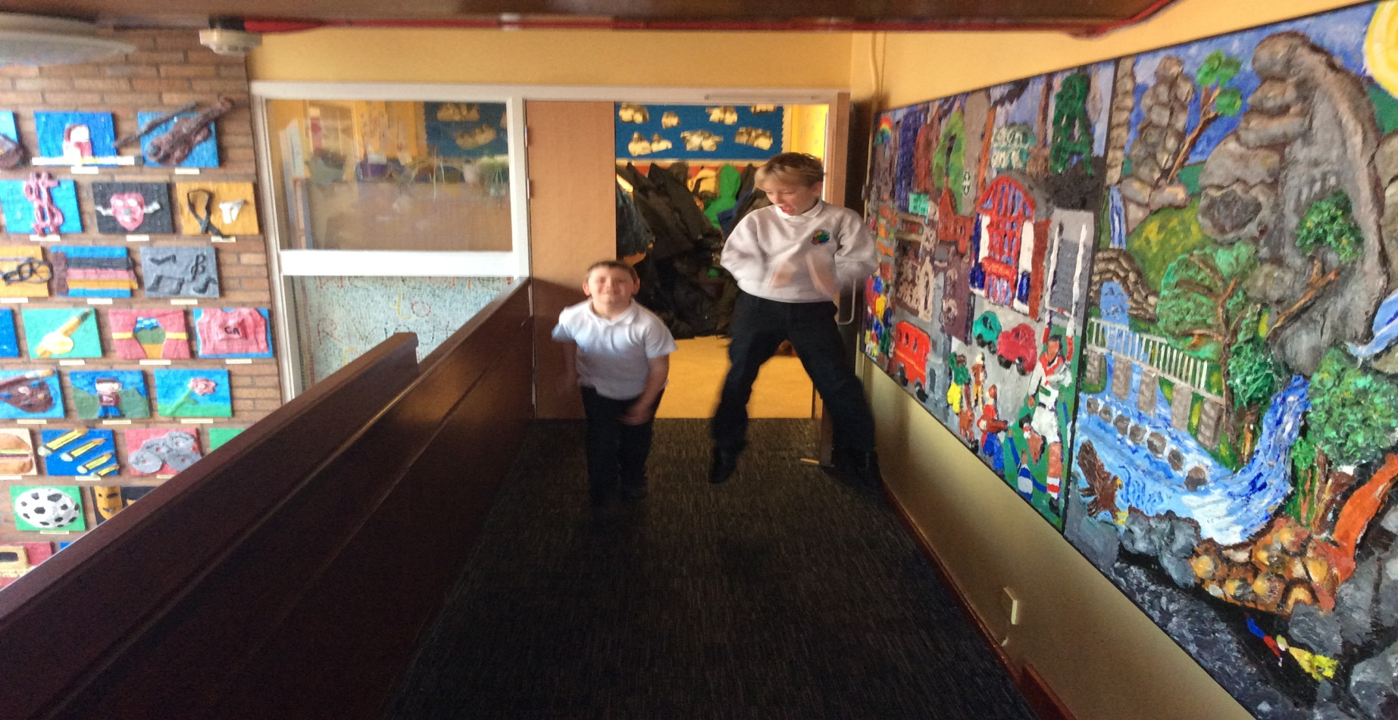
The children were bouncing
Off ceilings and walls,
And seemed to forget
How to walk in the halls.

Slide 4
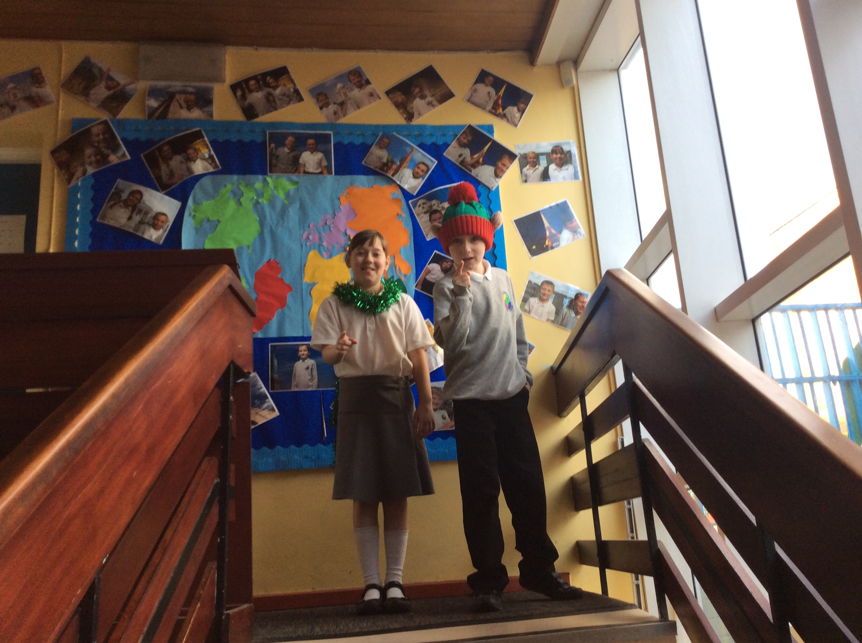
With ‘holiday shirts’
And ‘jingle bell jewels’,
The teachers looked festive
Enforcing the rules.

Slide 5
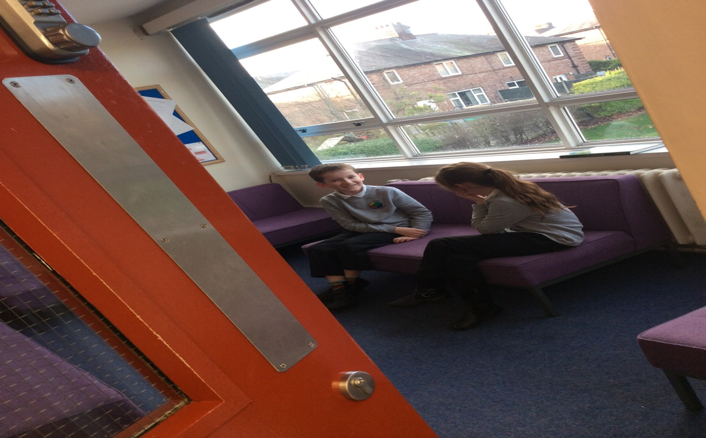
When out of the teachers lounge
There came such a chatter,
The head teacher went in
To see what was the matter.

Slide 6
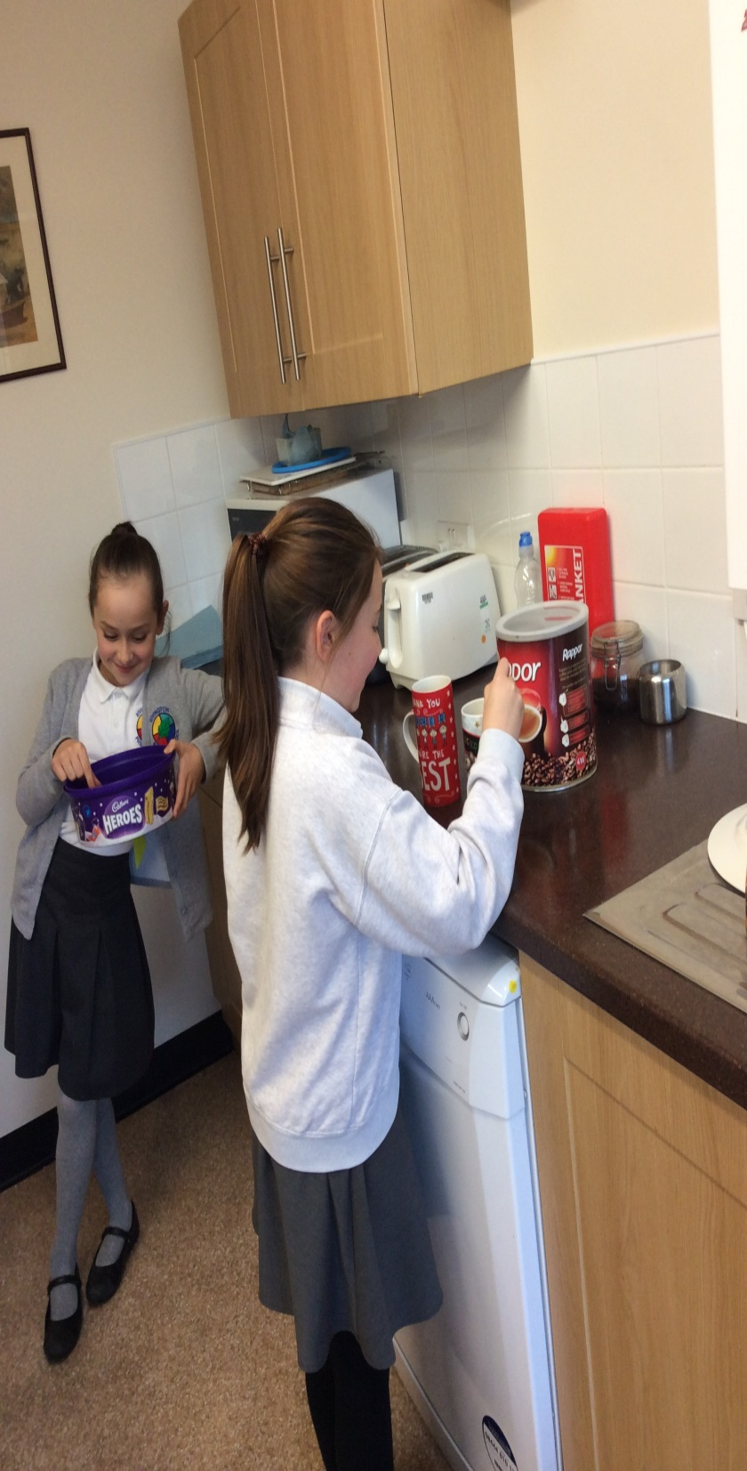
The teachers were hiding
And trying to refuel, On coffee and cookies
And treats from the Yule.
When what to their wondering
Ears do they hear,
But the ringing of school bells
- It’s the children they fear!

Slide 7
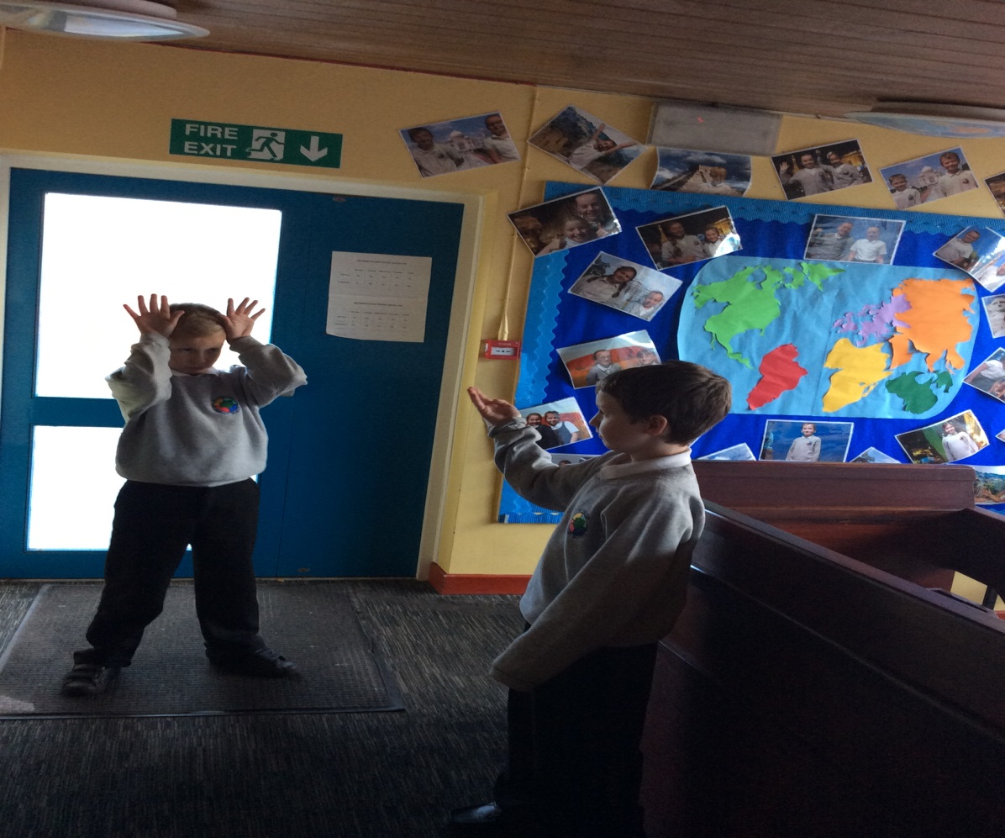
More rapid than reindeer
The little ones come,
And the teachers all shouted
And called them by name;

Slide 8
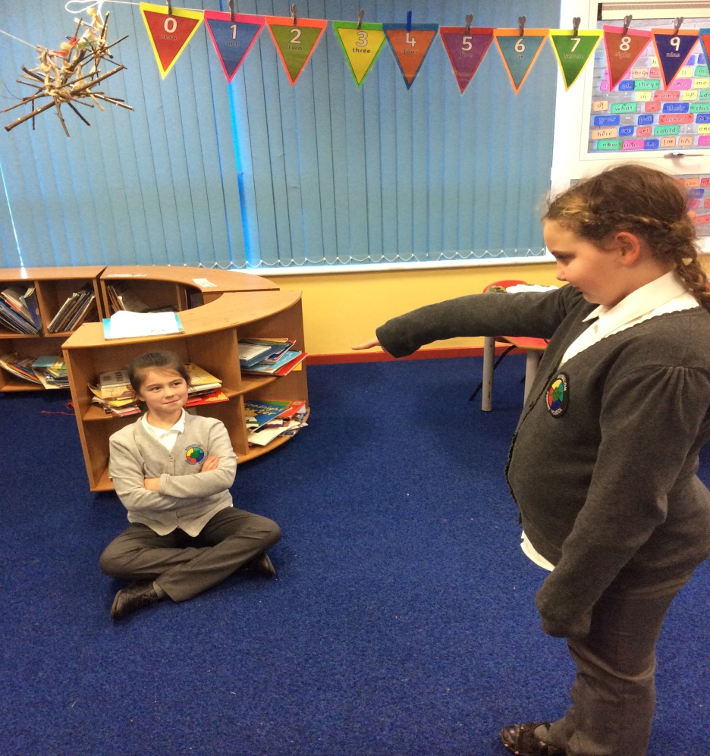
Walk Vincent! Walk Tanner!
Walk, Tyler and Sammy!
Sit, Jamie! Sit, Laura!
Sit, Tara and Tammy!

Slide 9
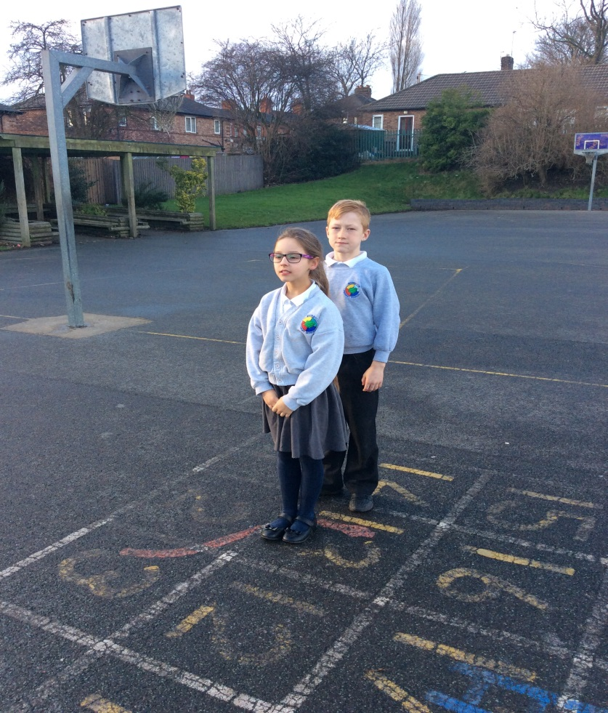
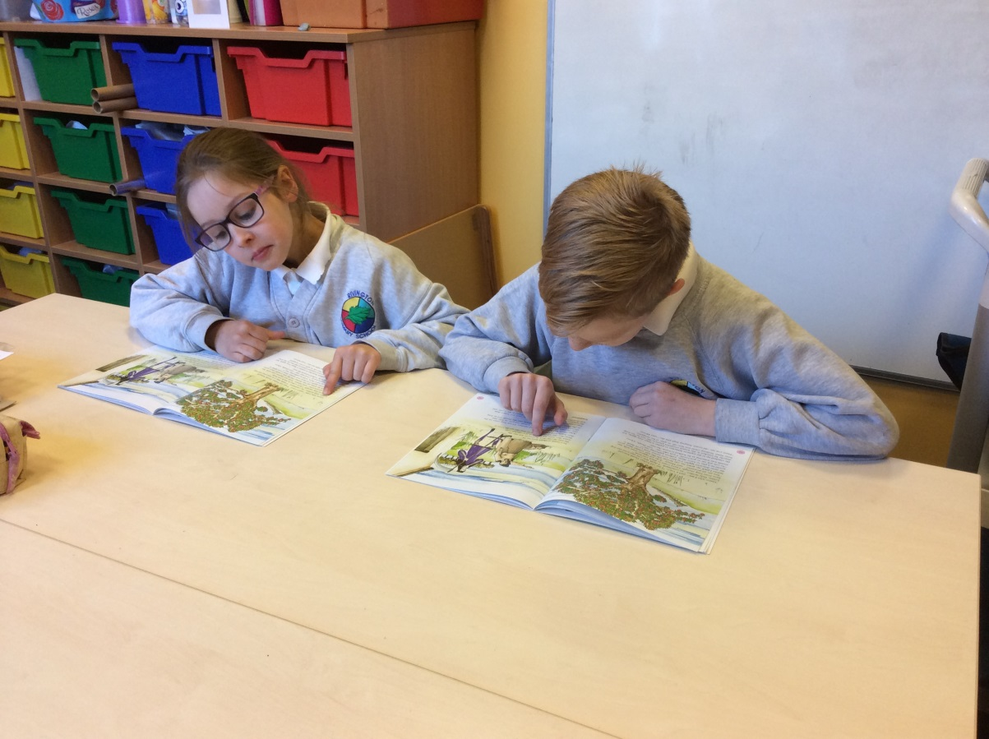
To your desks in the room!
To your spots in the line!
Now walk to them! Walk to them!
No running this time!

Slide 10
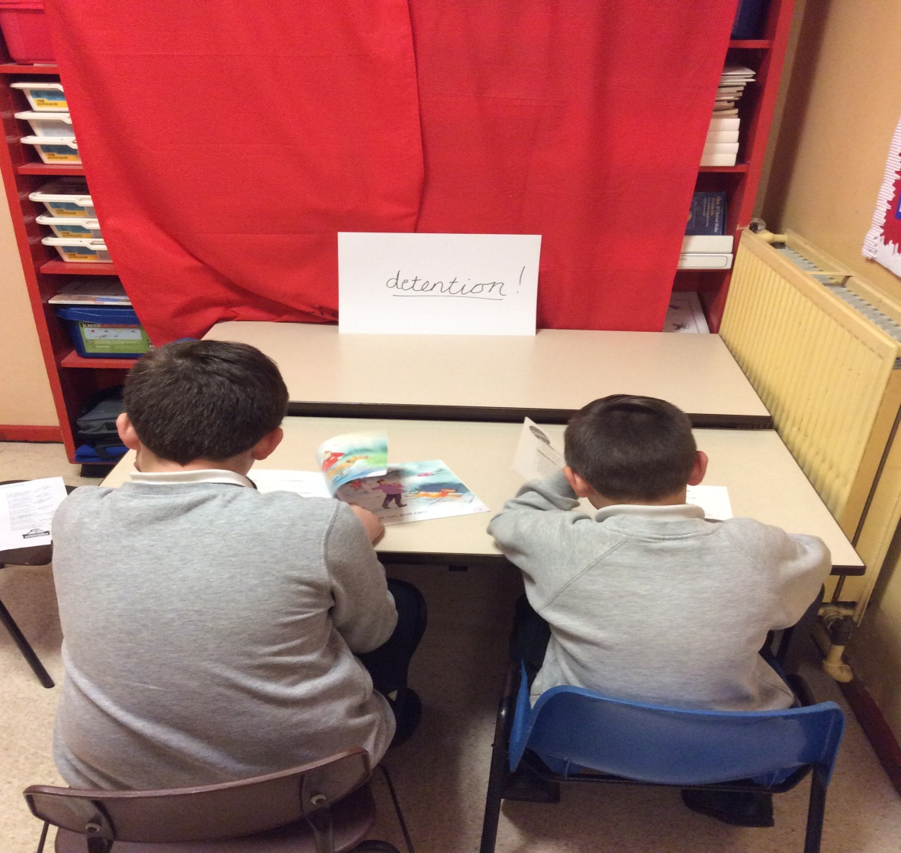
So straight to their places
The children all went.
With fear of detention
Where they could be sent.

Slide 11
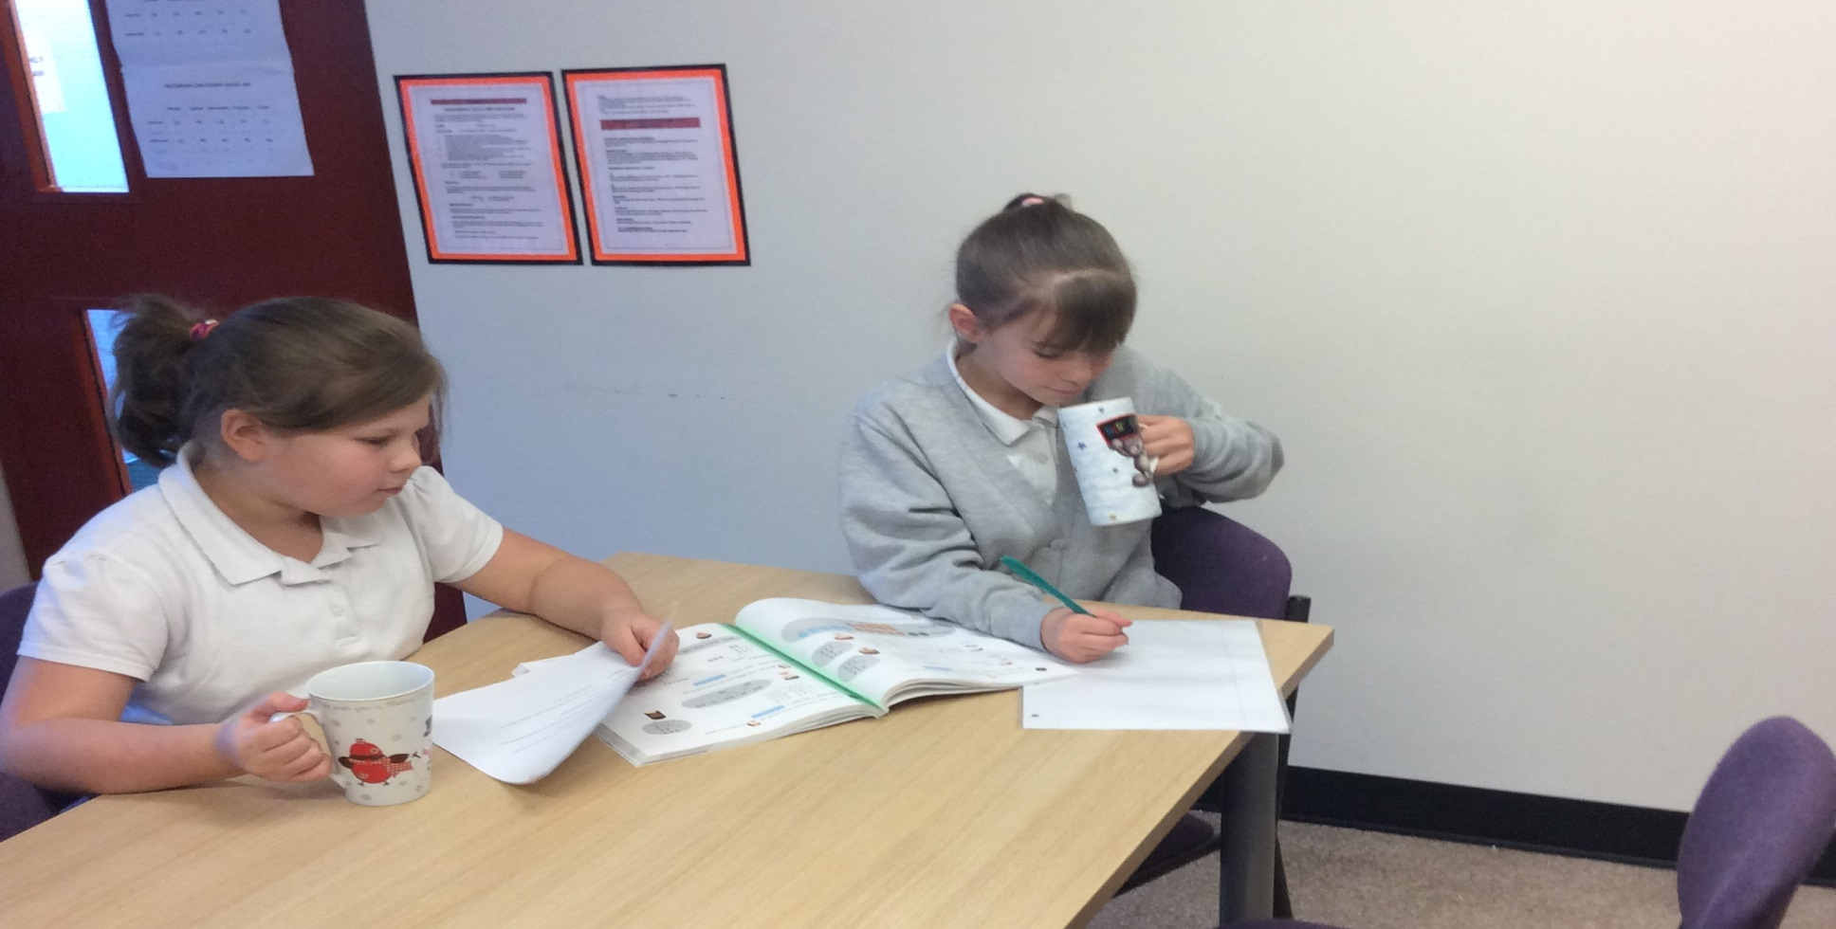
With planning of lessons
Cradled in arms,
The teachers began
To use all their charms.

Slide 12
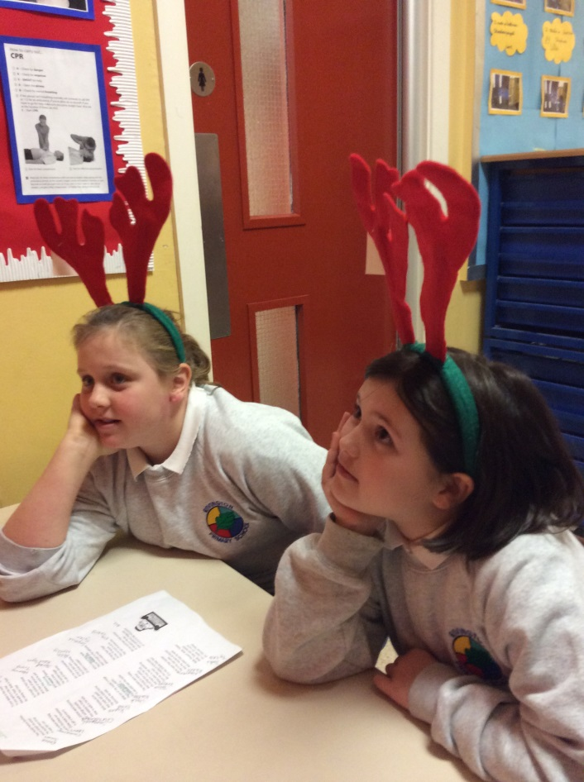
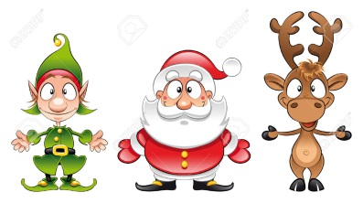
But the lessons presented
All fell on deaf ears.
The children were thinking
Of Santa’s reindeer!

Slide 13
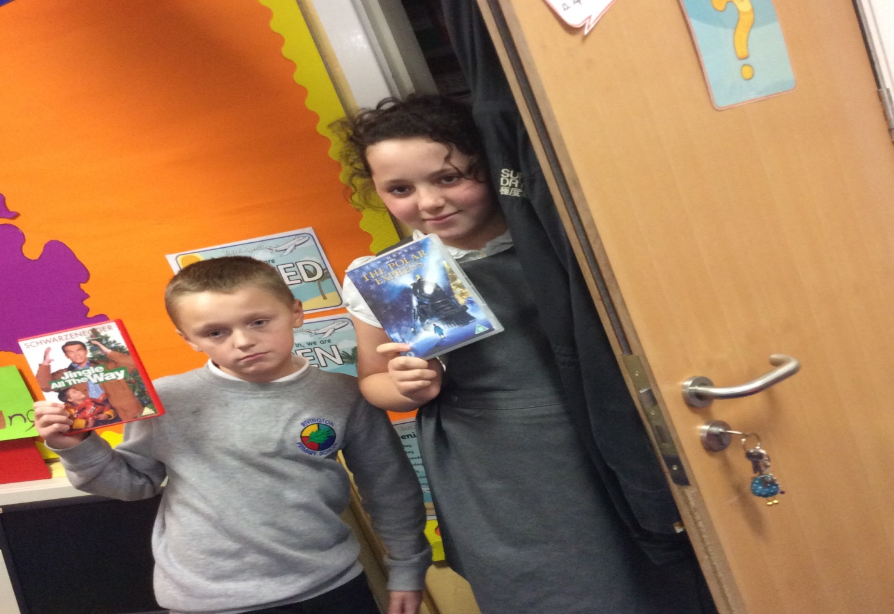
With a toss of their hands
They put planning aside,
Went straight to the cupboards
Where videos hide.

Slide 14
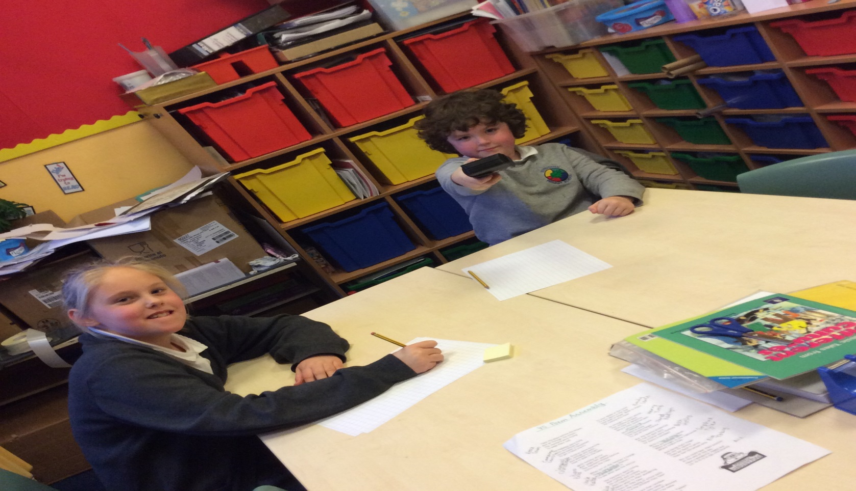
And laying their finger
On the TV remote
They sat back to write
Their last Christmas note.

Slide 15
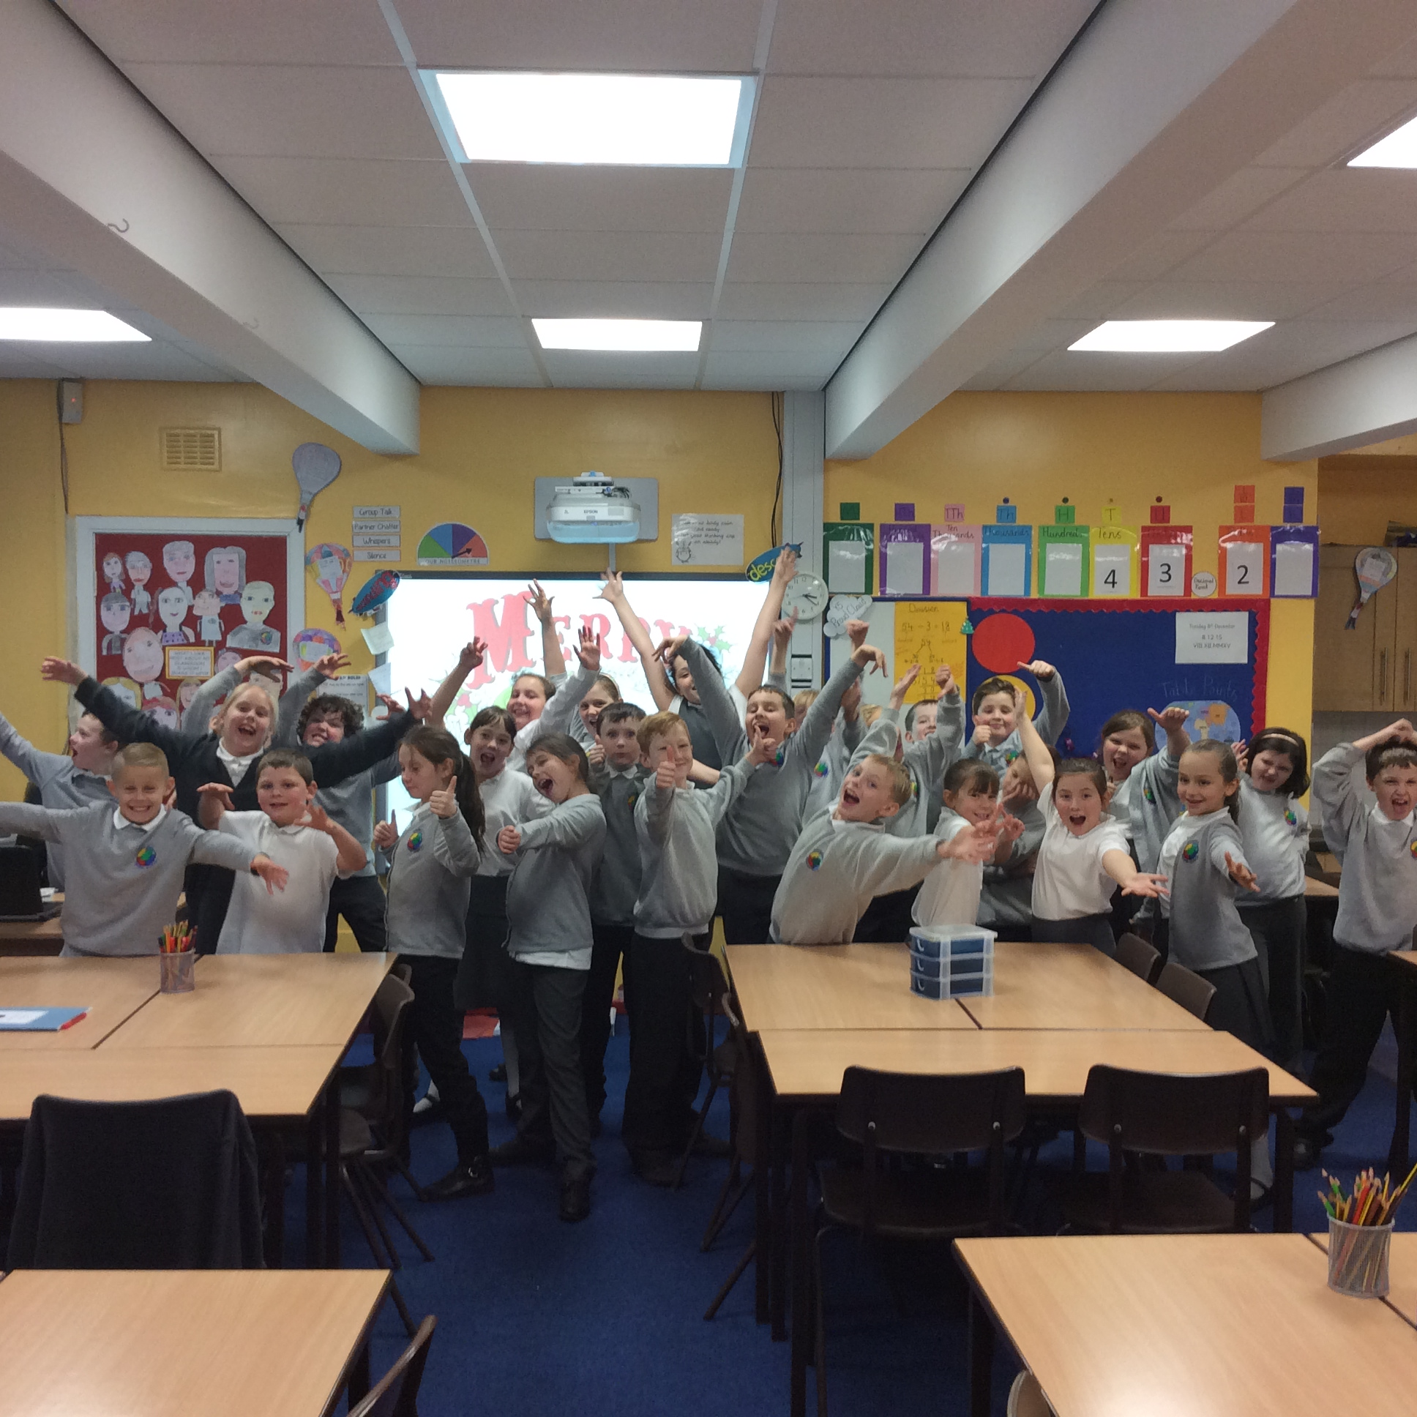
But you could hear them exclaim
At the end of the day –
Have a wonderful, happy and
LOOOOOOONG holiday!

Slide 16


