Slide 1

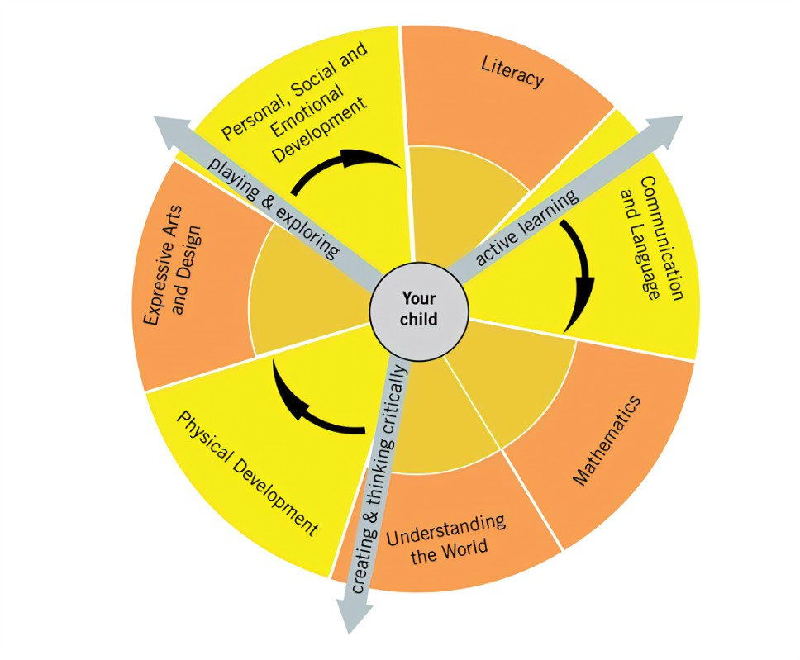


Rivington Primary School
Reception Long Term Plan
At Rivington Primary School, we are committed to providing a caring and stimulating environment in which every child is valued and can thrive.
Our philosophy is to nurture every child as an individual, recognising and valuing their unique qualities and abilities, in order to support their learning and exploration at this wonderful stage.
INTENT
The intent for our children is to feel safe, happy and eager to learn. At Rivington, we CARE.
COMMUNICATION – we strive for children to be able to communicate effectively and express themselves with confidence, sharing their thoughts, ideas and feelings with the knowledge that they will be listened to and understood.
ASPIRATION – developmentally appropriate and ambitious planning, responsive to individuals and group dynamics, and an approach which inspires and challenges children’s inquisitive minds is taken by all adults.
REFLECT – we reflect on our own practice as well as the children’s learning in order to offer the best opportunities and environment. We teach the children how to be skilful learners, developing independence, resilience, problem solving skills and how to collaborate.
EXPERIENCES – we aim for children to gain first-hand experiences to ignite their curiosity and embed their learning. We encourage children to independently access resources, develop their own play and ask for help, confident in the knowledge that they can co-construct their own learning environment and opportunities.

Slide 2







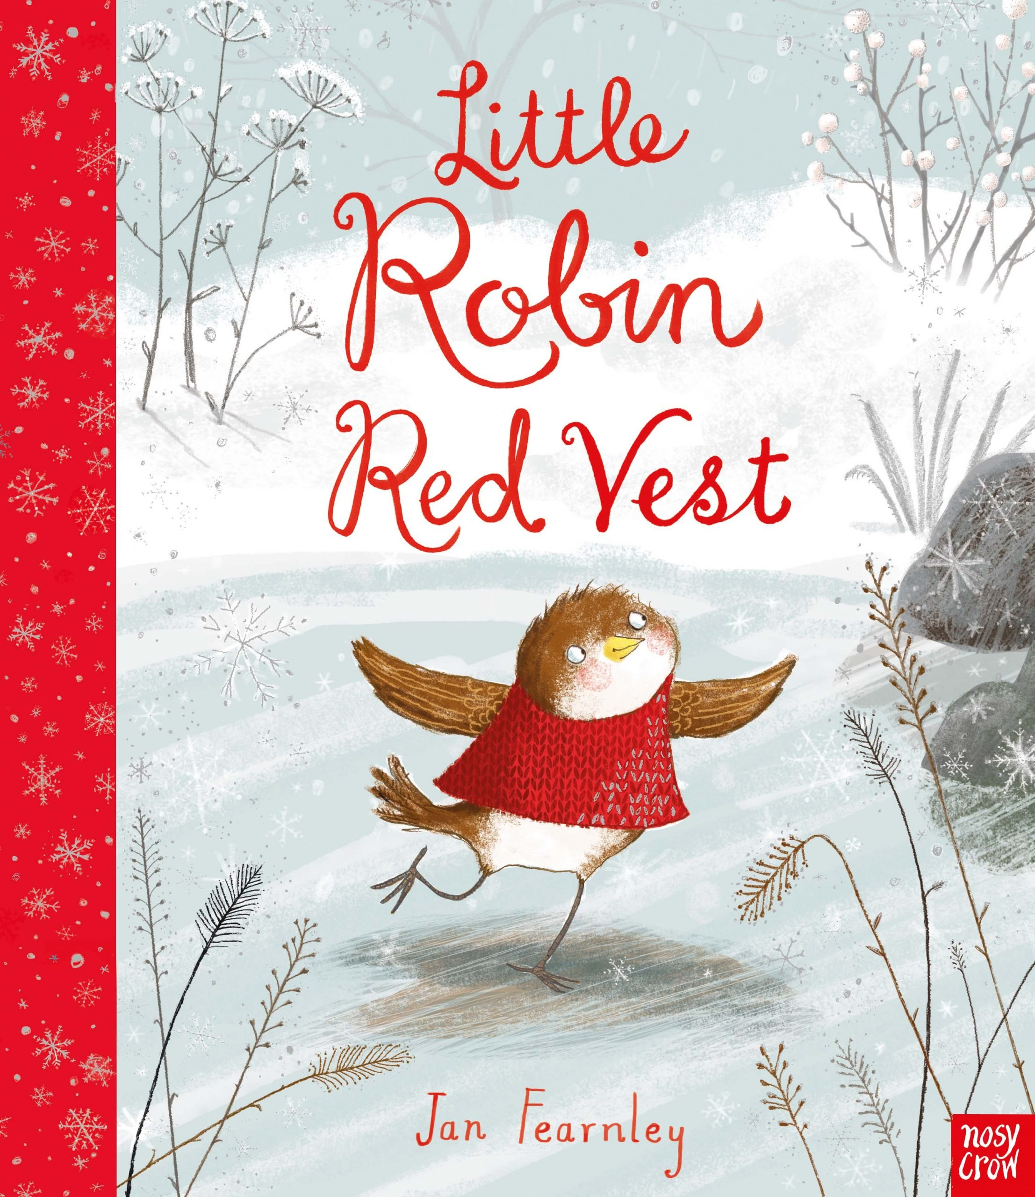





Overview
 | Autumn 1 | Autumn 2 | Spring 1 | Spring 2 | Summer 1 | Summer 2
General Themes Our plans are flexible to enable us to follow the interests of the children. | WHAT MAKES ME SPECIAL? Starting school All about me Families Emotions Diwali Autumn | HOW DO PEOPLE CELEBRATE? Bonfire night celebrations Harvest Hannukah The Nativity Christmas | WHO LIKES THE COLD? Chinese New Year Pancake day Weather/winter Cold countries Maps Arctic animals The ocean | LET’S EXPLORE! The great outdoors Plants & Flowers Space and stars Spring Planting Easter | ONCE UPON A TIME… Traditional tales Storytelling Life cycles Summer Poetry | WHAT’S MY TALENT? Holidays Journeys Comparing locations Local area Talents Performing Transition
High quality Texts
Songs/Poems *Poetry Basket | Chop Chop Falling Apples Leaves are Falling | Point Hat Five Little Pumpkins Breezy Weather | A Little House Pancakes Let’s Put On Our Mittens | Spring Wind Hungry Birdies Popcorn | I Have a Little Frog Sliced Bread Monkey Babies | Dance A Little Shell Thunderstorm
Key events & opportunities Parental involvement | Discovery time Diwali Day National Poetry Day Whole school assembly Stay and Learn Class Dojo | Bonfire/sparklers Campfire World nursery rhyme week Remembrance day Hannukah Christmas Walk to the post office Whole school assembly Nativity performance Class Dojo | Valentines day Chinese New Year National Storytelling week Pancake day Whole school assembly Stay and Learn Class Dojo | Living eggs Mother’s Day World Book Day Easter celebrations Whole school assembly Stay and Learn Class Dojo Church Visit | Father’s Day Caterpillars Contact a school overseas Whole school assembly Stay and Learn Class Dojo Sport’s Day | Talent show Walk to the park Acorn Farm Whole school assembly Class trip End of year assembly Class Dojo

Slide 3


Values and Learning Skills
 | Autumn 1 | Autumn 2 | Spring 1 | Spring 2 | Summer 1 | Summer 2
Overarching theme | What makes me special? | How do people celebrate? | Who likes the cold? | Let’s explore! | Once upon a time… | What’s my talent?
Characteristics of Effective Learning | Playing and exploring: - Children investigate and experience things, and ‘have a go’. Children who actively participate in their own play develop a larger store of information and experiences to draw on which positively supports their learning Active learning: - Children concentrate and keep on trying if they encounter difficulties. They are proud of their own achievements. For children to develop into self-regulating, lifelong learners they are required to take ownership, accept challenges and learn persistence. Creating and thinking critically: - Children develop their own ideas and make links between these ideas. They think flexibly and rationally, drawing on previous experiences which help them to solve problems and reach conclusions.
School Values | Respect | Give Thanks | Protect | Keep Peace | Respect | Give Thanks
British Values | Respect | Tolerance of others faiths and beliefs | Rule of Law | Democracy | Respect | Individual Liberty
CARE curriculum | COMMUNICATION – ASPIRATION – REFLECT – ENRICHING EXPERIENCES

Slide 4
Communication and Language
 | Autumn 1 | Autumn 2 | Spring 1 | Spring 2 | Summer 1 | Summer 2
Overarching theme | What makes me special? | How do people celebrate? | Who likes the cold? | Let’s explore! | Once upon a time… | What’s my talent?
Listening, attention and understanding Speaking *objectives are taught throughout CP across the year. | I am learning to: Concentrate until an activity is completed listen and respond to others’ talk. Answer why questions Initiate conversations. Join in with discussions Use new vocabulary Talk about simple feelings. Begin to use conjunctions. | I am learning to: Make sensible suggestions about what might happen next in a story Ask questions about the stories I have listened to Answer how questions with support. Talk about what I am thinking Give reasons Tell simple stories orally | I am learning to: Listen for longer periods of time Follow a story without visual clues Follow 3-part instructions. Talk about and explain my ideas Express my opinions Talk about a series of events Use conjunctions. | I am learning to: Make relevant comments about what I have heard Listen attentively in different situations Answer how questions clearly. Talk about my feelings, linking actions. Talk about a series of ideas. | I am learning to: Follow more complex instructions that have several ideas. Listen for longer sessions and make relevant comments to show that I have understood. Tell stories orally following a sequence. | I am learning to: Maintain conversations in a variety of situations. Talk about a series of events in sequence Be fluent and coherent when I talk to others Adapt my talk in response to the listener.
Statutory Framework for CL | The development of children’s spoken language underpins all seven areas of learning and development. Children’s back-and-forth interactions from an early age form the foundations for language and cognitive development. The number and quality of the conversations they have with adults and peers throughout the day in a language-rich environment is crucial. By commenting on what children are interested in or doing, and echoing back what they say with new vocabulary added, practitioners will build children's language effectively. Reading frequently to children, and engaging them actively in stories, non-fiction, rhymes and poems, and then providing them with extensive opportunities to use and embed new words in a range of contexts, will give children the opportunity to thrive. Through conversation, story-telling and role play, where children share their ideas with support and modelling from their teacher, and sensitive questioning that invites them to elaborate, children become comfortable using a rich range of vocabulary and language structures.
*WellComm interventions take place throughout the year.

Slide 5
Personal, Social and Emotional Development
 | Autumn 1 | Autumn 2 | Spring 1 | Spring 2 | Summer 1 | Summer 2
Overarching theme | What makes me special? | How do people celebrate? | Who likes the cold? | Let’s explore! | Once upon a time… | What’s my talent?
Managing Self Self-regulation Making relationships *objectives are taught throughout CP across the year. | I am learning to: Talk about my own feelings. Follow the rules Do some things without help Talk about what is right and wrong. Manage my own personal hygiene needs Dress and undress independently. Listen to what others say. | I am learning to: Talk about the feelings of others’ Begin to change my behaviour to suit the situation Tackle a challenge Talk about ways to be healthy through exercise. Resolve conflicts with support. Play cooperatively Share and take turns. | I am learning to: Talk about how my actions can affect others Accept changes in routine Attend to more than one thing at a time Try different ways to do things Play cooperatively with different groups. | I am learning to: talk about my own and others’ behaviour and how it can affect others. Be more independent Take risks Be more resilient Talk about why healthy food choices are important. Find ways to resolve conflicts independently. | I am learning to: Change my behaviour to suit the situation Reflect on my behaviour with support. Talk about the reasons for rules Talk about what is right and wrong in different contexts. Take account of and include others’ ideas. | I am learning to: Follow instructions involving several ideas. Link my behaviour to my own and others’ feelings. Follow rules independently. talk about healthy lifestyles. Think about how others’ feel when I make decisions and choices.
Statutory Framework for PSE | Children’s personal, social and emotional development (PSED) is crucial for children to lead healthy and happy lives, and is fundamental to their cognitive development. Underpinning their personal development are the important attachments that shape their social world. Strong, warm and supportive relationships with adults enable children to learn how to understand their own feelings and those of others. Children should be supported to manage emotions, develop a positive sense of self, set themselves simple goals, have confidence in their own abilities, to persist and wait for what they want and direct attention as necessary. Through adult modelling and guidance, they will learn how to look after their bodies, including healthy eating, and manage personal needs independently. Through supported interaction with other children, they learn how to make good friendships, co-operate and resolve conflicts peaceably. These attributes will provide a secure platform from which children can achieve at school and in later life.
*Jigsaw Scheme taught throughout the year in discrete sessions.

Slide 6
Physical Development
 | Autumn 1 | Autumn 2 | Spring 1 | Spring 2 | Summer 1 | Summer 2
Overarching theme | What makes me special? | How do people celebrate? | Who likes the cold? | Let’s explore! | Once upon a time… | What’s my talent?
Fine Motor/Gross Motor *objectives are taught throughout CP across the year. | I am learning to: Control and manipulate tools effectively Handle writing tools with dexterity. Move in a range of ways showing control and coordination. | I am learning to: Use anticlockwise movements in my writing. Retrace vertical lines. Develop spatial awareness to avoid obstacles. | I am learning to: Draw intersecting lines and shapes. Coordinate both sides of my body to do different things. Travel around, over, under and through obstacles. | I am learning to: Consistently use a tripod grip. Develop my hand-eye coordination. | I am learning to: Form all letters correctly. Throw, catch and kick with accuracy. | I am learning to: Form letters clearly so that they are legible to others. Develop my strength and stamina.
Statutory Framework for PD | Physical activity is vital in children’s all-round development, enabling them to pursue happy, healthy and active lives. Gross and fine motor experiences develop incrementally throughout early childhood, starting with sensory explorations and the development of a child’s strength, co-ordination and positional awareness through tummy time, crawling and play movement with both objects and adults. By creating games and providing opportunities for play both indoors and outdoors, adults can support children to develop their core strength, stability, balance, spatial awareness, co-ordination and agility. Gross motor skills provide the foundation for developing healthy bodies and social and emotional well-being. Fine motor control and precision helps with hand-eye co-ordination, which is later linked to early literacy. Repeated and varied opportunities to explore and play with small world activities, puzzles, arts and crafts and the practice of using small tools, with feedback and support from adults, allow children to develop proficiency, control and confidence.
*Get Set for PE Scheme taught throughout the year in discrete sessions.

Slide 7
Literacy
 | Autumn 1 | Autumn 2 | Spring 1 | Spring 2 | Summer 1 | Summer 2
Overarching theme | What makes me special? | How do people celebrate? | Who likes the cold? | Let’s explore! | Once upon a time… | What’s my talent?
Comprehension Word reading Writing *objectives are taught throughout CP across the year. | I am learning to: Listen to and enjoy a range of stories. Talk about stories using pictures. Predict the storyline. Hear and say initial sounds. Read some common exception words. Begin to link sounds to letters. Represent sounds with letter shapes. Write my own name in full. | I am learning to: Talk about the features of texts. Use new vocabulary from books. follow words with one-to-one correspondence. Begin to read words consistent with their phonic knowledge. Recognise rhyme and alliteration. Segment CVC words. Label initial sounds. Write sounds in the correct sequence. | I am learning to: Talk about how stories are structured. Describe the setting, characters and events. Read words consistent with their phonic knowledge. Locate and recall the title of a book. Match capital and lowercase letters. Form lower and uppercase letters. Write labels. Form letters clearly | I am learning to: Retell narratives in the correct sequence. Begin to repeat words or phrases to check it makes sense. Express preferences for books. Show awareness of rhyme and alliteration when reading. Reread appropriate books. Write captions. Write some irregular words. | I am learning to: Use and understand new vocabulary. Say how they feel about books, poems etc. Follow and read with 2/3 lines of text. Say the sound for each letter of the alphabet and at least 10 digraphs. Spell simple and multisyllabic words phonetically. Write irregular words. | I am learning to: Talk about what has been read to me, retell the stories and adapt narratives. Read aloud simple sentences consistent with phonic knowledge. Begin to take note of some punctuation. Write simple sentences.
Statutory Framework for Literacy | It is crucial for children to develop a life-long love of reading. Reading consists of two dimensions: language comprehension and word reading. Language comprehension (necessary for both reading and writing) starts from birth. It only develops when adults talk with children about the world around them and the books (stories and non-fiction) they read with them, and enjoy rhymes, poems and songs together. Skilled word reading, taught later, involves both the speedy working out of the pronunciation of unfamiliar printed words (decoding) and the speedy recognition of familiar printed words. Writing involves transcription (spelling and handwriting) and composition (articulating ideas and structuring them in speech, before writing).
*Read Write inc phonics taught daily. EY2P Literacy Scheme.

Slide 8
Mathematics
 | Autumn 1 | Autumn 2 | Spring 1 | Spring 2 | Summer 1 | Summer 2
Overarching theme | What makes me special? | How do people celebrate? | Who likes the cold? | Let’s explore! | Once upon a time… | What’s my talent?
Number Numerical patterns *objectives are taught throughout CP across the year. | I am learning to: Count actions or objects Count out objects from a larger group Match numeral to quantity 0-3 Read numerals. Count beyond 10. Compare amounts using mathematical language. Explore size, mass and capacity. Create patterns. | I am learning to: Estimate how many objects I can see. Identify smaller amounts within a larger amount. Count on and count back. Sequence numerals 0-5. Identify one more and one less. Compare size. Use positional language accurately. | I am learning to: Compare mass and capacity. Explore the composition of number 4 -7. Add two single digit numbers. Count two groups together to find the total. Find pairs. | I am learning to: Compare length and height. Explore 3D shapes. Explore the composition of 8-10. Spot patterns in numbers. Explore number bonds to 10. Represent patterns in numbers. | I am learning to: Match, rotate and manipulate shapes. Explore the composition and decomposition of shapes. Take away two single digit numbers. Use the right mathematical language when adding and taking away. | I am learning to: Recall number bonds. Recall double facts. Use number facts to solve mathematical problems.. Share a set of objects. Split a group in half. Identify odd and even numbers. Form numerals correctly.
Statutory Framework for Mathematics | Developing a strong grounding in number is essential so that all children develop the necessary building blocks to excel mathematically. Children should be able to count confidently, develop a deep understanding of the numbers to 10, the relationships between them and the patterns within those numbers. By providing frequent and varied opportunities to build and apply this understanding - such as using manipulatives, including small pebbles and tens frames for organising counting - children will develop a secure base of knowledge and vocabulary from which mastery of mathematics is built. In addition, it is important that the curriculum includes rich opportunities for children to develop their spatial reasoning skills across all areas of mathematics including shape, space and measures. It is important that children develop positive attitudes and interests in mathematics, look for patterns and relationships, spot connections, ‘have a go’, talk to adults and peers about what they notice and not be afraid to make mistakes.
*White Rose Maths scheme

Slide 9
Understanding the World
 | Autumn 1 | Autumn 2 | Spring 1 | Spring 2 | Summer 1 | Summer 2
Overarching theme | What makes me special? | How do people celebrate? | Who likes the cold? | Let’s explore! | Once upon a time… | What’s my talent?
History Geography Science RE *objectives are taught throughout CP across the year. | I am learning to: Talk about my own family and people special to me. Describe features of my own environment. Talk about what makes me special. Observe the natural world and draw their observations. Notice how some things are the same and some different. | I am learning to: Describe jobs that people do and why they are important. Use maps of my own environment. Talk about different ways that people celebrate. Talk about similarities and differences. Recognise seasonal changes. | I am learning to: Talk about how people lived in the past. Use maps and non-fiction texts to find out about other countries. Describe similarities and differences between environments . Explain the reasons for some traditions. Give reasons for he changes I notice e.g. melting. | I am learning to: Talk about the similarities and differences between things in the past and now. Describe and compare the seasons. Compare similarities and differences between different religions and cultures. Describe the features of plants and animals. | I am learning to: Talk about significant people and events in the past. Compare features of our environment to another environment. Talk about how seasons affect the natural world. | I am learning to: Sequence some significant historical events. Compare living in this country to living in another country. Talk about ways to look after the natural world.
Statutory Framework for Understanding the World | Understanding the world involves guiding children to make sense of their physical world and their community. The frequency and range of children’s personal experiences increases their knowledge and sense of the world around them – from visiting parks, libraries and museums to meeting important members of society such as police officers, nurses and firefighters. In addition, listening to a broad selection of stories, non-fiction, rhymes and poems will foster their understanding of our culturally, socially, technologically and ecologically diverse world. As well as building important knowledge, this extends their familiarity with words that support understanding across domains. Enriching and widening children’s vocabulary will support later reading comprehension.

Slide 10
Expressive Arts and Design
 | Autumn 1 | Autumn 2 | Spring 1 | Spring 2 | Summer 1 | Summer 2
Overarching theme | What makes me special? | How do people celebrate? | Who likes the cold? | Let’s explore! | Once upon a time… | What’s my talent?
Music Art Drama/dance DT *objectives are taught throughout CP across the year. | I am learning to: Mix colours to create shades and tones. Combine lines and shapes. Choose the most appropriate materials. Sing new songs and rhymes. Follow the melody of a song. | I am learning to: Draw detailed pictures. Use different textures. Manipulate materials in different ways. Compose and adapt songs. | I am learning to: Experiment with a range of tools Choose appropriate tools Mould and sculpt. Make a plan. Talk about my design. Compose and adapt music. | I am learning to: Explore and experiment with techniques Combine different media and materials. Join materials in different ways. Talk about how different music makes me feel. | I am learning to: Create 3D representations in different ways. Combine media in different ways. Adapt my plans. Express my opinions about different types of music. | I am learning to: Extend role play using props and materials. Describe and explain the processes I have used. Perform individually and in a group.
Artist | Richard Shilling - Nature |  | Barbara Hepworth – Sculpture |  | Peter Blake – Dazzle Ships
Statutory Framework for Expressive Arts and Design | The development of children’s artistic and cultural awareness supports their imagination and creativity. It is important that children have regular opportunities to engage with the arts, enabling them to explore and play with a wide range of media and materials. The quality and variety of what children see, hear and participate in is crucial for developing their understanding, self-expression, vocabulary and ability to communicate through the arts. The frequency, repetition and depth of their experiences are fundamental to their progress in interpreting and appreciating what they hear, respond to and observe. Give children an insight into new musical worlds. Invite musicians in to play music to children and talk about it. Encourage children to listen attentively to music. Discuss changes and patterns as a piece of music develops.

Slide 11
Early Learning Goals
End of Reception Assessment
Communication and Language | Personal, Social and Emotional Development | Physical Development | Literacy | Mathematics | Understanding the World | Expressive Arts and Design
ELG: Listening, Attention and Understanding Listen attentively and respond to what they hear with relevant questions, comments and actions when being read to and during whole class discussions and small group interactions Make comments about what they have heard and ask questions to clarify their understanding Hold conversation when engaged in back-and-forth exchanges with their teacher and peers ELG: Speaking Participate in small group, class and one-to-one discussions, offering their own ideas, using recently introduced vocabulary. Offer explanations for why things might happen, making use of recently introduced vocabulary from stories, non-fiction, rhymes and poems when appropriate. Express their ideas and feelings about their experiences using full sentences, including use of past, present and future tenses and making use of conjunctions, with modelling and support from their teacher. | ELG: Self-Regulation Show an understanding of their own feelings and those of others, and begin to regulate their behaviour accordingly. Set and work towards simple goals, being able to wait for what they want and control their immediate impulses when appropriate. Give focused attention to what the teacher says, responding appropriately even when engaged in activity, and show an ability to follow instructions involving several ideas or actions. ELG: Managing Self Be confident to try new activities and show independence, resilience and perseverance in the face of challenge. Explain the reasons for rules, know right from wrong and try to behave accordingly. Manage their own basic hygiene and personal needs, including dressing, going to the toilet and understanding the importance of healthy food choices. ELG: Building Relationships Work and play cooperatively and take turns with others. Form positive attachments to adults and friendships with peers;. Show sensitivity to their own and to others’ needs. | ELG: Gross Motor Skills Negotiate space and obstacles safely, with consideration for themselves and others. Demonstrate strength, balance and coordination when playing. Move energetically, such as running, jumping, dancing, hopping, skipping and climbing. ELG: Fine Motor Skills Hold a pencil effectively in preparation for fluent writing – using the tripod grip in almost all cases. Use a range of small tools, including scissors, paint brushes and cutlery. Begin to show accuracy and care when drawing. | ELG: Comprehension Demonstrate understanding of what has been read to them by retelling stories and narratives using their own words and recently introduced vocabulary. Anticipate – where appropriate – key events in stories. Use and understand recently introduced vocabulary during discussions about stories, non-fiction, rhymes and poems and during role-play. ELG: Word Reading Say a sound for each letter in the alphabet and at least 10 digraphs. Read words consistent with their phonic knowledge by sound-blending. Read aloud simple sentences and books that are consistent with their phonic knowledge, including some common exception words. ELG: Writing Write recognisable letters, most of which are correctly formed. Spell words by identifying sounds in them and representing the sounds with a letter or letters. Write simple phrases and sentences that can be read by others. | ELG: Number Have a deep understanding of number to 10, including the composition of each number; Subitise (recognise quantities without counting) up to 5; - Automatically recall (without reference to rhymes, counting or other aids) number bonds up to 5 (including subtraction facts) and some number bonds to 10, including double facts. ELG: Numerical Patterns Verbally count beyond 20, recognising the pattern of the counting system; - Compare quantities up to 10 in different contexts, recognising when one quantity is greater than, less than or the same as the other quantity. Explore and represent patterns within numbers up to 10, including evens and odds, double facts and how quantities can be distributed equally. | ELG: Past and Present Talk about the lives of the people around them and their roles in society. Know some similarities and differences between things in the past and now, drawing on their experiences and what has been read in class. Understand the past through settings, characters and events encountered in books read in class and storytelling. ELG: People, Culture and Communities Describe their immediate environment using knowledge from observation, discussion, stories, non-fiction texts and maps. Know some similarities and differences between different religious and cultural communities in this country, drawing on their experiences and what has been read in class. Explain some similarities and differences between life in this country and life in other countries, drawing on knowledge from stories, non-fiction texts and – when appropriate – maps. ELG: The Natural World Explore the natural world around them, making observations and drawing pictures of animals and plants. Know some similarities and differences between the natural world around them and contrasting environments, drawing on their experiences and what has been read in class. Understand some important processes and changes in the natural world around them, including the seasons and changing states of matter. | ELG: Creating with Materials Safely use and explore a variety of materials, tools and techniques, experimenting with colour, design, texture, form and function. Share their creations, explaining the process they have used; - Make use of props and materials when role playing characters in narratives and stories. ELG: Being Imaginative and Expressive Invent, adapt and recount narratives and stories with peers and their teacher. Sing a range of well-known nursery rhymes and songs; Perform songs, rhymes, poems and stories with others, and – when appropriate – try to move in time with music.

