Slide 1

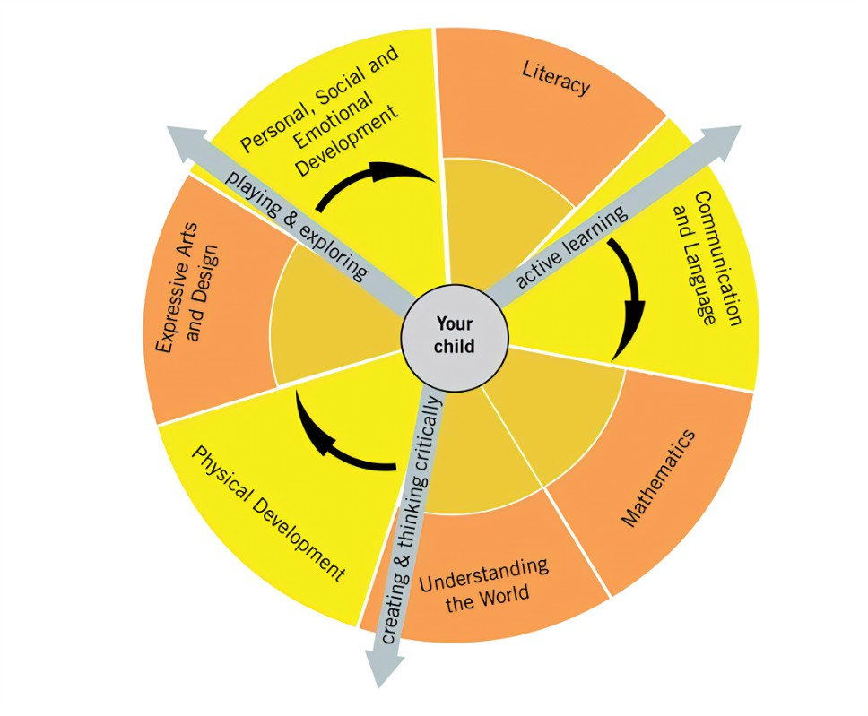


Rivington Primary School
Nursery Long Term Plan
At Rivington Primary School, we are committed to providing a caring and stimulating environment in which every child is valued and can thrive.
Our philosophy is to nurture every child as an individual, recognising and valuing their unique qualities and abilities, in order to support their learning and exploration at this wonderful stage.
INTENT
The intent for our children is to feel safe, happy and eager to learn. At Rivington, we CARE.
COMMUNICATION – we strive for children to be able to communicate effectively and express themselves with confidence, sharing their thoughts, ideas and feelings with the knowledge that they will be listened to and understood.
ASPIRATION – developmentally appropriate and ambitious planning, responsive to individuals and group dynamics, and an approach which inspires and challenges children’s inquisitive minds is taken by all adults.
REFLECT – we reflect on our own practice as well as the children’s learning in order to offer the best opportunities and environment. We teach the children how to be skilful learners, developing independence, resilience, problem solving skills and how to collaborate.
EXPERIENCES – we aim for children to gain first-hand experiences to ignite their curiosity and embed their learning. We encourage children to independently access resources, develop their own play and ask for help, confident in the knowledge that they can co-construct their own learning environment and opportunities.

Slide 2












Overview
 | Autumn 1 | Autumn 2 | Spring 1 | Spring 2 | Summer 1 | Summer 2
General Themes Our plans are flexible to enable us to follow the interests of the children. | WHAT MAKES ME SPECIAL? Starting school All about me Families Emotions Diwali | HOW DO PEOPLE CELEBRATE? Bonfire night celebrations Harvest Hannukah The Nativity Christmas | ONCE UPON A TIME Traditional tales Chinese New Year Pancake day Weather | HOW DOES MY GARDEN GROW? Real life superheroes The great outdoors Plants & Flowers Spring Planting Easter | LET’S EXPLORE! What lives in our pond? Life cycles Summer Maps | LET’S MAKE PLANS! Holidays Journeys Comparing locations Local area Transition
High quality Texts
Nursery Rhymes | Head, Shoulders, Knees and Toes If You’re Happy and You Know It Ten Little Fingers This Old Man Two Little Dicky Birds I’m a Little Teapot | Baa Baa Black Sheep Little Bo Peep Jack and Jill Hickory Dickory Dock Twinkle Twinkle It’s Raining, It’s Pouring | 1, 2, 3, 4, 5, Once I Caught a Fish Alive Doctor Foster Mulberry Bush Hey Diddle Diddle One, Two, Buckle My Shoe | Incy Wincy Spider Pat a Cake Georgie Porgie Ten in a Bed Five Little Men in a Flying Saucer Hot Cross Buns | Five Speckled Frogs Mary Had a Little Lamb Little Jack Horner Ten Green Bottles The Grand Ole Duke of York Five Little Ducks | Row, Row, Row Your Boat Little Boy Blue Sing a Song of Sixpence Ten Fat Sausages Mother Goose London Bridge
Key events & opportunities Parental involvement | Discovery time Welly walk Diwali Day National Poetry Day Stay and Learn Class Dojo Family Friday | Bonfire/sparklers Campfire World nursery rhyme week Remembrance day Hannukah Christmas Walk to the post office Nativity performance Class Dojo Family Friday | Valentines day Chinese New Year National Storytelling week Pancake day Stay and Learn Class Dojo Family Friday | Living eggs Mother’s Day World Book Day Easter celebrations Church visit Stay and Learn Class Dojo Family Friday | Father’s Day Caterpillars Pond visits Contact a school overseas Stay and Learn Class Dojo Family Friday | Camping outdoors Walk to the park Teddy bear’s picnic Acorn Farm Graduation Class Dojo Family Friday

Slide 3


Values and Learning Skills
 | Autumn 1 | Autumn 2 | Spring 1 | Spring 2 | Summer 1 | Summer 2
Overarching theme | What makes me special? | How do people celebrate? | Once upon a time… | How does my garden grow? | Let’s explore! | Let’s make plans!
Characteristics of Effective Learning | Playing and exploring: - Children investigate and experience things, and ‘have a go’. Children who actively participate in their own play develop a larger store of information and experiences to draw on which positively supports their learning Active learning: - Children concentrate and keep on trying if they encounter difficulties. They are proud of their own achievements. For children to develop into self-regulating, lifelong learners they are required to take ownership, accept challenges and learn persistence. Creating and thinking critically: - Children develop their own ideas and make links between these ideas. They think flexibly and rationally, drawing on previous experiences which help them to solve problems and reach conclusions.
School Values | Respect | Give Thanks | Keep Peace | Protect | Respect | Give Thanks
British Values | Respect | Tolerance of others faiths and beliefs | Rule of Law | Democracy | Respect | Individual Liberty
CARE curriculum | COMMUNICATION – ASPIRATION – REFLECT – ENRICHING EXPERIENCES

Slide 4
Communication and Language
 | Autumn 1 | Autumn 2 | Spring 1 | Spring 2 | Summer 1 | Summer 2
Overarching theme | What makes me special? | How do people celebrate? | Once upon a time… | How does my garden grow? | Let’s explore! | Let’s make plans!
Listening, attention and understanding Speaking *objectives are taught throughout CP across the year. | I am learning to: Listen with interest to a story Join in with rhymes Follow simple instructions. Talk in front of others Speak in simple sentences. | I am learning to: Listen to conversation Respond to stories and rhymes that I have heard Use pronouns in my talk Use new words in my talk. | I am learning to: Respond to conversations Remember some simple elements from a story Join in with a story Use describing words in my sentences Use time words in my talk. | I am learning to: Join in with conversation Take turns when I talk Answer questions Follow simple instructions that include prepositions. Recite songs and rhymes by heart Retell parts of a story. | I am learning to: Join in with repeated phrases Retell simple stories Talk about what is happening Predict what might happen next. | I am learning to: Respond to how and why questions. Talk about an event in the past Speak in full sentences Ask simple questions Describe actions and events.
Statutory Framework for CL | The development of children’s spoken language underpins all seven areas of learning and development. Children’s back-and-forth interactions from an early age form the foundations for language and cognitive development. The number and quality of the conversations they have with adults and peers throughout the day in a language-rich environment is crucial. By commenting on what children are interested in or doing, and echoing back what they say with new vocabulary added, practitioners will build children's language effectively. Reading frequently to children, and engaging them actively in stories, non-fiction, rhymes and poems, and then providing them with extensive opportunities to use and embed new words in a range of contexts, will give children the opportunity to thrive. Through conversation, story-telling and role play, where children share their ideas with support and modelling from their teacher, and sensitive questioning that invites them to elaborate, children become comfortable using a rich range of vocabulary and language structures.

Slide 5
Personal, Social and Emotional Development
 | Autumn 1 | Autumn 2 | Spring 1 | Spring 2 | Summer 1 | Summer 2
Overarching theme | What makes me special? | How do people celebrate? | Once upon a time… | How does my garden grow? | Let’s explore! | Let’s make plans!
Managing Self Self-regulation Making relationships *objectives are taught throughout CP across the year. | I am learning to: Join in with others during my play Talk to others who are playing near to me. Try new things with support Follow rules with support. Wash and dry my hands with support. That I have different emotions. Talk about myself and my family. | I am learning to: Choose who I play with To invite other children to play with me. Persevere with support Put on and take off some items of clothing with support. Talk about special times. | I am learning to: Respond appropriately to others in my play Talk to others in my play. Behave appropriately within boundaries. That my words and actions can affect others. Say how I feel with support. | I am learning to: Share and take turns with support. Be more independent in following the rules Persevere with challenges. To wait for my turn. Talk about bedtime routines. | I am learning to: Be aware of others’ needs and wishes. Put on and take off some items of clothing independently. Shift attention from one thing to another. Talk about how to be healthy through brushing my teeth. | I am learning to: Be a good friend. Recognise what is healthy and unhealthy. Follow a 2-part instruction. Help others. To compromise in play with support.
Statutory Framework for PSE | Children’s personal, social and emotional development (PSED) is crucial for children to lead healthy and happy lives, and is fundamental to their cognitive development. Underpinning their personal development are the important attachments that shape their social world. Strong, warm and supportive relationships with adults enable children to learn how to understand their own feelings and those of others. Children should be supported to manage emotions, develop a positive sense of self, set themselves simple goals, have confidence in their own abilities, to persist and wait for what they want and direct attention as necessary. Through adult modelling and guidance, they will learn how to look after their bodies, including healthy eating, and manage personal needs independently. Through supported interaction with other children, they learn how to make good friendships, co-operate and resolve conflicts peaceably. These attributes will provide a secure platform from which children can achieve at school and in later life.

Slide 6
Physical Development
 | Autumn 1 | Autumn 2 | Spring 1 | Spring 2 | Summer 1 | Summer 2
Overarching theme | What makes me special? | How do people celebrate? | Once upon a time… | How does my garden grow? | Let’s explore! | Let’s make plans!
Fine Motor/Gross Motor *objectives are taught throughout CP across the year. | I am learning to: Draw circles and lines Build my finger strength Use one handed tools Move in a range of ways Move around space safely Draw lines and circles using my whole arm. | I am learning to: Build my finger strength Draw simple representations of myself. Develop my core strength to balance Build my upper body strength. | I am learning to: Develop my wrist stability and strength Develop a pincer grip. Cross the midline Use both sides of my body to do the same thing at the same time. | I am learning to: Use one handed tools with increasing control Copy some letter shapes. Use both sides of my body to do the same thing alternately Kick a ball. | I am learning to: Hold writing tools using a tripod grip Copy letters in my name. Throw and catch a variety of objects of different weights and sizes. | I am learning to: Control writing tools using a tripod grip Form some letters from my name accurately. Move confidently in a range of ways.
Statutory Framework for PD | Physical activity is vital in children’s all-round development, enabling them to pursue happy, healthy and active lives. Gross and fine motor experiences develop incrementally throughout early childhood, starting with sensory explorations and the development of a child’s strength, co-ordination and positional awareness through tummy time, crawling and play movement with both objects and adults. By creating games and providing opportunities for play both indoors and outdoors, adults can support children to develop their core strength, stability, balance, spatial awareness, co-ordination and agility. Gross motor skills provide the foundation for developing healthy bodies and social and emotional well-being. Fine motor control and precision helps with hand-eye co-ordination, which is later linked to early literacy. Repeated and varied opportunities to explore and play with small world activities, puzzles, arts and crafts and the practice of using small tools, with feedback and support from adults, allow children to develop proficiency, control and confidence.

Slide 7
Literacy
 | Autumn 1 | Autumn 2 | Spring 1 | Spring 2 | Summer 1 | Summer 2
Overarching theme | What makes me special? | How do people celebrate? | Once upon a time… | How does my garden grow? | Let’s explore! | Let’s make plans!
Comprehension Word reading Writing *objectives are taught throughout CP across the year. | I am learning to: Listen and respond to stories, rhymes and poems. Discriminate between sounds Join in rhythmically with songs and rhymes Hold a book the right way up and turn the pages in order. Talk about the marks I make. | I am learning to: Talk about which stories I like. Act out parts of a familiar rhyme. Develop my auditory memory Copy a sequence of sounds. Keep in time to a beat. Use some shapes in my writing. | I am learning to: Listen and respond to stories, rhymes and poems Talk about key events in a story that I like. Recognise that some words sound the same. Know that a sentence has lots of words. | I am learning to: Act out parts of a familiar story or rhyme. Retell parts of a story. Recognsie that some words start with the same sound Identify syllables in a word. Copy letters in my name. | I am learning to: Talk about key events in stories. Say what has happened in a story. Make a set of rhyming words Recognise familiar words and signs. Write some letters in my name correctly. | I am learning to: Predict what might happen next in a story. Work from left to right and top to bottom. Write the initial sound for a word correctly with support.
Statutory Framework for Literacy | It is crucial for children to develop a life-long love of reading. Reading consists of two dimensions: language comprehension and word reading. Language comprehension (necessary for both reading and writing) starts from birth. It only develops when adults talk with children about the world around them and the books (stories and non-fiction) they read with them, and enjoy rhymes, poems and songs together. Skilled word reading, taught later, involves both the speedy working out of the pronunciation of unfamiliar printed words (decoding) and the speedy recognition of familiar printed words. Writing involves transcription (spelling and handwriting) and composition (articulating ideas and structuring them in speech, before writing).

Slide 8

Mathematics
 | Autumn 1 | Autumn 2 | Spring 1 | Spring 2 | Summer 1 | Summer 2
Overarching theme | What makes me special? | How do people celebrate? | Once upon a time… | How does my garden grow? | Let’s explore! | Let’s make plans!
Number Numerical patterns *objectives are taught throughout CP across the year. | I am learning to: Notice and talk about patterns Count forwards Recognise some numerals. Sort objects Compare objects by size, shape and quantity. Count with support Subitise with support Use shapes within play. | I am learning to: Copy a simple pattern Recognise when two amounts are the same Recognise numerals 0-3. Count a set of objects using 1:1 correspondence. Use number names in rhymes and songs Recognise similarities and difference between shapes. | I am learning to: Compare amounts Know that amounts will change if things are added or taken away Use number names to identify how many Subitise to 3 Know that when I am counting, the last number I say is always the total. Use shapes within play. | I am learning to: Continue a simple pattern recognise when there is more or fewer in a group recognise 0-5. Count an irreguar arrangement of objects. Find the correct shape to complete a picture or structure e.g. circle for a face. | I am learning to: Count backwards Recognise some numerals between 6-10. Subitise to 5 using fingers Recite numbers in order to 20. Name some 2D shapes. | I am learning to: Create a new pattern following an example Order 0-5. Recognise that an amount stays the same no matter how it is displayed.
Statutory Framework for Mathematics | Developing a strong grounding in number is essential so that all children develop the necessary building blocks to excel mathematically. Children should be able to count confidently, develop a deep understanding of the numbers to 10, the relationships between them and the patterns within those numbers. By providing frequent and varied opportunities to build and apply this understanding - such as using manipulatives, including small pebbles and tens frames for organising counting - children will develop a secure base of knowledge and vocabulary from which mastery of mathematics is built. In addition, it is important that the curriculum includes rich opportunities for children to develop their spatial reasoning skills across all areas of mathematics including shape, space and measures. It is important that children develop positive attitudes and interests in mathematics, look for patterns and relationships, spot connections, ‘have a go’, talk to adults and peers about what they notice and not be afraid to make mistakes.

Slide 9
Understanding the World
 | Autumn 1 | Autumn 2 | Spring 1 | Spring 2 | Summer 1 | Summer 2
Overarching theme | What makes me special? | How do people celebrate? | Once upon a time… | How does my garden grow? | Let’s explore! | Let’s make plans!
History Geography Science RE *objectives are taught throughout CP across the year. | I am learning to: talk about myself and people that I know. Notice features of my immediate environment Say what makes me special. Use my senses to explore natural materials. | I am learning to: Talk about the jobs of people that I know. Talk about the features of my immediate environment. Talk about how people celebrate different traditions. Use my senses to explore living things Notice things in the natural world. Talk about the changes I notice. | I am learning to: Talk about past and present events that happened in my own life. Use maps of my immediate environment. Use non-fiction books to find out about where we live. Talk about different religions and cultures. Talk about how things look, feel, sound and smell. | I am learning to: Talk about events in nursery that happened in the past. Use maps of my environment to identify landmarks. Recognise that some people celebrate particular festivals. Ask questions and make comments about the world around me. Talk about how things grow and change. | I am learning to: Talk about myself as a baby Compare myself as a baby to now Talk about past events in the lives of familiar people. Talk about the features of where we live. Talk about different religions and cultures. Take care of living things. | I am learning to: Talk about people that I come across and the jobs that they do Talk about how I have changed since I started nursery. Use maps and non-fiction books to talk about different countries. Talk about ways that people we know are different and unique. Talk about different weather and seasons.
Statutory Framework for Understanding the World | Understanding the world involves guiding children to make sense of their physical world and their community. The frequency and range of children’s personal experiences increases their knowledge and sense of the world around them – from visiting parks, libraries and museums to meeting important members of society such as police officers, nurses and firefighters. In addition, listening to a broad selection of stories, non-fiction, rhymes and poems will foster their understanding of our culturally, socially, technologically and ecologically diverse world. As well as building important knowledge, this extends their familiarity with words that support understanding across domains. Enriching and widening children’s vocabulary will support later reading comprehension.

Slide 10
Expressive Arts and Design
 | Autumn 1 | Autumn 2 | Spring 1 | Spring 2 | Summer 1 | Summer 2
Overarching theme | What makes me special? | How do people celebrate? | Once upon a time… | How does my garden grow? | Let’s explore! | Let’s make plans!
Music Art Drama/dance DT *objectives are taught throughout CP across the year. | I am learning to: Explore colour Explore texture Explore different media. Join materials. Experiment with sounds Listen carefully and respond to the sounds I hear. Engage in pretend play based on own experiences. Experiment with movements. | I am learning to: Use malleable materials Use a variety of tools Draw different lines. Say what I am doing. Talk about the sounds I hear Sing familiar songs and rhymes by heart. Engage in role play with others. Negotiate space within dance. | I am learning to: Experiment with different techniques Use lines to draw shapes Use simple shapes in my drawings. Make up my own simple songs and rhymes Experiment with different instruments. Act out familiar stories using props and character voices. | I am learning to: Draw a person with some features Represent my ideas using 3D materials. Talk about my ideas. Keep in time with music. Develop narratives in my imaginary play. Balance and cross the midline within dance. Copy movements and move to music. | I am learning to: Talk about what I am doing in my art Explore colour mixing. Talk about my plans when constructing. Tap out a rhythm I have heard. Engage in imaginary play within a group. Copy sequences of movement within dance. | I am learning to: Make and use props when pretending Draw with more detail. Solve problems Find different ways of doing things. Share my music making with others. Negotiate roles within imaginary play and role play with friends.
Statutory Framework for Expressive Arts and Design | The development of children’s artistic and cultural awareness supports their imagination and creativity. It is important that children have regular opportunities to engage with the arts, enabling them to explore and play with a wide range of media and materials. The quality and variety of what children see, hear and participate in is crucial for developing their understanding, self-expression, vocabulary and ability to communicate through the arts. The frequency, repetition and depth of their experiences are fundamental to their progress in interpreting and appreciating what they hear, respond to and observe. Give children an insight into new musical worlds. Invite musicians in to play music to children and talk about it. Encourage children to listen attentively to music. Discuss changes and patterns as a piece of music develops.

