Slide 1
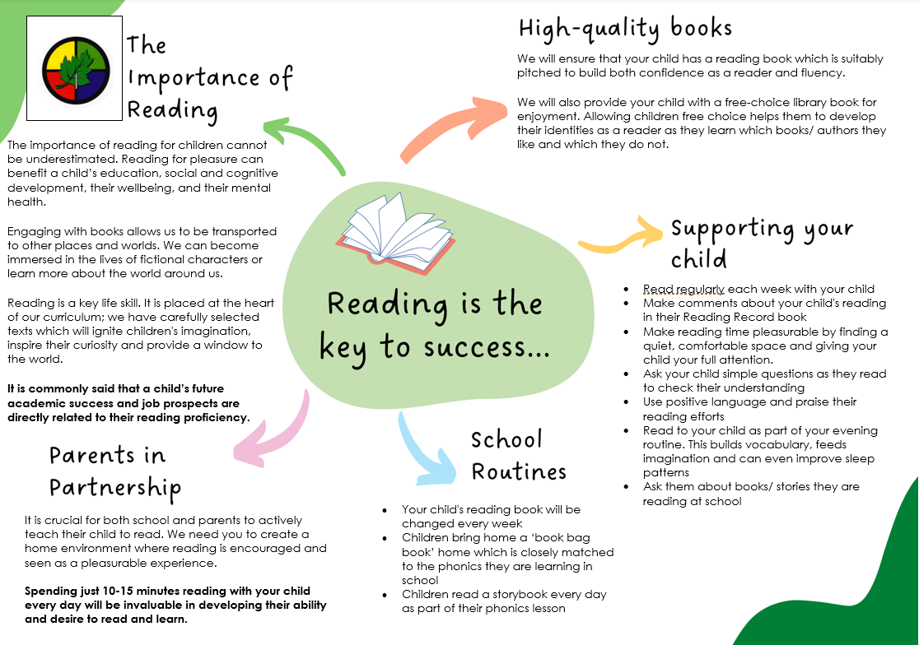


Slide 2


Your child is learning to read with
Read Write Inc. Phonics, a very popular and successful literacy programme.
Your child will learn to read in a very simple way. He or she will learn to:
Read letters by their ‘sounds’
Blend these sounds into words
Read the words in a story.

Slide 3
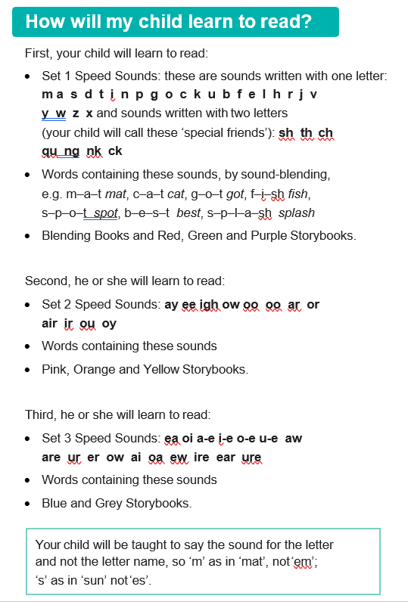
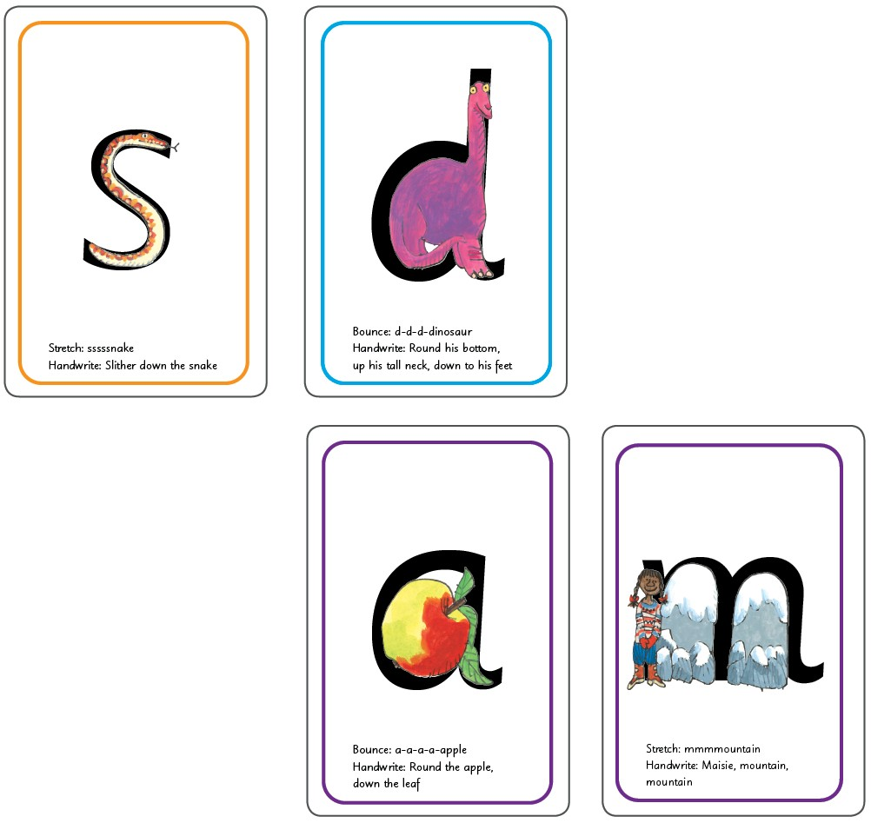
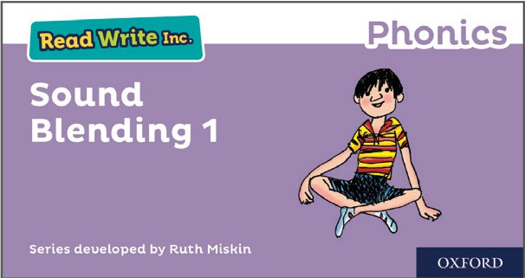


Slide 4
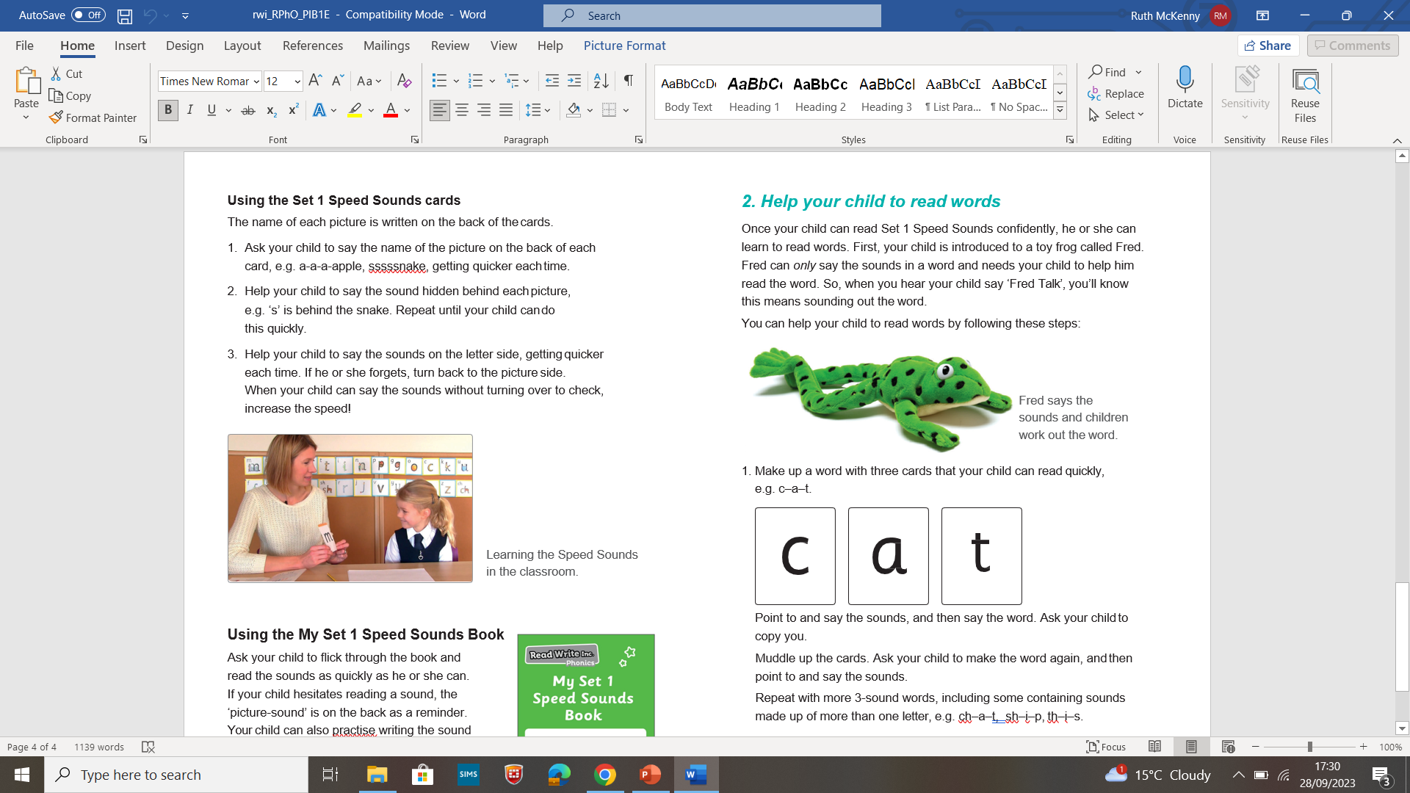
https://www.ruthmiskin.com/parents/

Slide 5
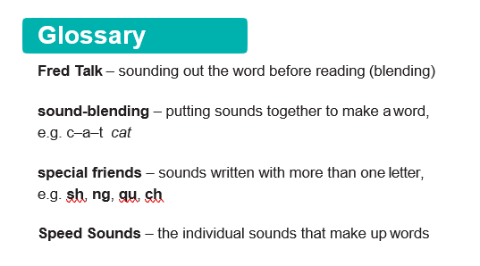

Slide 6
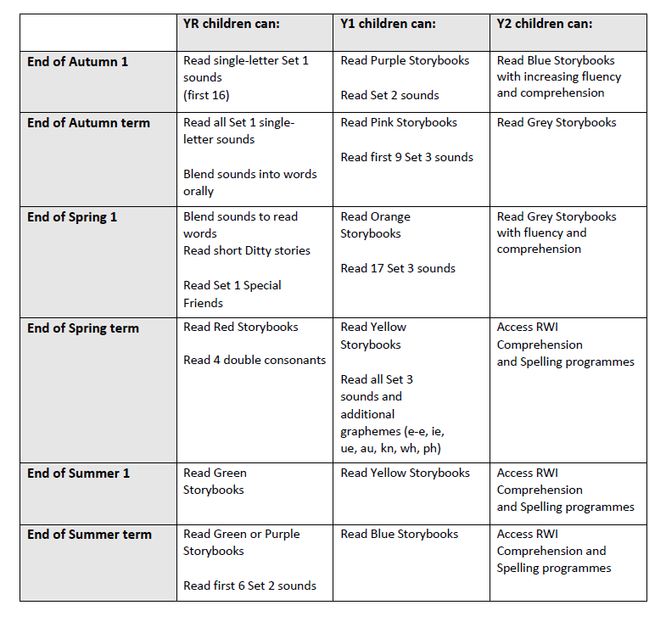
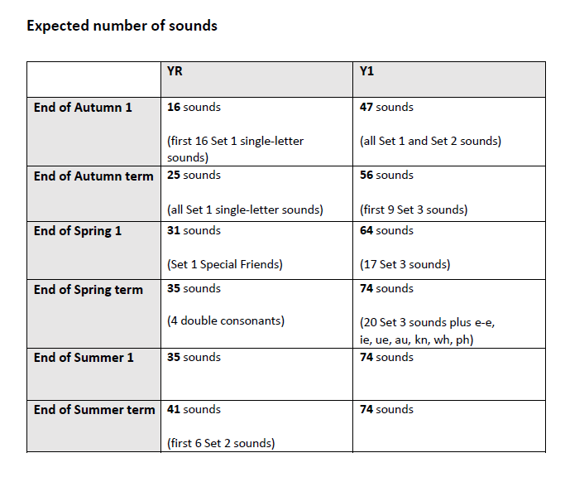

Slide 7
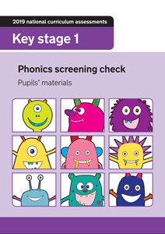
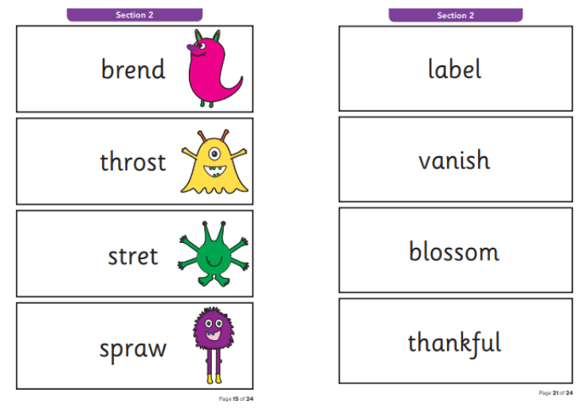

Slide 8
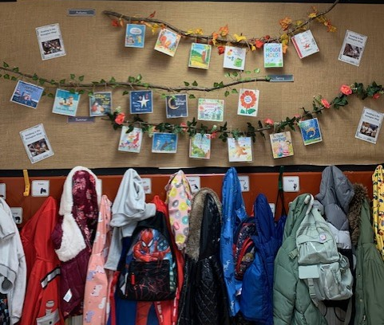
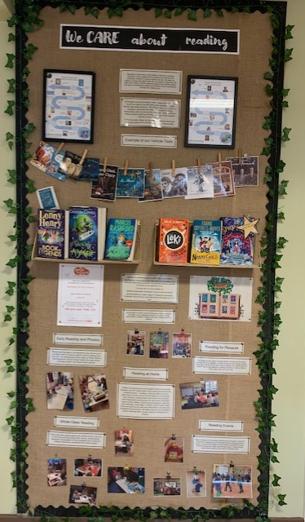

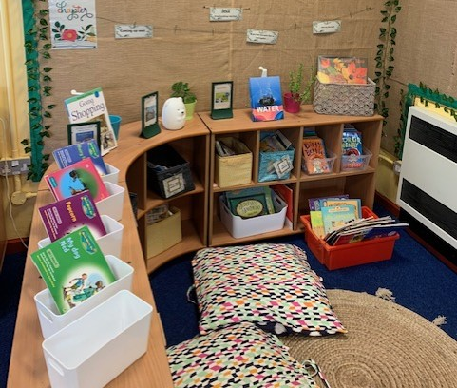
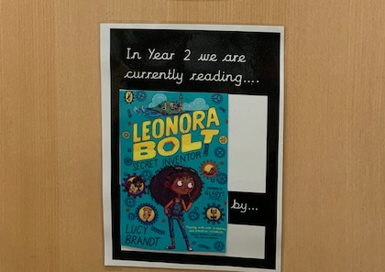

Slide 9
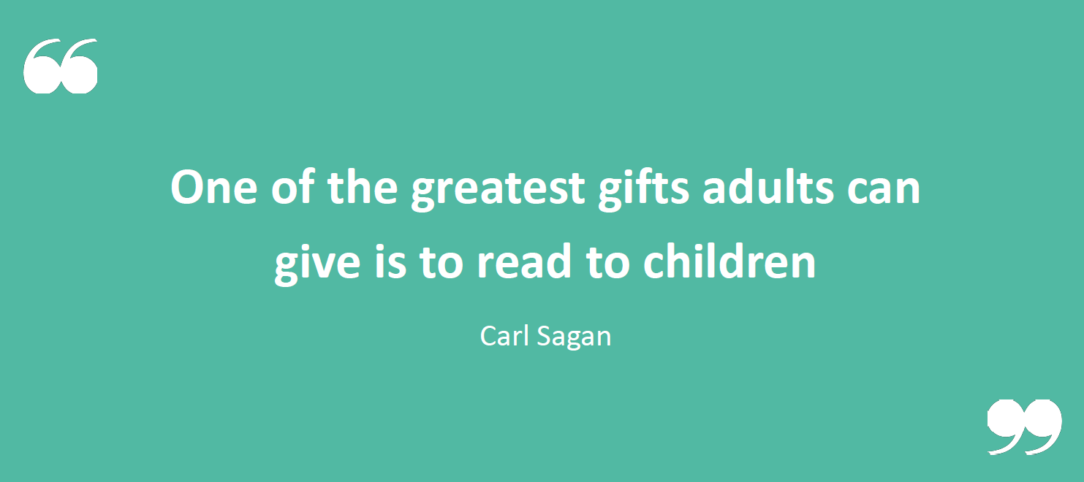

Slide 10
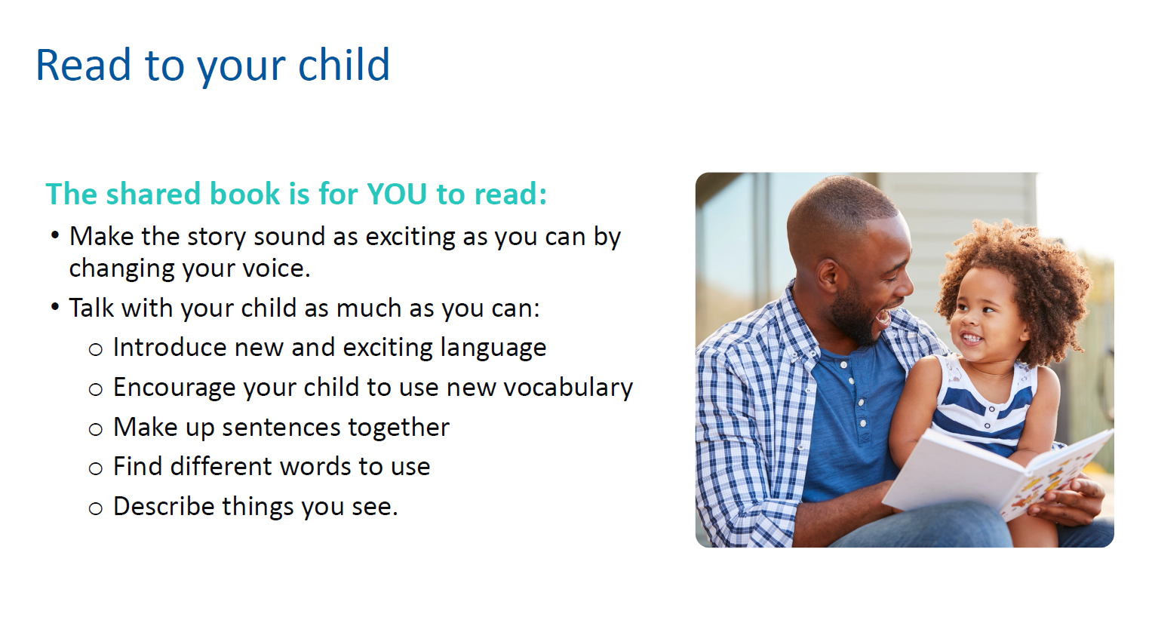

Slide 11
Strategies to help reluctant readers
Read the book to them – they are getting the valuable story language.
Share reading – take turns to read a page or as you read stop at a certain point and ask your child to read the next bit.
Reading can be comics, cereal boxes, signs, recipes, instructions for games.
Find out what they like to read and visit the library.
My child is a great reader. Can I still help them?
Use questioning to develop their comprehension.
Check that they understand the vocabulary that they are reading.
Look for different types of words like adjectives, verbs, adverbs.

Slide 12


Slide 13
