Slide 1

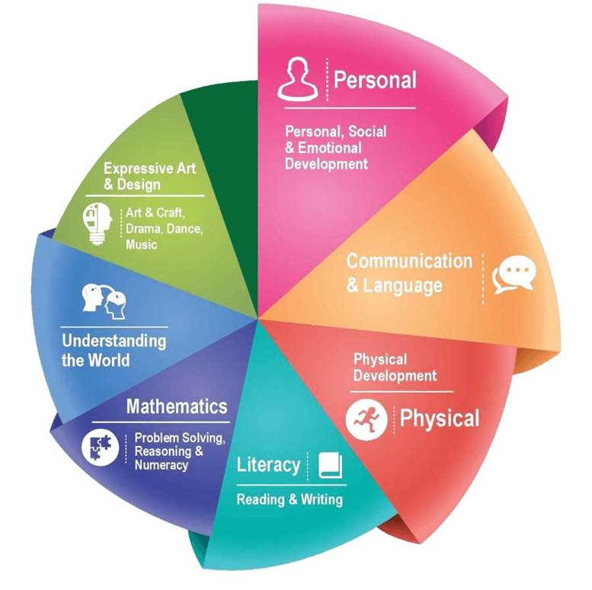
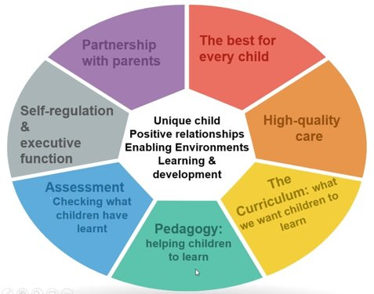
Rivington Primary School
Reception Long Term Plan
At Rivington Primary School, we are committed to providing a caring and stimulating environment in which every child is valued and can thrive.
Our philosophy is to nurture every child as an individual, recognising and valuing their unique qualities and abilities, in order to support their learning and exploration at this wonderful stage.
INTENT
The intent for our children is to feel safe, happy and eager to learn.
COMMUNICATION – we strive for children to be able to communicate effectively and express themselves with confidence, sharing their thoughts, ideas and feelings with the knowledge that they will be listened to and understood.
ASPIRATION – developmentally appropriate and ambitious planning, responsive to individuals and group dynamics, and an approach which inspires and challenges children’s inquisitive minds is taken by all adults.
REFLECT – we reflect on our own practice, as well as the children’s learning, in order to offer the best opportunities and environment. We teach the children how to be skilful learners, developing independence, resilience, problem solving skills and how to collaborate.
EXPERIENCES – we aim for children to gain first-hand experiences to ignite their curiosity and embed their learning. We encourage children to independently access resources, develop their own play and ask for help, confident in the knowledge that they can co-construct their own learning environment and opportunities.

Slide 2


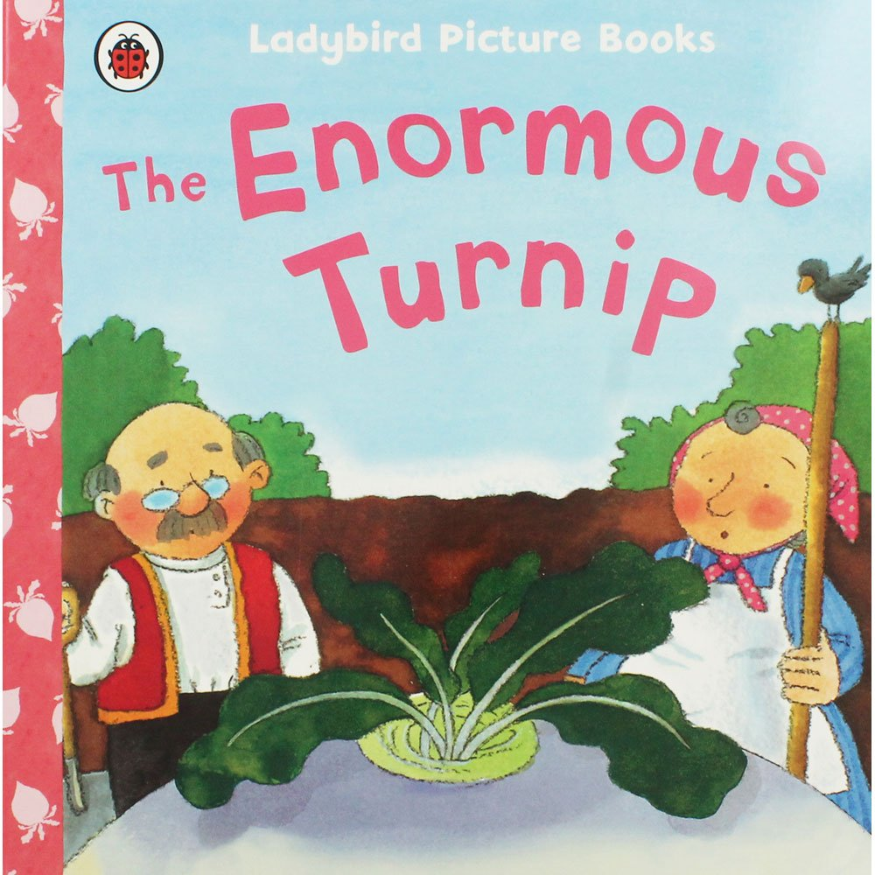
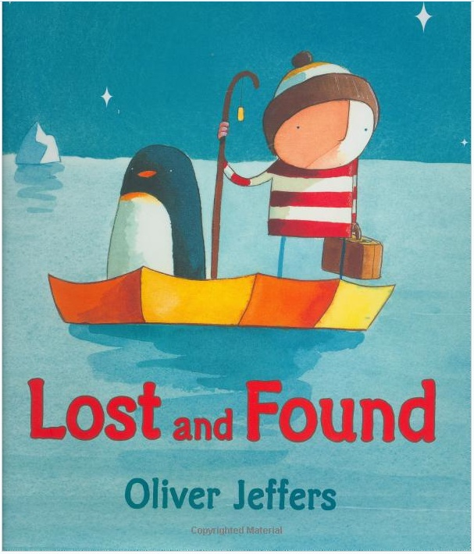











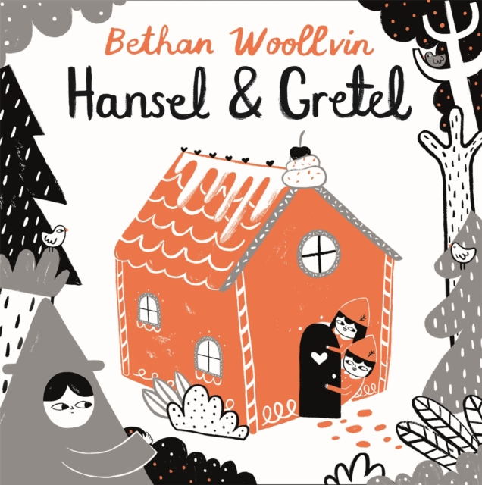
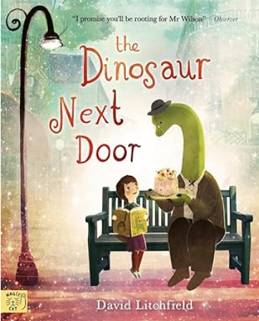

Overview
 | Autumn 1 | Autumn 2 | Spring 1 | Spring 2 | Summer 1 | Summer 2
General Themes Our plans are flexible to enable us to follow the interests of the children. | WHAT MAKES ME SPECIAL? Starting school All about me Families Emotions Diwali Autumn | HOW DO PEOPLE CELEBRATE? Bonfire night celebrations Harvest Hannukah The Nativity Christmas | WHO LIKES THE COLD? Lunar New Year Pancake day Winter Cold countries Maps Arctic animals | LET’S EXPLORE! Plants & Flowers Space and stars Spring Planting Easter Birdwatch Week | ONCE UPON A TIME… Traditional tales Storytelling Life cycles Summer | WHAT’S MY TALENT? Holidays Comparing locations Local area Dinosaurs Talents Transition
High quality Texts
Non-Fiction | All are Welcome | Festivals | One day on our Blue Planet | Little People Big Dreams Mae Jemison | The Big Book of Minibeasts | Lifesize Dinosaurs
Songs/Poems *Poetry Basket | Chop Chop Leaves are Falling | Five Little Pumpkins Breezy Weather | A Little House Pancakes | Spring Wind Hungry Birdies | I Have a Little Frog Monkey Babies | Dance A Little Shell
Opportunities and Parental involvement | Diwali National Poetry Day Stay and Learn Class Dojo | Bonfire/sparklers World nursery rhyme week Remembrance day Hannukah Christmas Nativity performance Class Dojo | Valentines day Lunar New Year National Storytelling week Pancake day Whole school assembly Phonics Stay and Learn Class Dojo | Eid Mother’s Day World Book Day Easter celebrations Class Dojo | Father’s Day Caterpillars Class Dojo Sport’s Day | Talent show Walk to the park Class trip Class Dojo
British Values | Respect | Tolerance of other faiths and beliefs | Rule of Law | Democracy | Respect | Individual Liberty

Slide 3
Communication and Language
 | Autumn 1 | Autumn 2 | Spring 1 | Spring 2 | Summer 1 | Summer 2
Listening, attention and understanding Speaking | Begins to show the physical attributes of a good listener (sit, look, listen, simple comprehension and memory). Begins to show physical attributes of a good speaker, e.g face the person they are communicating with etc. | Demonstrates good listening through increased interaction. Starts to interact with more confidence. | Shows an understanding of a broader vocabulary. Starts to use more appropriateness, structure and vocabulary. | Initiates interactions and shows an understanding of more-complex questions. Uses more complex vocabulary. | Begins to express own opinions and justify them. Begins to articulate their own thought and ideas. Uses talk for a range of purposes. Performs a range of rhymes, poems and songs off-by-heart (from memory). | Listens attentively and responds to what they hear with relevant questions, comments and actions when being read to and during whole-class discussions and small group interaction. Holds conversation when engaged in back-and-forth exchanges with their teacher and peers. Make comments about what they have heard and ask questions to clarify their understanding. Participates in small group, class and one-to-one discussions, offering their own ideas, using recently introduced vocabulary. Offers explanations for why things might happen, making use of recently introduced vocabulary from stories, non-fiction, rhymes and poems when appropriate. Expresses their ideas and feeling about their experiences using full sentences including use of past, present and future tenses and making use of conjunctions, with modelling and support from their teacher.
Statutory Framework for CL | The development of children’s spoken language underpins all seven areas of learning and development. Children’s back-and-forth interactions from an early age form the foundations for language and cognitive development. The number and quality of the conversations they have with adults and peers throughout the day in a language-rich environment is crucial. By commenting on what children are interested in or doing, and echoing back what they say with new vocabulary added, practitioners will build children's language effectively. Reading frequently to children, and engaging them actively in stories, non-fiction, rhymes and poems, and then providing them with extensive opportunities to use and embed new words in a range of contexts, will give children the opportunity to thrive. Through conversation, storytelling and role play, where children share their ideas with support and modelling from their teacher, and sensitive questioning that invites them to elaborate, children become comfortable using a rich range of vocabulary and language structures.
*WellComm interventions take place throughout the year.

Slide 4
Personal, Social and Emotional Development
 | Autumn 1 | Autumn 2 | Spring 1 | Spring 2 | Summer 1 | Summer 2
Managing Self Self-regulation Making relationships | Begins to develop confidence and cooperation. Begins to develop confidence with children and sustained interest in play. Manages coat and toilet with help, and cutlery. Shows friendly behaviour, contributing to increasingly positive play and relationships. Beginning to respond well to adults. | Increasing ability to share, recognises emotions of self and shows good manners. Builds own confidence with adults. Responds increasingly well to positive and negative experiences. Manages jumper and toilet independently. Initiates play. Follows instructions. | Beginning to find ways to resolve conflicts. Cooperates increasingly with routines. Develops confidence in new situations. Understands classroom expectations. Can identify when they require support or help. Can start to play in a group more effectively. | Starts to consider the feelings of others. Begins to develop a positive self-image. Increased understanding of behaviour expectations and why the expectations exist. Increasingly able to share, take turns and respond positively to other children. | Begins to understand how others might be feeling, to show empathy. Increased confidence and resilience and this can include supporting peers. Starts to understand the needs of other children and their own feelings. | Confidently tries new activities and shows independence, resilience and perseverance in the face of challenge. Knows right from wrong and tries to behave accordingly and explains reasons for rules. Shows an understanding of their own feelings and those of others, and begins to regulate their behaviour accordingly. Sets and works towards simple goals, being able to wait for what they want and control their immediate impulses where appropriate. Gives focussed attention to what the teacher says, responding appropriately even when engaged in activity, and shows an ability to follow instructions involving several ideas or actions. Manages their own basic hygiene and personal needs, including dressing, going to the toilet and understands the importance of healthy food choices. Works and plays cooperatively and takes turns with others.
Statutory Framework for PSE | Children’s personal, social and emotional development (PSED) is crucial for children to lead healthy and happy lives and is fundamental to their cognitive development. Underpinning their personal development are the important attachments that shape their social world. Strong, warm and supportive relationships with adults enable children to learn how to understand their own feelings and those of others. Children should be supported to manage emotions, develop a positive sense of self, set themselves simple goals, have confidence in their own abilities, to persist and wait for what they want and direct attention as necessary. Through adult modelling and guidance, they will learn how to look after their bodies, including healthy eating, and manage personal needs independently. Through supported interaction with other children, they learn how to make good friendships, co-operate and resolve conflicts peaceably. These attributes will provide a secure platform from which children can achieve at school and in later life.
*Jigsaw Scheme taught throughout the year in discrete sessions.

Slide 5
Physical Development
 | Autumn 1 | Autumn 2 | Spring 1 | Spring 2 | Summer 1 | Summer 2
Fine Motor/Gross Motor | Moves in a variety of ways for example, skipping, slithering, shuffling. Shows some hand eye coordination with larger objects. Starts to develop balance by safely using equipment in the playground. Shows some core strength by standing in one place. Shows an increasing awareness of what their own body can do. Engages with physical play. Gives meaning to marks they have made. Uses large paintbrush. Develops hand and wrist flexibility. Begins to make marks and shapes using simple equipment. | Negotiates obstacles when running in a large space. Improved hand-eye coordination. Can hop confidently. Becomes increasingly aware of the space around them and what they can do in the space. Shows further control, for example, drawings include squares, rectangles and circles, crosses and letters. Uses/hold scissors correctly or uses a knife and fork with support/ modelled by an adult. Uses medium brushes. Uses a wider range of equipment to make more refined shapes and marks, models and construction. | Travels skilfully and safely on and around, for example, on the climbing frame. Shows increasing control, for example, can hold a small ball on a spoon. Balances when using climbing equipment. Refines the way they move in the space around them. Majority of letters are recognisable, and the many are formed correctly. Tripod grasp used. Adds more detail to shapes. | Moves in a wide range of ways, for example, rolls, crawls, skips, hops, jumps, climbs. Can skilfully throw/kick a large ball. Sits comfortably on the carpet or on a chair and so can concentrate. Better control means that the majority of letters are recognisable and the majority formed correctly. Shows good dexterity as tripod grip used and with good control. Can use glue sticks and twist the end when needed. Shows increased control. | Replicates and makes up simple dances. Shows good balance and control in most aspects of play. Cuts around circles and other shapes with control. Holds a smaller paintbrush correctly. Letters are formed correctly and writing is more fluid. Showing more control | Negotiates space and obstacles safely, with consideration for themselves and others, demonstrates strength, balance and coordination when playing, more energetically, such as running, jumping, dancing, hopping, skipping and climbing. Hold a pencil effectively in preparation for fluent writing (using the tripod grip in almost all cases). Uses a wide range of small tools, including scissors, paintbrushes and cutlery. Begins to show accuracy and care when drawing.
Statutory Framework for PD | Physical activity is vital in children’s all-round development, enabling them to pursue happy, healthy and active lives11. Gross and fine motor experiences develop incrementally throughout early childhood, starting with sensory explorations and the development of a child’s strength, co-ordination and positional awareness through tummy time, crawling and play movement with both objects and adults. By creating games and providing opportunities for play both indoors and outdoors, adults can support children to develop their core strength, stability, balance, spatial awareness, co-ordination and agility. Gross motor skills provide the foundation for developing healthy bodies and social and emotional well-being. Fine motor control and precision helps with hand-eye co-ordination, which is later linked to early literacy. Repeated and varied opportunities to explore and play with small world activities, puzzles, arts and crafts and the practice of using small tools, with feedback and support from adults, allow children to develop proficiency, control and confidence.
*Get Set for PE Scheme taught throughout the year in discrete sessions. LetterJoin scheme is taught in Reception.

Slide 6
Literacy
 | Autumn 1 | Autumn 2 | Spring 1 | Spring 2 | Summer 1 | Summer 2
Comprehension Word reading Writing | Shows an interest in reading often choosing a book to look at themselves or with friends. Orally segment and blend words. Beginning to recognise some individual letters by saying the sounds for them. Draws their own large-scale lines and circles (clockwise).Uses tools for mark marking with increasing control. Uses threading equipment with increasing control and confidence. Uses Five finger grasp. Identifies sounds in own name and other familiar words. Begins to write some individual letters by saying the sounds for them. Children have the confidence to mark make using their physical skills to increase control over tools and equipment. They mark make as part of their play. | Listens to a story and can give simple details about the story. Starts to use some of the events in their own play. Recognise all 26 alphabet letters by saying the sounds for them. Blends sounds together to read VC or CVC words containing individual graphemes. Tracks letters in word reading. Ladder Letters l, i, t, u, y, and j are correctly formed. Has dominant hand for writing. Uses pincers and tweezers with increasing control and confidence. Can copy shapes, letters and numbers. Writes words containing the graphemes known. Children mark make consistently as part of their play and can talk about the meaning of their marks. | Can answer questions about the content of a book and shows an interest in reading by themselves. Fluently reads CVC words and captions. Tracks words in sentence reading. One-Armed Robot Letters r, n, m, k, b and p are correctly formed. Majority of letters are recognisable. Uses Tripod grasp. Curly caterpillar letters c, o, a,d,e,g,q,s, and are correctly formed. Knows grapheme/phoneme for the digraphs 'sh', 'ch', 'th', 'ng'. Writes captions containing the graphemes known. Might need support to retain sentence. E.g., the cat sat on the mat. Sentence structure starts to be evident. Some phonic awareness is evident. Children are good at oral rehearsal. | Shows a preference for a book, story type, genre, author. Chooses to read to friends. Likes to join in with reading in class. Begins to read words and sentences containing digraphs. Reads words with initial two-letter consonant blends, e.g., bl, br, cl, cr, etc. Reads and identifies: Zig-Zag Letters v, w, x, and z are correctly formed. All letters are recognisable, and the majority are formed correctly. Sits with a straight back with feet on the floor. Writes caption with known graphemes. Composes a sentence with some sentence structure more-consistently used. Phonic awareness is more evident. Physical control is evident. | Can answer more-complex questions about books and stories. Says a sound for each letter in the alphabet and at least 10 diagraphs. Fluently reads words and sentences. Majority of letters sit correctly on the line. Digits 0-9 are correctly formed. Some capital letters are correctly formed. Write a simple sentence with known graphemes. Writes recognisable letters and words and reads back what has been written. | Reads words consistent with their phonic knowledge by sound blending. Fluently reads aloud simple sentences and books that are consistent with their phonics knowledge, including some common exception words. Writes recognisable letters, most of which are correctly formed. Spells words by identifying sounds in them and representing the sounds with a letter or letters. Writes simple phrases and sentences that can be read by others.
Statutory Framework for Literacy | It is crucial for children to develop a life-long love of reading. Reading consists of two dimensions: language comprehension and word reading. Language comprehension (necessary for both reading and writing) starts from birth. It only develops when adults talk with children about the world around them and the books (stories and non-fiction) they read with them, and enjoy rhymes, poems and songs together. Skilled word reading, taught later, involves both the speedy working out of the pronunciation of unfamiliar printed words (decoding) and the speedy recognition of familiar printed words. Writing involves transcription (spelling and handwriting) and composition (articulating ideas and structuring them in speech, before writing).
*Read Write inc phonics taught daily.

Slide 7
Mathematics
 | Autumn 1 | Autumn 2 | Spring 1 | Spring 2 | Summer 1 | Summer 2
Number Numerical patterns | Counts objects and selects the numeral card (1-5). Uses the language of counting confidently and as part of play. Identifies simple 2D shapes in the environment. | Uses five frames and talks about the significance of the formation. Counts the total number of objects in two groups. Starts to understand one more and one less. Knows that the world is made of 2D and 3D shapes. Recognises 2D shapes and their properties. Subitises to 5. | Counts on without starting at 1. Counts an irregular arrangement of up to 10 objects. Chooses familiar objects to create and recreate repeating patterns beyond AB patterns and begins to identify the unit of repeat. Knows some units of measure. | Realises that counting back gives a smaller number. In practical activities, adds one and subtracts one with numbers to 10. Uses 10 frames and talks about the arrangements. Starts to estimate. Uses the language of 'more' and 'fewer' to compare two sets of objects. Uses language of time when talking about the day and events in their life. Recognises some 3D shapes. | Orders, identifies, subitises, combines and manipulates numbers to 10. Knows 1 more/less than. Recognises mathematical features of some shapes. Starts to explore problems including shape. | Have a deep understanding of numbers 1 to 10, including the compositions of each number. Automatically recalls number bonds up to five and some number bonds to 10 including double facts. Verbally counts beyond 20, recognises the patterns of the counting system. Compares quantities up to 10 in different contexts, recognising when one quantity is greater than, less than or the same as the other quantity. Explores and represents patterns within numbers up to 10, including evens and odds, double facts and how quantities can be distributed equally.
Statutory Framework for Mathematics | Developing a strong grounding in number is essential so that all children develop the necessary building blocks to excel mathematically. Children should be able to count confidently, develop a deep understanding of the numbers to 10, the relationships between them and the patterns within those numbers. By providing frequent and varied opportunities to build and apply this understanding - such as using manipulatives, including small pebbles and tens frames for organising counting - children will develop a secure base of knowledge and vocabulary from which mastery of mathematics is built. In addition, it is important that the curriculum includes rich opportunities for children to develop their spatial reasoning skills across all areas of mathematics including shape, space and measures. It is important that children develop positive attitudes and interests in mathematics, look for patterns and relationships, spot connections, ‘have a go’, talk to adults and peers about what they notice and not be afraid to make mistakes.
*Power Maths and Mastering Number are taught in Reception.

Slide 8
Understanding the World
 | Autumn 1 | Autumn 2 | Spring 1 | Spring 2 | Summer 1 | Summer 2
History Geography Science RE | Can talk about their own family and the people around them describing features about them. Knows features of their own environment. Says what they can hear, feel and see whilst outside. Notices features of the immediate environment. | Knows the names of the days of the week and their order. Starts to talk about the passage of time and understands significant events in their own timeline. Knows some features of a different environment and what makes it different. Starts to talk about changes like the weather. | Starts to understand events outside their own timeline. Understands 'different'. Knows there are locations beyond their own and that these are represented in different ways. Names the four seasons and talks about their differences. Shows wonder when involved in investigation. | Talks about events of personal significance. Starts to understand 'similarity'. Knows that there are different and significant celebrations. Understands animals have similar features to live in specific habitat for example, camouflage, fur to protect from the cold etc. Shows some understanding of difference. | Sequences events using time-specific vocabulary. Identifies some features of personal significance and some features that others find significant. Starts to talk about the passage of time in relation to changes. | Knows some similarities and difference between things in the past and now drawing on their experiences and what they have read in class. Understands the past through settings, characters and events encountered in books read in class and storytelling. Describes the immediate environment using knowledge from observation, discussion, stories, non-fiction texts and maps. Knows some similarities and differences between different religious and cultural communities in this country, drawing on their experiences and what has been read in class. Explains some similarities and difference between life in this country and life in other countries, drawing on knowledge from stories, non-fiction texts
Statutory Framework for Understanding the World | Understanding the world involves guiding children to make sense of their physical world and their community. The frequency and range of children’s personal experiences increases their knowledge and sense of the world around them – from visiting parks, libraries and museums to meeting important members of society such as police officers, nurses and firefighters. In addition, listening to a broad selection of stories, non-fiction, rhymes and poems will foster their understanding of our culturally, socially, technologically and ecologically diverse world. As well as building important knowledge, this extends their familiarity with words that support understanding across domains. Enriching and widening children’s vocabulary will support later reading comprehension.

Slide 9
Expressive Arts and Design
 | Autumn 1 | Autumn 2 | Spring 1 | Spring 2 | Summer 1 | Summer 2
Music Art Drama/dance DT | Creates movement in response to music. Engages in imaginative role play based on own first-hand experiences. Identifies and matches an instrumental sound. Sings a few familiar songs. Claps or taps to the pulse of the song. Plays instruments with control to play loud/quiet, fast/slow. Uses what they know and what they like to be musical and to create role play. Begins to show an understanding and enjoyment of music and arts. Understands that they can use lines to enclose a space and begins to use these shapes to represent objects. Uses large and medium brushes to add colour to add lines in sweeping movements to make simple representations. Manipulates malleable materials to create shapes. Knows how to and can join construction pieces together to build and balance. |  | Develops storylines with detail in their pretend play. Plans and communicates collaboratively about their play. Keeps a steady beat whilst playing instruments. Taps rhythms to accompany words. Devises their own role play with greater sophistication. Music becomes more melodic and meaningful. They can talk about music, what is sounds like and what it makes them think of. Selects a colour for a purpose. Selects from a variety of resources for collage due to their effectiveness to represent ideas. Says what they are going to make before doing so and what it will look like. Explains to an adult what they have created and what it is for. Shows pride in their creations, labelling them for safe keeping. |  | Invents, adapts and recounts narratives and stories with peers and their teacher. Sings a range of well-known nursery rhymes and songs. Performs songs, rhymes poems and stories with others and (when appropriate) tries to move in time with music. Draws a variety of objects with increased detail and shapes, some based on detailed observations. Selects own painting techniques, resources and tools to create representations.
Statutory Framework for Expressive Arts and Design | The development of children’s artistic and cultural awareness supports their imagination and creativity. It is important that children have regular opportunities to engage with the arts, enabling them to explore and play with a wide range of media and materials. The quality and variety of what children see, hear and participate in is crucial for developing their understanding, self-expression, vocabulary and ability to communicate through the arts. The frequency, repetition and depth of their experiences are fundamental to their progress in interpreting and appreciating what they hear, respond to and observe.

Slide 10
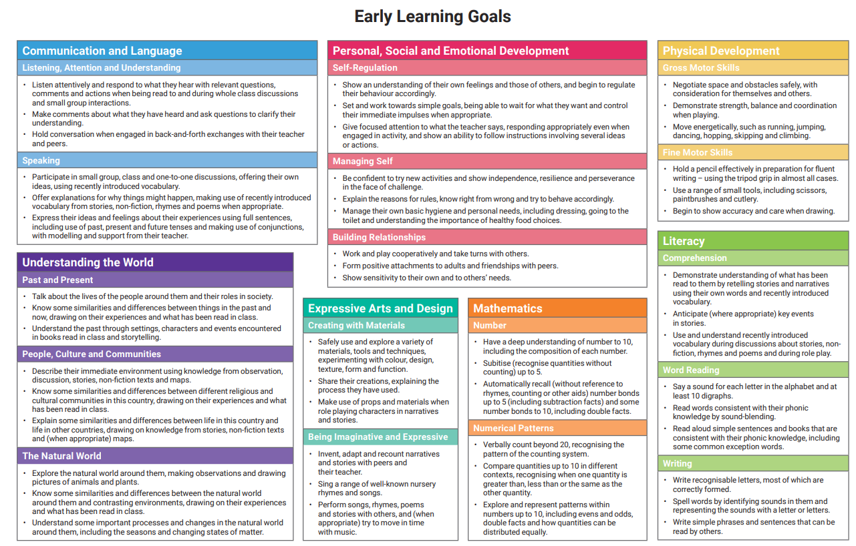
Early Learning Goals
End of Reception Assessment

