Slide 1

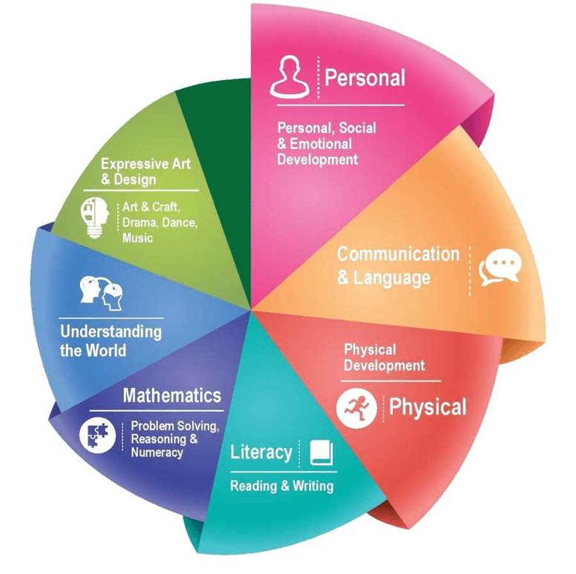
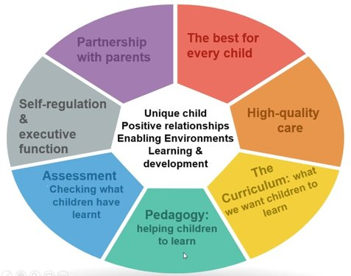
Rivington Primary School
Nursery Long Term Plan
At Rivington Primary School, we are committed to providing a caring and stimulating environment in which every child is valued and can thrive.
Our philosophy is to nurture every child as an individual, recognising and valuing their unique qualities and abilities, in order to support their learning and exploration at this wonderful stage.
INTENT
The intent for our children is to feel safe, happy and eager to learn.
COMMUNICATION – we strive for children to be able to communicate effectively and express themselves with confidence, sharing their thoughts, ideas and feelings with the knowledge that they will be listened to and understood.
ASPIRATION – developmentally appropriate and ambitious planning, responsive to individuals and group dynamics, and an approach which inspires and challenges children’s inquisitive minds is taken by all adults.
REFLECT – we reflect on our own practice as well as the children’s learning in order to offer the best opportunities and environment. We teach the children how to be skilful learners, developing independence, resilience, problem solving skills and how to collaborate.
EXPERIENCES – we aim for children to gain first-hand experiences to ignite their curiosity and embed their learning. We encourage children to independently access resources, develop their own play and ask for help, confident in the knowledge that they can co-construct their own learning environment and opportunities.

Slide 2


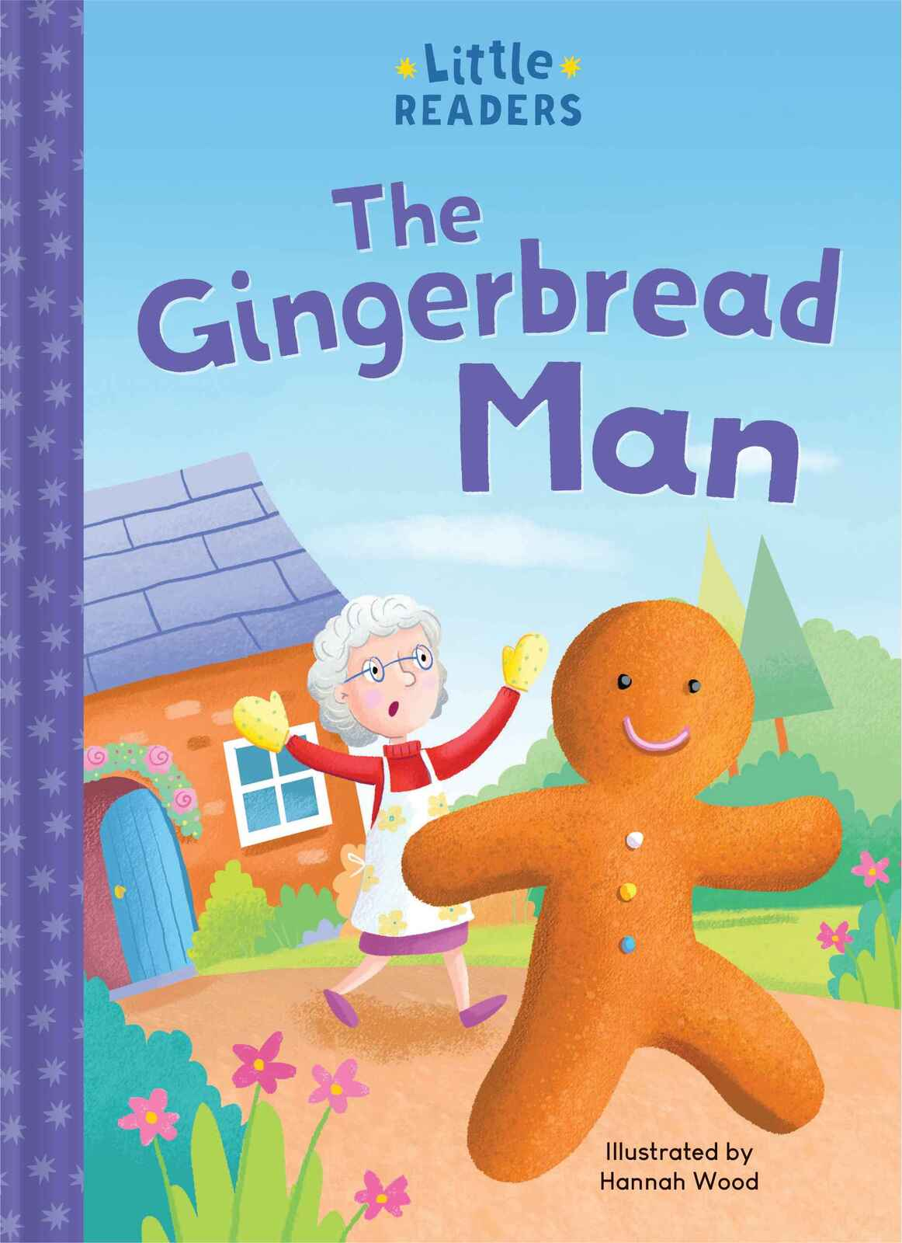
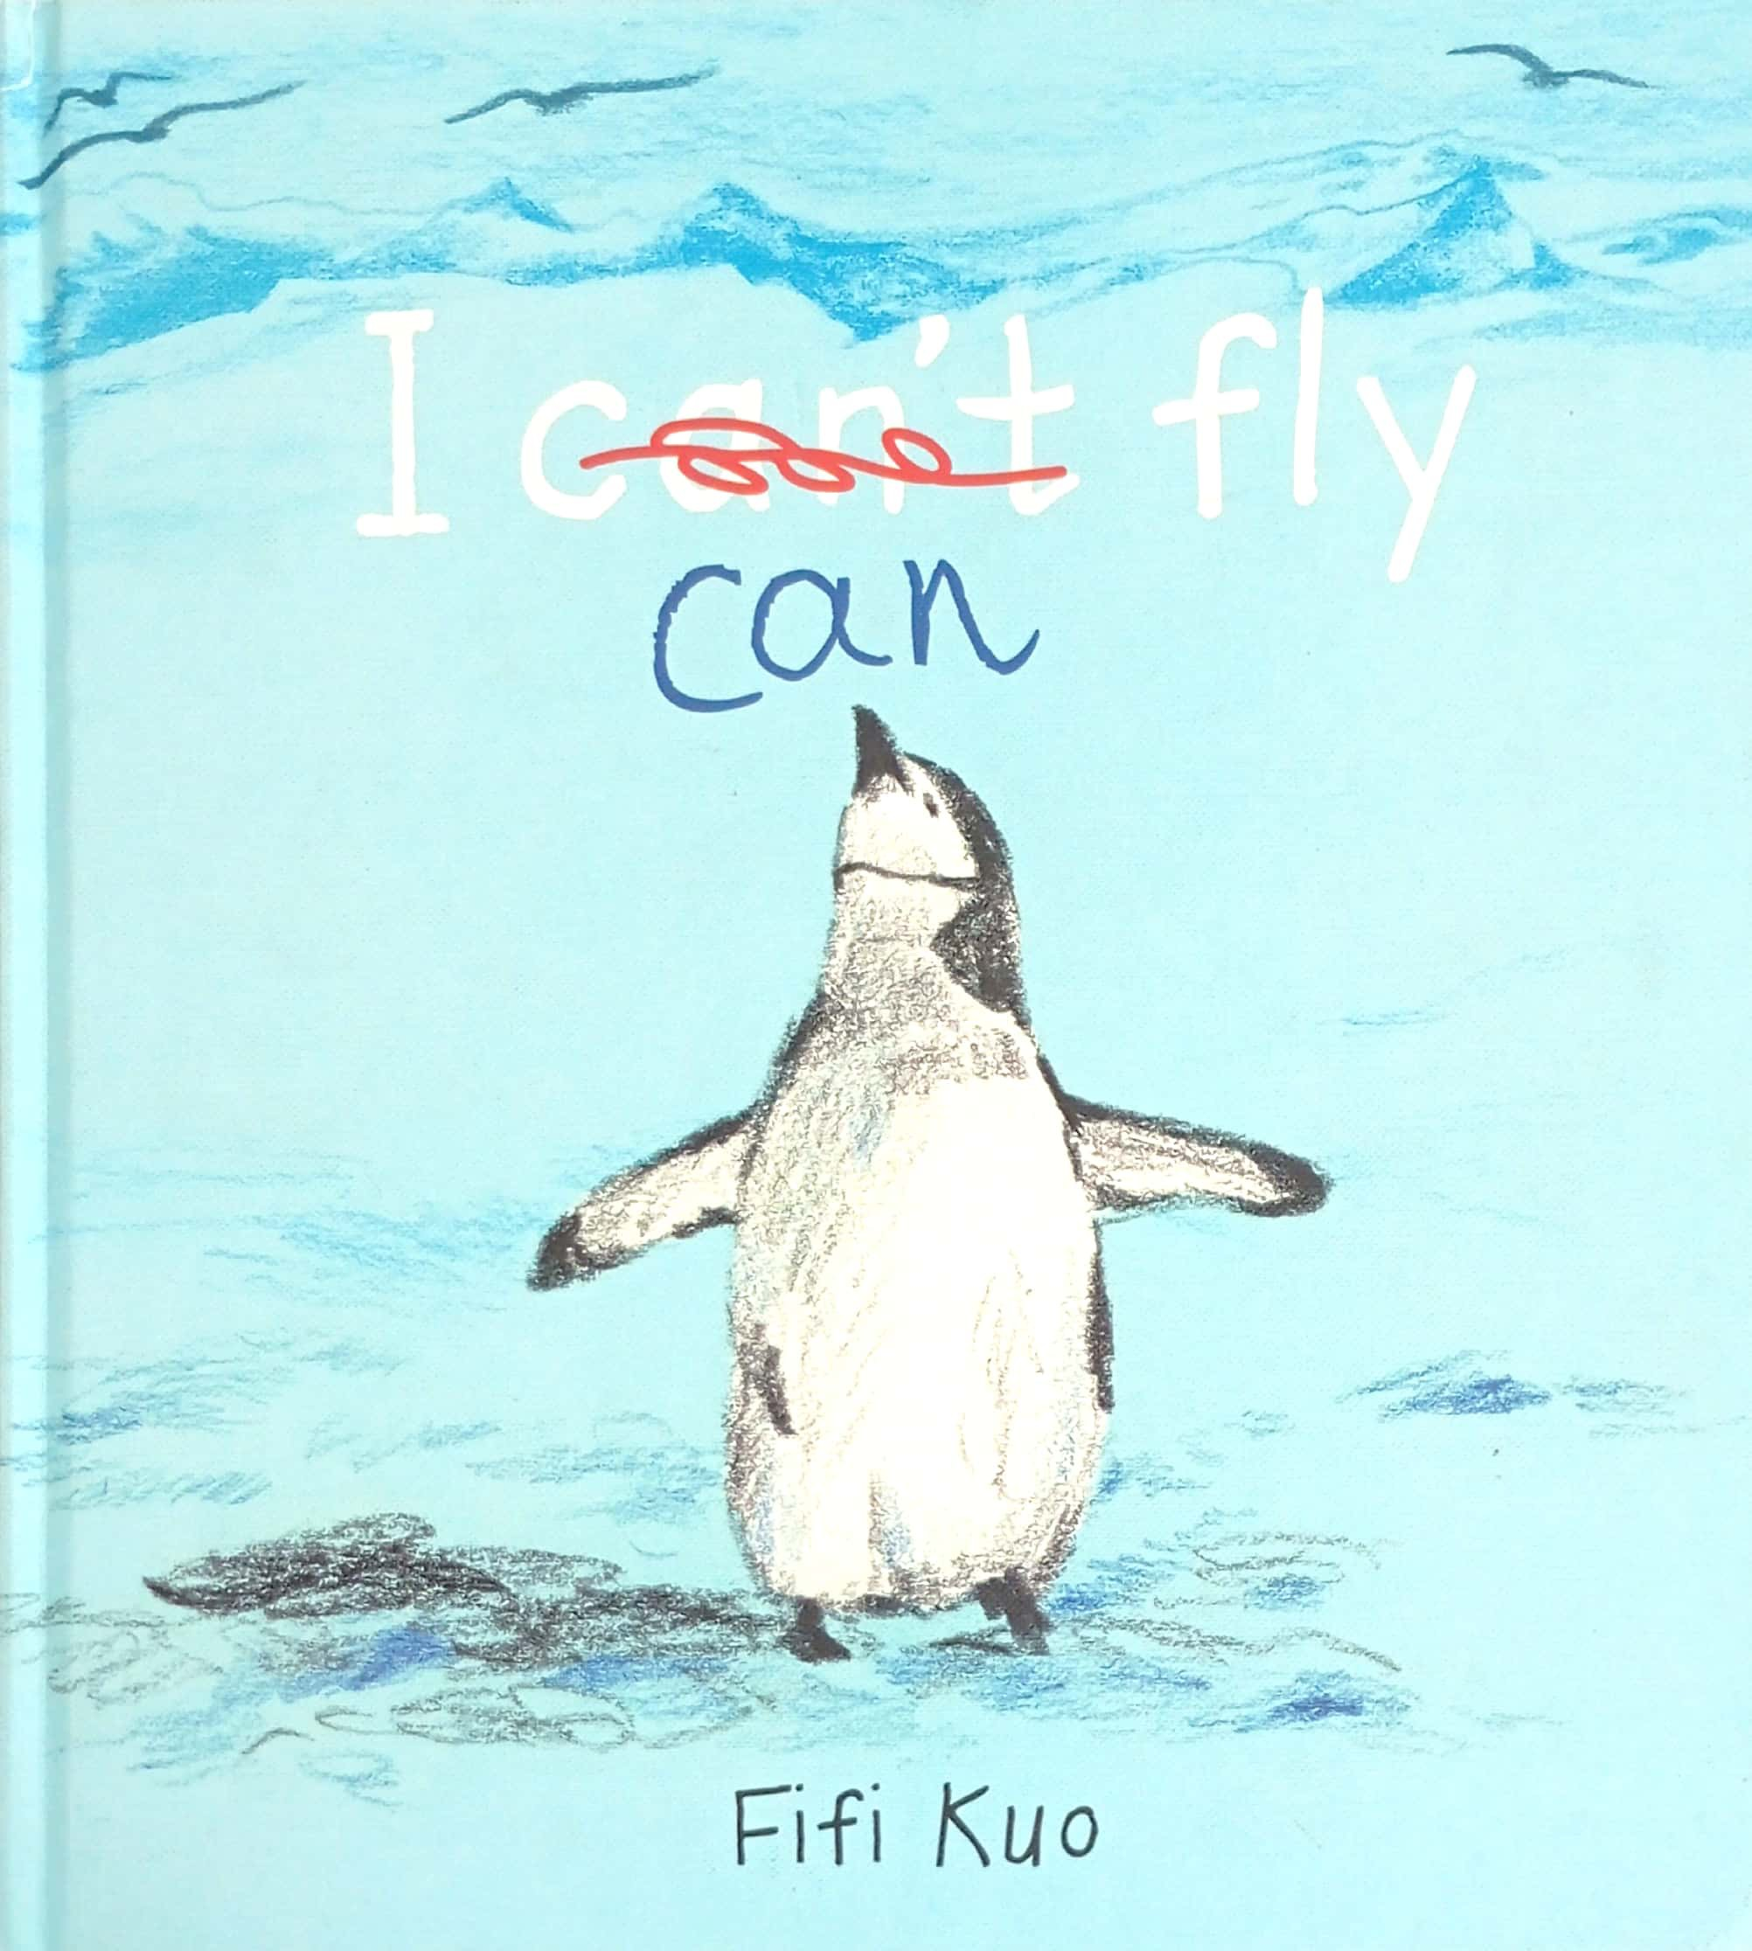









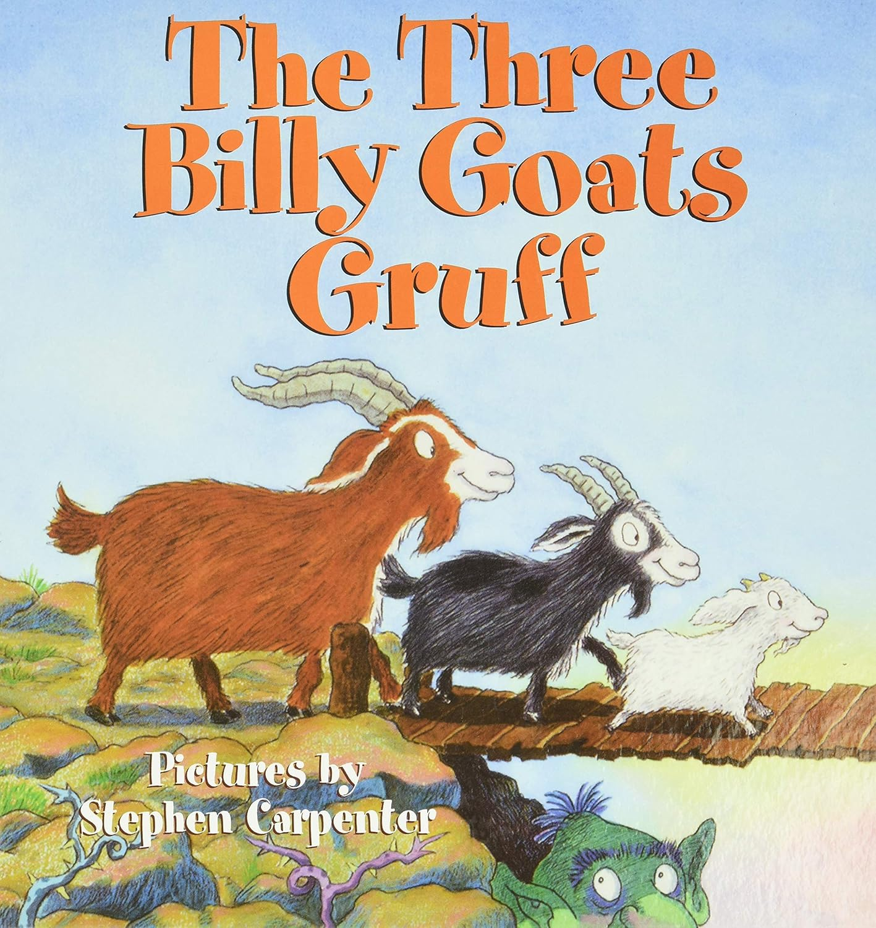

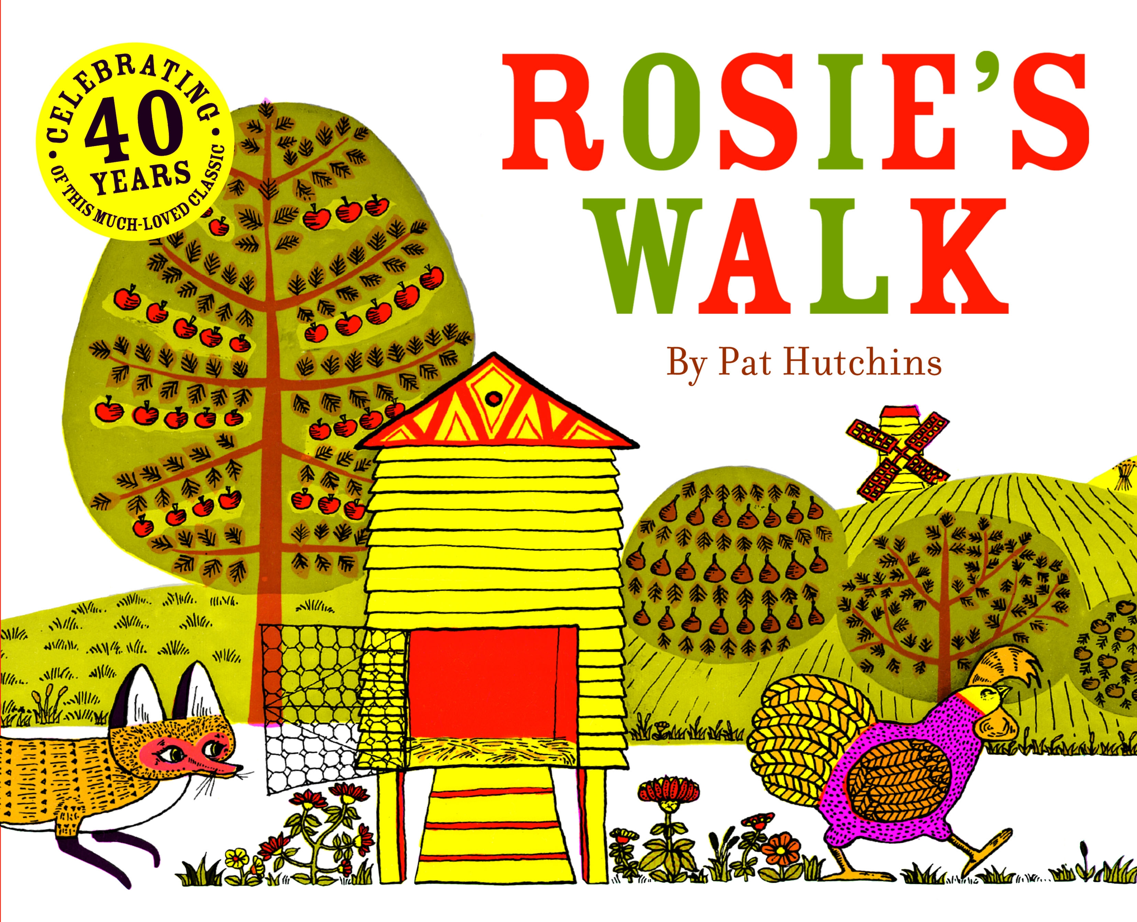
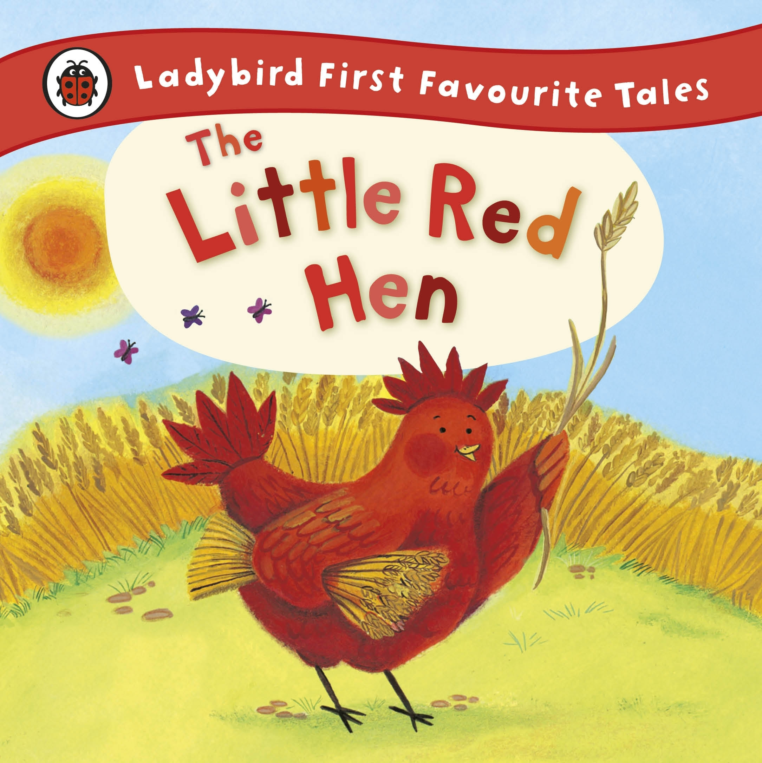


Overview
 | Autumn 1 | Autumn 2 | Spring 1 | Spring 2 | Summer 1 | Summer 2
General Themes Our plans are flexible to enable us to follow the interests of the children. | WHAT MAKES ME SPECIAL? Starting school All about me Families Emotions Diwali Autumn | HOW DO PEOPLE CELEBRATE? Bonfire night celebrations Harvest Hannukah The Nativity Christmas | LET’S GO ON AN ADVENTURE Lunar New Year Pancake day Winter Journeys Maps Arctic animals | HOW DOES YOUR GARDEN GROW? The great outdoors Plants & Flowers Spring Planting Easter | ONCE UPON A TIME… Traditional tales Storytelling Life cycles Summer Food | LET’S EXPLORE Holidays Comparing locations Dinosaurs Talents Transition
High quality Texts
Nursery Rhymes | Head, Shoulders, Knees and Toes If You’re Happy and You Know It Ten Little Fingers This Old Man Two Little Dicky Birds I’m a Little Teapot | Baa Baa Black Sheep Little Bo Peep Jack and Jill Hickory Dickory Dock Twinkle Twinkle It’s Raining, It’s Pouring | 1, 2, 3, 4, 5, Once I Caught a Fish Alive Doctor Foster Mulberry Bush Hey Diddle Diddle One, Two, Buckle My Shoe | Incy Wincy Spider Pat a Cake Georgie Porgie Ten in a Bed Five Little Men in a Flying Saucer Hot Cross Buns | Five Speckled Frogs Mary Had a Little Lamb Little Jack Horner Ten Green Bottles The Grand Ole Duke of York Five Little Ducks | Row, Row, Row Your Boat Little Boy Blue Sing a Song of Sixpence Ten Fat Sausages Mother Goose London Bridge
Opportunities and Parental involvement | Diwali National Poetry Day Stay and Learn Class Dojo | Bonfire/sparklers World nursery rhyme week Remembrance day Hannukah Christmas Christmas Carol Singing Class Dojo | Valentines day Lunar New Year National Storytelling week Pancake day Stay and Learn Class Dojo | Eid Mother’s Day World Book Day Easter celebrations Class Dojo | Father’s Day Caterpillars Class Dojo Sport’s Day | Walk to the park Class trip Graduation Class Dojo
British Values | Respect | Tolerance of other faiths and beliefs | Rule of Law | Democracy | Respect | Individual Liberty

Slide 3
Communication and Language
 | Autumn 1 | Autumn 2 | Spring 1 | Spring 2 | Summer 1 | Summer 2
Listening, attention and understanding Speaking | Knows there are boundaries in school. Listens to other people with interest but can easily be distracted by other things. Watches somebody’s face as they talk. Listens to simple stories and understands what is happening with the help of the pictures. Understands simple questions with 1 or 2 information carrying words, e.g., ‘Where is teddy?’ Responds to very simple requests especially when shown first by an adult. Starts to listen to adults around them and will respond to very simple requests, usually on their own terms. Communicates through gestures and sounds. | Follows a simple instruction. Concentrates for a longer period of time e.g., 3 minutes. Joins in with rhymes and songs by making sounds and by moving their body. Can find it difficult to pay attention to more than one thing at a time. Listens and responds to a simple instruction. Responds to adults making sounds or moving their bodies, e.g., clapping to stop activities. Understands and acts on longer sentences like ‘make teddy jump’ or ‘find your coat’. Starts to understand more specific vocabulary. Pupils are starting to communicate through words and gestures. | Follows the routine of the setting with some support. Focuses on the person who is talking in a calm environment, e.g., small group activity. Responds to others pretending to be characters in books. Understands very simple questions about ‘who’, ‘what’ and ‘where’ (but generally not ‘why’). Responds to their name and will change activity when encouraged by adults. Responds to simple questions and attempts to answer by speaking, pointing or gesturing. Regular plural forms are consistent. Uses 'is', 'are', 'am' in a sentence. | Follows the routine of the setting with little support. Switches attention when given a clear prompt, e.g., stops and listens. Concentrates for a longer period of time, e.g., 6 minutes. Begins to use characters and actions from stories and rhymes in their play, e.g., ‘pig’ for the three little pigs, in simple terms. Understands questions that may be more abstract. E.g., ‘Where is the bear going?’. Responds to two requests with space in between them. Will use characters in their play but not necessarily the features of the characters or the events from a story. Pupils are starting to engage in longer dialogues. | Able to show a small amount of control, e.g., waiting for their turn and resisting the impulse to grab what they want with support from an adult. Listens to their friends with increasing interest. Join in with familiar rhymes and stories. Follows a story with props and pictures. Has increased vocabulary to match their language-rich environment. Listens to and follows simple directions. Is starting to use some new vocabulary and join in with songs, stories and rhymes. Pupils are more confident when using fantasy language in play. | Identifies problems and seeks assistance from a familiar adult although not always articulate in their request. Knows to look and listen when an adult is speaking. Begins to show what good listeners do – eyes looking, ears listening, sitting still and quiet for a short period of time (5-10 minutes). Able to turn their head and focus on adults and friends as they speak and play, responding to comments. Listens to a picture book story that is stage appropriate (repetitive). Identifies characters in a story. Shows an interest in others and events. Enjoys listening to longer stories and can remember much of what happens. Listens to songs with repetition and joins in. Understands ‘why’ questions. Understands a question or instruction that has two parts, such as: “Get your coat and wait at the door”. Can follow a single instruction with little support. Begins to show the physical attributes of a good listener (sit, look, listen, simple comprehension and memory). Knows some colours and prepositions.
Statutory Framework for CL | The development of children’s spoken language underpins all seven areas of learning and development. Children’s back-and-forth interactions from an early age form the foundations for language and cognitive development. The number and quality of the conversations they have with adults and peers throughout the day in a language-rich environment is crucial. By commenting on what children are interested in or doing, and echoing back what they say with new vocabulary added, practitioners will build children's language effectively. Reading frequently to children, and engaging them actively in stories, non-fiction, rhymes and poems, and then providing them with extensive opportunities to use and embed new words in a range of contexts, will give children the opportunity to thrive. Through conversation, storytelling and role play, where children share their ideas with support and modelling from their teacher, and sensitive questioning that invites them to elaborate, children become comfortable using a rich range of vocabulary and language structures.
*WellComm interventions take place throughout the year.

Slide 4
Personal, Social and Emotional Development
 | Autumn 1 | Autumn 2 | Spring 1 | Spring 2 | Summer 1 | Summer 2
Managing Self Self-regulation Making relationships . | Knows what is expected in school in very simple terms for example, knows where to put their coat. Has some awareness of self and others. Shows more independence and more confidence to make choices for themselves. Forms an attachment with an adult in the setting. | Asserts themselves as an individual person with likes and dislikes. Shows awareness that things don’t always go their way and has more flexibility when things are different. Plays alongside other children. | Finds what they want to play with and stays with the activity for longer periods of time. Accepts help from adults when they need it. Starts to comply with the boundaries of school knowing there are rules. Shows an awareness of how their choices may affect and involve others around them. Starts to ‘dip’ into others’ play. | More aware of other children around them and starts to interact. Is able to make simple choices. Seeks out adults for specific help. Begins to accept the needs of others. Shows more awareness of others in the setting and starts to interact during play. | Starts to be more confident to play with others and is beginning to self-regulate in play situations. More aware of others around them and the need to take account of others around them. Has some accountability for their actions. Shows interest in other children's play and may start to observe with interest and join in the game. | Starts to show responsibility for their own feelings and their own play. Able to manage a task seeing it through from beginning to end. Showing independence in their choices. Joins in with others’ play.
Statutory Framework for PSE | Children’s personal, social and emotional development (PSED) is crucial for children to lead healthy and happy lives and is fundamental to their cognitive development. Underpinning their personal development are the important attachments that shape their social world. Strong, warm and supportive relationships with adults enable children to learn how to understand their own feelings and those of others. Children should be supported to manage emotions, develop a positive sense of self, set themselves simple goals, have confidence in their own abilities, to persist and wait for what they want and direct attention as necessary. Through adult modelling and guidance, they will learn how to look after their bodies, including healthy eating, and manage personal needs independently. Through supported interaction with other children, they learn how to make good friendships, co-operate and resolve conflicts peaceably. These attributes will provide a secure platform from which children can achieve at school and in later life.
*Jigsaw Scheme taught throughout the year in discrete sessions.

Slide 5
Physical Development
 | Autumn 1 | Autumn 2 | Spring 1 | Spring 2 | Summer 1 | Summer 2
Fine Motor/Gross Motor | Can use their strength to move from one thing to another. Can run safely on whole foot. Begins to balance with support. Uses a range of tools and equipment. Develops hand–eye coordination by starting to show a preference for a dominant hand when eating and can accurately aim for the mouth. Begins to pull myself up on nursery play climbing equipment. | Shows some control over their choice of tools. Uses a range of tools and equipment with some control. Stops confidently when moving around the environment. Develops hand–eye coordination by, for example, kicking a large ball into an open space. Shows balance and control on two feet. | Shows increasing development of control over trickier tools, e.g. a flag, a spade. Starts to recognise the changes they can make using tools and equipment. Uses hand–eye coordination to be increasingly independent in meeting their own needs, e.g. putting on their own coat. Can start to walk over obstacles with balance and control, sometimes with support. Digital Grasp - Pupils begin to use a digital grasp when making marks. | Starts to control the body to work with others. Shows more fine motor control with tools. Understands how to jump up and down and move in different ways. Uses large and small motor skills to do things independently, for example starts to manage buttons and zips, and pour drinks. | Shows good control in large movements like changing direction when running. Shows finer control with smaller tools whilst still needing some help with tricky things like buttons. | Begins to control smaller tools. Be more in control of the tools being used, e.g., can make some more-controlled marks with crayons and pencils. Can run skilfully and negotiate space successfully, adjusting speed or direction to avoid obstacles.
Statutory Framework for PD | Physical activity is vital in children’s all-round development, enabling them to pursue happy, healthy and active lives11. Gross and fine motor experiences develop incrementally throughout early childhood, starting with sensory explorations and the development of a child’s strength, co-ordination and positional awareness through tummy time, crawling and play movement with both objects and adults. By creating games and providing opportunities for play both indoors and outdoors, adults can support children to develop their core strength, stability, balance, spatial awareness, co-ordination and agility. Gross motor skills provide the foundation for developing healthy bodies and social and emotional well-being. Fine motor control and precision helps with hand-eye co-ordination, which is later linked to early literacy. Repeated and varied opportunities to explore and play with small world activities, puzzles, arts and crafts and the practice of using small tools, with feedback and support from adults, allow children to develop proficiency, control and confidence.
*Get Set for PE Scheme taught throughout the year in discrete sessions.

Slide 6
Literacy
 | Autumn 1 | Autumn 2 | Spring 1 | Spring 2 | Summer 1 | Summer 2
Comprehension Word reading Writing | Have favourite books and seeks them out, to share with an adult, with another child, or to look at alone. Identifies environmental sounds and can copy/repeat some. Mark making and drawing with a range of tools and equipment. | Pays attention and responds to the pictures or the words. Fills in missing words from well-known rhymes. Identifies instrumental sounds and can copy/repeat some. Can say what their marks mean. | Understands the names of the different parts of a book, e.g., pictures, words cover. Understands that print has meaning. Explores different ways of making sounds with their bodies, sings songs and rhymes independently. Shows consideration when mark making. Starts to take their time changing their tool as the marks progress. | Understands that print can have different purposes. Notices some print, such as the first letter(s) of their name, door number or a logo. Hears initial sound phonemes and applies knowledge to alliteration. Can copy with increasing control. | Understands that we read English text from left to right and from top to bottom. Is beginning to identify the main character and a key event in a story that they know well (with support). Explores and creates sound words. Claps syllables in words. Starts to make shapes that are recognisable as pre-letter shapes. Can start to write name as a shape. | Makes simple suggestions about what might happen next in a story. Engages in extended conversation about stories, learning new vocabulary. Read own name. Orally blend words. Writes their name and identify their name.
Statutory Framework for Literacy | It is crucial for children to develop a life-long love of reading. Reading consists of two dimensions: language comprehension and word reading. Language comprehension (necessary for both reading and writing) starts from birth. It only develops when adults talk with children about the world around them and the books (stories and non-fiction) they read with them, and enjoy rhymes, poems and songs together. Skilled word reading, taught later, involves both the speedy working out of the pronunciation of unfamiliar printed words (decoding) and the speedy recognition of familiar printed words. Writing involves transcription (spelling and handwriting) and composition (articulating ideas and structuring them in speech, before writing).

Slide 7
Mathematics
 | Autumn 1 | Autumn 2 | Spring 1 | Spring 2 | Summer 1 | Summer 2
Number Numerical patterns | Starts to use some number names and starts to ascribe names to objects in a rhythmical way. Counts rhythmically and can count in songs and rhymes. Builds using different equipment of different sizes and shapes. | Can identify 1 and 2 objects when asked. Starts to use number comparison language. Talks about their models and what they used to build their models, identifying different bricks and colours. | Subitises and counts to 3. Enjoys counting as far as they can and uses numbers in their play. Sorts using simple criteria. | Notices the last number said when counting. Can say what number comes next when counting and singing number songs. Starts to identify simple patterns. | Counts up to five and is starting to understand cardinal principle. Can use "more than” to identify different groups. Makes simple comparisons. | Uses number in play. Can identify numerals to 5. Can identify when two groups have the same number. Starts to use simple shape names.
Statutory Framework for Mathematics | Developing a strong grounding in number is essential so that all children develop the necessary building blocks to excel mathematically. Children should be able to count confidently, develop a deep understanding of the numbers to 10, the relationships between them and the patterns within those numbers. By providing frequent and varied opportunities to build and apply this understanding - such as using manipulatives, including small pebbles and tens frames for organising counting - children will develop a secure base of knowledge and vocabulary from which mastery of mathematics is built. In addition, it is important that the curriculum includes rich opportunities for children to develop their spatial reasoning skills across all areas of mathematics including shape, space and measures. It is important that children develop positive attitudes and interests in mathematics, look for patterns and relationships, spot connections, ‘have a go’, talk to adults and peers about what they notice and not be afraid to make mistakes.
*Power Maths and Mastering Number are taught in Reception.

Slide 8
Understanding the World
 | Autumn 1 | Autumn 2 | Spring 1 | Spring 2 | Summer 1 | Summer 2
History Geography Science RE | Children start to be curious about the people around them. They show interest in characters in stories and also people in school. Children notice different story books. Children start to explore the environment around them. |  | Children show an interest in the people in their family and can tell some simple facts about their family. They recognise some families have similar features. Makes connections between the features of their family and other families. Children start to notice when things have changes with support from an adult. |  | Children start to use simple language about the passage of time. They comment on photographs and images and can talk about similarities and differences in simple terms. Knows simple features of their own environment. Children start to understand they can influence their environment and make changes to the space around them.
Statutory Framework for Understanding the World | Understanding the world involves guiding children to make sense of their physical world and their community. The frequency and range of children’s personal experiences increases their knowledge and sense of the world around them – from visiting parks, libraries and museums to meeting important members of society such as police officers, nurses and firefighters. In addition, listening to a broad selection of stories, non-fiction, rhymes and poems will foster their understanding of our culturally, socially, technologically and ecologically diverse world. As well as building important knowledge, this extends their familiarity with words that support understanding across domains. Enriching and widening children’s vocabulary will support later reading comprehension.

Slide 9
Expressive Arts and Design
 | Autumn 1 | Autumn 2 | Spring 1 | Spring 2 | Summer 1 | Summer 2
Music Art Drama/dance DT | Sings to and with toys, props, resources. Repeats phrases of songs. Enjoys making sounds with musical instruments whilst moving to music. Likes listening to music and responds to songs and music. Develops a bank of motions to produce marks. Begins to use representation to communicate, e.g., Drawing a line and saying, 'That’s me' and the meaning remains consistent when asked. Uses the arm, wrist, and finger muscles. Has an interest in objects that are their favourite colour. Shows an interest in making marks and controlling the tools and equipment needed to manipulate marks on the paper. |  | Remembers and sings an entire song or nursery rhyme from school or home. Imaginatively plays with small world and in the role play developing ideas and scenarios. Listens to music and moves in a way that starts to show interpretation. E.g. this is like a mouse. Drawings include squares, rectangles and circles. Shows interest in and describes (simple vocabulary) the texture of objects. Experimentation of marks and mark making using colour, texture and senses. |  | Sings a few familiar songs. Shows a preference for types and methods of expression and shows more control when expressing themselves. Understands that they can use lines to enclose a space and begins to use these shapes to represent objects. Manipulates malleable materials to create shapes. More deliberate use of materials and colour with more deliberate exploration of colour and changes.
Statutory Framework for Expressive Arts and Design | The development of children’s artistic and cultural awareness supports their imagination and creativity. It is important that children have regular opportunities to engage with the arts, enabling them to explore and play with a wide range of media and materials. The quality and variety of what children see, hear and participate in is crucial for developing their understanding, self-expression, vocabulary and ability to communicate through the arts. The frequency, repetition and depth of their experiences are fundamental to their progress in interpreting and appreciating what they hear, respond to and observe.

Slide 10
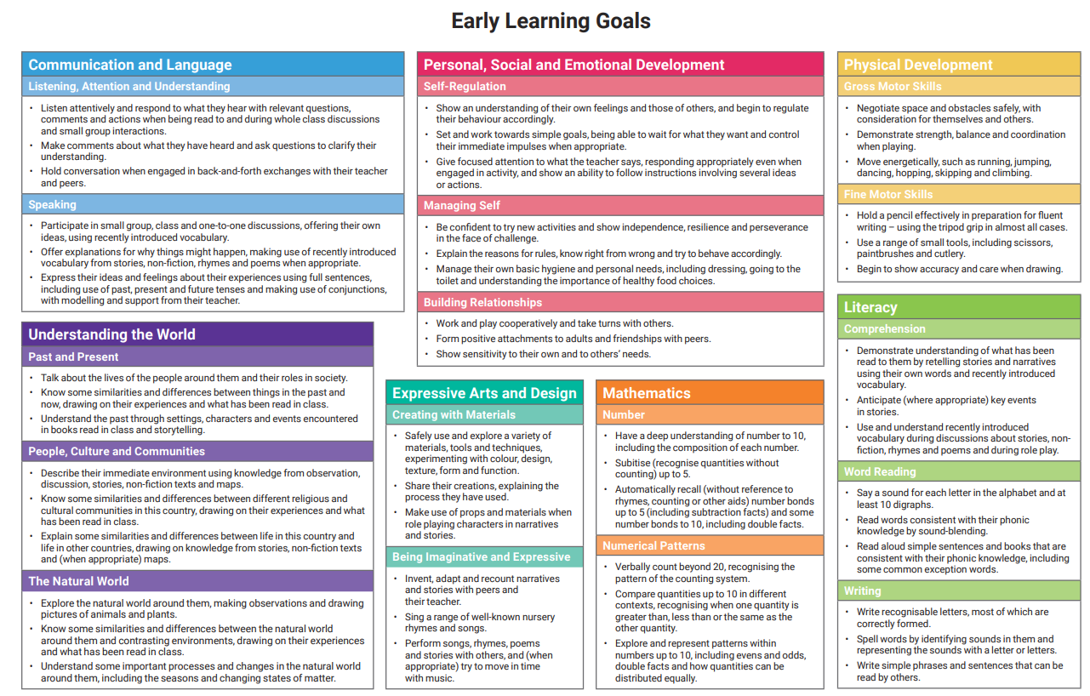
Early Learning Goals
End of Reception Assessment

