Slide 1

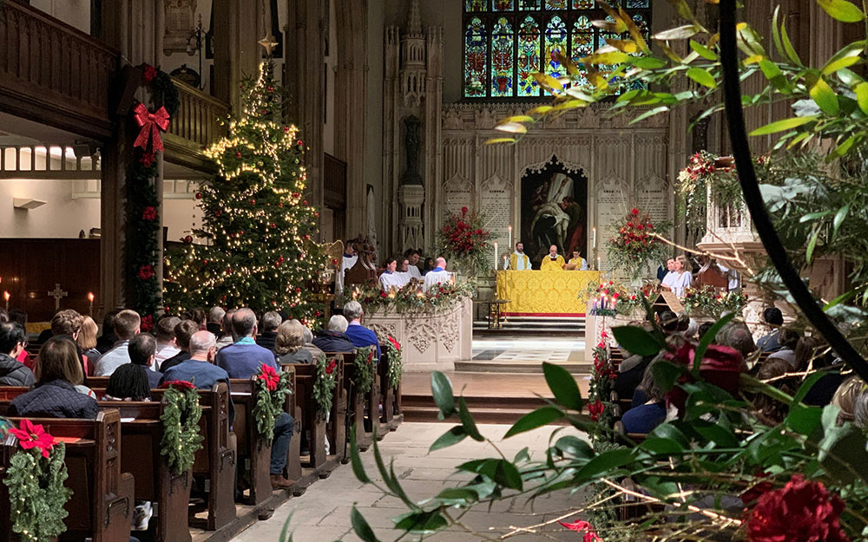

Knowledge Organiser RE
Theme: Christmas
Religion: Christianity
Key Vocabulary
Bible | A holy book for Christians that contains stories, rules, and guidance, telling the story of God and his love for people.
Gospel | The record of Christ's life and teaching in the first four books of the New Testament
sin | An immoral act considered to be a transgression against divine law
forgiveness | To stop being angry with someone who has done something wrong.
Miracles | An extraordinary and welcome event that is not explainable by natural or scientific laws.
Incarnation | A spirit or god taking a physical body to live on Earth.
Key Question: Do Christmas celebrations and
traditions help Christians understand
who Jesus was and why he was born?
Debate questions to consider:
Does it matter if people are celebrating or giving gifts to one another without really thinking about the cause?
Prior learning:
Year R- Christmas Year 1- The Christmas story Year 2- Jesus is a gift. Year 3, 4 & 5- Christmas

