Slide 1


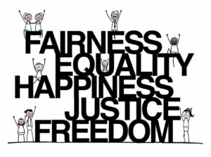
Knowledge Organiser RE Religion: Christianity Theme: ‘Beliefs and meaning’
Key Vocabulary
Agape | Unconditional love.
Eternal life | It means when life ends here, it continues somewhere else.
Resurrection | The act or fact of bringing someone back to life, or bringing something back into use or existence.
Parable | A simple story used to illustrate a moral or spiritual lesson, as told by Jesus in the Gospels.
Ten Commandments | The ten laws that God gave the Israelites at Sinai have come to be known as The Ten Commandments.
Key Question: Is anything ever eternal?
Humanists believe there is no god, there is one life and
when it is over that is the end.
Questions to consider:
Can a non-Christian go to Heaven?
Is going to Heaven a Christian’s only motivation for doing good things?
Prior learning:
Year 5- Christianity and Humanism Year 4- Christianity- Prayer and worship Year 3- Christianity- Easter Year 1- God and Creation

