Slide 1

Welcome to The Foundation Stage

Slide 2
Key Staff
Mrs Powell – Head Teacher
Mrs Cooper– Deputy Head Teacher
Mrs Smith – FS Lead/Reception Teacher
Mrs Mars – Nursery Teacher
Miss Graham – Business Manager
Miss Tierney – Clerical Officer
Mrs Swift – School Cook

Slide 3

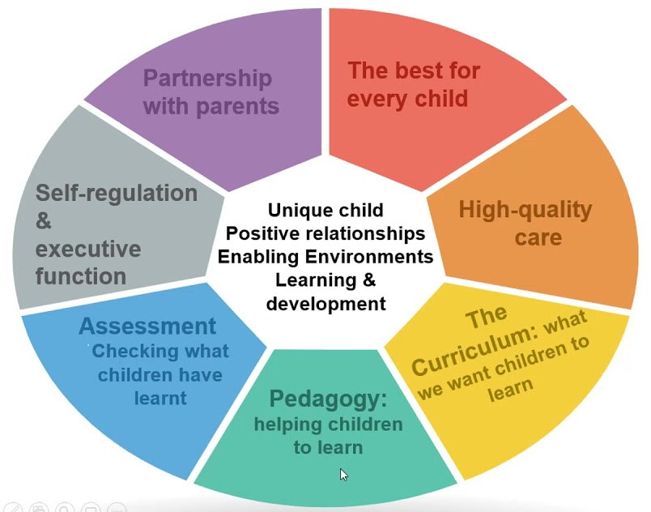
EYFS Curriculum

Slide 4
The Nursery Day
8:40 – 8:50am Doors open
11:40am Lunch/AM session finishes
12:30pm Afternoon session starts
3:20pm School collection
3:30pm Nursery closes
Learning time
Phonics (Letters and Sounds, phase 1 phonics)
Literacy
Mathematics
Story/poetry/singing
PSHE/circle time
Continuous Provision

Slide 5
Sharing Information
School Spider app
Class Dojo
Parent’s evening
Family Friday
Stay and Learn
Home learning
Speak to a member of the team

Slide 6
Attendance
We expect all children to come everyday (and they will want to!).
The Nursery door closes at 8:50am. Your child will be marked as late on our register after this time.
You must inform us if your child is going to be absent from Nursery for any reason e.g. Sickness, Medical appointments by ringing the School office before 9am on 01744678493.

Slide 7
Uniform
We encourage Nursery children to wear the school uniform e.g. Green sweatshirt/cardigan, plain black jogging pants/trousers/leggings and a white polo shirt.
Please ensure that names labels are in EVERYTHING!
Send coats EVERYDAY
Sensible shoes (No open toe sandals or laces)and no jewellery
Please provide spare clothes and underwear to keep in school.
A pair of wellies to keep at Nursery as children go out in all weathers.

Slide 8
Class Fund
We run a snack table throughout the day in Nursery. We provide the children with a range of healthy snacks. To continue to do this we ask for every child to pay £5.00 per half term. This must be paid using the School Money app. Cash can not be accepted.
We also use Nursery fund towards the cost of baking and playdough ingredients and enhancing the weekly learning focus.

Slide 9
Wrap Around Care
The school has a breakfast club that starts at 7:45am and an afterschool club that runs up until 5:30pm.
Cost for 2024-25 TBC. These sessions must be booked via the booking form from the school office and paid for in advance on the School Money app.
If your child attends 30 hours, you can book and pay for the additional time (2:50-3:30pm) via a booking form from the school office at £1 per session.

Slide 10
School Dinners
School Dinners
Lunch is cooked on site and will be served in our classroom (vegetarian meals are catered for)
Parents are to order and pay using School Grid. Cost TBC (currently £12.50 per week). Please pay in advance.
Children are able to choose from a selection of healthy, nutritional and well balanced lunches.
Packed lunches
Lunches from home must be brought into school in a plastic lunch box/ bag clearly labelled with the child’s name.
In keeping with the healthy schools programme we recommend a balanced lunch which contains fruit and vegetables
No sweets, chocolate or fizzy drinks please!

Slide 11
Toilet Training
We would appreciate it if your child is toilet trained before starting Nursery in September.
Please do not send your child to Nursery in nappies or pull-ups.
If you are struggling with toilet training please speak to a member of staff.

Slide 12
Please Make Sure…
You return ALL the necessary forms from your pack to us ASAP.
Download the Class Dojo, School Money and School Spider app.

