Slide 1

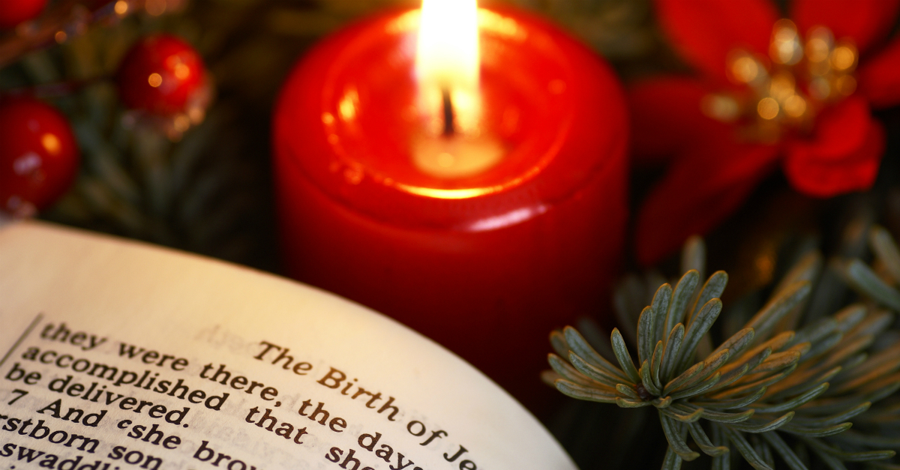
Knowledge Organiser RE
Theme: Christmas
Religion: Christianity
Key Vocabulary
Bible | A holy book for Christians that contains stories, rules, and guidance, telling the story of God and his love for people.
Historical | Stories and information about the past that are important or significant
Scientific | Doing things carefully, like a scientist, to find out if an idea is true by observing the world and doing experiments.
Personal beliefs | An individual's conviction or perspective on certain matters, which can influence their actions and decisions
Incarnation | A spirit or god taking a physical body to live on Earth.
Key Question: Is the Christmas story true?
There are different versions of the Birth of Jesus in the bible.
Luke Ch 1: 26-38 and Ch 2: 1-20
Matthew Ch 1: 18 - Ch 2: 12
Debate questions to consider:
If we are questioning the factual side of the Christmas story, can it be true in a different way?
Prior learning:
Year R- Christmas Year 1- The Christmas story Year 2- Jesus is a gift. Year 3 &4- Christmas

