Slide 1

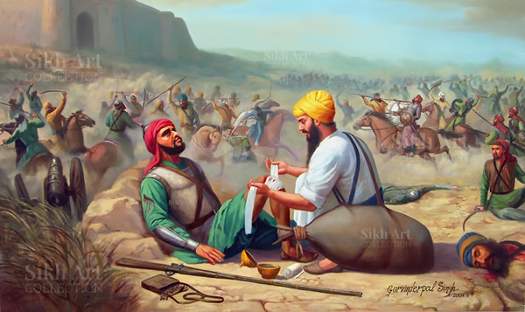
Knowledge Organiser RE Religion: Sikhism Theme: ‘Beliefs and moral values’
Key Question: Are Sikh stories important today?
Key Vocabulary
Guru Granth Sahib | The central holy scripture of Sikhism, a religious text compiled by the Sikh Gurus.
Gurdwara | The Sikh place of worship, literally meaning "doorway to the Guru"
Guru Gobind Singh | The last of the ten Gurus, the one who transformed the Sikh faith.
Waheguru | Is the Sikh name for God
Chappati | Is a piece of Indian bread
Guru Nanak | Guru Nanak is considered the first Sikh Guru.
Bhai Kanhaiya is one of the most inspiring figures in Sikh history, celebrated for his profound compassion and dedication to selfless service
Questions to consider:
Does religion play a big role in teaching people how to treat each other?
Can you think of a selfless act of service?
Prior learning:
Year 3- Prayer and worship Year 3- Amrit ceremony Year 4- Sharing and community

