Slide 1

The planet Of Neverbelive
By Isaac Staden
Map

Slide 2
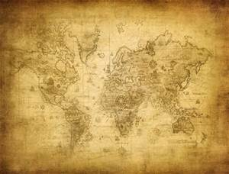
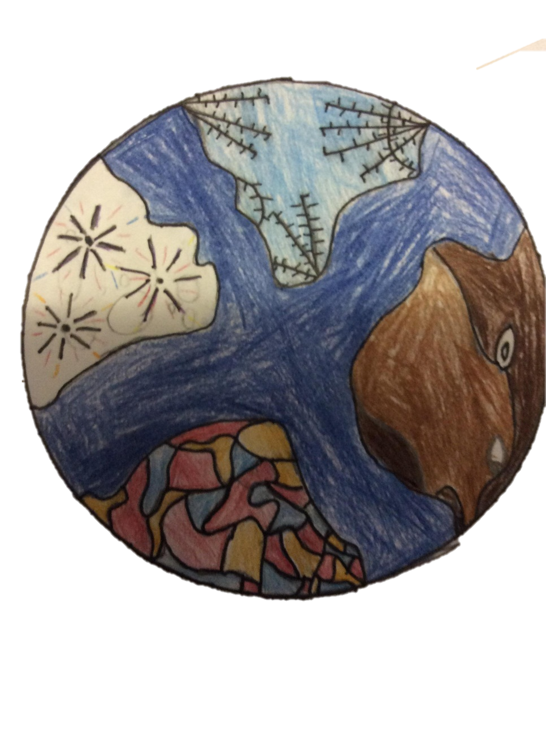
THE LAVA TEMPLE
The lava temple is guarded by
Lava dragons , in the moat there are eels that swim round.
FIRE WORK TREE
On a full moon it will do a display for the zoggoniones.
CHOCOLATE TREE
It’s hollow and the zogoniones sometimes cut them down for a chocolate cake . Chocolate foxes guard the last tree and make sure it’s not chopped down.
THE ICE PALACE
The ice queen lives there, with 20 guards it is impossible to kill her

Slide 3
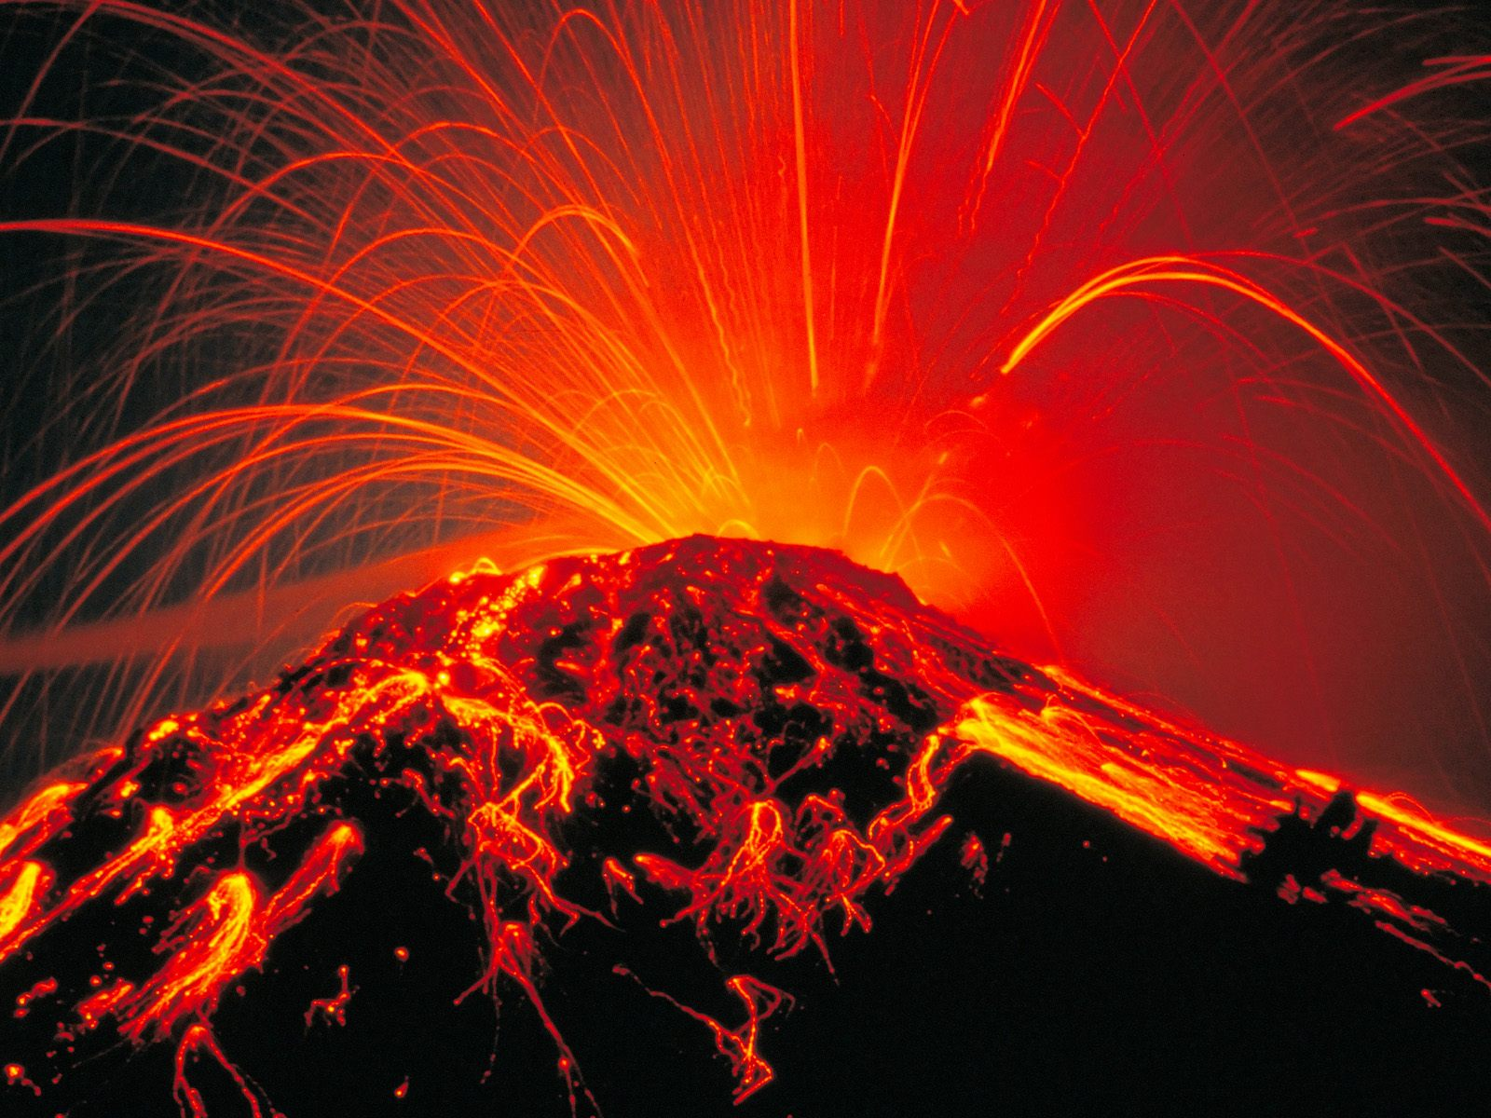
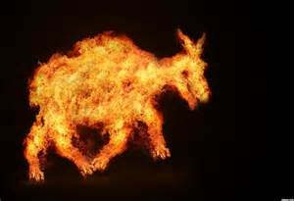
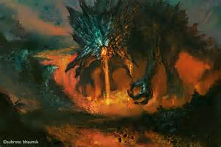
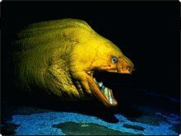
LAVA GOATS!!!
Although they sound grim, they are very cute.
I stumbled across one , I wanted to hug it but then I remembered it is made of lava . That’s how they hunt ,
You think it’s cute so you hug it then you will melt.
LAVA DRAGONS!!!
The lava dragon is a fearsome monster that if you stumble across them you will be turned to crisp . I only sore it from far but the beam of light is truly stunning. They feed on the lava goats and eels.
back
LAVA EEL!!!
The teeth are venomous and will bite though anything in seconds , the venom will also kick in seconds . They have spots of lava on there body so the lava will not effect them.
There fin makes them very quick.

Slide 4

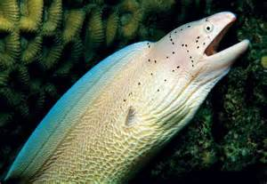
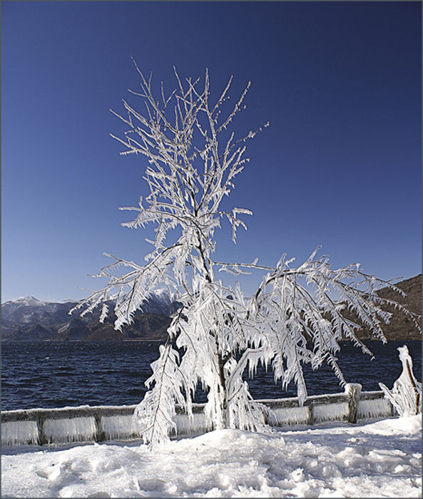
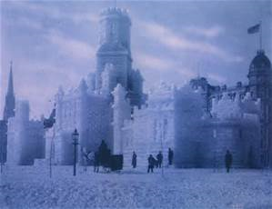
ICE EELS!!!
The ice ell has a diamond spine that protects them from the ice. It eats sea weeds, so no fish get hurt. They act like they are there's. I was amazed by the site, it was astonishing beautiful etc.
THE ICE TREE!!!
The ice tree is ironic it’s one of a kind there are many other types of ice tree but none like this. On every double moon it does a display and makes sculptures for schools.
Back

Slide 5
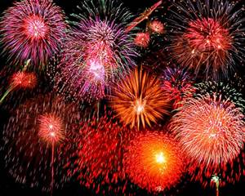
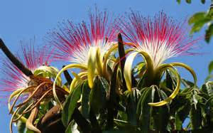
back
FIREWORK DOGS!!!
They guard the tree and shoot them selves at enemies until they’re dead. They eat the oranges of the chocolate tree. They all so eat gun powder so they can kill their prey . Their prey is eels and fish.

Slide 6

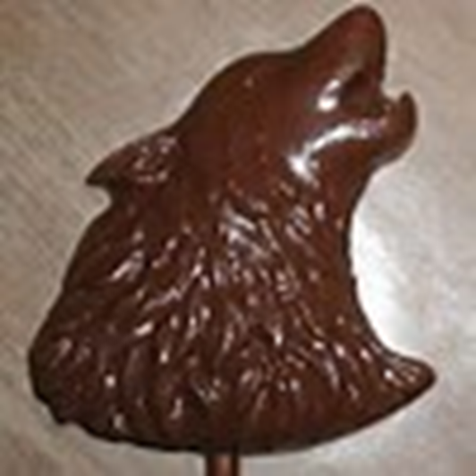
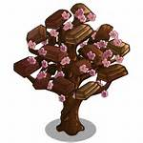
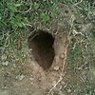
THE CHOCOLATE FOX!!!
They harvest the tree for chocolate oranges and that is what they eat . They dig holes round the tree so if anyone tries to chop it down, they will then fall down. On firework night, people will worship the tree because they think it’s their god. I was lucky enough to worship the tree - thousands went.
back

