Slide 1
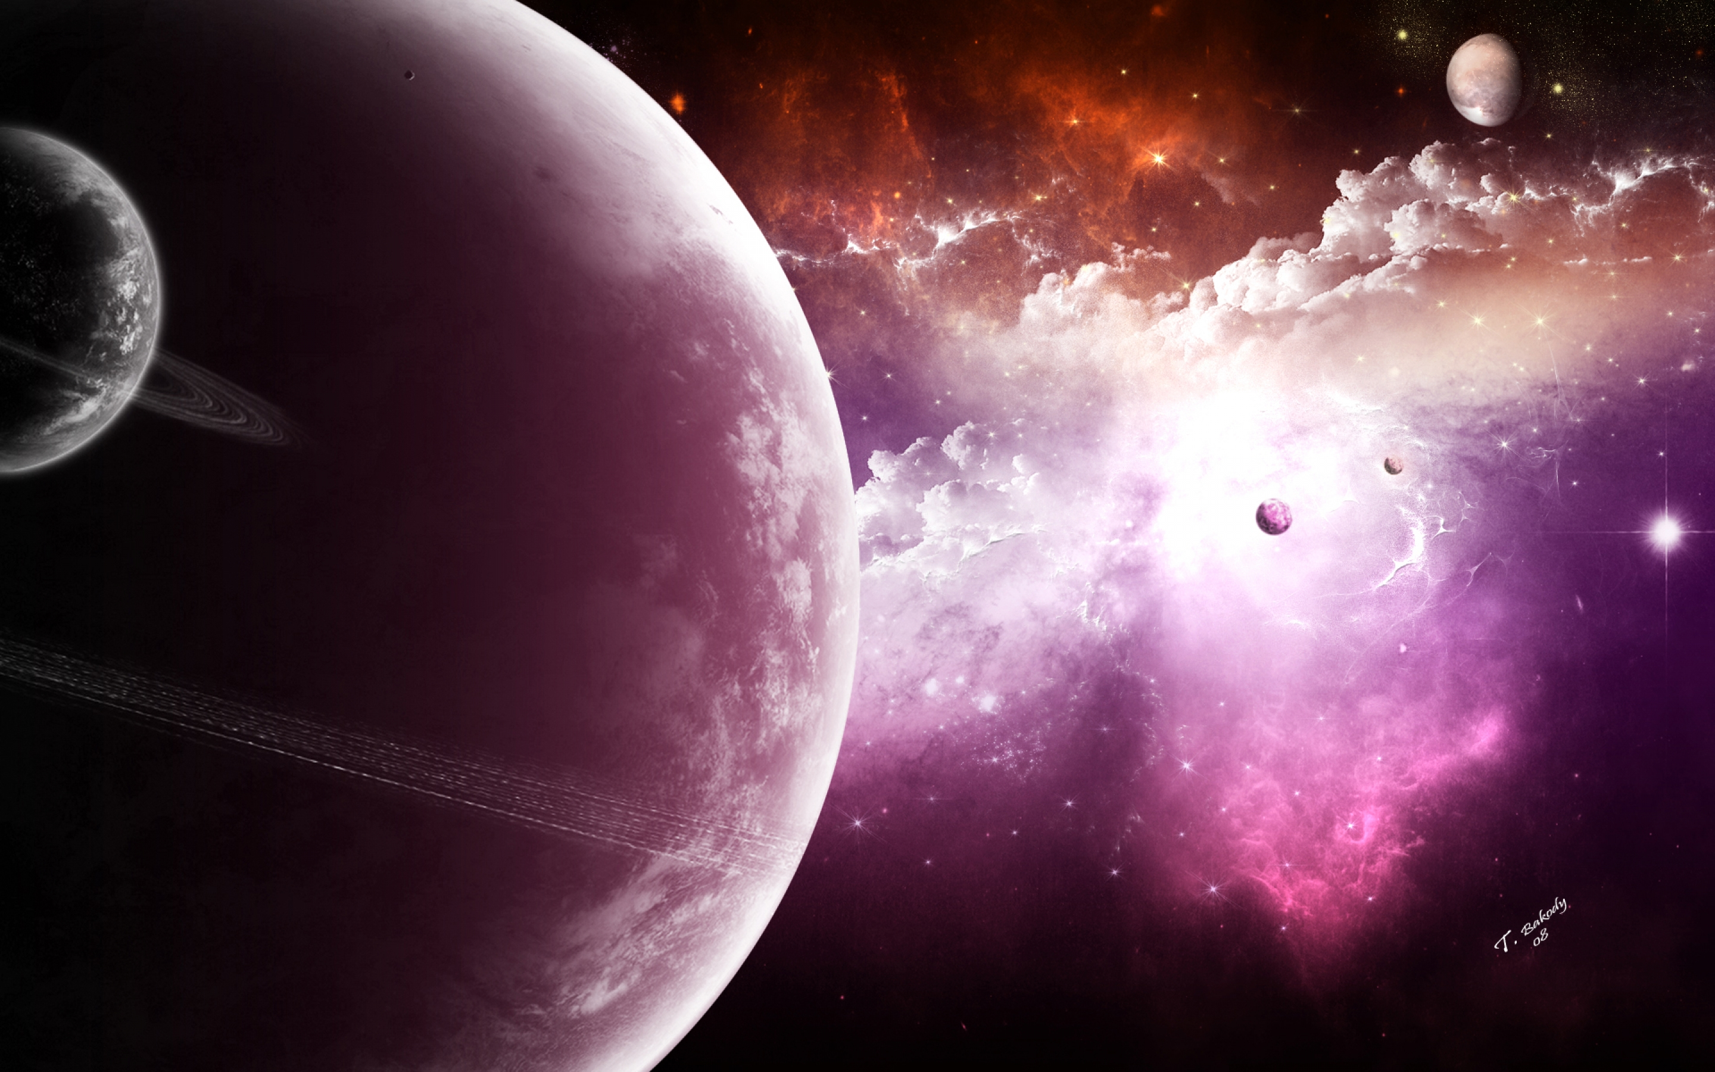
The planet of never believe
Explore the planet
By Abbie

Slide 2
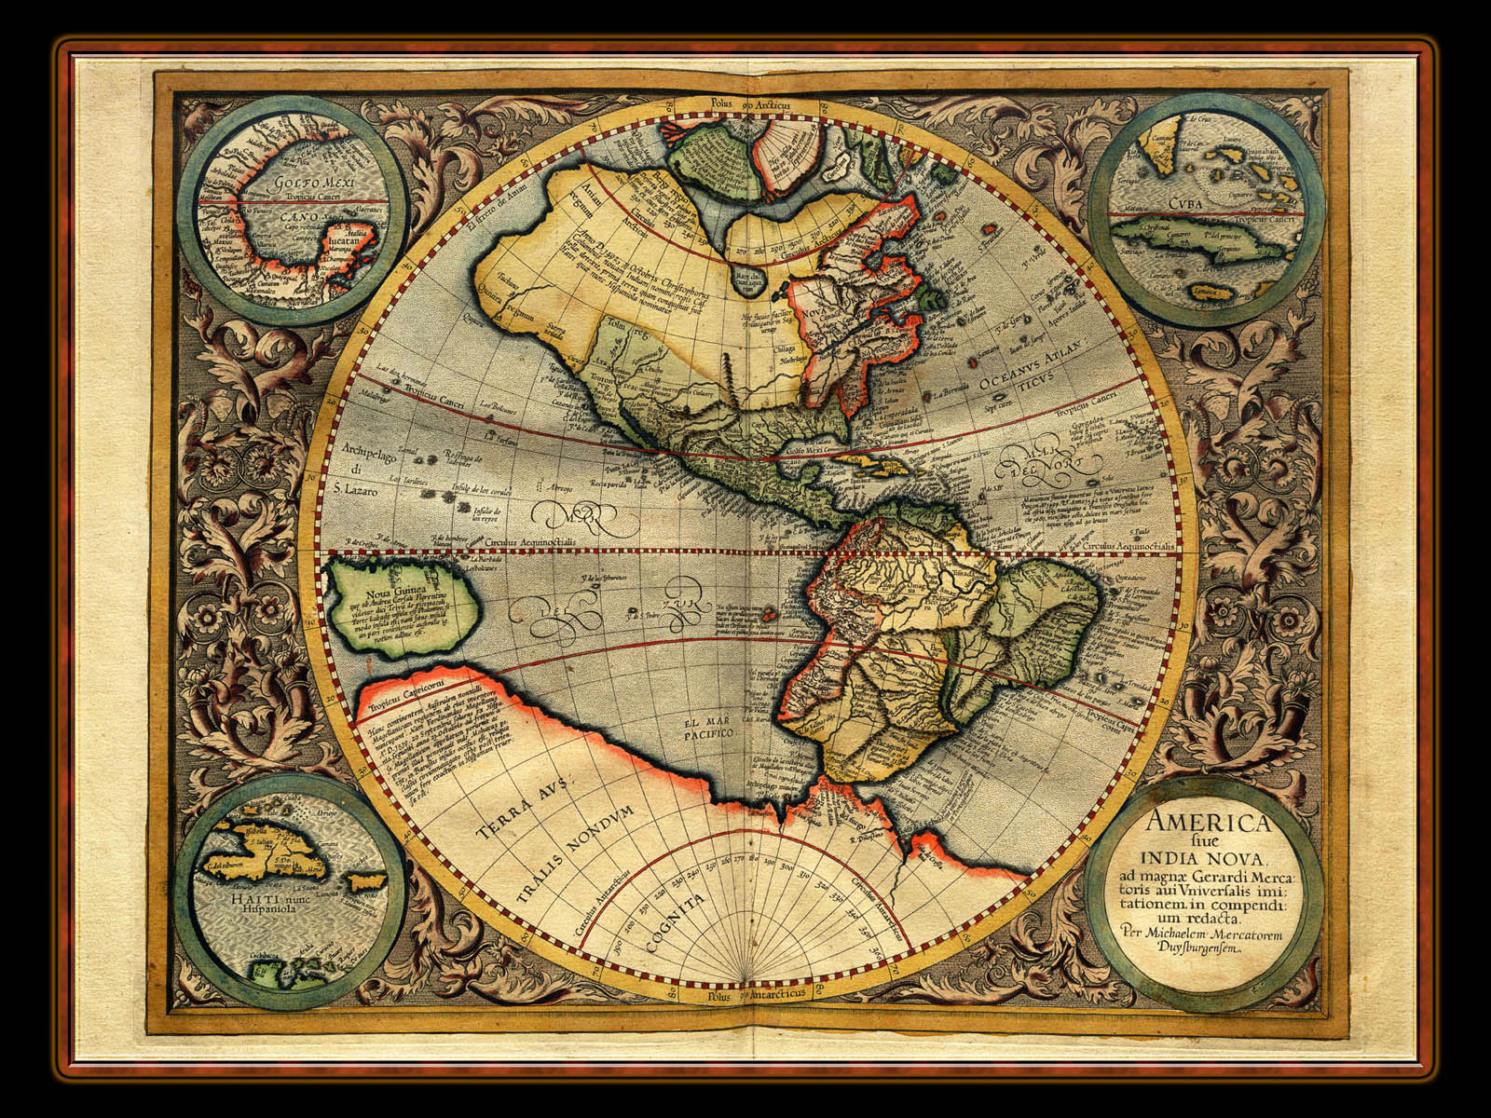
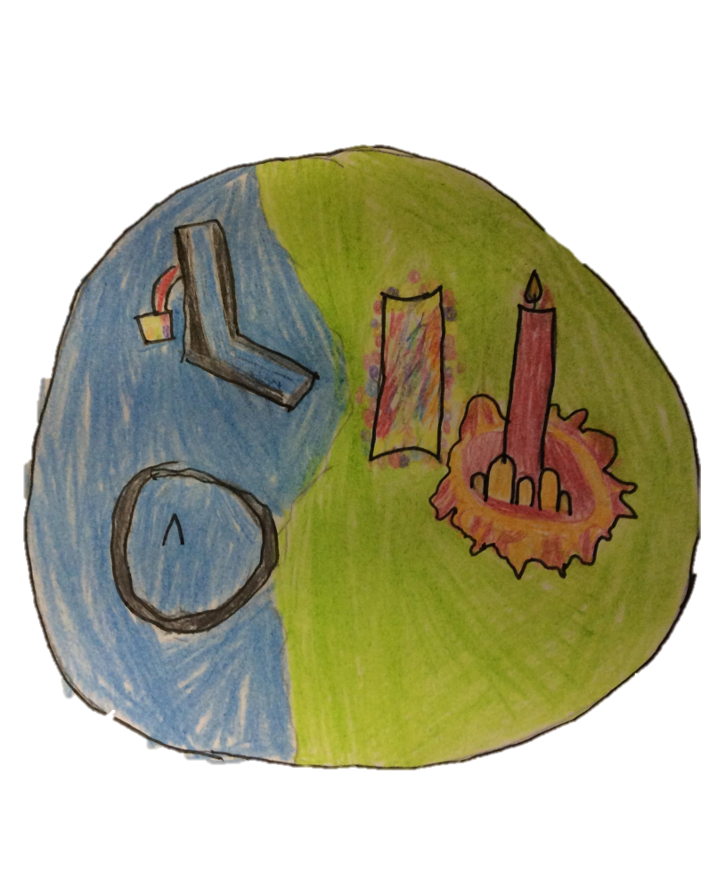
Ice falls
This menacing
AREA Is full of
Shivers and surprises
Like frozen fish and scary faces.
The great candle
The great candle should always be lit otherwise everyone will freeze.
Goo canyon
This oozing place is steamy and warm for anyone. zoggiownians enjoy bathing there on their days off.
Ice shark lake
You will never
Believe the menacing coldness
Around this pool of ice.

Slide 3
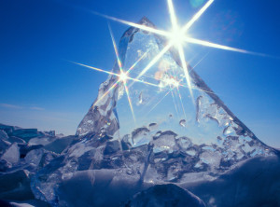
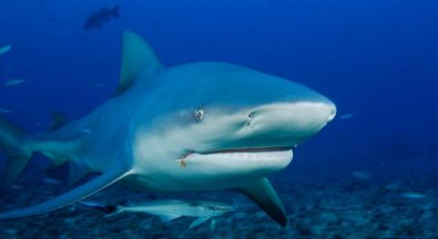


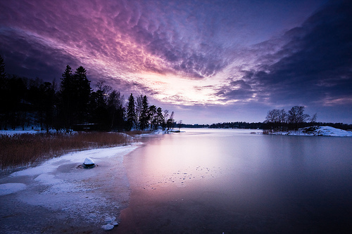
ice shark lake
Ice shark lake has the only ice shark of its kind, bib .she has fifty razor sharp teeth , I still have the scar.
Bib is the guard of the ice palace and lives in a lake that can freeze anything. .
back

Slide 4
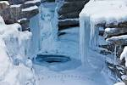


Ice falls
In Ice falls there is a squid with 70 legs. It can freeze anything that is dropped in the water and drops into a cup.
Meet killer.
one slap from him and you would be frozen - I am still recovering, my arm is still half frozen.
Scary faces appear everywhere . I was so scared when this one jumped out at me.
back

Slide 5

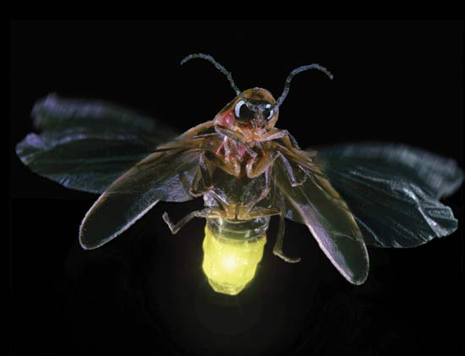
Great candle
Fire flies have a very painful sting - my leg is swollen.
This candle should always be lit because of fire flies that are actually on fire and light it every day.
back

Slide 6


Goo canyon
Goo canyon has zoggownian eating snails although they are small, they are very dangerous.
From ice shark lake to the great candle nothing compares to goo canyon. it is a great place to have fun and bathe but it is extremely hot
back

