Slide 1
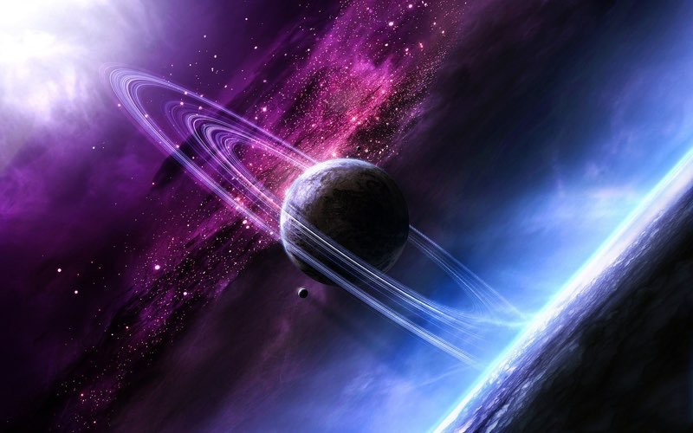
Zogg
Zogg
Zogg is a planet of wonder and mystery with strange beauty lurking inside it. Did you know Zogg was founded on the 15th January 2016 by Emily Stephens? Find out more about Zogg and read this text.
Zogg is a planet of wonder and mystery with strange beauty lurking inside it. Did you know Zogg was founded on the 15th January 2016 by Emily Stephens? Find out more about Zogg and read this text.
By Emily Stephens
By Emily Stephens

Slide 2
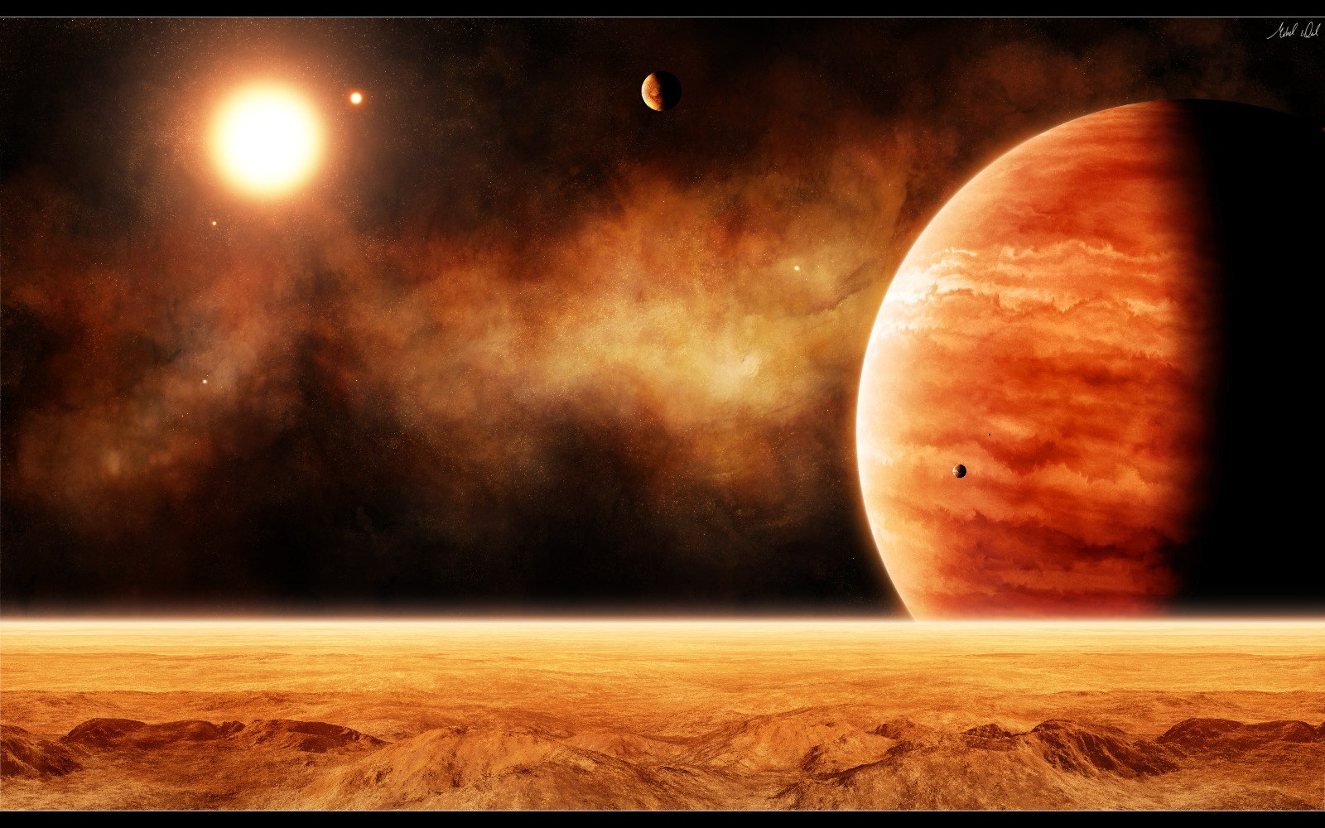
where is Zogg in Zoggimus?
where is Zogg in Zoggimus?
Zogg is the 2nd planet in the solar system of Zoggimus . The sun is called Alpha Zeta the planet closest to the sun is called Nogg then Zogg and last but not least mega. Surprisingly Zogg is 1000 times larger then earth. Its also the biggest planet in the solar system.
translation
Zogg is the 2nd planet in the solar system of Zoggimus . The sun is called Alpha Zeta the planet closest to the sun is called Nogg then Zogg and last but not least mega. Surprisingly Zogg is 1000 times larger then earth. Its also the biggest planet in the solar system.

Slide 3
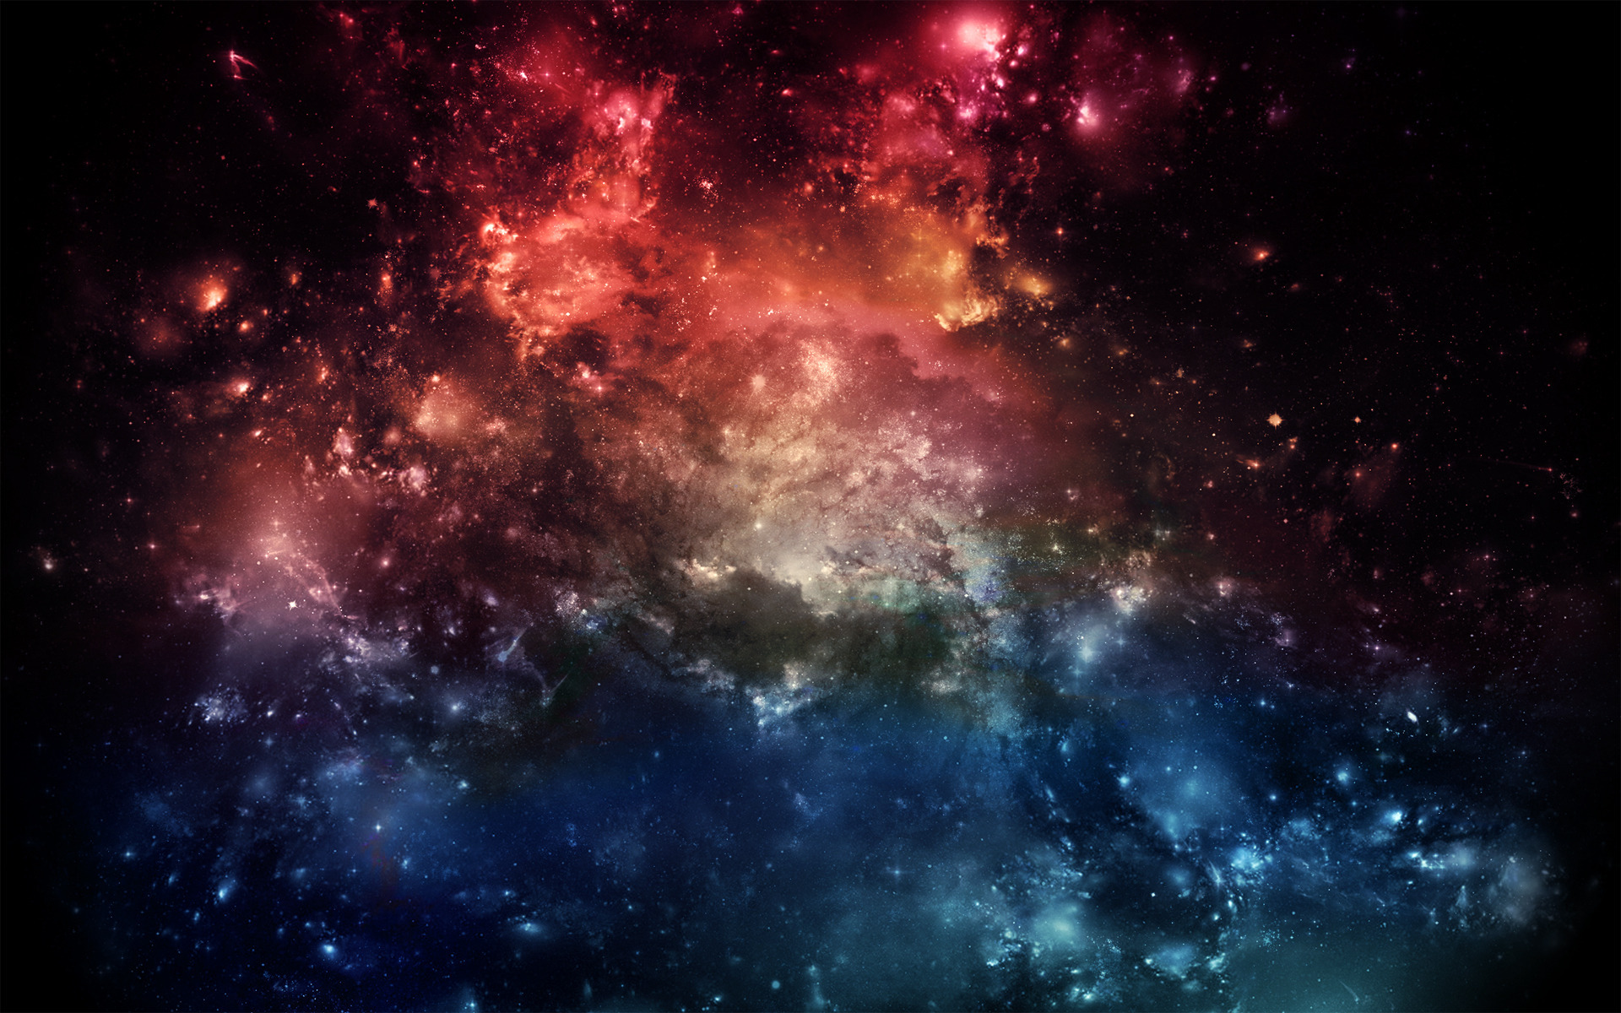
What does Zogg look like?
What does Zogg look like?
Planet Zogg is three quarters red and one quarter blue and squashed in the middle there is yellow water. Once in a while, there is a pop of red which scientists think is lava. Most of the time, we can’t see the blue but we can see big thick snow clouds . Zogg is unusual because it is nearly as large as its sun, Alpha Zeta.
Translation
Planet Zogg is three quarters red and one quarter blue and squashed in the middle there is yellow water. Once in a while, there is a pop of red which scientists think is lava. Most of the time, we can’t see the blue but we can see big thick snow clouds . Zogg is unusual because it is nearly as large as its sun, Alpha Zeta.

Slide 4
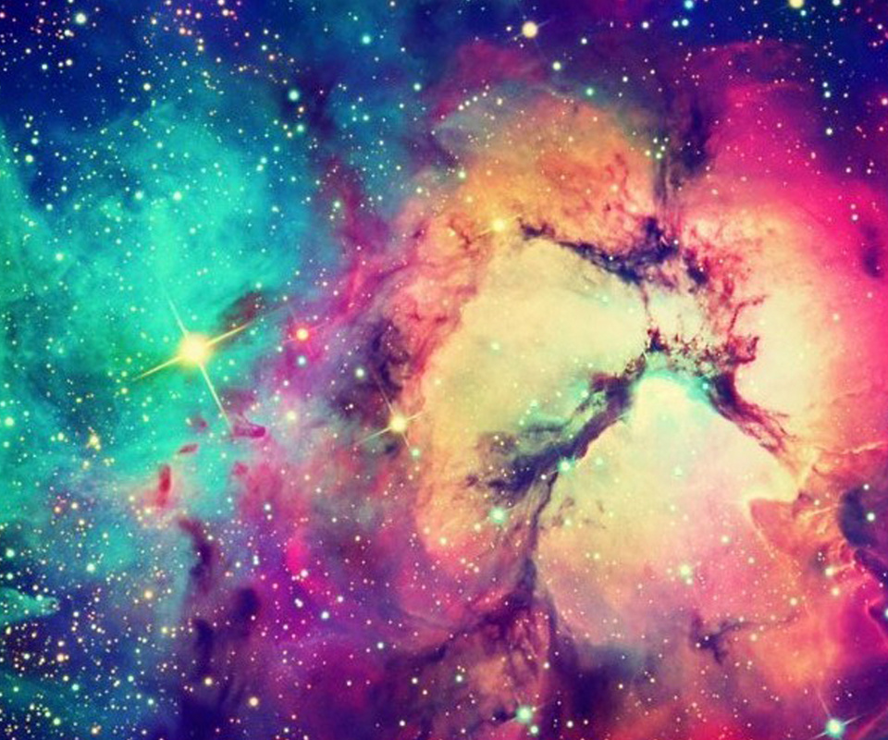
What is Zogg made of and then how is it formed?
What is Zogg made of and then how is it formed?
The red part of Zogg can get up to 9999°c. The blue part can go down to -9999°c and the yellow water is around 0°c.The red part is rocky with volcanoes and lava which is by the yellow water . The blue part is icy , cold and slippery with snow caves . By the yellow water there is normal water. When both of the liquids are mixed together it makes yellow water
Translation
The red part of Zogg can get up to 9999°c. The blue part can go down to -9999°c and the yellow water is around 0°c.The red part is rocky with volcanoes and lava which is by the yellow water . The blue part is icy , cold and slippery with snow caves . By the yellow water, there is normal water. When both of the liquids are mixed together, it makes yellow water

Slide 5
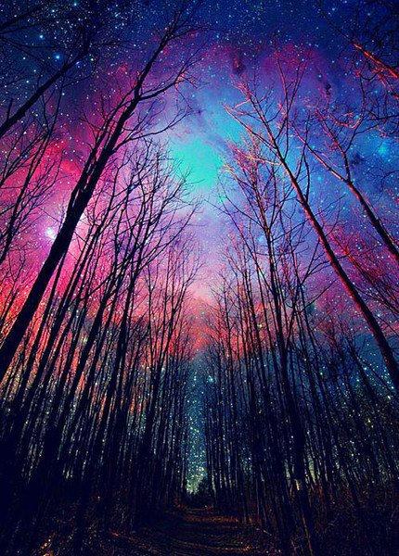
What are Zogg’s moons?
What are Zogg’s moons?
Zogg has 4 moons pi Mu, Sigma Iota, Nu Ma and Iota Omega. Iota Omega is the most well known and there are signs of life, water and we will be sending a probe up in the very soon in the near future. Sigma Iota is half the size of Zogg yet Nu Ma is one eighth of planet Zogg
translation
Zogg has 4 moons pi Mu, Sigma Iota, Nu Ma and Iota Omega. Iota Omega is the most well known and there are signs of life, water and we will be sending a probe up in the very soon in the near future. Sigma Iota is half the size of Zogg yet Nu Ma is one eighth of planet Zogg

Slide 6
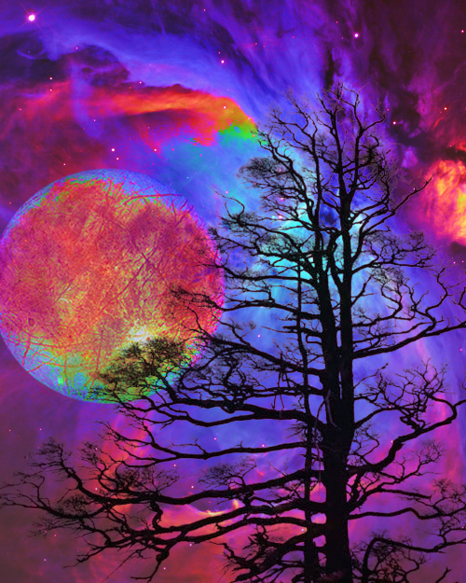
Zogg is a very extremely interesting planet in the solar system Zoggimus . We are hoping to find out more about this fascinating planet in the near 3 months when the probe has finally reached Zogg

Slide 7
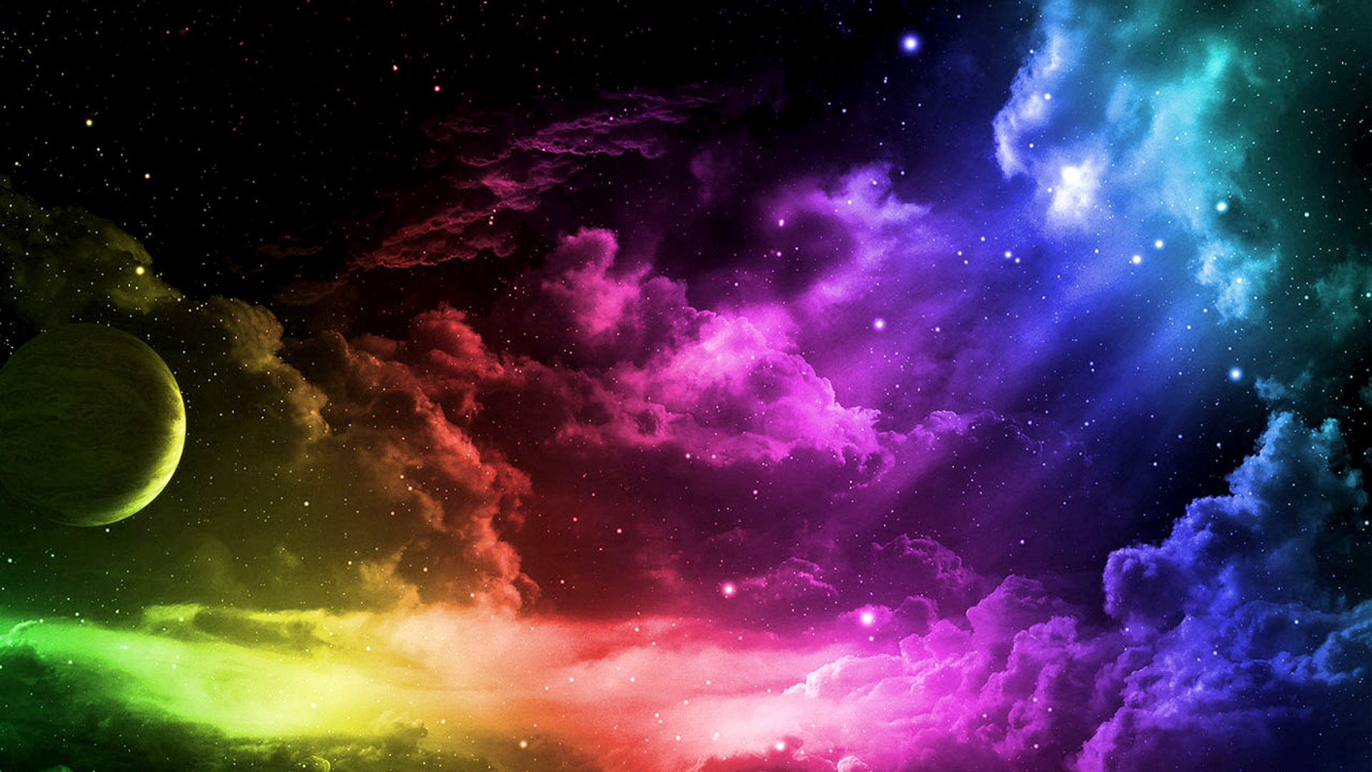
I hope we can find out more about Zogg and Zoggimus but I guess we will never know all the secrets of this amazing solar system and we will never fully uncover the secrets of our solar system as well.
That’s all for now on the amazing plant of zogg

