Slide 1
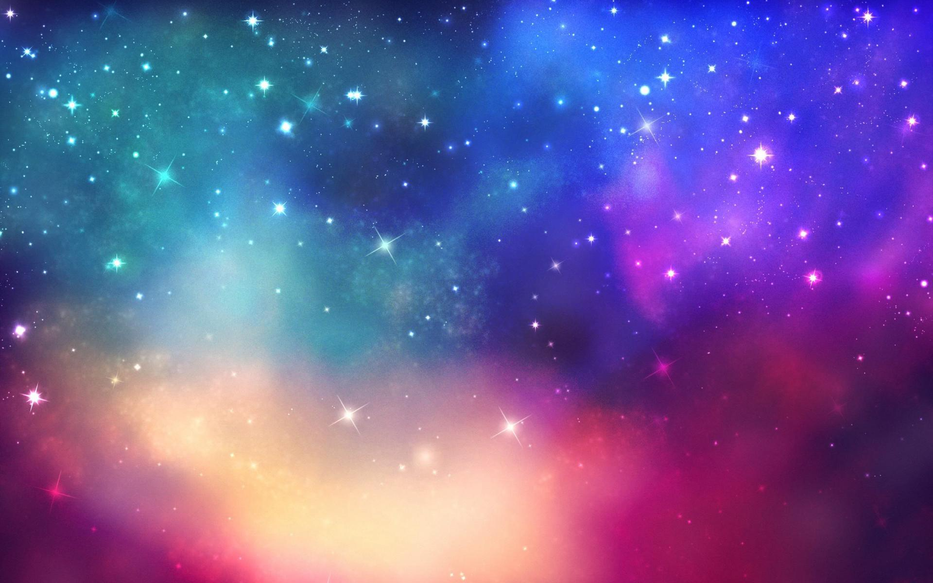
The Planet of Never Believe
By Amelia Metcalf
EXPLORE THE PLANET

Slide 2

When most of my exploring and recording had been achieved, I realized that I had begun to feel very at home here and did not want to leave. All the friendly Zoggonians and never before seen creatures and trees it seemed too much to leave behind . Unfortunately though, my amazing adventure had come to an end.
However, now I have the fantastic opportunity of writing a wonderful book on my fabulous trip and relive all the memories.
On the day I discovered the Planet Of Never Believe I was on a once in a life time trip through space and I suddenly became aware of a spectacular looking planet . Fascinated and enthralled by its intriguing features I began to approach it to investigate.
On setting foot on the planet I was immediately spellbound by its beauty. There could be nowhere else in the galaxy quite like this. Such trees, creatures and amazing Zoggonians you would never believe it. This was a place I had to explore and record
I hope this book will give some insight into the peculiar and mesmerizing encounters I had on the planet
Planet of Never Believe expert Amelia Metcalf

Slide 3
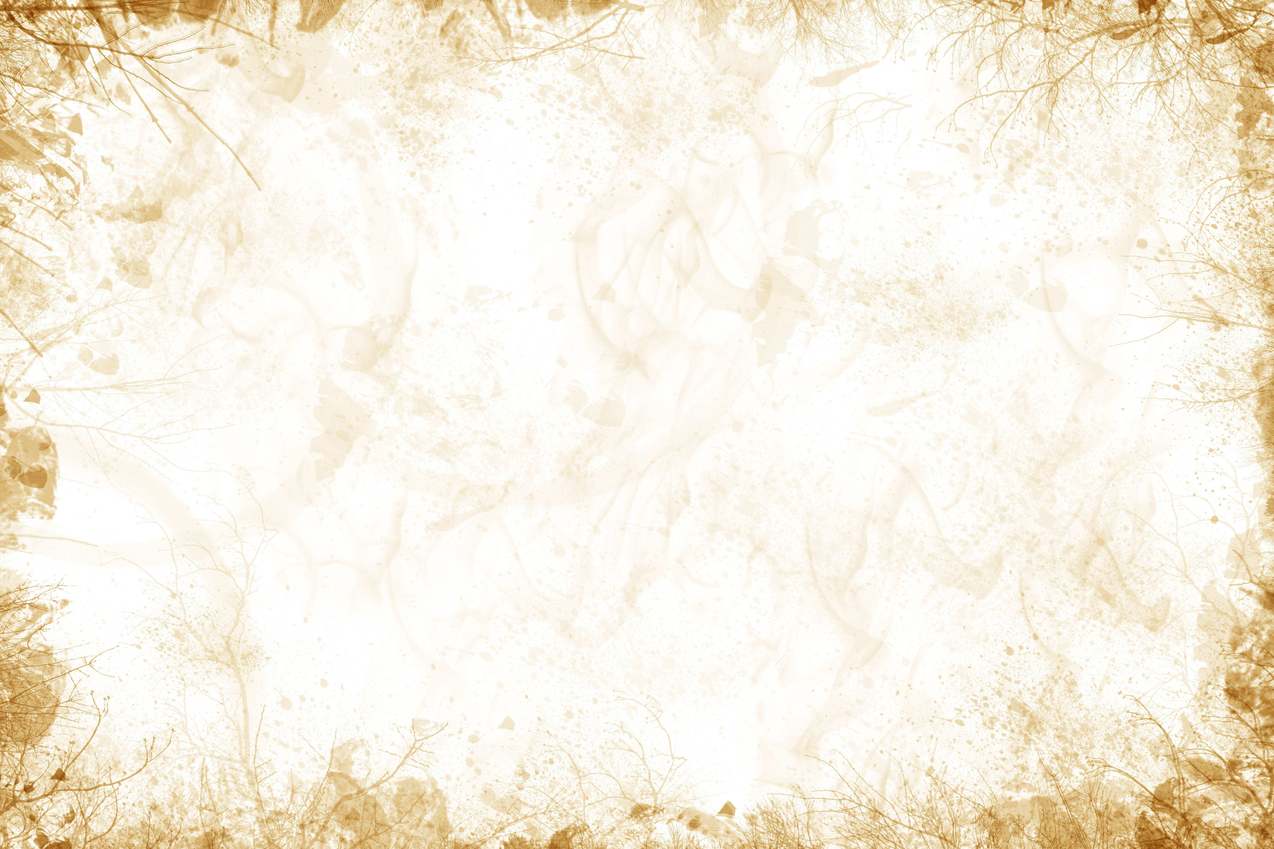
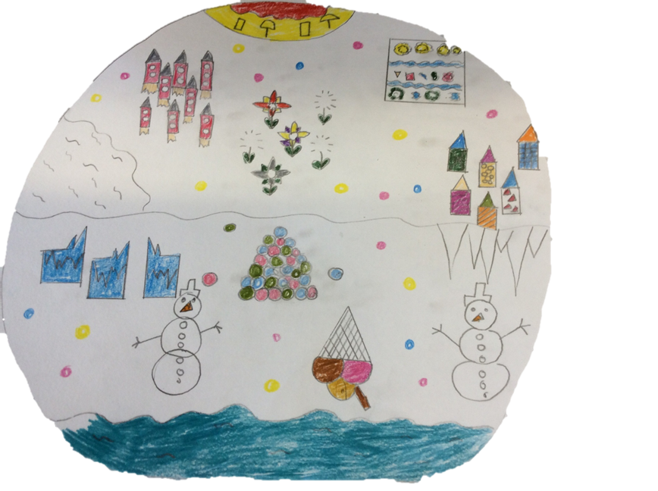
Beach Hut Close
A wonderful huddle of quirky, fanciful beach huts lie in the centre of the picturesque landscape.
Planet Allotment
This, what seems to be normal, allotment in fact produces some of the strangest fruit and veg known to man.
Flower Pop Meadow
An intense mix of colours explodes over Flower Pop Meadow. This enchanting area sees many Zogonnians hunting for flowers with a twist.
Rocket Lake and Rocket Forest
In and around the forest is Rocket Fuel Lake used for refuelling and transportation in the Rocket Trees.
Zair Salon
Imagine a place where you could get multi-coloured hair, a place where you can get any hair style at the touch of a button, a place where you can have a luxurious hair experience any time you like; well if you like the sound of that then you will want to come to the Zaire Salon.
Fire Forest Beach
Fire Forest Beach is a beautiful place with golden sands and crystal blue waters perfect for a peaceful break.
Ice Palace Place
Crystal carvings, beautiful patterns and luxurious snowy furniture. This is the place Zoggonians call home.
I
Bubble Mountain
Snow bubbles grow on Bubble Mountain and are used for yummy snacks for Ziggupils at the Iceychool.
Iceychool
You will never believe it but Ziggupils only go to this school of wonderment and education 3 times a week.

Slide 4
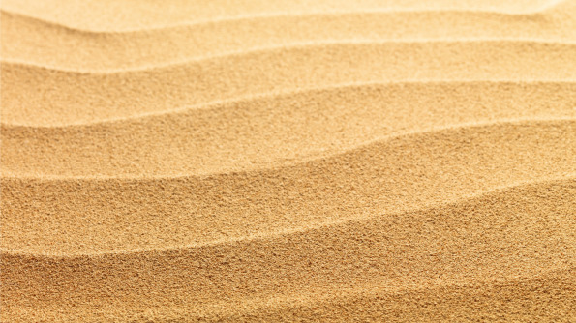
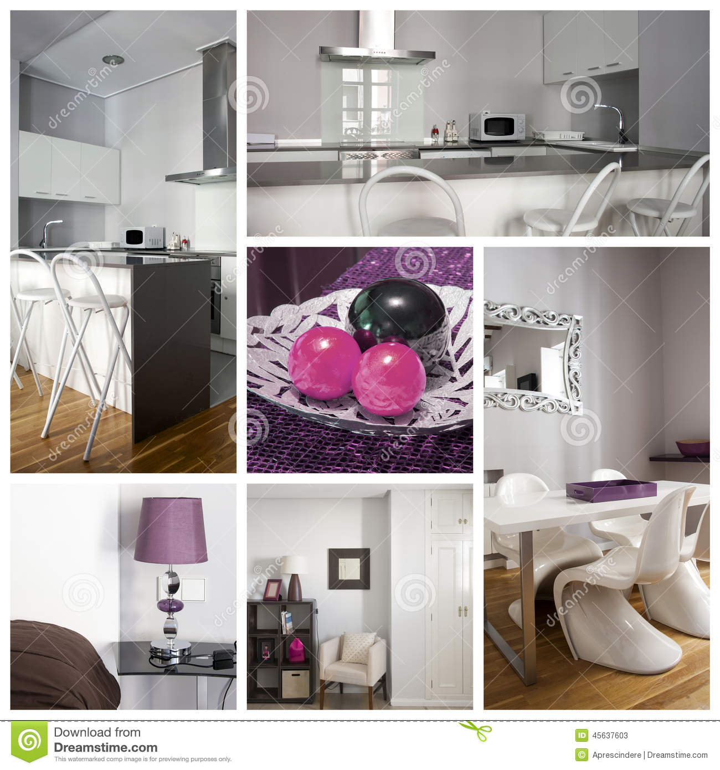
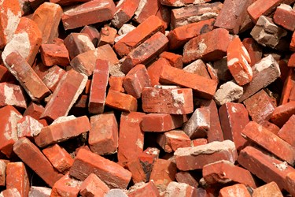

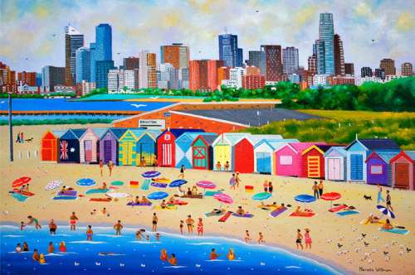
Beach Hut Close
Somehow Zoggonians manage to turn the blandest and broadest spaces into a land of magic and wonder
From triangular to circular and curved to straight. The most finest bricks are used to build the exquisite huts.
No two buildings are the same. The interiors are ornately decorated and exteriors painted in sugary colours giving them an edible cake- like appearance.
Back

Slide 5
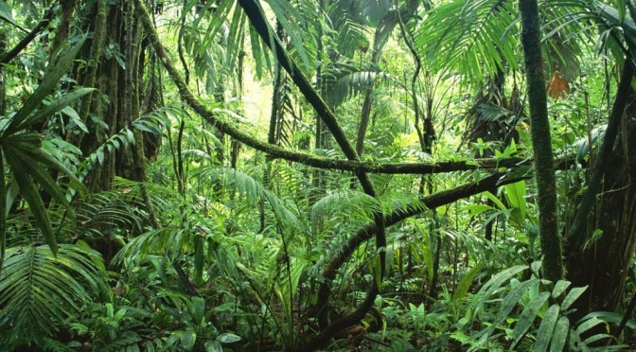
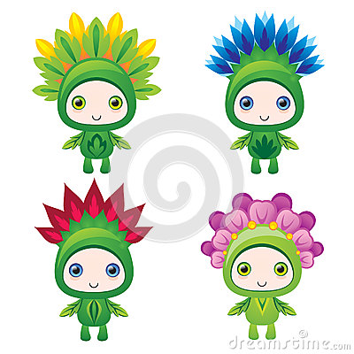
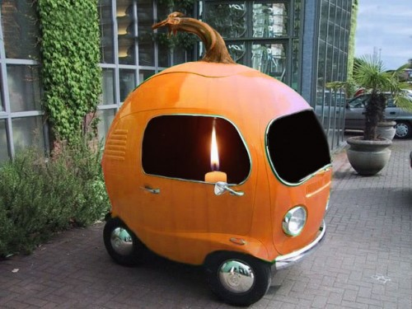
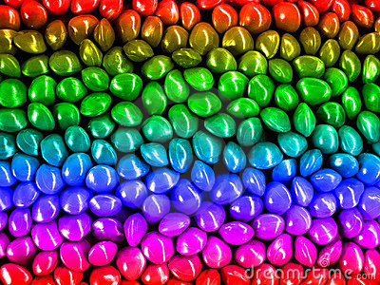
Planet Allotment
Rain or shine , thunder or snow nothing will stop the Zoggonians from sewing the seeds and watering the plants.
Pumpkin Cars
You will never believe it but Zoggonians use the most peculiar type of transport … Pumpkin cars.
Planet Food
Seeds of various planet plants come in such unusual shapes and striking colours. This strange variety of fruits and veg are deliciously delicious to eat.
Back

Slide 6
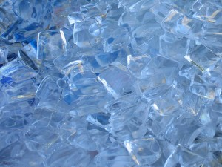
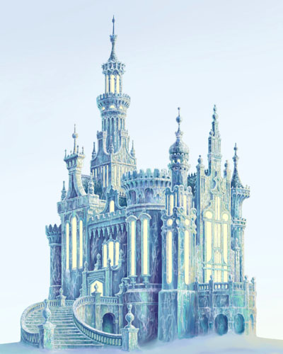
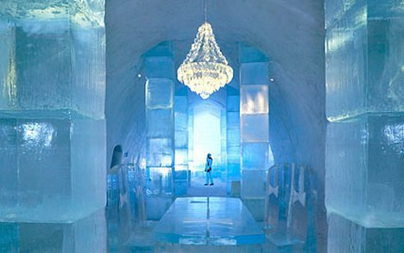
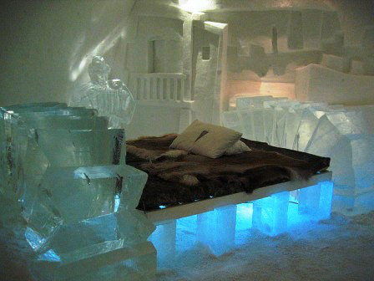
Ice Palace Place
What could be nicer than living in an ice palace? All buildings hand carved with the most precise measurements and use of wonderful patterns.
Many strange natural things are used to decorate the palaces.
Ice bricks are made and carved ending up with beautiful and mind blowing patterns.
Back

Slide 7
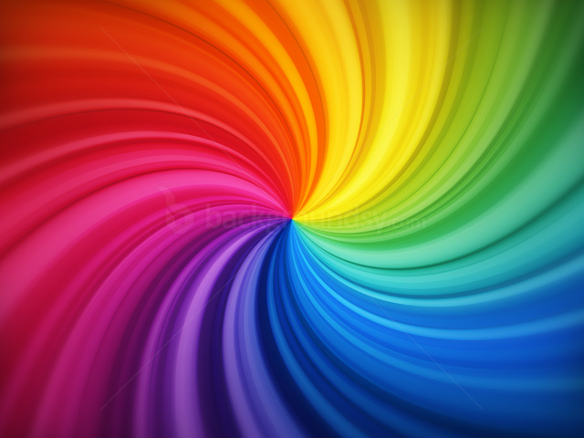
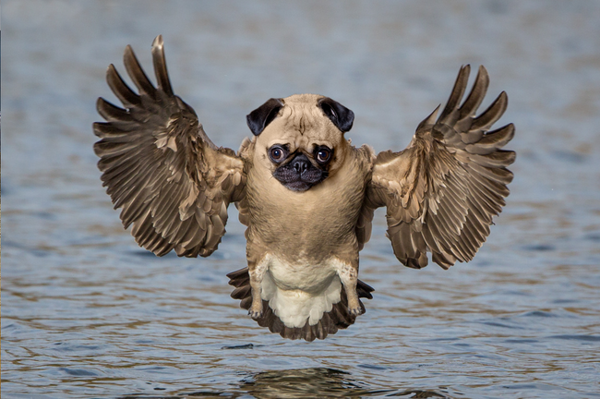

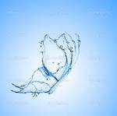

Rocket Forest and Rocket Fuel Lake
Fancy a dip in a Rainbow Lake? Well I have had that experience and it was amazing…but it is not only used for swimming it is Rocket Forest fuel as well.
Wow!
Every full moon the lake creates jaw-droppingly good formations made of rainbow.
Meeting all these tropical creatures was an unforgettable experience. These animals lurk at the depths of the lake but in summer they enjoy playing with the Zoggonians
Back

Slide 8

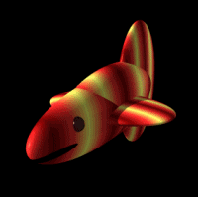
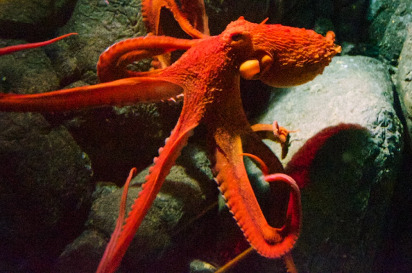
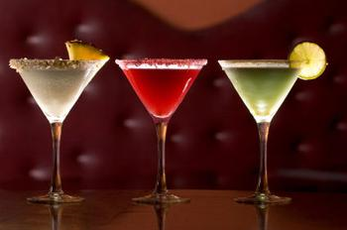
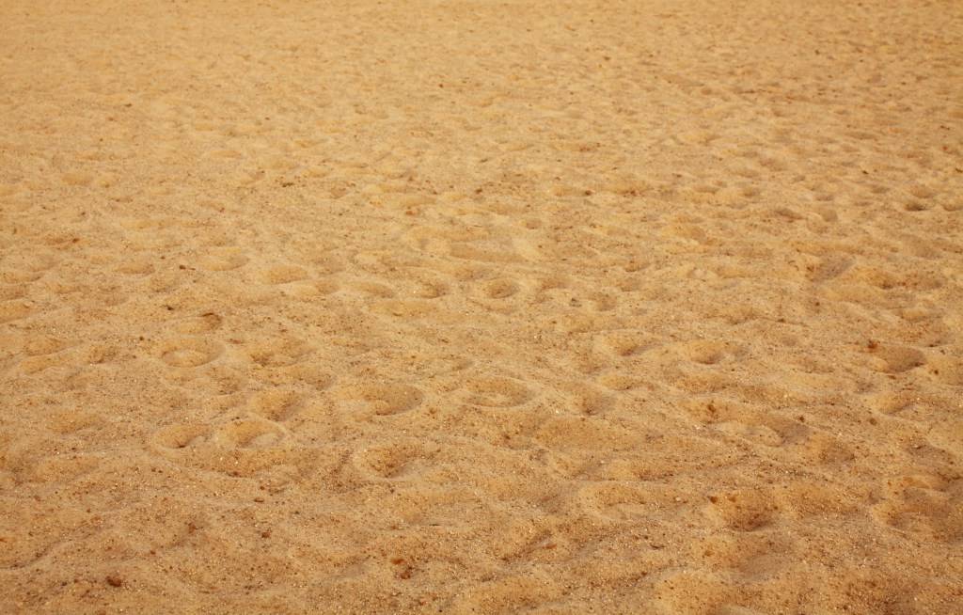
Fire Forest Beach
An abundance of amazing animals lurk in the dark depths of the ocean.
Do not stay to long though you might turn into a frazzle.
The sand so soft and warm. Not only that but you can relax on sunbeds whilst drinking the most exotic smoothies and cocktails.
Back

Slide 9
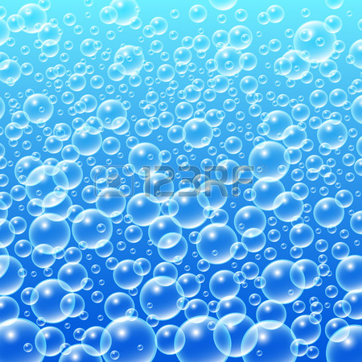
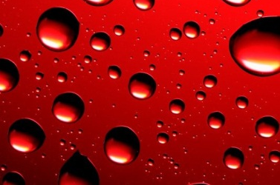


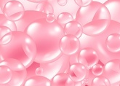
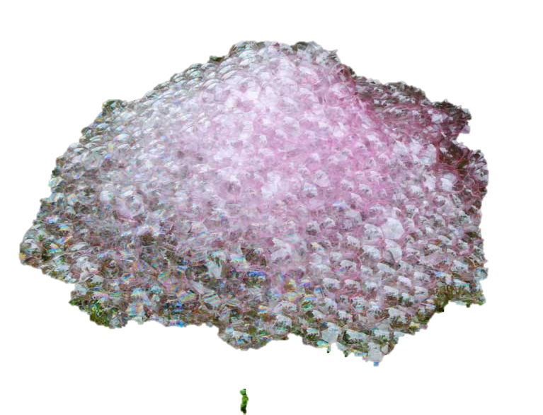
Bubble Mountain
I tasted the most delightful bubbles filled with the most flavoursome pumpkin.
The view from the top is marvellous. The whole of Zogg is in view.
This calm, tranquil area lies in the heart of the southern hemisphere. It's bubbles are picked and stored then used as yummy snacks at the Iceychool.
In the seasons the colours change. In winter they are blue. Summer red, Spring yellow and Autumn green.
Back

Slide 10

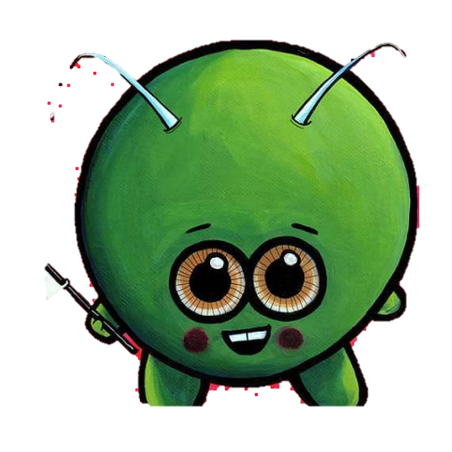
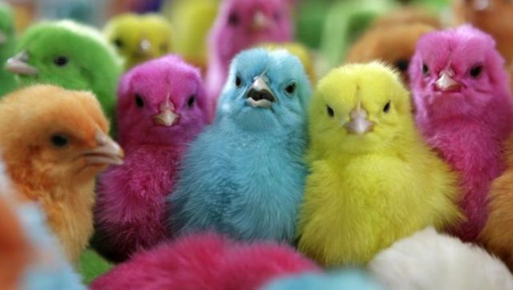
Iceychool
The Boo Boo Chink is an entertaining creature, which grows just above the Icy Ooze Lake liked to watch the Zupils run around and play with the school pet.
Pupils live in a world of excitement and 5 star education.
Maths,literacy,science,icecream making you name a class this school will teach it.But they do not use pencils and rulers oh no they use Pop Flowers moulded into anything they like.
Wild and weird that is what you would call these school dinners. I was lucky enough to try a plate of bubbles and glass of icy ooze water. As well as the beautiful appearance the taste is exotic and tangy..
Back

Slide 11
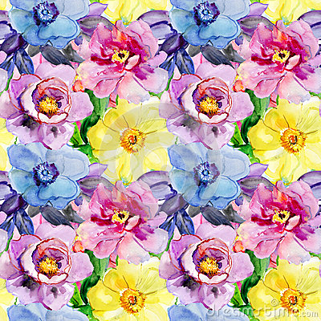
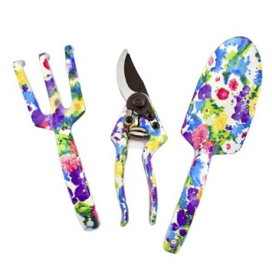
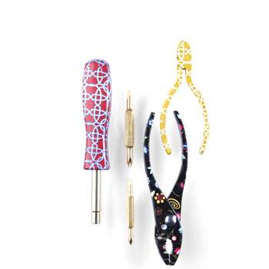
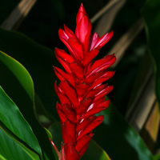
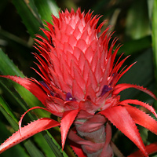
Flower Pop Meadow
When the petals pop off they are moulded into anything and everything needed on the planet.
Pop Flower Meadow sees many Zoggonians come and go searching for an unusual way to decorate their living pods
You will never believe it but all Zaire salons on the planet use these flowers of amazement to die hair and decorate.
Back

Slide 12

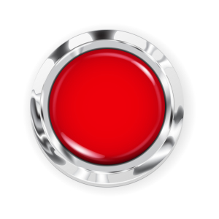
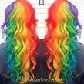
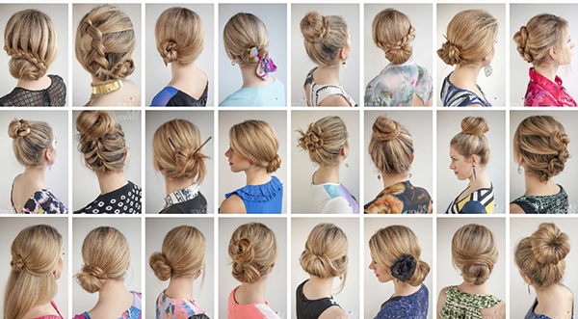

Zaire Salon
Imagine a place where you could get multi-coloured hair, a place where you can get any hair style at the touch of a button, a place where you can have a luxurious hair experience any time you like; well if you like the sound of that then you will want to come to the Zaire Salon.
At the touch of a button you will have your dream hairstyle.
Not only are you getting a fab new look you are having it done by Lord Zairington the best stylist in the world.
The salon also offers a range of wonderful planet wigs available at extremely reasonable prices.
Back

Slide 13
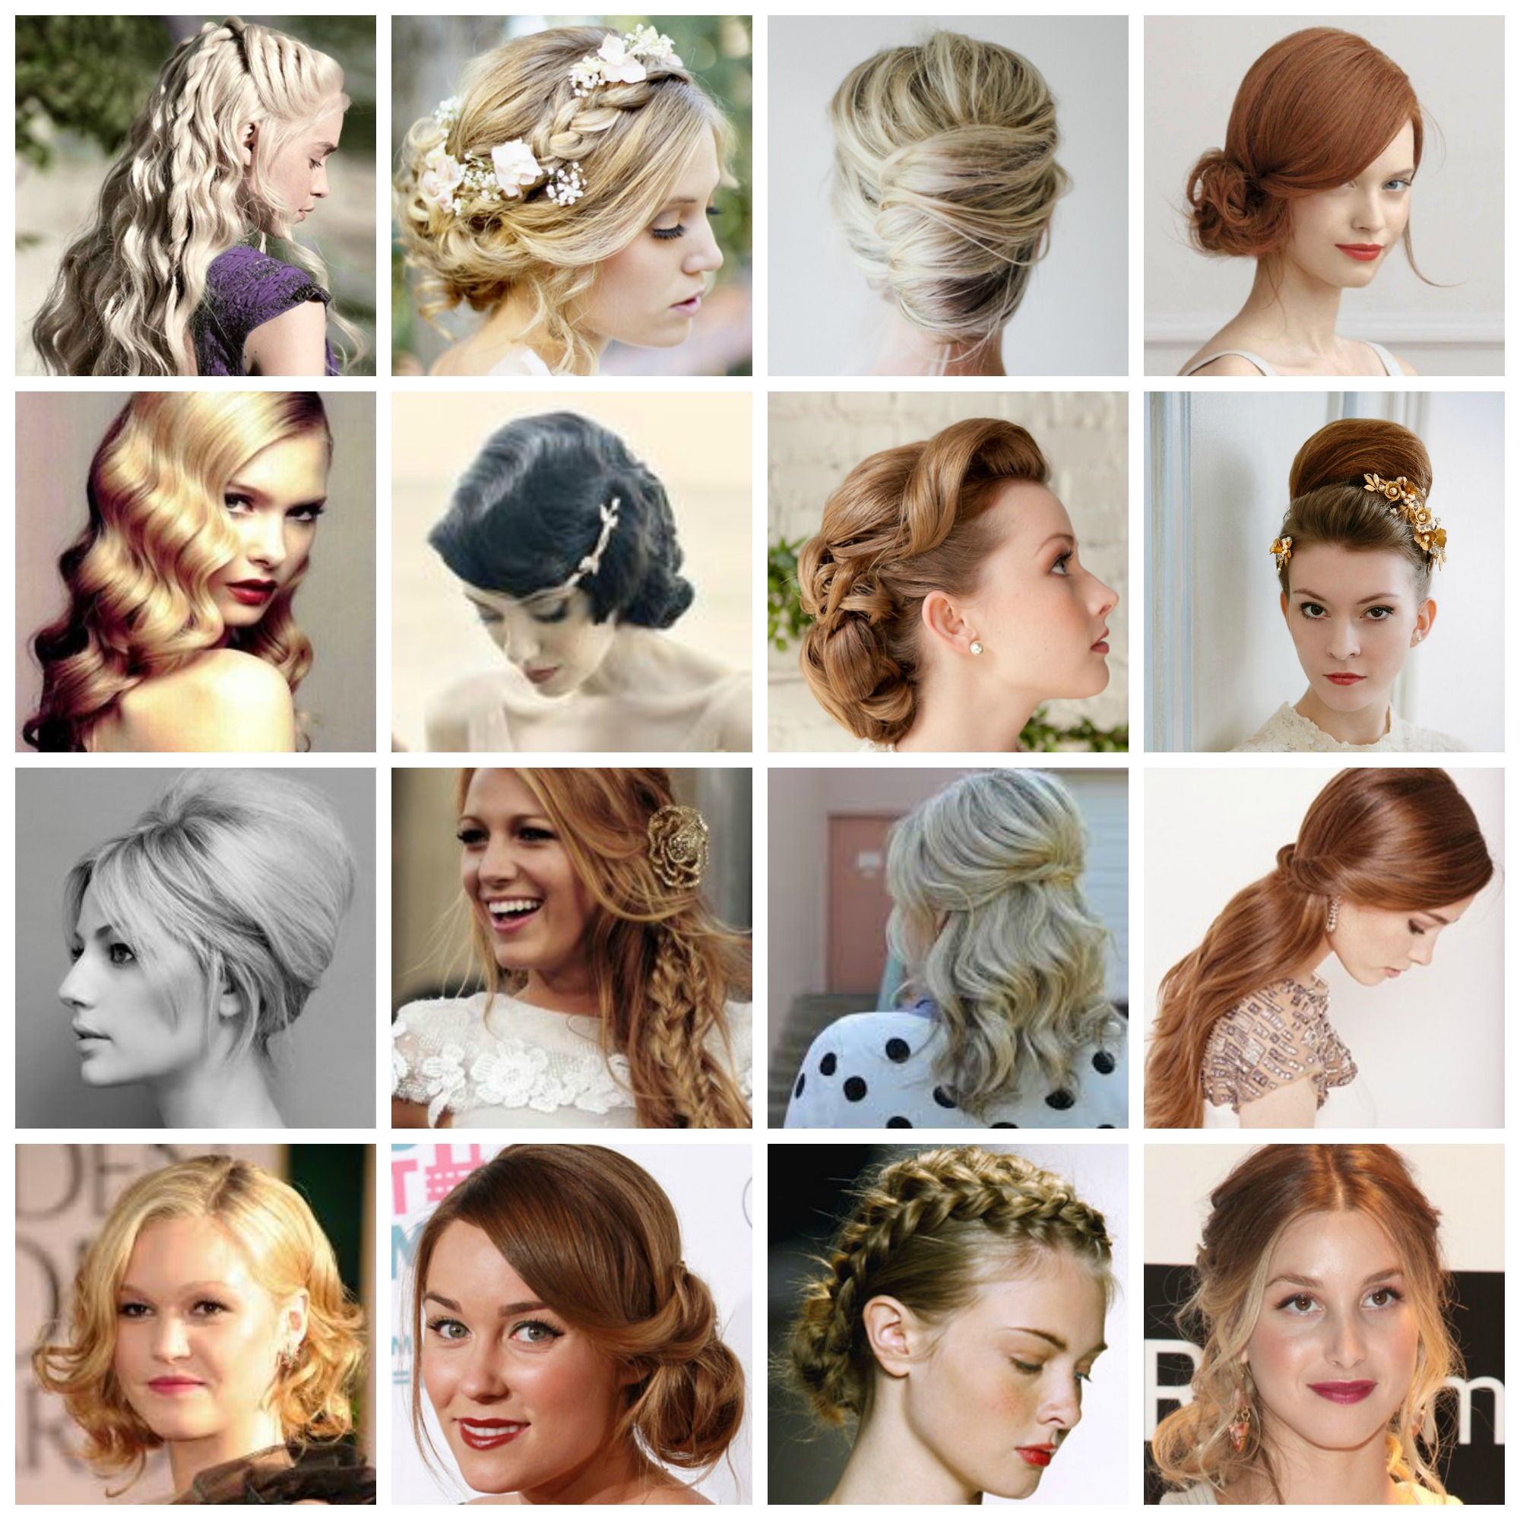
I told you, you could have a dream hairstyle at the touch of a button.
Back

