Slide 1
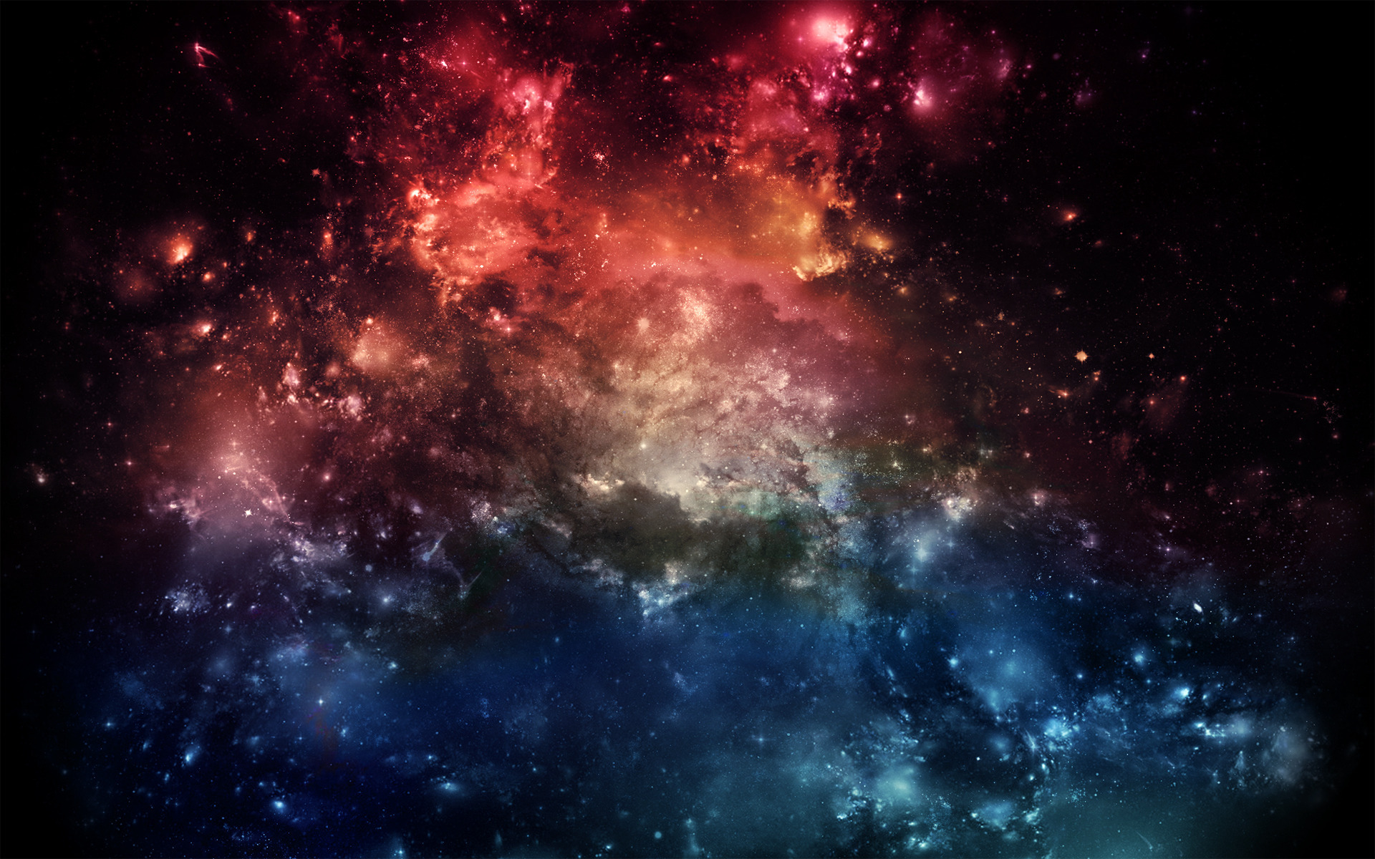
The Planet of Neverbelieve
Jump to hyperspace
By Henry Scott

Slide 2
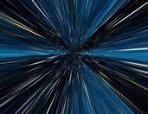

Slide 3
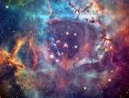

ZOGG. A world of incredible danger and strange beauty. ZOGG was first observed by 9 year old Henry Scott who was at astronomy camp at the time. Did you know humans can’t breath on this extra terrestrial planet?
Translation ZOGG. A world of incredible danger and strange beauty. ZOGG was first observed by 9 year old Henry Scott who was at astronomy camp at the time. Did you know humans can’t breath on this extra terrestrial planet?

Slide 4

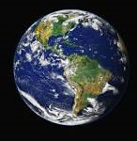
Where is ZOGG’s solar system?
You can see ZOGG’s solar system from the southern hemisphere of Earth
ZOGG’s solar system is called Omicron Omega.
It is the 5th planet from the sun.

Slide 5

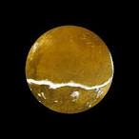
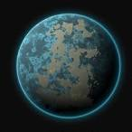
What does ZOGG look like?
ZOGG in the summer
ZOGG is a yellow like colour in the in the summer and blue with orange blobs in the winter.
ZOGG in winter.
This planet has invisible rings that can only be seen with thermal goggles.

Slide 6
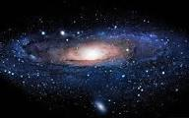
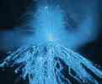
What is ZOGG’S structure/atmosphere like?
When you enter ZOGG’s atmosphere you will experience 8g because of the intense gravity.
At the North and South of ZOGG there is a volcano. The one at the north is a normal volcano and the one at the South is a ice volcano which hasn't erupted in 20 years.

Slide 7

How many moons orbit ZOGG?
Sigma gives the most gravity.
There are 10 moons orbiting ZOGG and they are…
Sigma (main),Psi,Chi,Rho, Lambda, Alfa, Beta,Zeta,Epolition and Iota.

Slide 8

In June 2016, N.A.S.A is launching a 10 man rocket to research on ZOGG.
Scientists know almost everything about ZOGG.
The Pentagon hope they will bring back more facts about this fascinating planet.
Until then, ZOGG is another unknown mystery…

Slide 9


Slide 10


Slide 11


