Slide 1


Slide 2
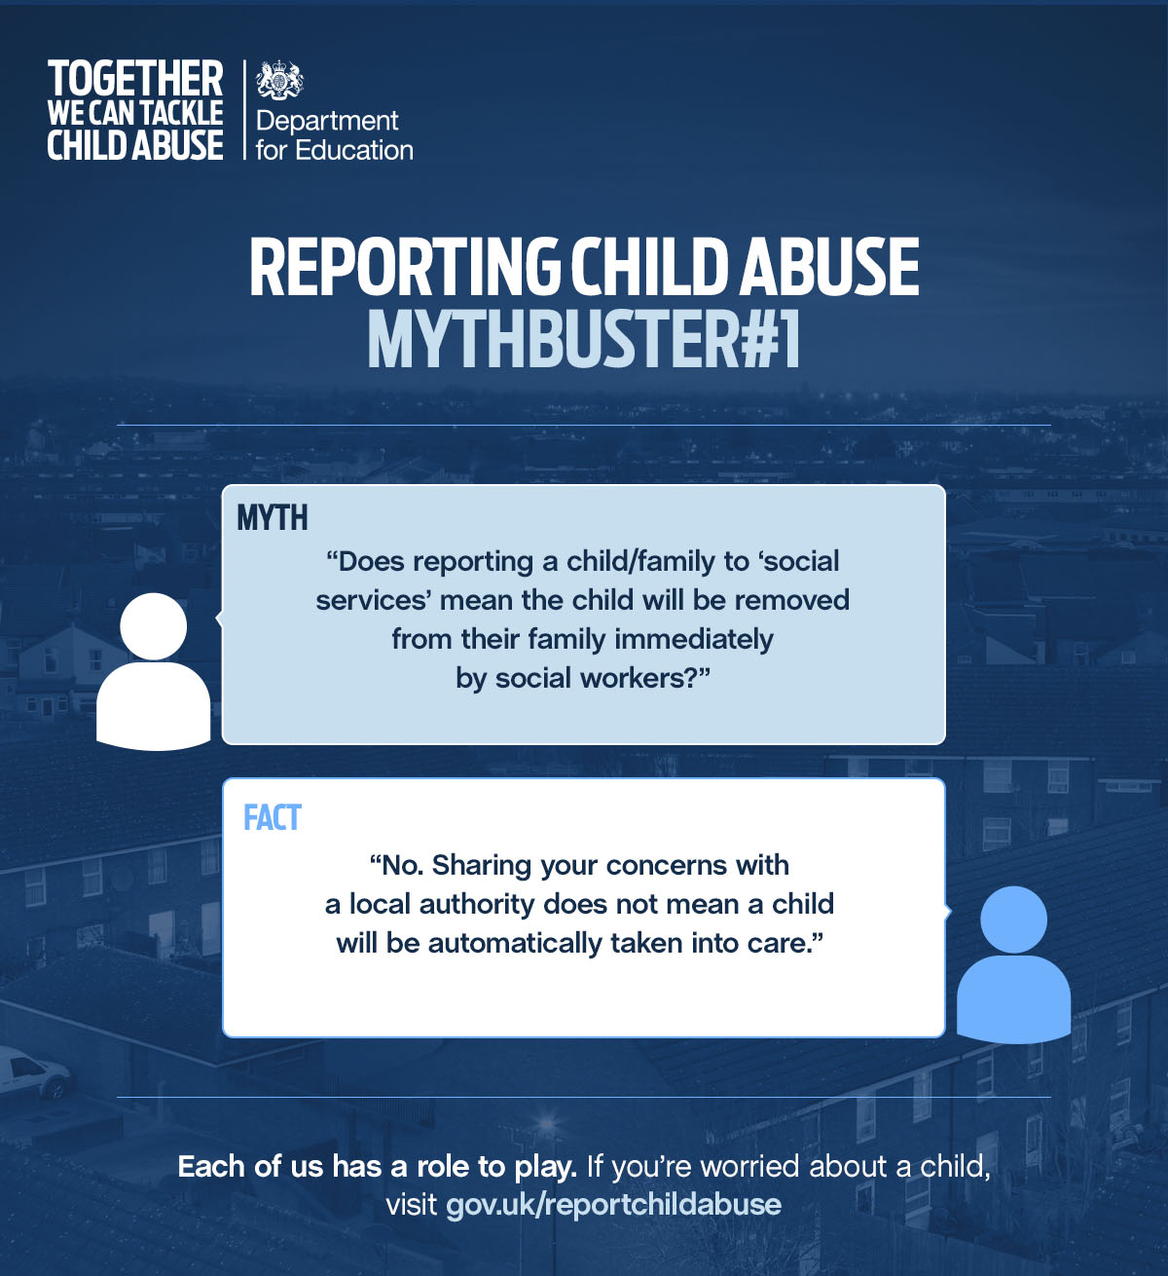

Slide 3


Slide 4


Slide 5
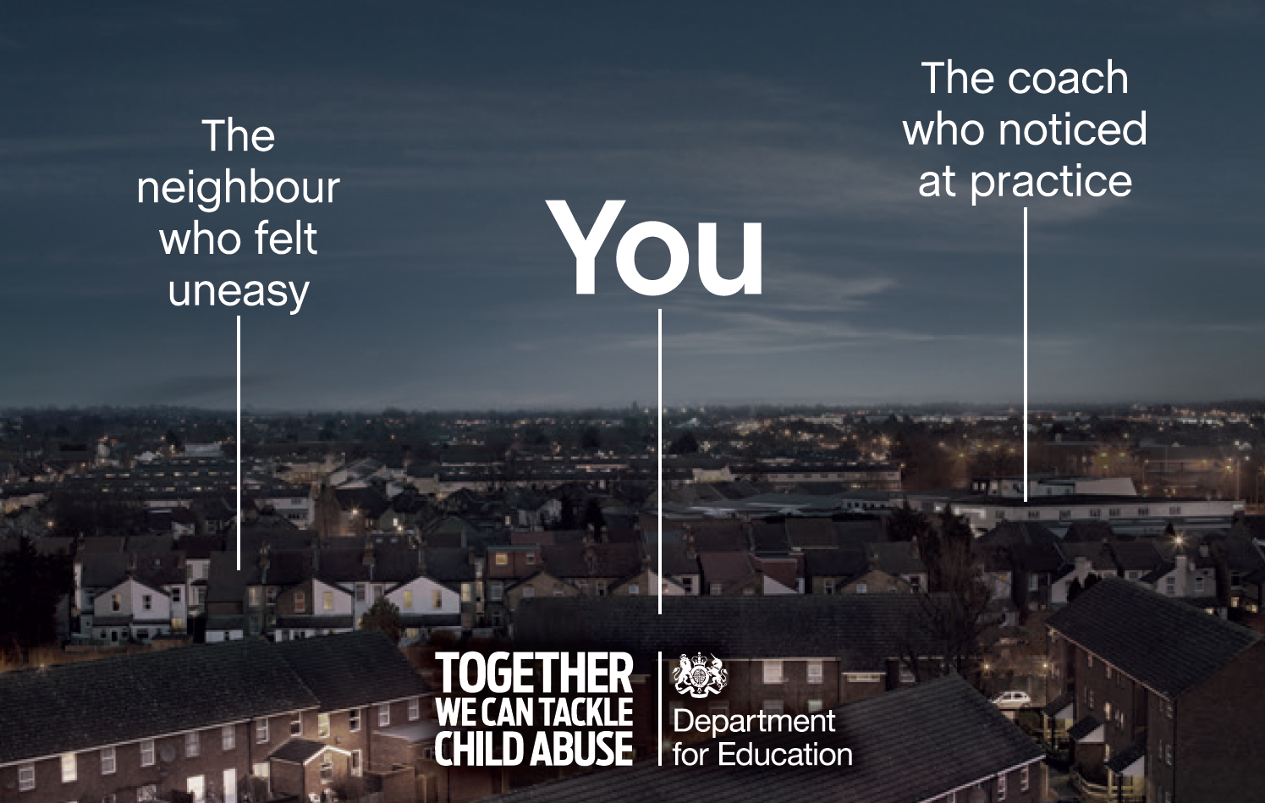

Slide 6


Slide 7
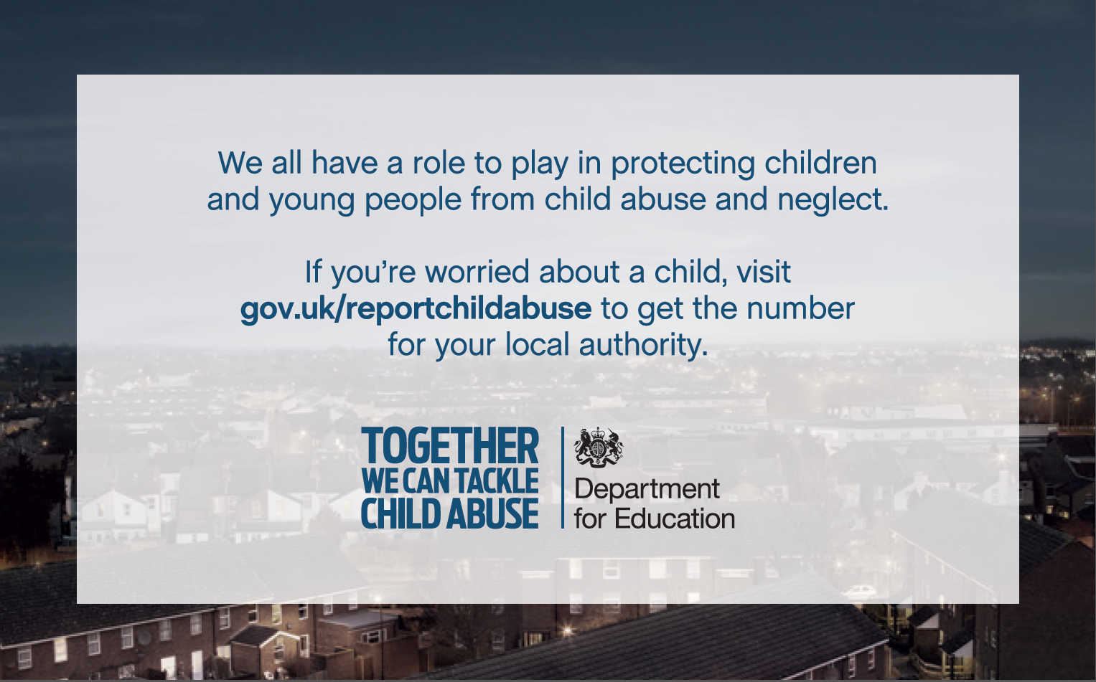

Cheshire West and Chester Council Children’s Social Care
Call us on: 01606 275099
During out of office hours call our
Emergency Duty Team on: 01244 977277

