Slide 1
Read Write Inc. Phonics
Parents’ Information
Notes:
Approximately 20 minutes is needed for this session.
Notes are provided to help you lead the presentation.
Notes in italics are for your attention only.
Provide copies of ‘Reading at Home Booklet 1 or 2’ from Oxford Owl.
Booklet 1 is sound groups and Ditty/ Red Groups and Booklet 2 for Green – Grey Storybooks.
Children will make the best possible progress if they read as often as possible.
Today we are going to discuss how to listen to your child read their Read Write Inc. Phonics decodable storybook when they bring it home.

Slide 2
Welcome
Introductions
RWI
EYFS
Reading books
Q&A
PA

Slide 3




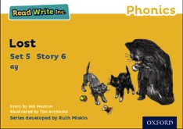



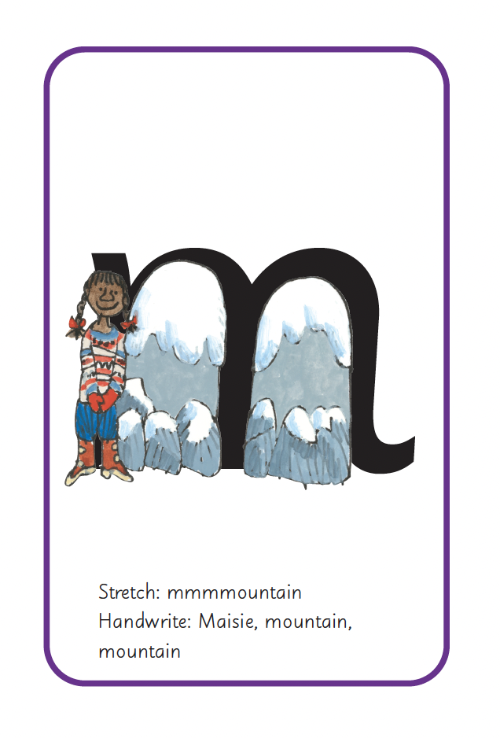
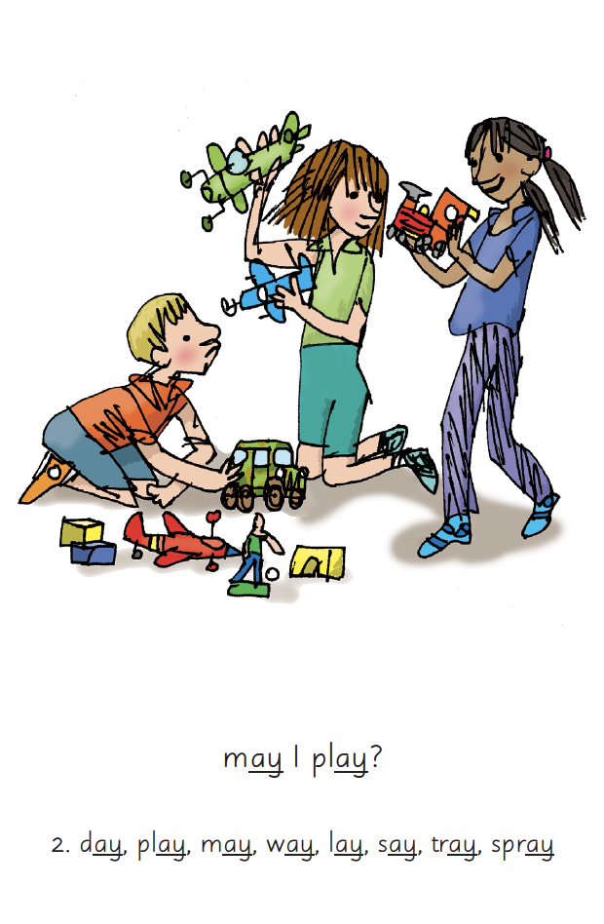
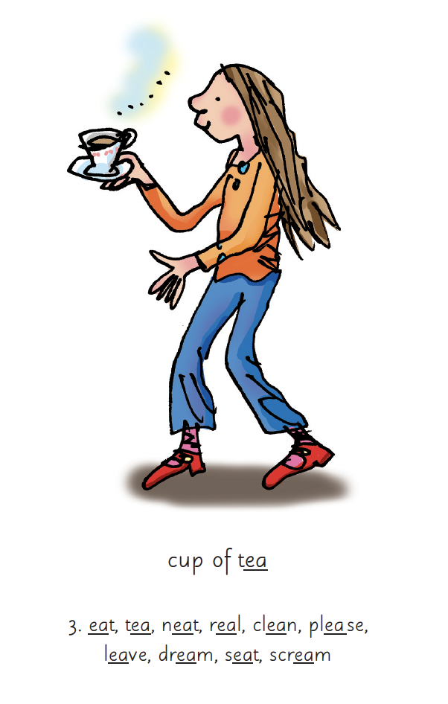
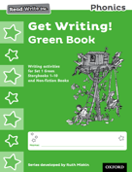
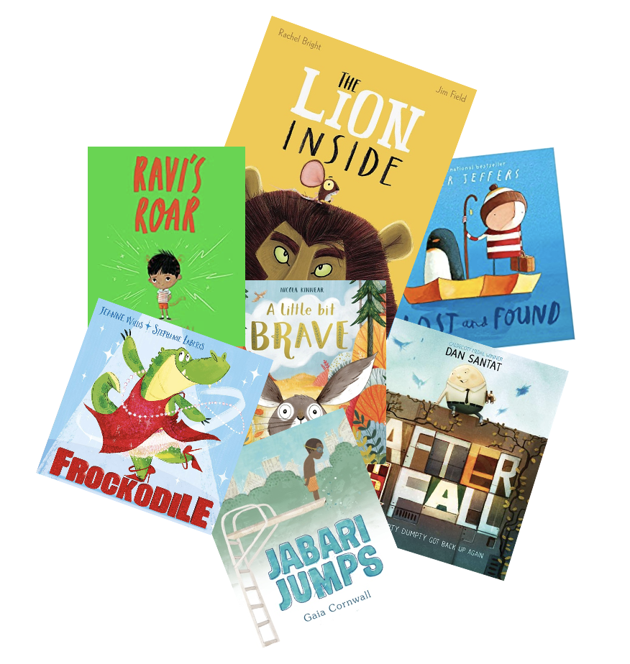
Read Write Inc. Phonics daily lessons
PA
Notes:
What Read Write Inc. does is simple - we teach children to read and write sounds (click), children practise reading and spelling words containing these sounds (click), then we give children decodable books (click) containing sounds and words they can read.
They read each Storybook three times at school and again with you at home.
On each reading, children’s fluency increases and the more they can focus on what the story is about.
Children also learn to spell the words they have been reading and develop their ideas into sentences so that they can write about the Storybooks they read.
Alongside this we read stories to children: (click) stories they cannot yet read for themselves

Slide 4


What is phonics?
Sounds
Graphemes
demonstrate, containing, roamed, trivial, injured, whimper
PA
Notes:
All words are made up of individual sounds. These sounds are blended together to form words.
e.g. in ‘mat’ we have the sounds ‘m’, ‘a’, ‘t’, ship – ‘sh’, ‘i’, ‘p’.
Click A grapheme is another name for the letters we use to write the sound. It’s spelling of a sound on the page.
Using phonics, children learn to read by saying each sound and blending them to read a word.
Children learn to spell by segmenting a word into sounds and writing the matching graphemes.
The National Curriculum ensures that all children are taught Phonics systematically.
This gives your children the tools to read any word, for example demonstrate, containing, roamed, trivial, injured, whimper.

Slide 5
English alphabetic code
44 sounds
26 letters
Over 150+ graphemes (letter combinations)
One of the most complex alphabetic codes in the world.
PA
Notes:
We use 44 sounds to make all the words in the English language.
This means we’ve got a problem.
Click. We’ve got 44 sounds and only 26 letters.
The 26 letters work singly, in pairs and sometimes in threes to represent one sound.
We have to group letters together to write some sounds e.g. ‘igh’, ‘air’.
In English we have more than 150 ways to represent 44 sounds, using the 26 letters in the alphabet.
Click. This makes our language one of the most complex in the world!

Slide 6
Speed Sounds Set 1 and Set 2
PA
Notes:
Read Write Inc, Phonics makes learning to read easy for children because we start by teaching them just one way of reading and writing every sound. Here they are on the Simple Speed Sounds chart.
We teach Set 1 sounds first - (sounds as far as a e i o u). Then Set 2 – one way to read and write each of the long vowel sounds.

Slide 7
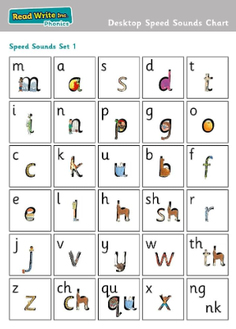
Sounds are taught in this order:
Assessed half termly for progress groups.
PA

Slide 8
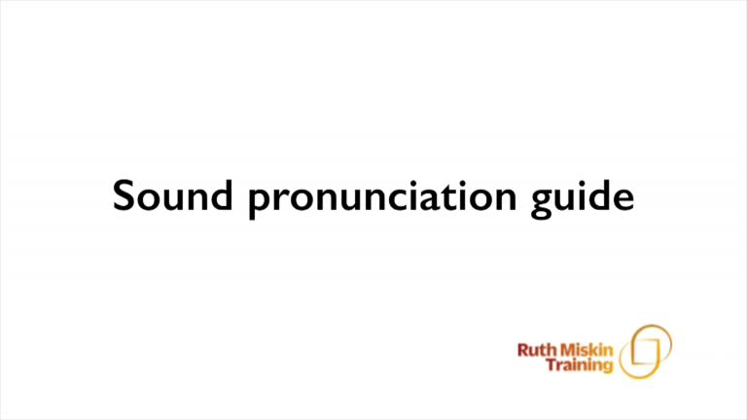
Pure Sounds (ruthmiskin.com)
VB
Notes:
Children need to know sounds – not letter names – to read words.
We say the sounds in a way to make them easy to blend into a word.
We aim to eliminate the ‘uh’ at the end of the sound. This is called a ‘schwa’ sound.
We say ‘c’ ‘a’ ‘t’ rather than cuh a tuh.
Use MTYT to teach each of the Set 1 sounds to parents.
You can watch this film of little Sylvie on the Ruth Miskin website to practise using pure sounds. Play a little bit of the video.

Slide 9
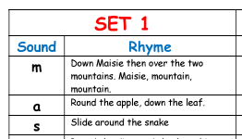
Rhymes to help write the letters
Handout of rhymes to help at home
VB

Slide 10
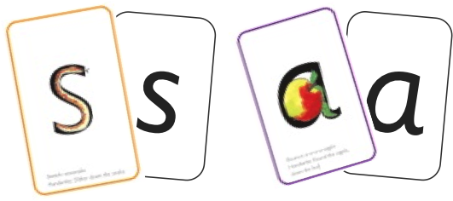
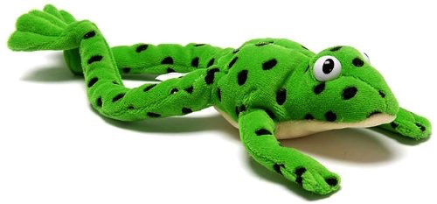

Sounds + blending = word reading
+
=
VB
Notes:
Alongside teaching children sounds, we teach them to blend sounds to read words e.g. s-a-t, sat.
Once children can read sounds speedily, like this, (show how speedily this needs to be) and understand Fred (m-a-t...mat) (click), they can decode words.

Slide 11
Meet Fred
VB
Notes:
Let me introduce you to Fred.
Fred helps children learn to blend sounds into a word.
Fred can only speak in sounds. He says d-o-g, h-a-t etc.
He says the sounds c-a-t, and then children help him to say the word.
This is how we quickly teach all of our children to blend orally.
We practise blending orally so children will find word-reading easier.

Slide 12

Teach spelling using Fred Fingers
VB
Notes:
We use Fred Fingers to help children sound out words to spell easily.
It means they do not have to memorise lists of spelling words.
It is a tool so they will be able to spell any word.

Slide 13




Reading with Fred Talk and Word time
During word time double sounds are taught:​
ll ff zz ss​
PCB
Notes:
We teach children to read words using Fred Talk to blend together the sounds they know e.g. m-a-t, mat.
We say ‘Fred Talk, read the word’.

Slide 14
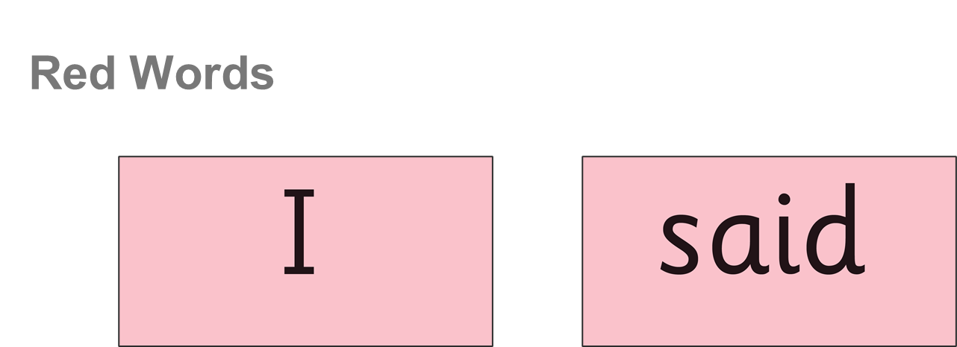
PCB
Notes:
These words can’t be sounded out – the children just have to read them on sight

Slide 15
What to expect at home ?
Library Book to share with your child and develop that very important love of reading
Single letter sounds, green words and red words to practise - RWI at home book
Later on ditty sheets
Blending book and a BookBag Book
RWI Reading book and a BookBag Book
PCB

Slide 16
‘Three with me, four at home’
Accuracy
Fluency
Comprehension
Read and enjoy at home
PCB
Notes:
In our school, children read each Read Write Inc. Storybook three times in class with their partner.
Re-reading the same book helps children to become confident readers. Each time they re-read, they build their fluency/speed and comprehension.
They love reading and want to read because they can read all of the words in the Storybook.
We set a focus for each re-read in school.
(Click) The first read focuses on reading every word accurately.
(Click) The second on reading the story more quickly.
(Click) The third read on comprehension - understanding what they read.
Then your child brings the same book home to read and enjoy with you again and again at home.
It’s ‘three with me, four at home.’
We do not send stories home the children cannot read because we always want them to be set up to succeed in their reading.
We want to make sure they enjoy reading so that they want to read.
The more they read, the faster progress they will make.

Slide 17
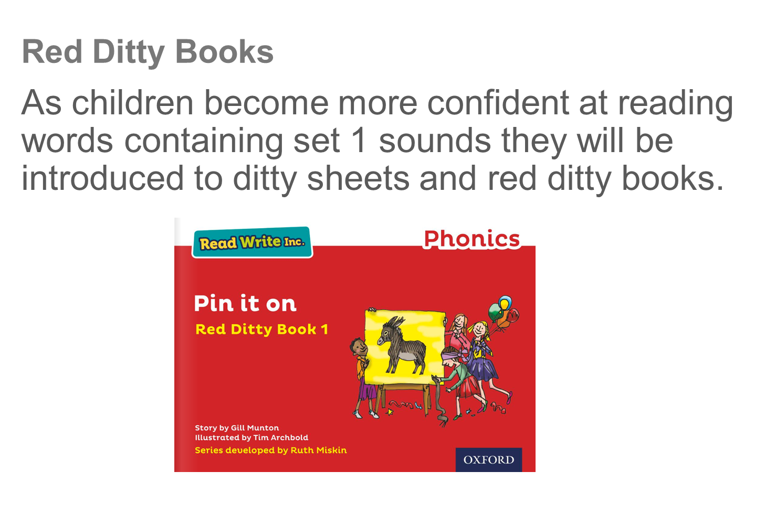
PCB

Slide 18

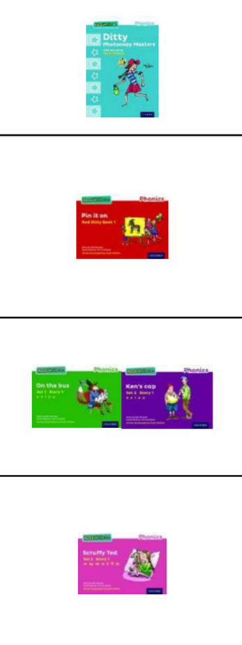
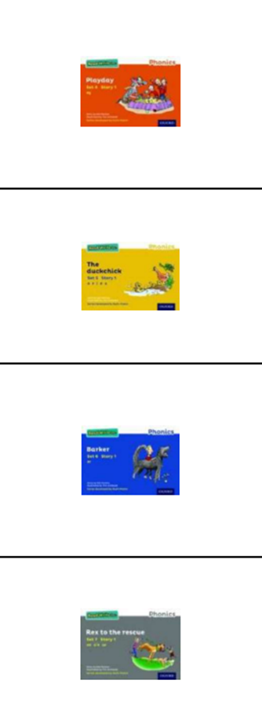
PCB

Slide 19
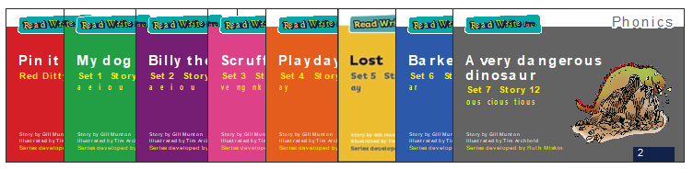

Reading books
A book they have read in school:
A new book with similar words to their colour book:
PA

Slide 20
More information
Video on Google classroom
Cards from Amazon
PA

Slide 21

The more that you read, the more things you will know. The more that you learn, the more places you’ll go!
Dr. Seuss
Notes:
In the words of Dr Seuss…read quote.
Good readers do well in school – and in life.
By listening to your child read, you are making sure they have the opportunity to practise and become a good reader quickly.
Remember that all parents have the power to change outcomes for their children.

Slide 22
Any other questions
Q&A

