Slide 2
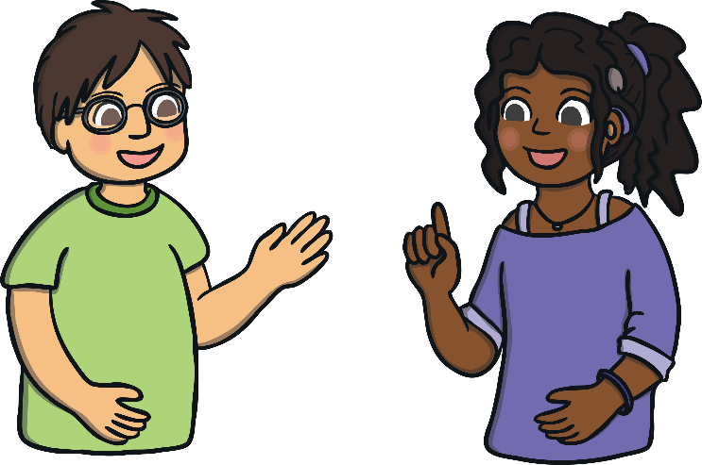
What Is Pupil Voice?
Pupil voice gives learners (that is you) the opportunity to play an active role in decisions that affect you. You can plan and review the actions you have taken as well as taking responsibility for how this will happen.
Article 12 - Respect for the child's views: When adults make decisions that affect children, children have the right to say what they think should happen and that their views are taken into account.
UNICEF

Slide 3
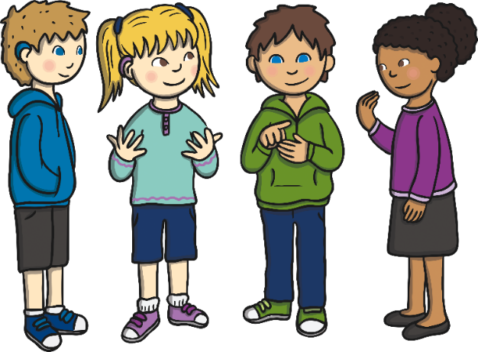
Why Should I Have My Say?
Pupil voice encourages children to become active members in a democratic society.
School councils help develop skills, such as collaboration and communication, and encourage pupils to take responsibility for their decisions.
Pupils involved in making decisions benefit in a variety of different ways: increased confidence, self-esteem, ability and a greater sense of responsibility.
democratic society – A place where everyone’s opinions matter.

Slide 4

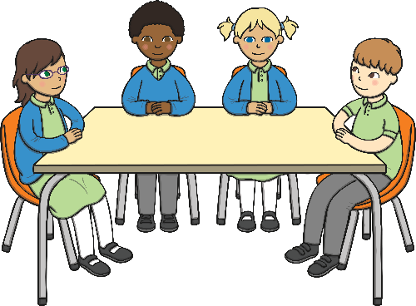
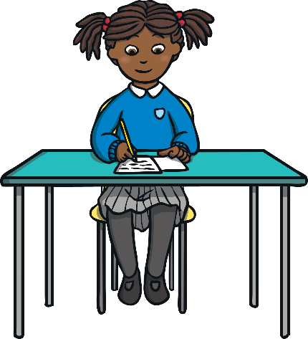
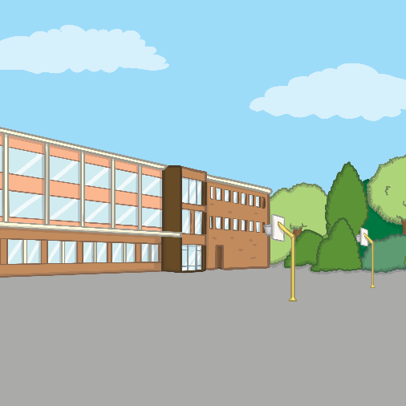
How Can I Play a Role?
Click on the different shapes to learn more.
Eco Council
Curriculum Focus Groups
Planning Your Own Work
School Council
Next

Slide 5

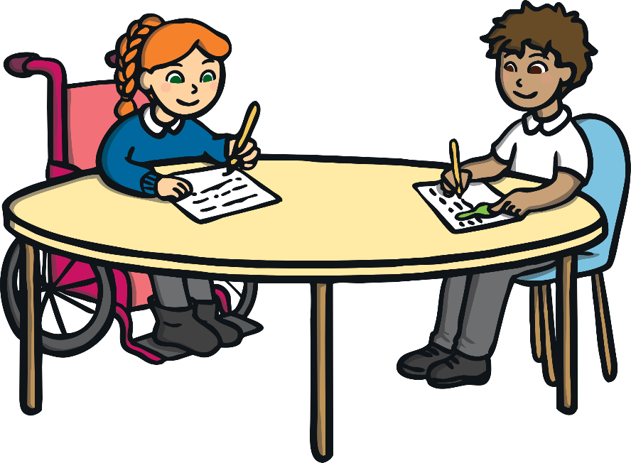
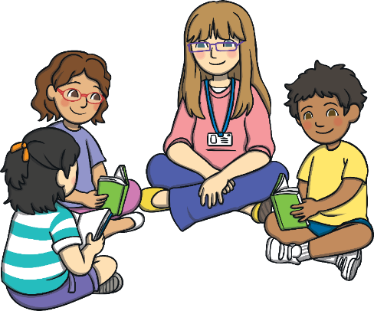
Eco Council / School Council
The Eco Council is made up of volunteers from all classes as well as teachers and other members of the community with an interest in the environment. The Eco Council is responsible for carrying out environmental reviews and preparing a whole-school action plan.
Regular meetings are arranged to discuss environmental action for the school. Often, pupils lead these meetings, write the minutes and make sure that the whole school is asked when making decisions.
It is important that the School Council has good communication to make sure that all information, ideas and developments are shared with the whole school.
Members of the School Council are responsible for bringing the ideas of the rest of the pupils to the committee and feeding back the results of committee meetings to every class in the school.
Back

Slide 6
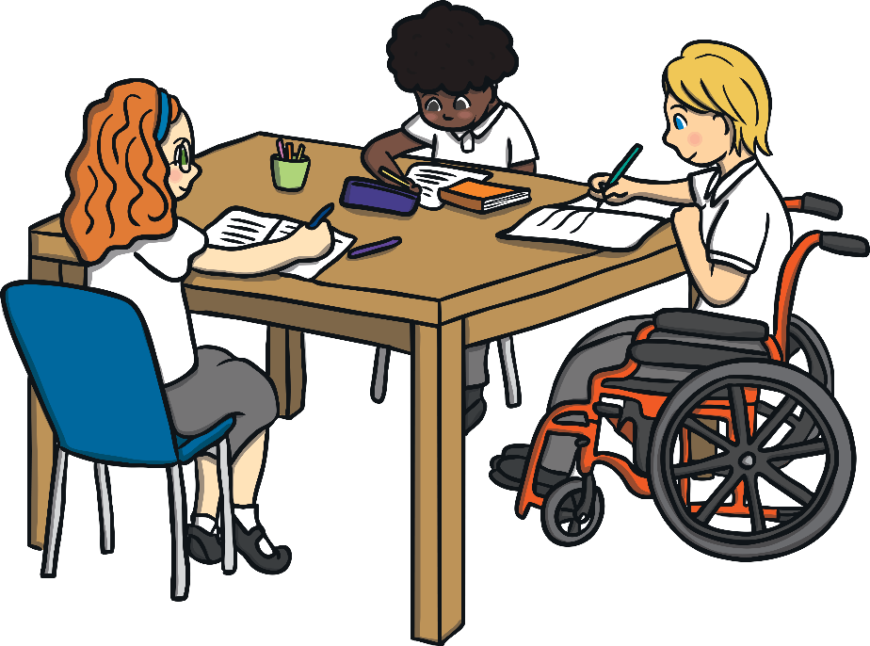
Curriculum Focus Groups
As a member of the curriculum focus group, you can:
Curriculum focus groups can be set up for any subjects within the curriculum. Pupils will look at the learning that has been done over the previous weeks and have the opportunity to suggest activities that they would like to do again and ideas for new activities.
talk to your class about what they have enjoyed doing;
find out what children would like to learn more about;
look at all the great learning going on in your school and tell your teachers what you like doing.
Back

Slide 7
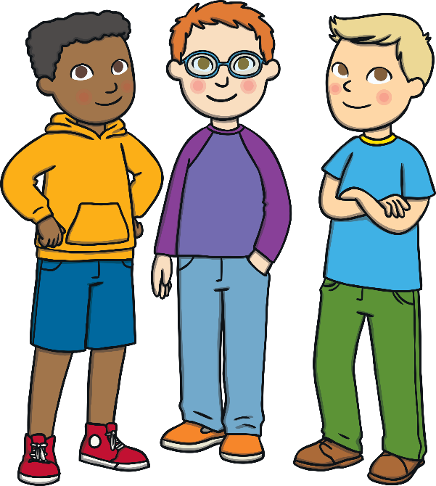
School Council
What do members do?
The School Council is made up of members from each class. This group of children will meet at least once every half term and at these meetings they will have the opportunity to discuss and implement ideas that could help improve the school.
These ideas could be problems that need to be resolved or new suggestions. Members of the School Council will be responsible for implementing the ideas discussed at the meetings.
Help any visitors to the school.
Act as representatives for the school at important events.
Identify what classes think about various issues and share this at meetings.
Help with improving parts of the school.
Help organise events.
Decide on action points for improvements.
Back

Slide 8
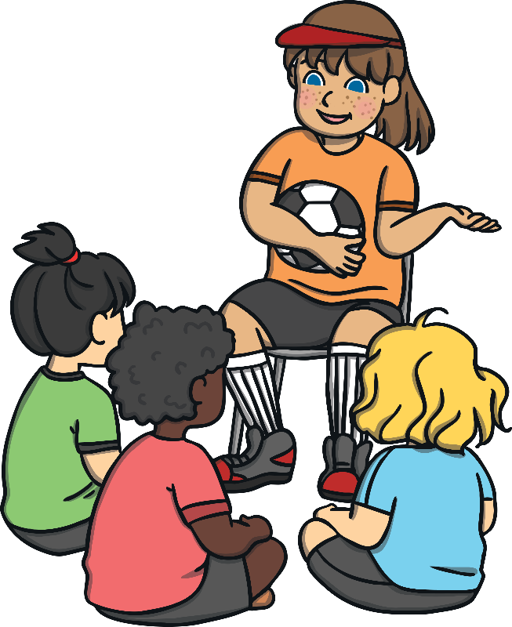
Planning Our Own Work
Child-led planning helps to guide the direction of learning. This gives all pupils the opportunity to share their ideas on the topic they will be learning, decide what they’d like to learn about and discuss what interests them.
In doing this, teachers will be able to plan and deliver activities that will be engaging and exciting for the pupils (that’s you!).
Back

Slide 9



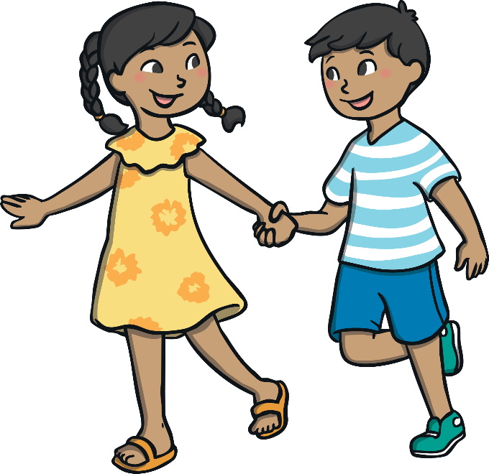
Go for It!
Even if you choose not to say much or become members of action groups, you will learn in an environment where you can be confident that your input is valued and respected.
Go for it, and let everyone hear!
Pupil Voice!

