Slide 1
End of Key Stage Assessment Information Evening
Wednesday 17th October 2018
Mrs Axon

Slide 2
Hello and Welcome!
Purpose of the meeting:
National curriculum and assessment arrangements
Explain school arrangements for KS1 SATs
Look at sample test materials and discuss
Opportunity to ask questions
Notes:
NOTE: To change images on this slide, select a picture and delete it. Then click the Insert Picture icon in the placeholder to insert your own image.

Slide 3
What’s changed since 2014?
The new key stage assessments were first took by pupils in May 2016.
Curriculum levels are no longer used to report results.
A new curriculum was introduced in 2014.
This changed the expectations for each year group and the assessment process.
Notes:
NOTE: To change images on this slide, select a picture and delete it. Then click the Insert Picture icon in the placeholder to insert your own image.

Slide 4
Key Stage 1 Assessment
Children take KS1 assessment papers in two core subjects: English and Maths.
Taken by children in Year Two as part of the National Curriculum assessment programme.
Children are assessed throughout the year and the end of year result will reflect this. The emphasis is on teacher judgement NOT just how they do on the assessment paper on the day.
The Year 2 assessments will take place in May, after half term.
The results of the teacher assessment will be sent home in your child’s report in July.
Notes:
NOTE: To change images on this slide, select a picture and delete it. Then click the Insert Picture icon in the placeholder to insert your own image.

Slide 5
Results of teacher assessment
Working below test standard.
Working towards expected standard.
Working at the expected standard.
The children will be assessed against age related expectations which are split into 4 different bands.
Working at greater depth within the expected standard.
Notes:
NOTE: To change images on this slide, select a picture and delete it. Then click the Insert Picture icon in the placeholder to insert your own image.

Slide 6
Mathematics
Two papers:
Paper 1 - Arithmetic
25 marks
15 minutes
Paper 2 – Fluency, problem solving & reasoning
35marks
35 minutes
Children will not be able to use any tools such as number lines, objects or calculators

Slide 7
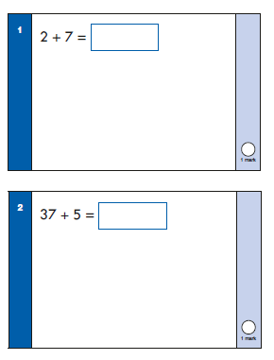
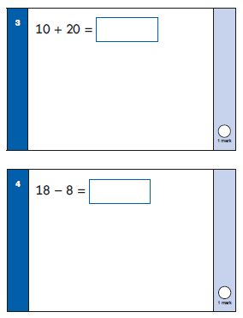
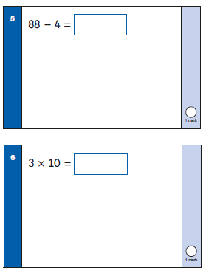
Arithmetic example:
Great resource to help improve your child’s mental Maths
https://www.topmarks.co.uk/maths-games/daily10

Slide 8
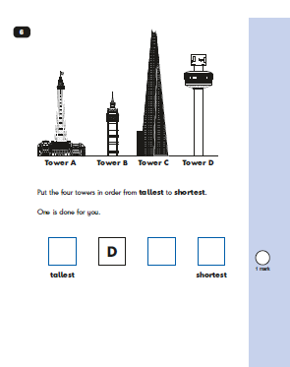
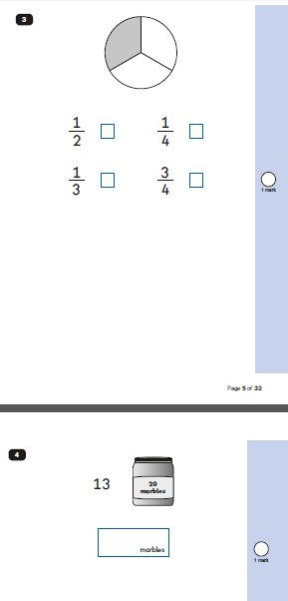
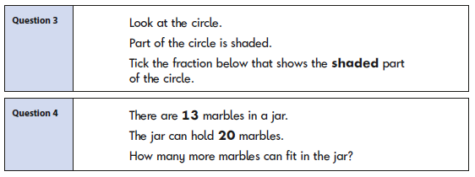
Fluency, problem solving and reasoning example:
Independent questions:
Aural questions:

Slide 9
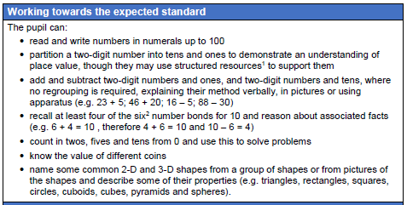
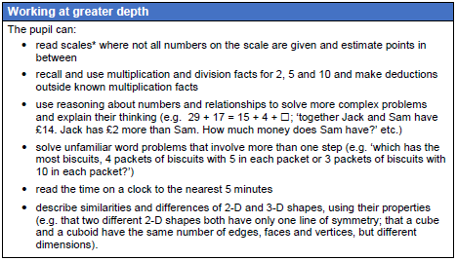
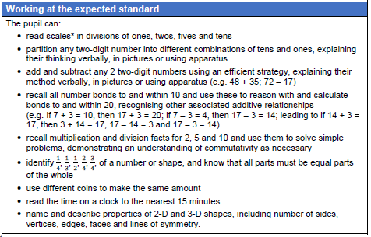
Frameworks – Teacher judgement

Slide 10
Writing
No specific writing task:
Writing is assessed using interim framework.
SPAG test used to help inform teacher judgement.

Slide 11
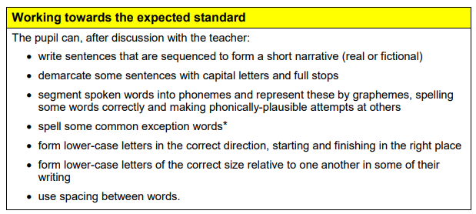
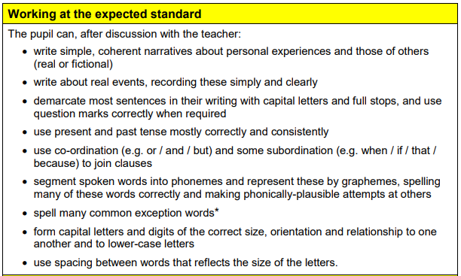
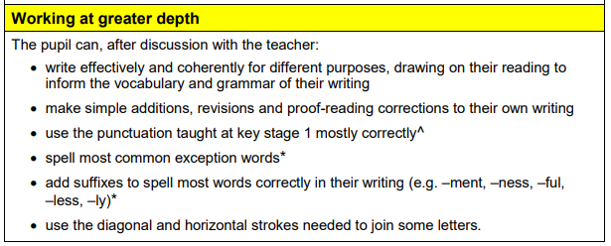
Framework:

Slide 12
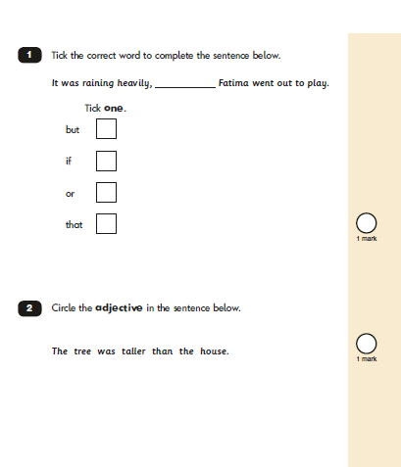
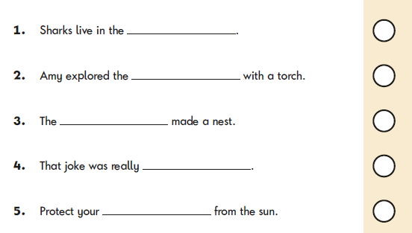
SPAG example:
Spelling:
Grammar and punctuation:

Slide 13
Reading
Two papers:
Paper 1
Selection of texts with questions interspersed
400 – 700 words
50% of marks
Roughly 30 mins not timed
Paper 2
Text and questions in a separate booklet
800 – 1100 words
Requires more in-depth responses
50% of marks
Roughly 30 mins not timed
Range of fiction, non-fiction & poetry

Slide 14
Variety of questions:
Multiple choice
Ranking/ordering, e.g. ‘Number the events below to show in which order they happened in the story’
Matching, e.g. ‘Match the character to the job that they do in the story’
Labelling, e.g. ‘Label the text to show the title’
Find and copy, e.g. ‘Find and copy one word that shows what the weather was like in the story’
Short answer, e.g. ‘What does the bear eat?’
Open-ended answer, e.g. ‘Why did Lucy write the letter to her grandmother? Give two reasons’

Slide 15
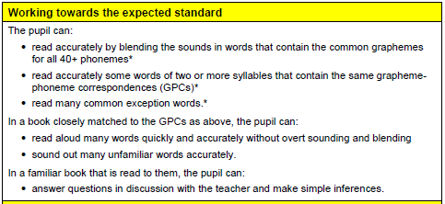
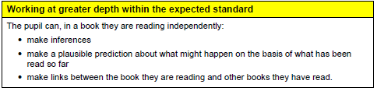
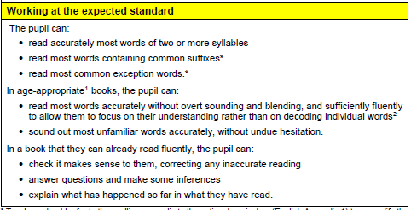
Frameworks – Teacher judgement

Slide 16
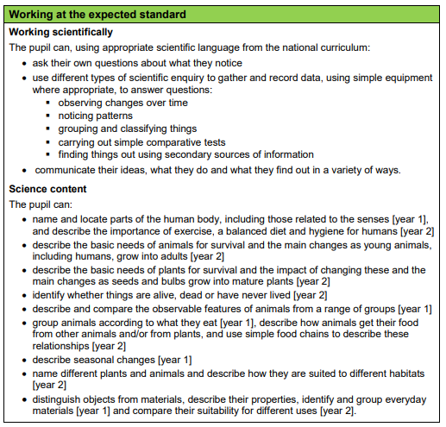
Science
Teacher Judgement NO assessment papers:
Based on class work throughout Year2

Slide 17
Relaxed and calm environment
All the formal assessments will be done in May 2019.
The timetable will be designed by myself and Mr Walker.
Children will complete the assessments in groups.
The children are used to having assessments in groups termly.
Notes:
NOTE: To change images on this slide, select a picture and delete it. Then click the Insert Picture icon in the placeholder to insert your own image.

Slide 18
Support at school
Children will be shown similar questions so they are familiar with the formats and routines.
Have high expectations of EVERY child.
Teach in differentiated / collaborative groups every day- guided reading, writing, spelling groups and maths.
Be positive and encourage children to reflect about their work.
Build children’s confidence to work independently.

Slide 19
Support at home
Encourage your child positively, without putting too much pressure on him/her.
Discuss with your child about what they have been learning in school.
Read, read, and read at every opportunity and ask children to answer questions finding words/ phrases in books.
Support writing by getting children to develop vocabulary- keep listening to fabulous books, visit the library for inspiring new texts, CDs in the car etc.
Ask your child to help you with spellings (even if you know how to spell the words
Spend time helping your child to practise their Mental Maths - 5 minutes each day makes an enormous difference- keep developing rapid recall of number bond facts and times tables- x2, x5 x10
Keep up to date with homework / extra work
Ensure best attendance possible

Slide 20

Thank you for attending.

