Slide 1
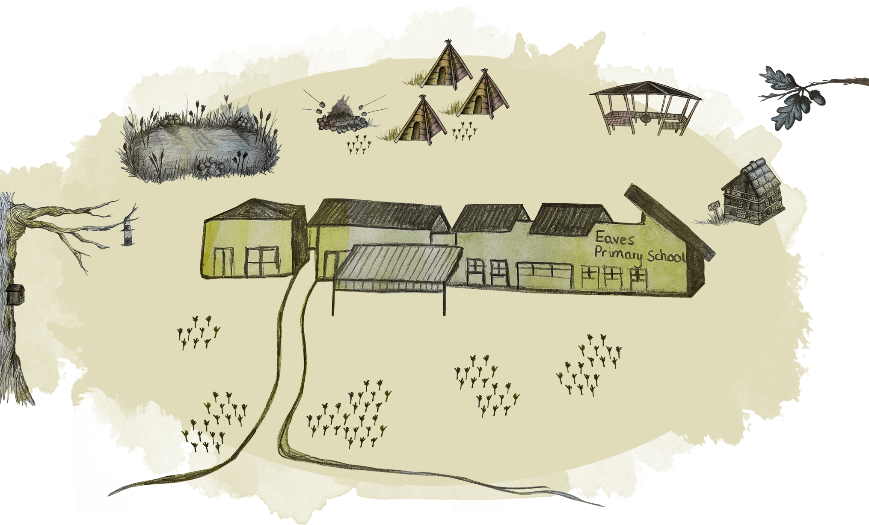
Welcome to Year 1!
Insert your Email address

Slide 2

Vision
Eaves: Excellence in Everything

Slide 3
Mission
Inspiring Outstanding Citizens
of the Future

Slide 4
Core Values
Trust: Doing the right thing even when nobody is watching
Equality: Respecting and valuing the needs of all
Aspirations: Our dreams are never too far away
Compassion: Caring and feeling responsible for the achievements and concerns of all
Happiness: Unique for all, all unique

Slide 5
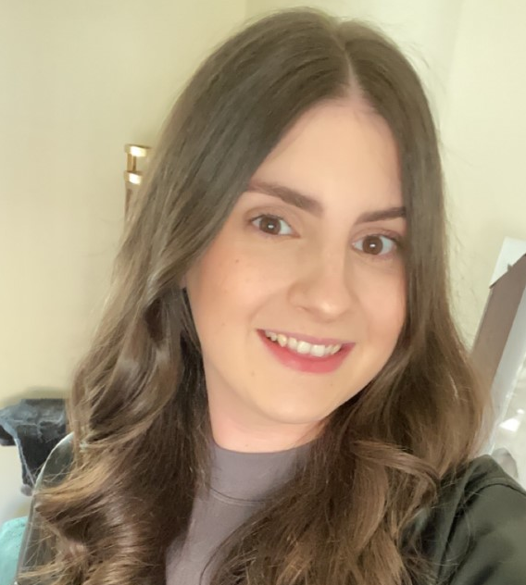
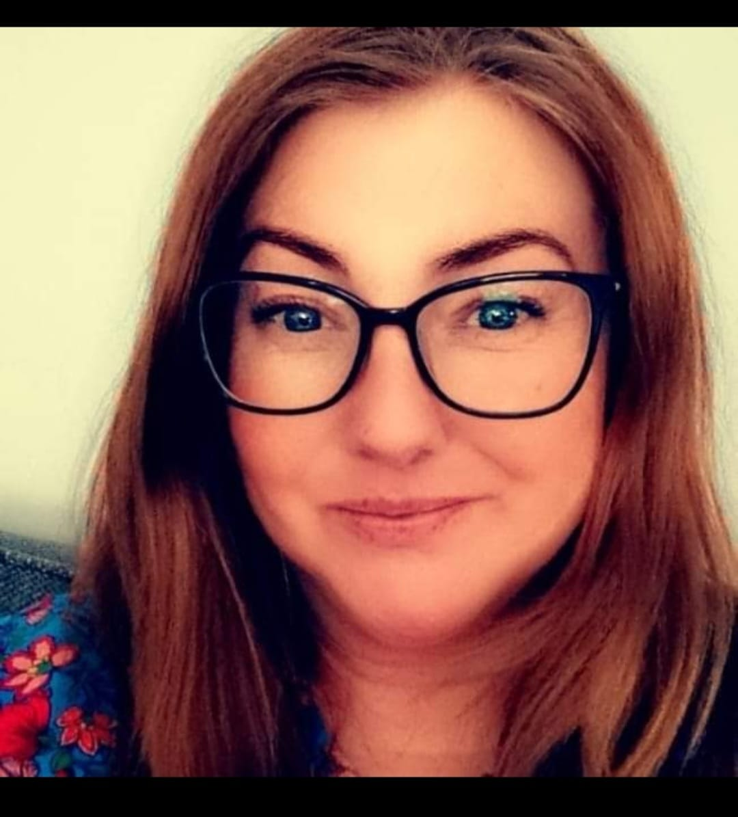

Year Staff
Mrs Clarke
Mrs McDonough
Class Teacher
Teaching Assistant

Slide 6
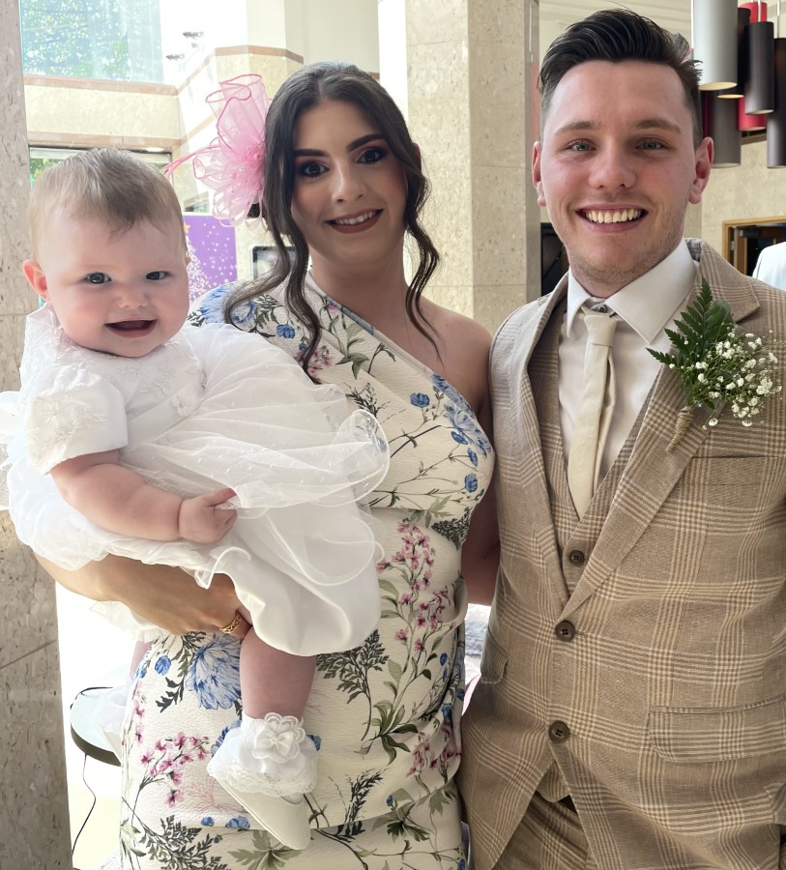
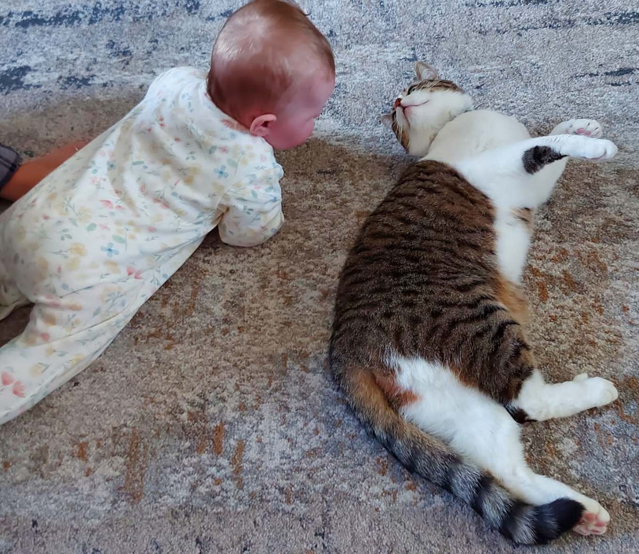
Something about me!
Hi, I’m Mrs Clarke!
I have a degree in Primary Education with English and History from Edge Hill University.
I have been at Eaves since 2017, previously working in Year 4 and Year 3. This is my first year teaching Year 1!
I live with my husband Matt, my 1 year old daughter Niamh and my cat Luna.
At Eaves, I have the honour of leading English, History and Music which I absolutely love!
I love going for long walks, a good crime drama, reading when I get the chance and being a new mum, I really, really love a full nights sleep!

Slide 7
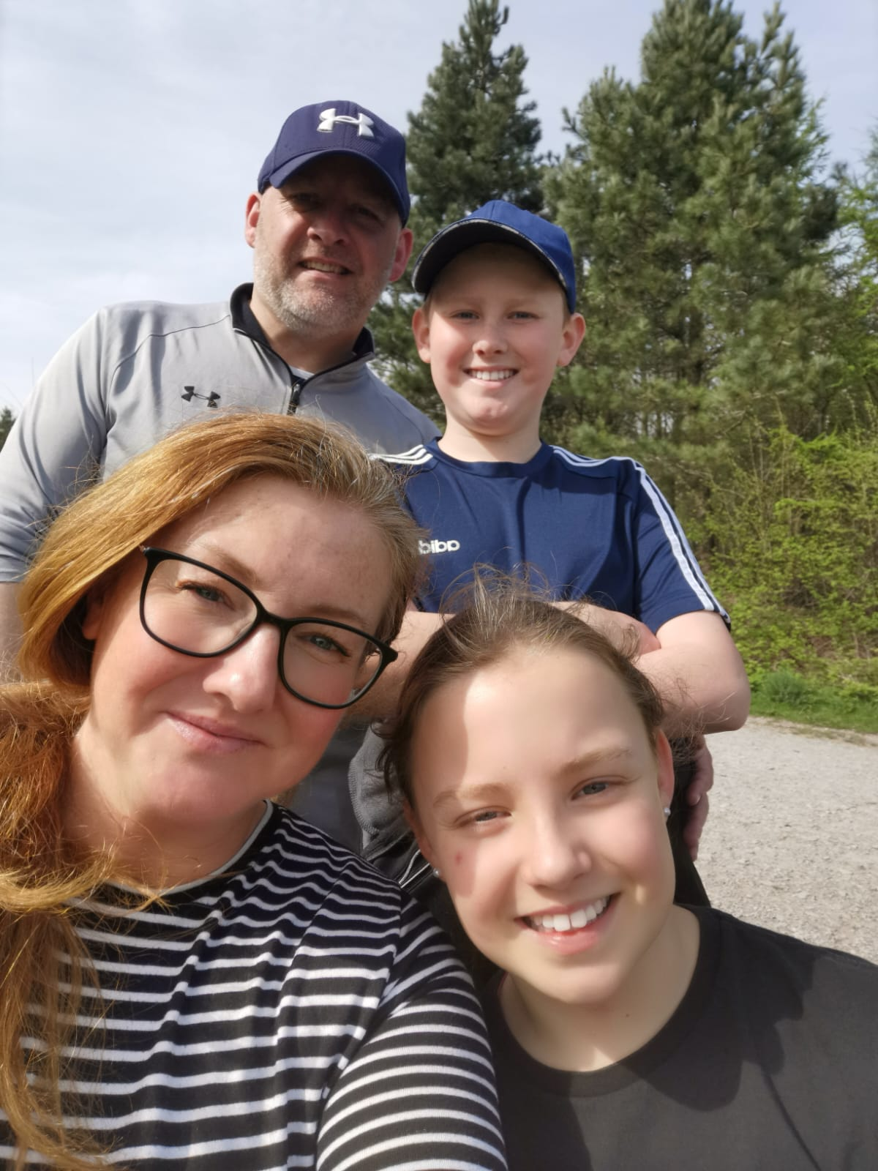
Something about me!
Hi, I’m Mrs McDonough!
This is my second year working in Year 1 after so many years in Nursery and a brief stint in Year 4.
I live with my husband and 2 children, Cameron and Eva. We have a dog called Bailey.
I love chocolate and I don’t like bugs and creepy crawlies!
I love a good dance!

Slide 8
Life in Year 1
A typical day in Year 1 will include reading/phonics before break, followed by English and Maths that will take us up to lunch!
In the afternoon, children will have lessons related to foundation subjects such as Art and DT, Computing, History, Geography and Science.
As we settle back into school life in the Autumn term, there will be a blended curriculum which will incorporate lots of opportunities for learning through play – just like FS2.
There will also be opportunities to visit our Eaves Woodland area – to enrich our curriculum through outdoor learning.

Slide 9
The Year 1 Curriculum
04

Slide 10

English in Year 1
Following the Pathways to Write scheme.
Autumn | Spring | Summer
Autumn 1 Lost and Found by Oliver Jeffers | Spring 1 The Lion Inside by Rachel Bright | Summer 1 Toys in Space by Mini Grey
Autumn 2 Nibbles by Emma Yarlett | Spring 2 The curious case of the missing mammoth by Ellie Hattie | Summer 2 Goldilocks and just the one bear by Leigh Hodgkinson
Autumn | Spring | Summer
Autumn 1 Adventure narrative Lost and Found by Oliver Jeffers | Spring 1 Journey narrative The Lion inside by Rachel Bright | Summer 1 Fantasy story Toys in space by Mini Grey
Autumn 2 Diary recount Nibbles by Emma Yarlett | Spring 2 Adventure narrative The curious case of the missing mammoth by Ellie Hattie | Summer 2 Traditional story Goldilocks and just the one bear by Leigh Hodgkinson

Slide 11

Phonics
We teach our children to read through the Ruth Miskin Read, Write, Inc phonics programme.
Children have daily phonics during Big Skills time, they will then have an additional phonics session in class and may attend targeted 1:1 intervention if necessary.
It’s important that children develop a natural love of reading. We aim to learn to read so we can read to learn!
Year 1 children sit a statutory phonics screening in June. More information regarding this will be offered after Christmas.

Slide 12
Maths in Year 1
Children will be following a Maths Mastery curriculum throughout the year
Autumn | Spring | Summer
Number: Place Value (within 10) Number: Addition and Subtraction (within 10) Geometry: Shape Number: Place Value (within 20) | Number: Addition and Subtraction (within 20) Number: Place Value (within 50) Measurement: Length and Height Measurement: Weight and Volume | Number: Multiplication and Division Number: Fractions Geometry: Position and direction Number: Place Value (within 100) Measurement: Money Measurement: Time

Slide 13
Knowledge Overview
Year 1 | Autumn Term | Spring Term | Summer Term
History | How do our toys and games compare with those of children in the 1960s? | Who is the greatest history maker? | The Great Fire of London
Geography | What is the geography of my school like? | How does weather affect our lives? | Why do we love being beside the sea so much?
Science | Animals and Humans Seasonal Change | Everyday Materials Seasonal Change | Plants Seasonal Change
DT | Mechanisms, levers and sliders- Moving Pictures | Food Technology Sensational Salads | Free standing structures Chair for baby bear
Art | Painting- Colour | Digital Media- digital techniques | Printing – press, roll, rub and stamp

Slide 14

Thinking Schools
Over the past year, Eaves has been working towards becoming a ‘Thinking School’.
Our school ‘Drive Team’ have led the project with the aim of embedding the Thinking School approach across the whole school,
‘a desire to develop independent thinkers and learners’
Outcomes we want to achieve:
regular careful thought to everything that takes place
both students and staff learning how to think reflectively, critically and creatively
children will demonstrate independent and co-operative learning skills, high levels of achievement and both enjoyment and satisfaction in learning
This year:
We have looked at the structure of our brains and the role each part plays
Understood how our short-term and long-term memories work
Looked at our attitudes to learning when we get stuck and how we can overcome this
Introduced ‘flashbacks’ and ‘Thinking Frames’ to our lessons to support our thinking
Metacognition is an awareness of one's thought processes and an understanding of the patterns behind them- ‘thinking about thinking’

Slide 15
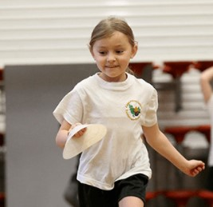
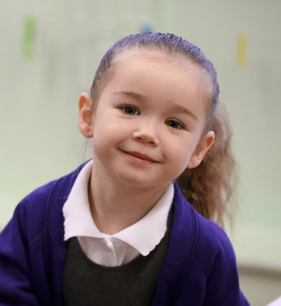
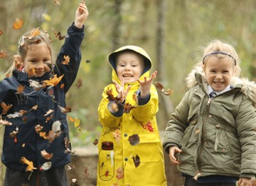
Physical Education
Children need to come to school wearing appropriate PE kits on their PE days.
Miss Newby, our specialist PE teacher, will be working with each class throughout the year.

Slide 16
Homework
Homework is linked to the curriculum and the skills needed to achieve year end expectations. Please support your child to complete their homework to a high quality just like we expect from them in school.

Slide 17
Reading
Your child needs to bring their reading book and diary to school on their allocated day.
Your child should read at home to an adult at least 4 times a week.
Please sign and comment in your child’s reading diary.

Slide 18
Enrichment
We have enrichment trips linked to the curriculum throughout the year.
Further information will be provided in advance of the trips.

Slide 19
Attendance
We are striving for 100% attendance for your child
We work on ‘First day response’
Please contact the office each day to inform us if your child will be absent
Leave of absence/ holidays must be applied for using the written form on the website/ at school office
Leave of absence during term time will only be authorised if there are exceptional circumstances
Punctuality is monitored very closely. Children need to enter school before 8.55am via the Year 1 door. If they arrive after this time, they are classed as late. Learning starts the second your child enters the classroom so it is essential that they are in school on time
The school works with Education and Welfare Services when attendance/ punctuality is a concern

Slide 20
Uniform
If your child is unable to wear full uniform please send a letter in with your child explaining the reasons for this, or simply ring school and leave a message for your child’s class teacher.
We all have very high expectations of the children's presentation which is closely monitored.
Oversized bobbles and clips are not permitted due to health and safety. No nail varnish permitted.
Earrings must be taken out prior to the start of the day.
Children not in full school uniform, including footwear, will not be allowed to take part in school trips, off site visits or represent school in competitions/events.

Slide 21
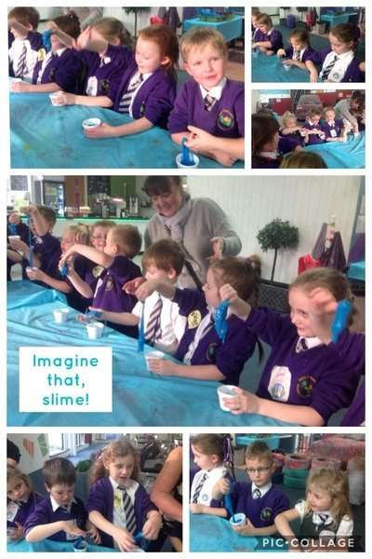
Communications
Letters that are sent home need to be read carefully and any reply slips returned to school promptly. Keep checking Seesaw and PA Connect for updates.
Message staff are on the doors every morning. If you need to speak to a teacher please ring the office and we will endeavour to get back to you within 48 hours.
Policies and other important documents are available on our website: http://www.eaves.st-helens.sch.uk/
Seesaw
PA Connect

Slide 22
Communications Procedure
Please always follow the communications procedure if you have a query/concern:
4
Headteacher
Mrs Kearney
3
Deputy Headteacher
Mrs Jennings
2
Assistant Headteachers
Mrs Leavesley
1
Class Teacher / Class Team

Slide 23
Any questions?

