Slide 1


Welcome to Year 3 – Louis Braille

Slide 2
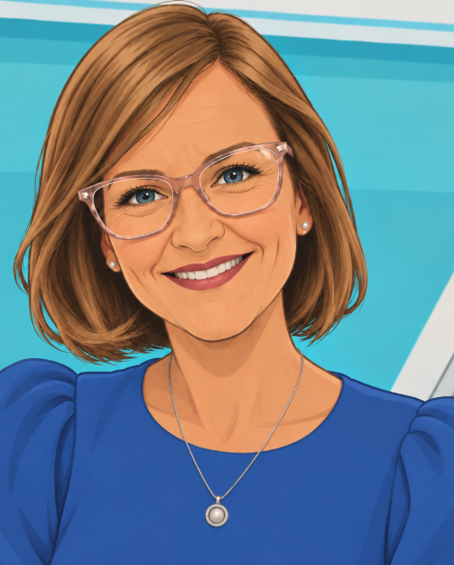



Meet the Team
Miss Lane - Class Teacher
Mrs Hill - Class Teacher
Mrs Davidson - Teaching Assistant
Mrs Simpson - Teaching Assistant

Slide 3
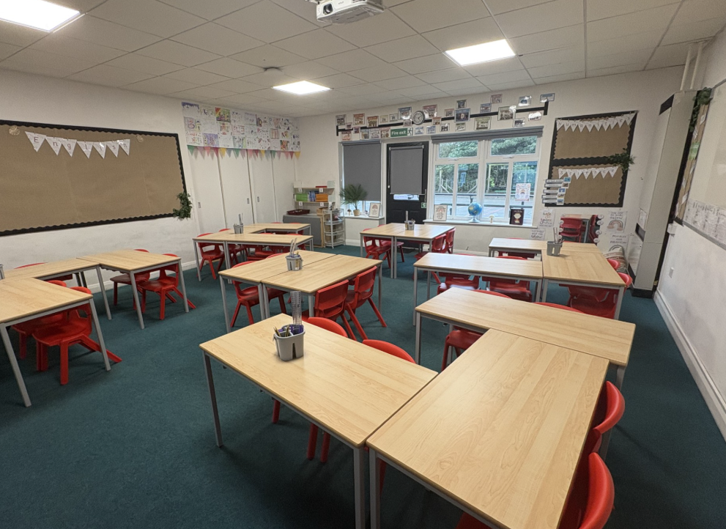
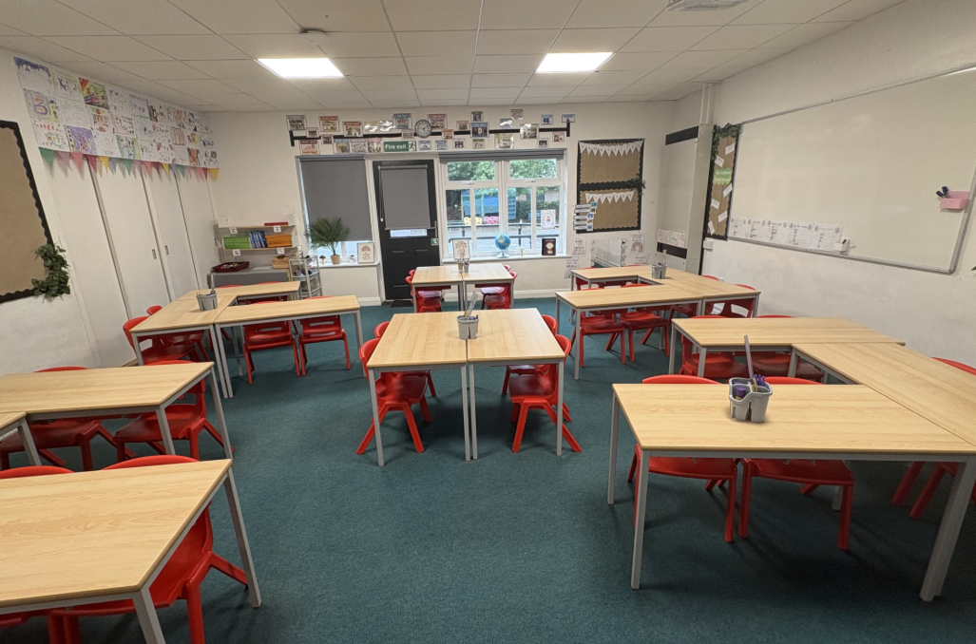
Our Classroom

Slide 4
Daily Routine
8.40am School opens
8.40 – 9.00am Morning work
8.50am – Doors close and register is taken
9.00 – 10.00am Lesson
10.00 – 10.20am Assembly/Lesson
10.20 -10.35am Playtime
10.35 – 11.35am Lesson
11.35 – 12.15pm Lesson
12.15-1.15pm Lunch
1.15 – 2.15pm Lesson
2.15 – 3.15pm Lesson
3.15pm Home time

Slide 5
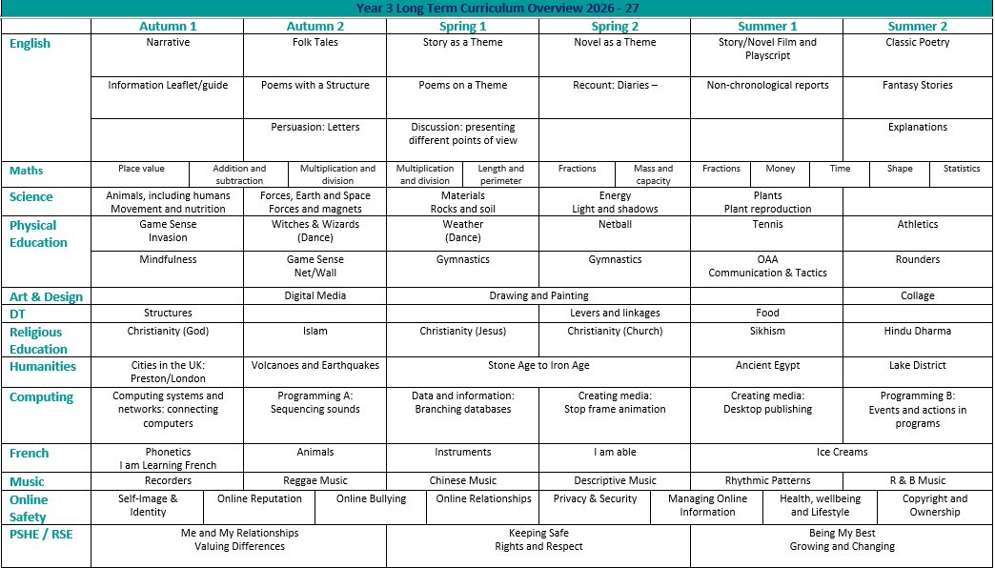
Yearly Overview

Slide 6
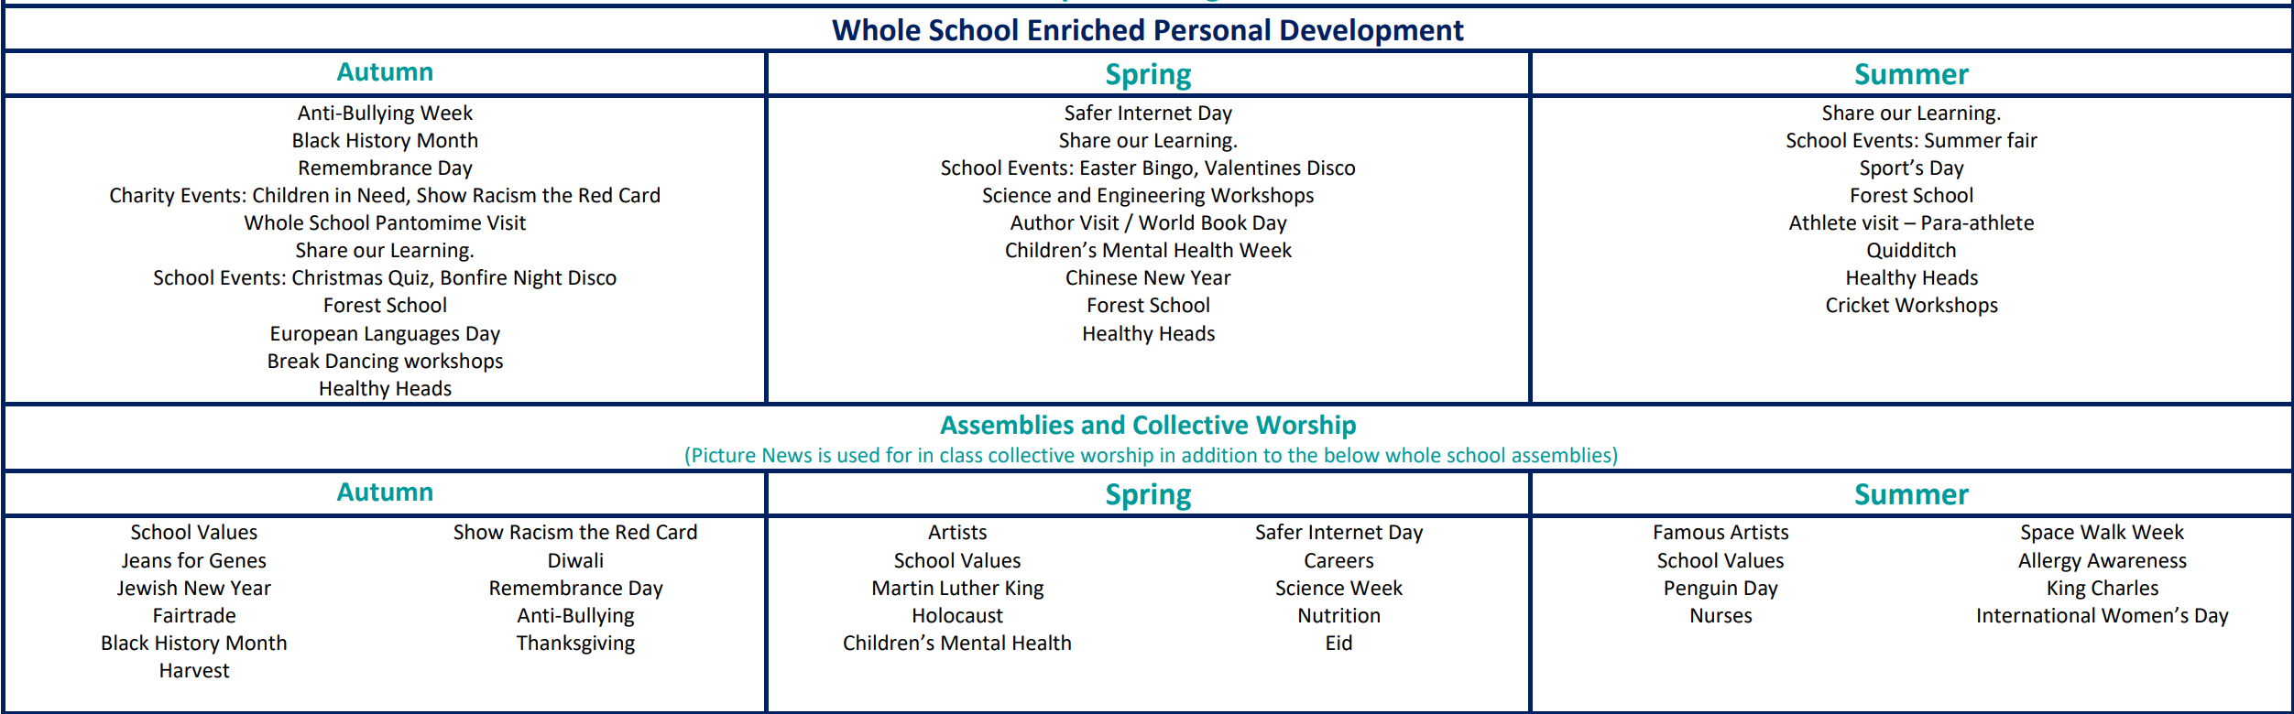
Enrichment

Slide 7
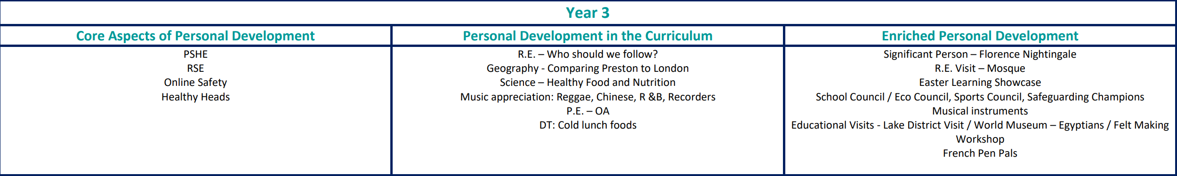
Enrichment

Slide 8
Communication
Please feel free to use the following methods of communication:
Email: bursar@cottam.lancs.sch.uk or admin@cottam.lancs.sch.uk
Send a message in your child’s reading diary
Send a message via Seesaw
Speak to the class teacher at the start or end of the day
If you need a longer conversation, please make an appointment for a mutually convenient time via our school office
Please know that during the school day, the primary focus is teaching and supporting children in the classroom. As a result, we may not be able to respond to messages immediately.
We will do our best to reply to any emails or messages within 48 hours. If something is urgent, please contact the school office directly.

Slide 9
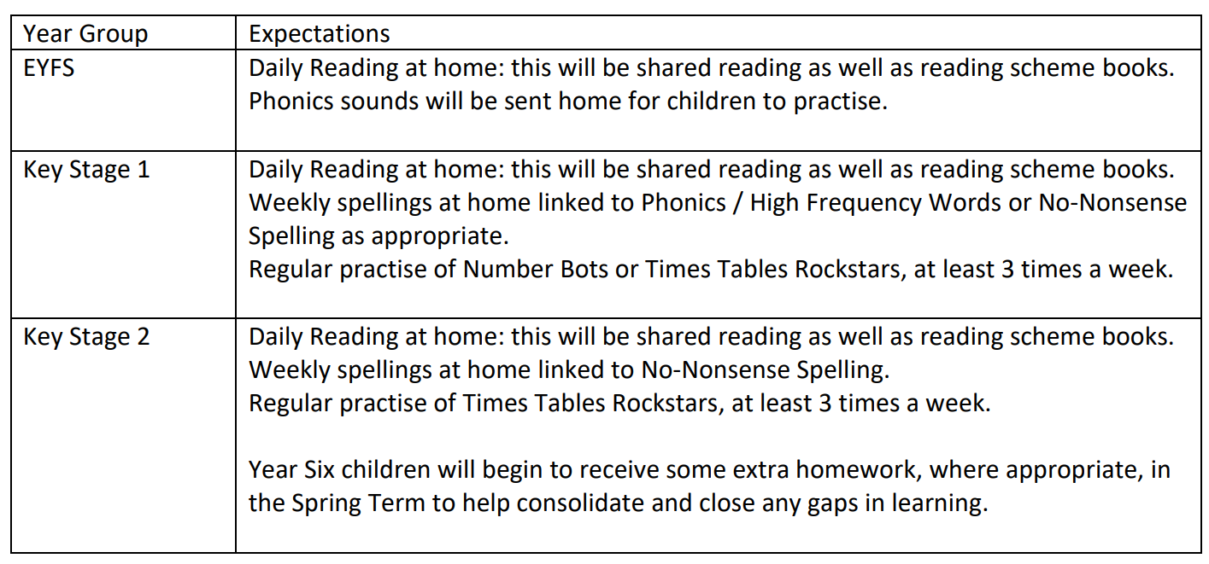
Homework
Homework is shared through your child’s SeeSaw account on a Friday and should be completed by the following Thursday.

Slide 10
Uniform
Our uniform comprises:
Jade green school sweatshirt or cardigan - preferably with school badge
White polo shirt - preferably with school badge
Navy blue trousers, skirt or pinafore
White, navy, or black socks or tights
Black sensible shoes / unmarked black trainers
Summer Uniform
Navy blue gingham dress for summer with white socks
Navy blue tailored shorts
Black sensible school shoes / unmarked black trainers
Footwear
Black shoes / unmarked black trainers with a sensible heel to ensure pupils' safety. Sandals, fashion shoes, knee or ankle length boots are not considered appropriate footwear for school. Younger pupils are encouraged to wear shoes with a Velcro fastening.
Coat
Please send your child to school with an appropriate warm, waterproof coat so that we can get out of doors in all weather.
PE Kit
Children come into school on PE days dressed in their school PE kit.
School PE t-shirt
Navy blue shorts, skort, leggings or joggers
Black trainers
Children can wear their school jumper over their PE kit.
Optional: navy blue hoodie with school logo
Year 6
Year 6 are allowed to wear their Leavers Hoodie as part of their school uniform.
Labelling
Please ensure that all of your child's clothing is labelled (including shoes). Please mark all items of clothing and footwear with your child’s name. This ensures that lost items are easily returned to their owner. We do try to trace owners of items of clothing or equipment as soon as possible, but items of lost property will be stored and if not claimed will be disposed of at the end of term.
For religious convictions ONLY:
A plain headscarf in black or navy only
Hair
During term time, children are asked not to wear fashion hairstyles which include shaved, dyed, tramlines or Mohawks. If hair is long enough, it should be completely tied back with a neutral, discreet hair tie or bobble. Hair should be kept out of children’s eyes using headbands, clips and slides; again plain using school colours. No large party-style bows or headbands thank you.
Jewellery
No jewellery should be worn in school. A watch and plain, stud earrings are acceptable. However, pupils must remove earrings for PE. Tape is not allowed. If you are considering having your child's ears pierced, please do so at the beginning of the summer 6-week break to ensure your child does not miss any PE lessons.

Slide 11
Equipment
Coat (everyday)​
Bag with reading book and diary​
Non spill water bottle filled with water​
Packed lunch (if not having a school meal)​
Healthy Snack for morning breaktime

Slide 12
Behaviour
Our school has three simple rules: ‘Be Ready, Be Respectful and Be Safe’, which are applicable to a wide variety of situations.
Be Ready
• I will help myself and others to learn by being in the right place, with the right equipment and ready to listen and complete my work.
Be Safe
• I will be kind and look after myself and others, following appropriate instructions from adults.
• Zero tolerance for any form of aggression or violence towards others
• Resolve arguments or conflicts by discussion
• Respond immediately to instruction
Be Respectful
• I will listen and talk politely to adults and other pupils;
• Look after equipment and other people’s possessions.
• Respond quickly to instructions
• Move around school quietly and on the left-hand side in an orderly manner
• Raise hand to ask / answer questions
• Stay in place as appropriate Cottam Primary School Behaviour Policy September 2024 4
• Work hard at tasks set
• Put litter in the bins

Slide 13

PE Days
PE days for Year 3 are Thursday and Friday. Please ensure your child comes to school in their PE kits on these days.
Remember, no earrings can be worn for PE.

Slide 14
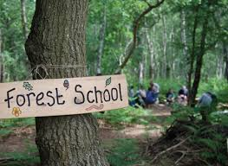
Forest School
Forest School is an inspirational process that offers all learners regular opportunities to achieve and develop confidence and self-esteem through hands-on learning experiences in a woodland or natural environment. It is a specialised learning approach that sits within and compliments the wider context of outdoor and woodland education.
At Cottam, we teach Forest School lessons so that all the children have a chance to develop a wide range of skills that they wouldn't otherwise have the opportunity to do so inside the classroom. It also supports our children's self-esteem and confidence and allows them the chance to achieve things they thought they might not have been able to previously. More information will come out via email when your child is due to take part.
We believe that outdoor learning is something all children should have regular access to in order to better develop their understanding of the world around them, apply learning from a variety of different subjects and sustain a healthy lifestyle.

Slide 15
Snack
Healthy Snack
In Key Stage 2 children are able to enjoy a healthy snack at break time. Fruit is always available from school or children are welcome to bring in their own healthy snack. We have a number of children with nut allergies across school and are therefore a Nut Free School. Please do not send your child to school with any snacks containing nuts.
A healthy snack may include: fruit, cereal bars, crackers, cheese strings, rice crackers, etc.
In Key Stage 2 children are also able to order toast to enjoy as a snack. This must be preordered and paid for through Parentpay prior to children receiving it.
Milk
Cool Milk supply school with milk for our children. Children under the age of 5 are entitled to free milk but must be registered through the Cool Milk website by a parent or carer to received their entitlement. Children over the age of 5 are also able to have milk in school but this must be paid for through the Cool Milk website by a parent or carer.

Slide 16
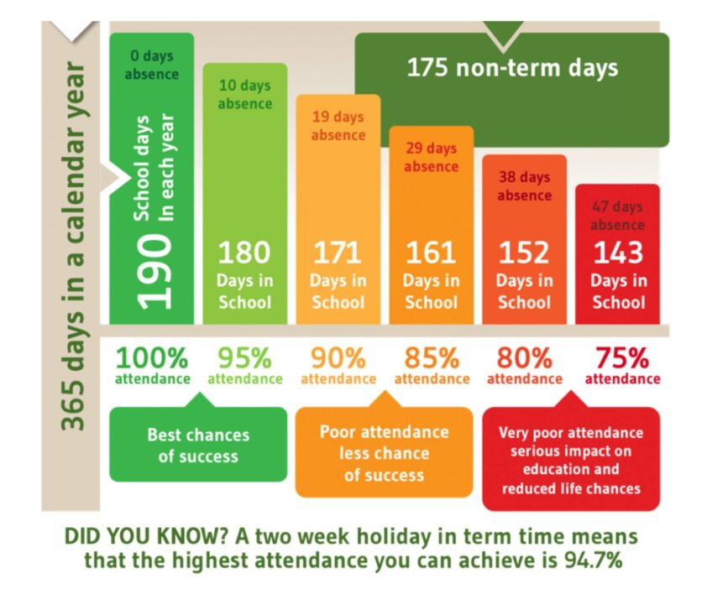
Attendance
School attendance target is 97%​
​
We have a weekly award in assembly for the class with the best attendance.

Slide 17
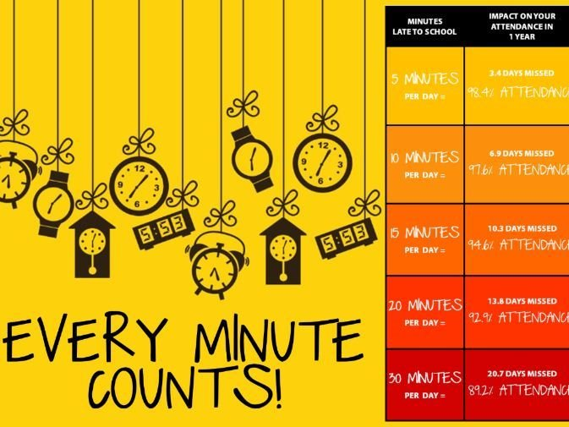
Punctuality
The school doors open at 8.40am.​

Slide 18
"This classroom is a place to grow, explore, and shine. Let’s make it an amazing year!"

