Slide 1

St Clement’s Catholic Primary School
EYFS parent meeting
24th Septemeber 2025
Together in Love and Faith

Slide 2
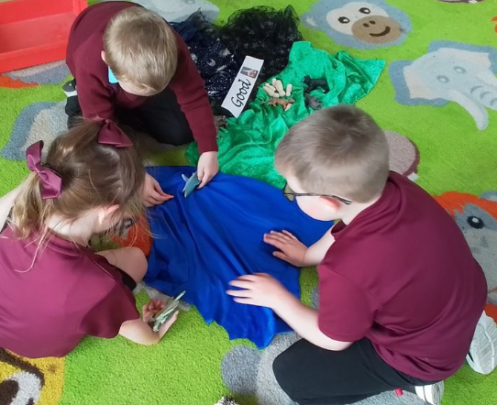
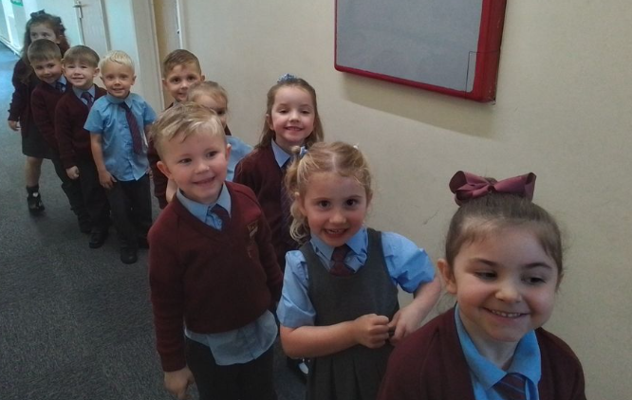
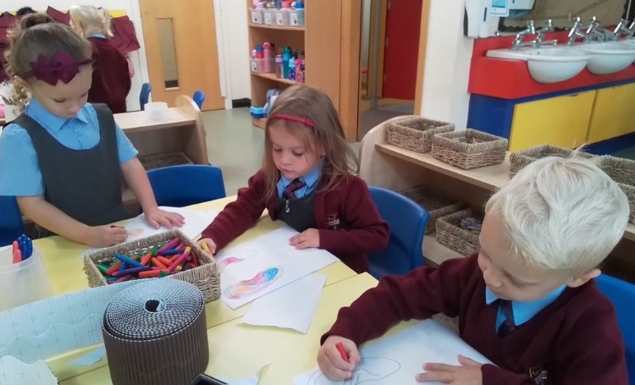
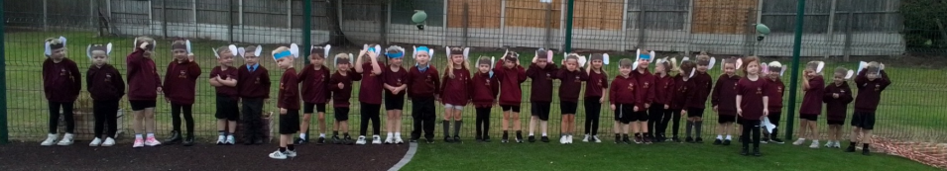
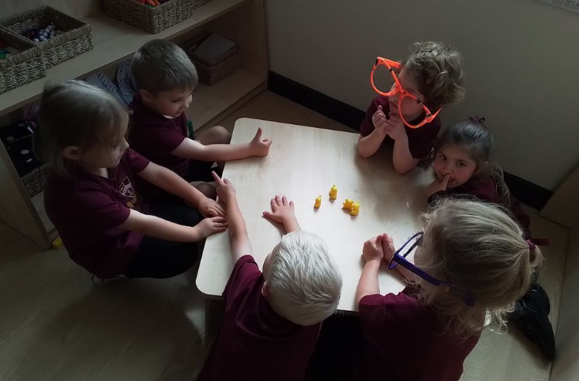
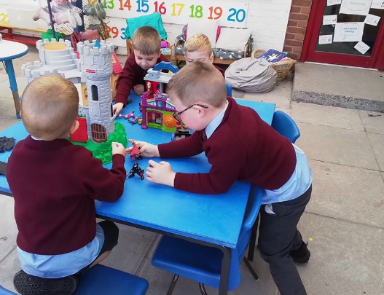
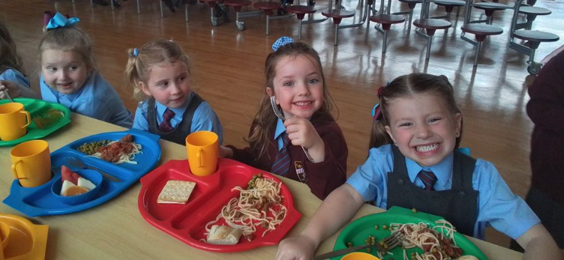
Thank you!

Slide 3

Reminders
Please book your child on for their dinner each day, whether this is a hot dinner or a packed lunch.
Morning snack can be booked through the school gateway or children can bring in their own morning snack. Fruit is provided for free every afternoon.
Please name all clothing, water bottles, packed lunches etc as this ensures we can return all items quickly.
Please send in a named waterproof puddle suit and pair of wellies to enable your child to access out outdoor area in all weathers.
If your child’s spare clothes bag is sent home because they have got changed at school, please restock this and send it back into school.
We now have our after-school club up and running on site until 5.30pm, as well as our breakfast club from 7.30am. Sessions can be booked via the gateway.
All messages, information and homework for Reception Class will be posted on Seesaw. If you are not yet connected to your child’s account please ask us for another QR code or help in getting set up.
Please return all library books on a Tuesday and send your child’s reading book and diary into school every day.
Please return the school phonic reading book each Friday, as we only have one full class set, so need every book to be returned in order to have enough.

Slide 4

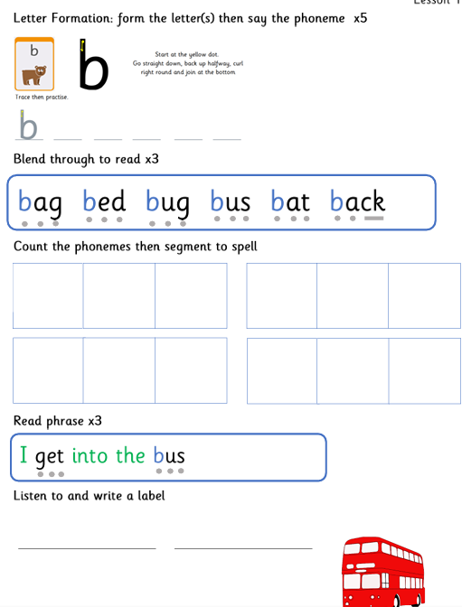
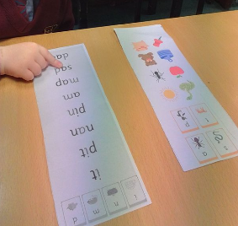
Reading
Children are now completing daily phonics sessions learning one sound per day, with consolidation at the end of the week.
Children can be supported in this at home by reading 5-10 minutes a night, using their school reading book, sound mat or common exception word mat.
Other ways to support your child in reading:
Spot sounds and words whilst out and about.
Talk about the sounds in words and use ‘robot talk’ to sound words out.
Play games like ‘I spy’ using initial sounds in words.
Share stories and rhymes and discuss them together.

Slide 5



Writing
We have now started our literacy sessions using high quality texts to support comprehension and writing.
Children will be focussing on writing their name, simple lists and captions.
Children will then move onto writing simple sentences.
Ways to support your child in writing:
Practice and model speaking in full sentences. Play copy cat games.
Orally rehearse a word/caption/sentence before writing. In school we clap each word in a sentence before we write. (A lot of our practice for writing is oral and modelling being able to hold a sentence in your head and then say it out loud.)
Write lists, labels, captions together using the phonic sounds the children know, even if this is just the first and last sound. E.g. shopping lists, labels for pictures/models, names in birthday cards/ on pictures.
Support motor skills – stickers, playdough, threading, big writing/drawing – paint, chalk, water.

Slide 6

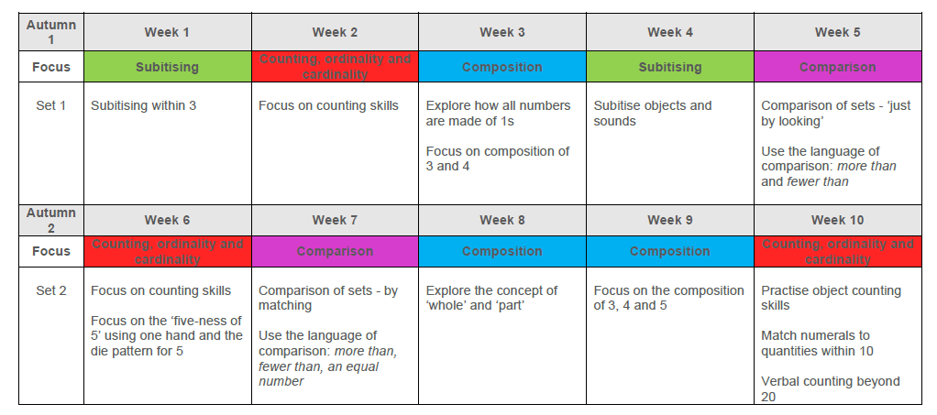
Maths
Children have started their maths sessions through ‘mastering number’.
Children will be focussing on a deeper understanding of numbers to 5, and then to 10.
Covering different strands over each half term.
Ways to support your child with maths:
Count and spot numbers when out and about – steps, cars, houses, toys.
Get children to ‘see’ numbers in the environment as a pattern or group. E.g five as 3 and 2, or three as 2 and 1. In school we call this ‘subitising’. We do this with our fingers, on five frames, on dice and in the environment.
Encourage children to compare groups and numbers they find. ‘More’, ‘fewer’ and ‘equal’.
Encourage children to explain their thinking about number and patterns that they see around them.

Slide 7

Numbots
All children will shortly receive their own log in to access numbots.
Numbots supports our mastering number approach and increases number fluency in a fun way. It also prepares children for when they later move on to Times Tables Rockstars.
https://numbots.com/

Slide 8
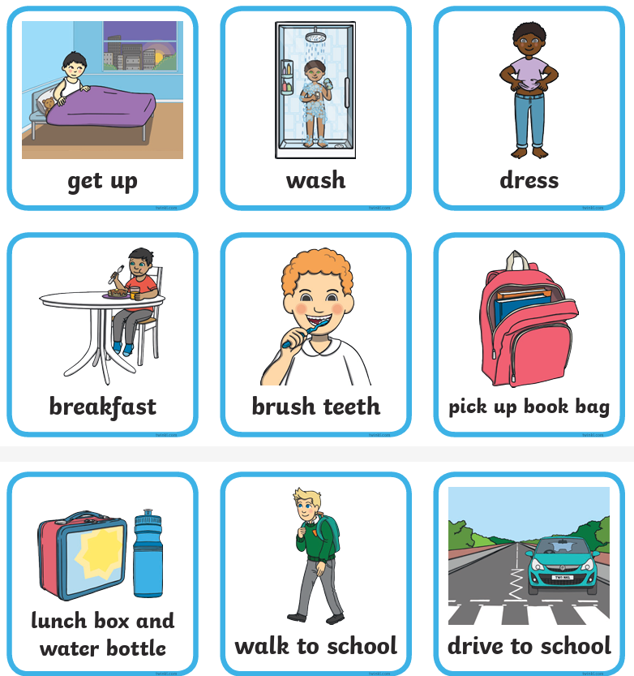
Transition into school.
Children can sometimes find the transition from home to school hard for different reasons, at any time over the school year. Some ideas to try if needed are:
Drawing out a timetable of the week, using pictures to represent school days, activities and who is dropping off and collecting your child.
Using a visual timetable to get ready in the morning, so children know what tasks to complete in which order. These can be gone through the night before so children know what to expect. (We can provide and go through these if needed.)
Setting up an activity at the start of the day, to come home to and do together at the end of the day. E.g. Lego, drawing, a story book.
Please come and see us if you need any support.

Slide 9
Any questions

