Slide 1

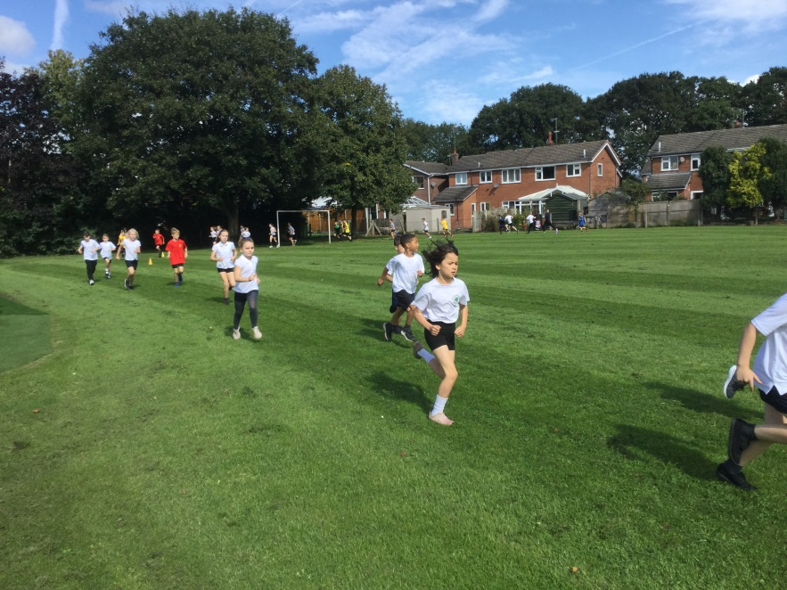
Welcome to Year 3 Curriculum Evening
Key Stage 2
Mr Randall

Slide 2
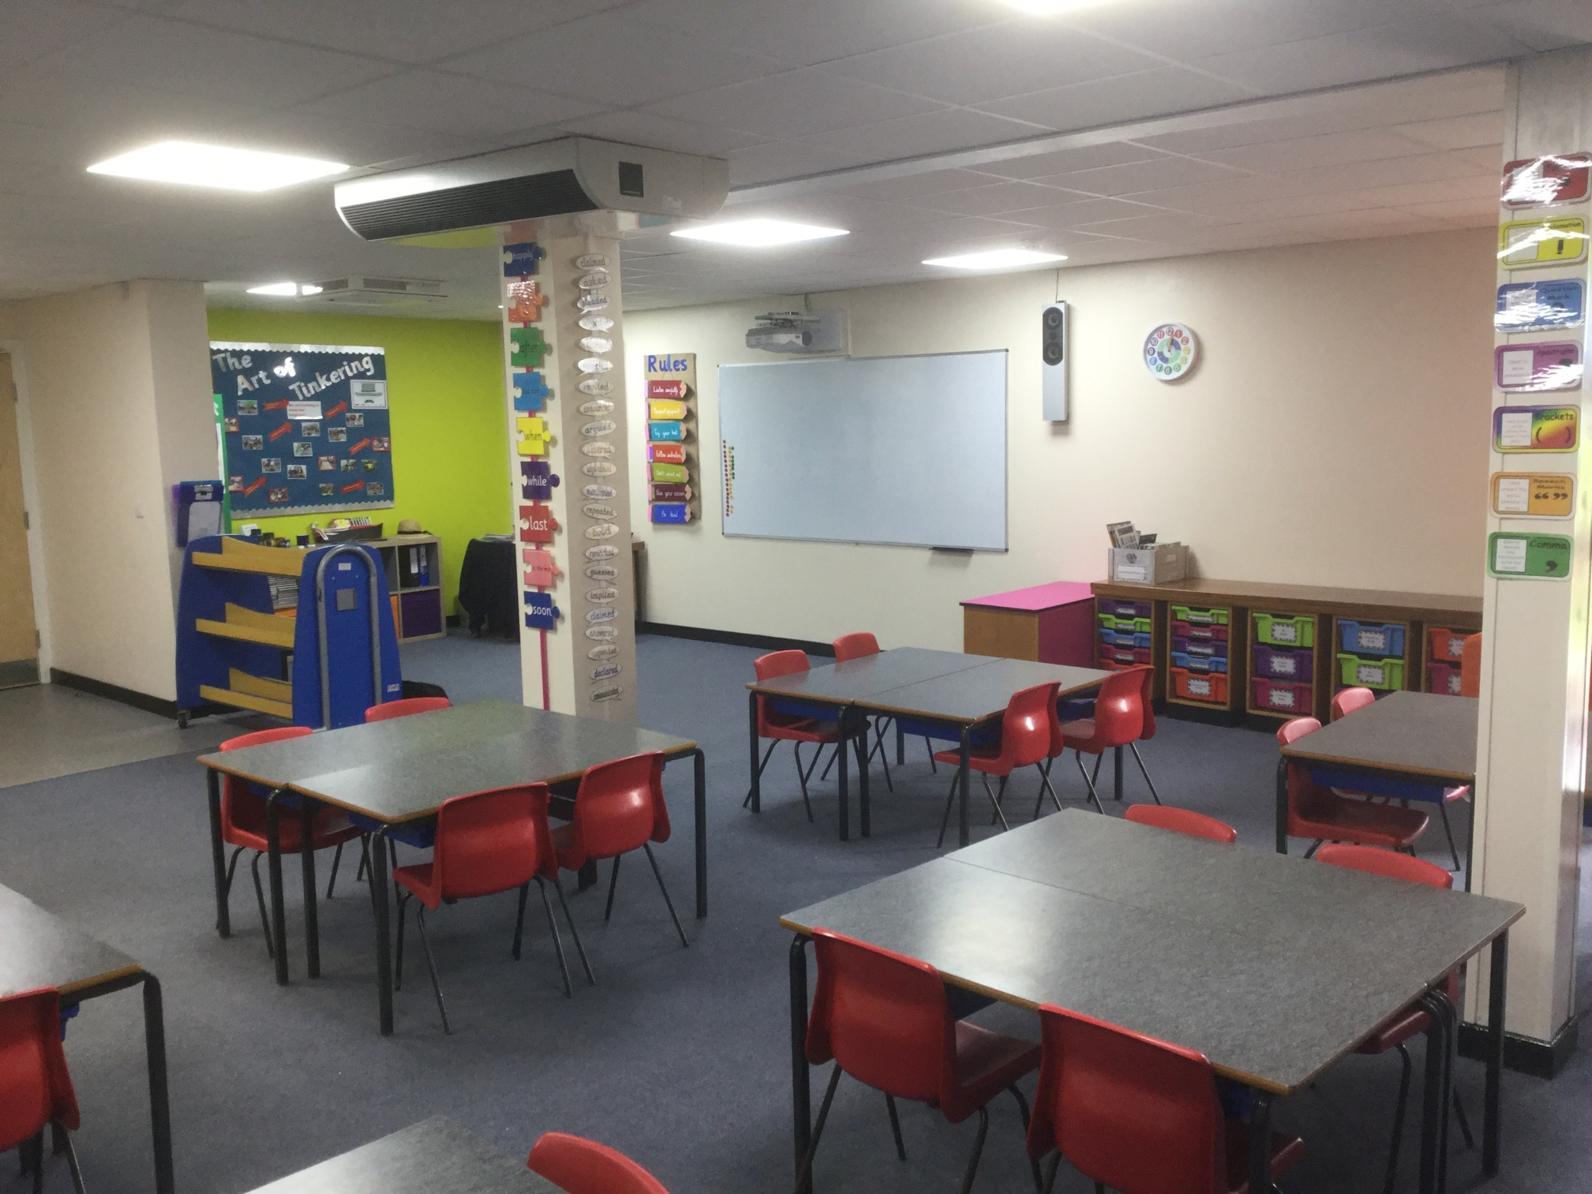

Slide 3
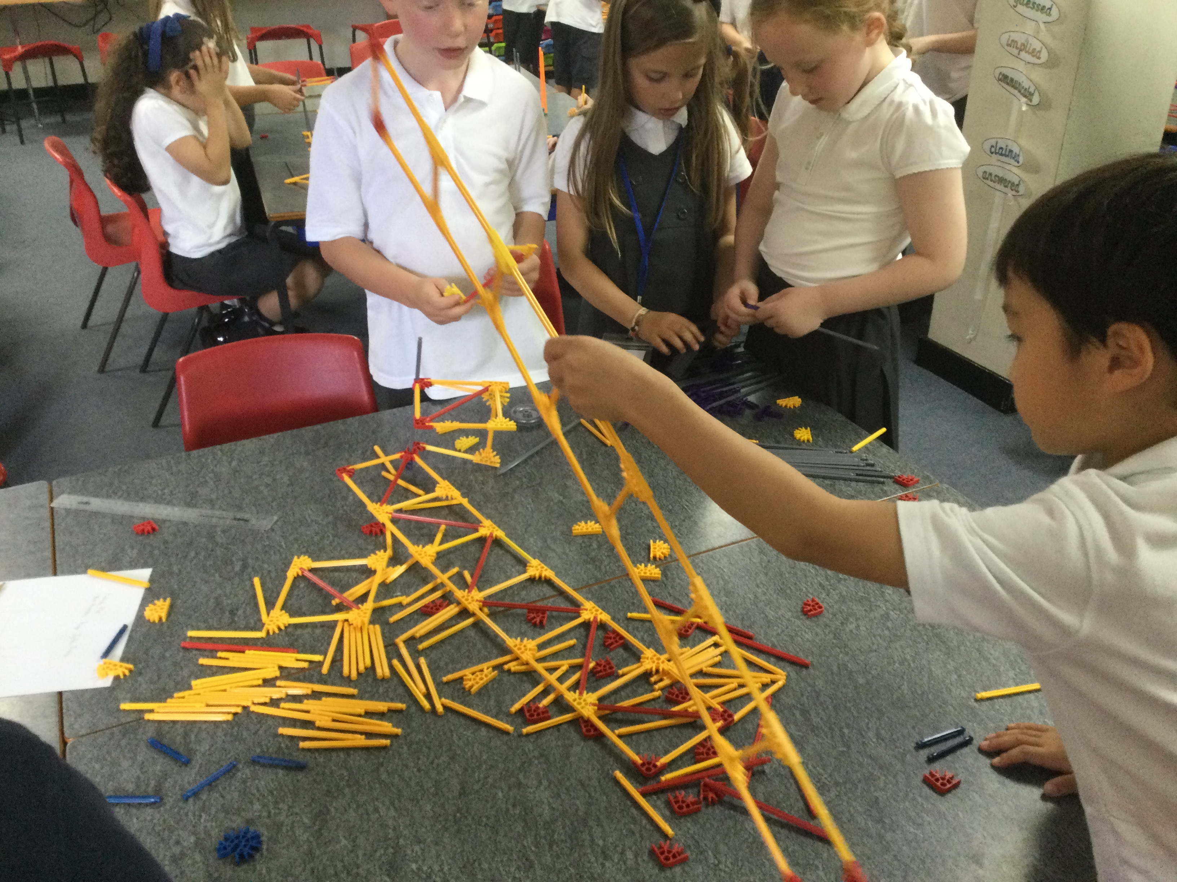
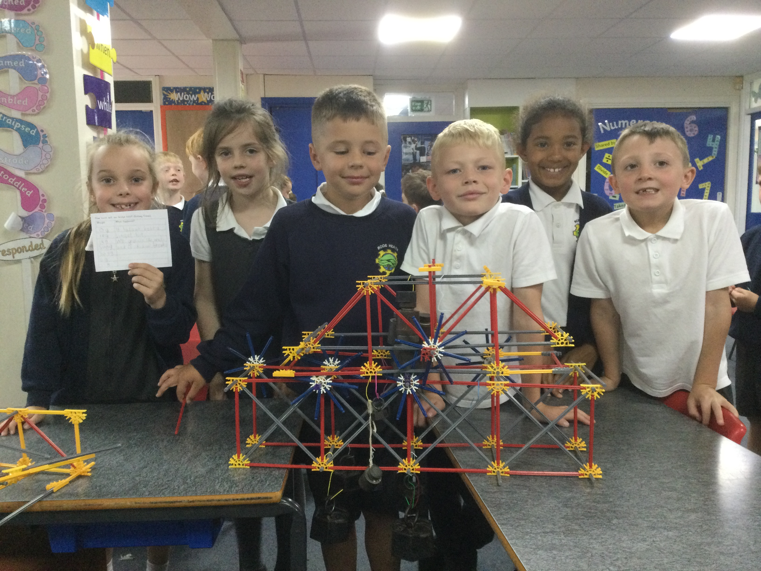

Slide 4
Year 3
Some of the Main Themes
Autumn – Canals - Seal Surfer
- Ellesmere Boat Museum Trip
- Winter’s Child
Spring – Rocks (various text) - Winter’s Child - Stone Age Boy
Summer – Living off the Land’ linked to residential - Big Blue Whale
- Journey
- Kibblestone Camp Residential

Slide 5
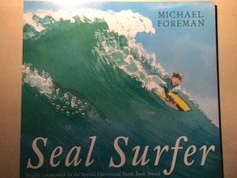
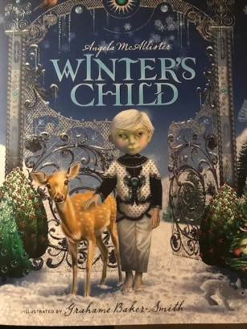
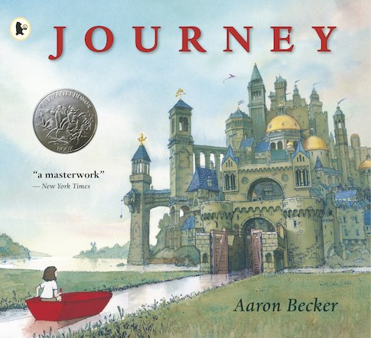

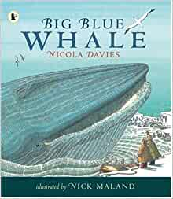
English
Diaries
Instructions
Poetry
Letters
Stories
Play Scripts
Descriptions
Spelling
Full stops, capital letters, commas, speech marks, exclamation marks and handwriting.

Slide 6
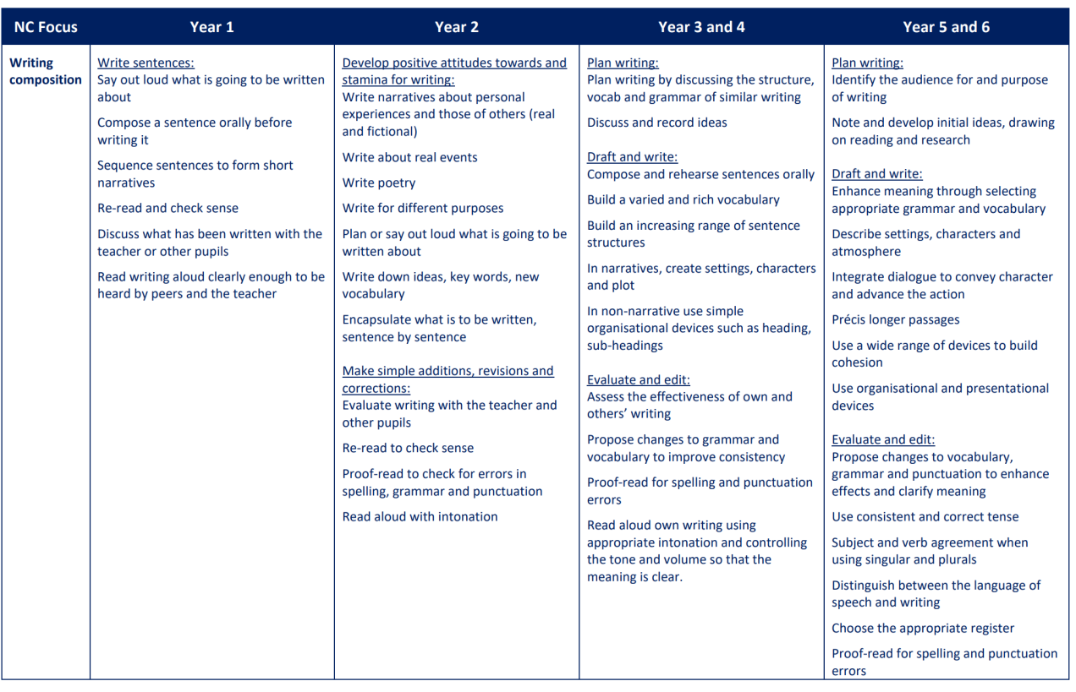
English Expectations are on the website.

Slide 7
Reading
It is imperative that children read at least 4 times a week at home
Books will follow the book colour band until completion
Books should match your child’s ZPD which is written in the front of your child’s reading diary
Children are free to choose from a wide selection of books but please encourage/check that books do match the ZPD or their correct colour book band
Please encourage your child to write any new vocabulary they come across in the designated section at the back of the reading diary.

Slide 8
How to help
Ask questions about the book your child is reading
Read to your child in order to model good reading habits
Encourage your child to read from a variety of different authors
Daily diet or reading and building up reading stamina
Look at the recommended reads for Y3 (web page) encourage children to read at least some books from this list

Slide 9
Maths
Teach Mathematics every morning with the support of the MNP scheme
Teach basic fluency skills daily and consolidation of work taught previously
We ensure that your child gets a daily diet of written, verbal and practical mathematics

Slide 10
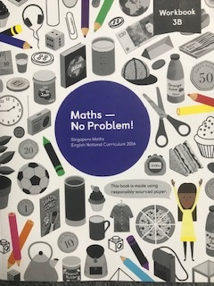
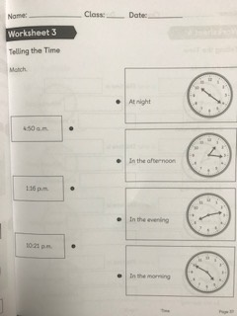

Slide 11
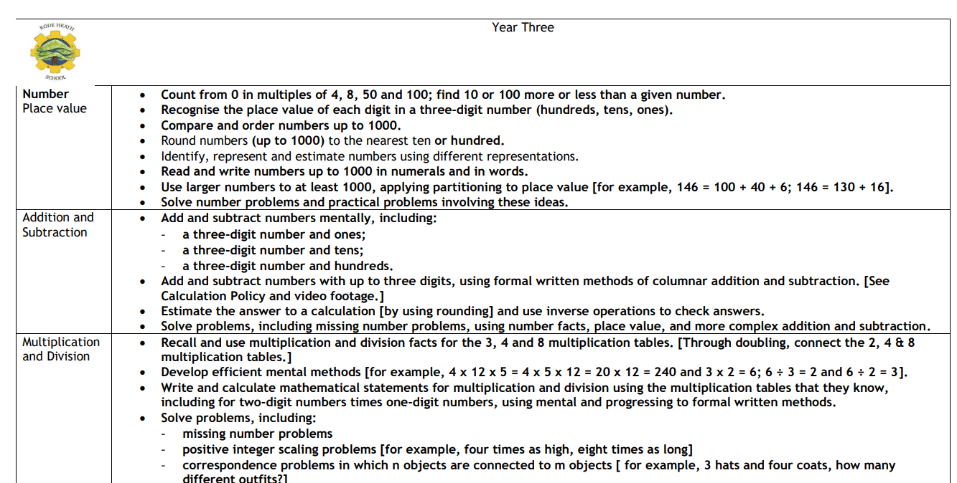
Maths Expectations

Slide 12
What can help you?
Please spend time visiting the website
Y3 page has videos to show you how we teach calculation and it has the end of year expectations as well as the weekly learning objectives
The maths web page also gives you all the detail you need to support your child and to understand truly how we teach maths at Rode Heath

Slide 13
What can you do?
Please support with home learning
Basic mental addition and subtraction
Practice more formal methods of addition and subtraction
Help your child to tell the time to the nearest 30 minutes (this will be an ongoing thing throughout the year)
Help your child to understand their multiplications – 2,3,4,5,8,10

Slide 14
Year 3
Science - Forces and Magnets, Light, Rocks, Animals
including Humans and Plants.
D&T - Pneumatics, Textiles, Cooking, links with Engineering
RE - Muslim Beliefs, Christmas around the World, The Bible & Prayer, God and Descriptions of God
Computing - Programming, digital awareness, electrical systems
(includes e-safety)
Art - Progression of art skills; printing, painting, drawing, sculpture
Music - Listening, Composing, Performing and Appraising
PE - Gym, Swimming, Athletics, Dance, Games (kit required Tuesday & Friday)
Humanities - Geography and History (canals, stone age, settlements, Antarctica)
Hearts & Minds - Belonging, Myself, My Family, diversity and democracy
MFL - Spanish
(The class website page gives you a more detailed curriculum grid)

Slide 15
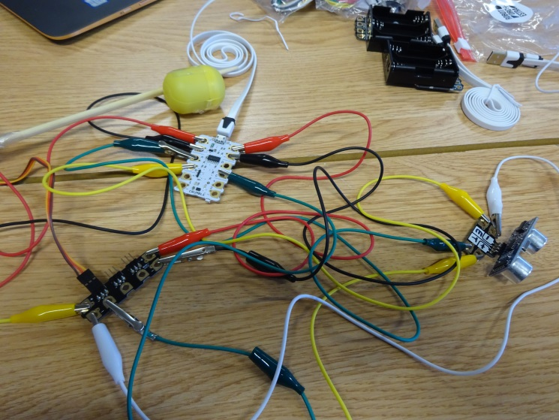

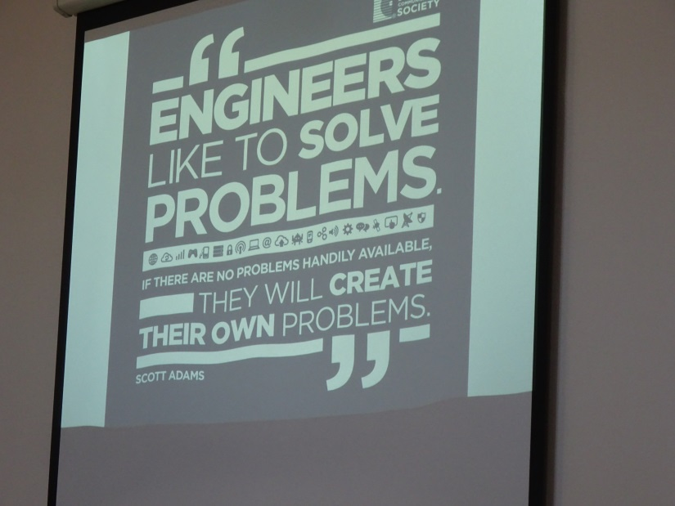
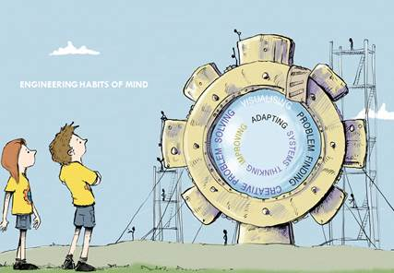
Engineering/Science Projects

Slide 16
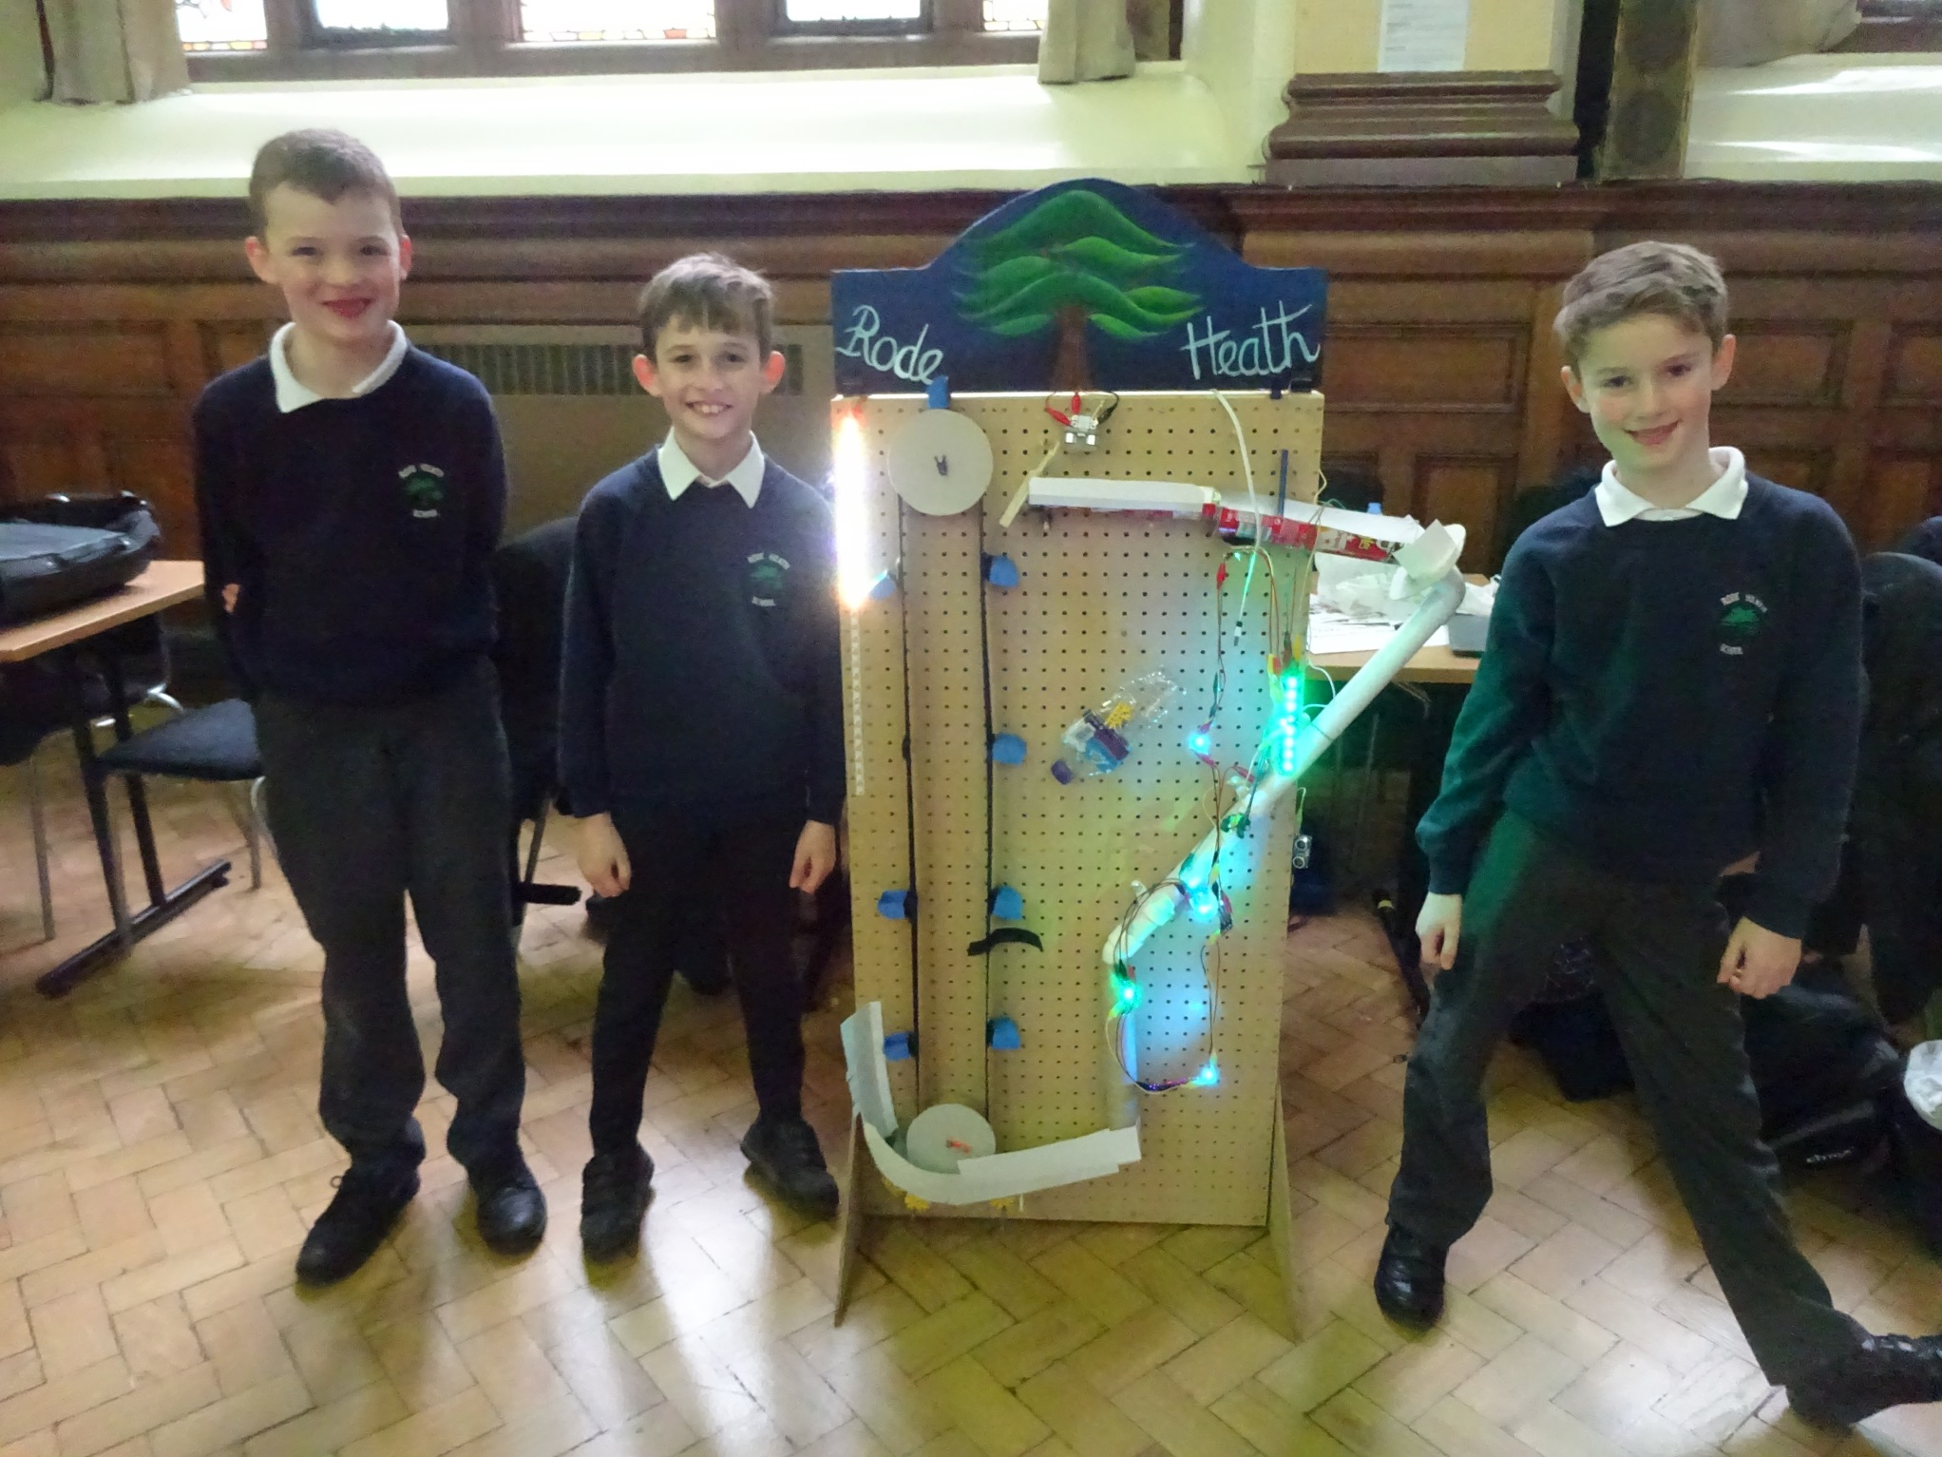

Slide 17

Homework
Year 3
Weekly Maths Atom Learning online
Weekly English Atom Learning online
Weekly Spelling homework (sheet in pink book)
Times Table Rock Stars (online activities)
Given out Wednesday and in on a Monday

Slide 18

Reading Books
Children take a reading book home and read to an adult, this is written in the Reading Record.
Renaissance Reading
Banded books
Sign Reading Record at least 4x a week please.

Slide 19
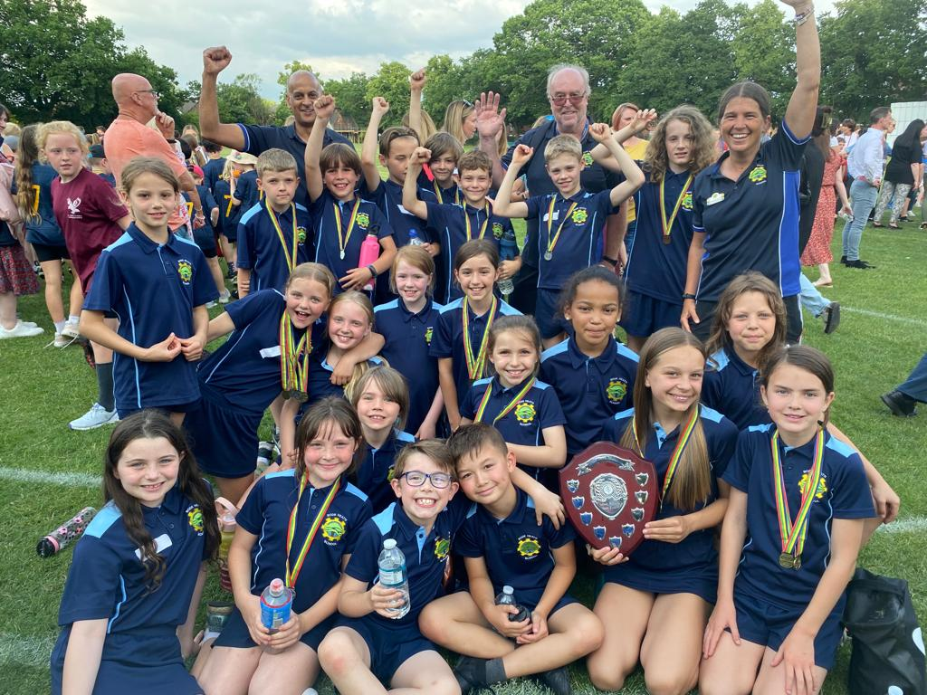
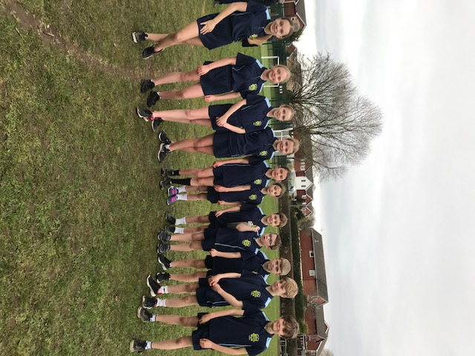
After-school sports clubs
NAR Football
Athletics/basketball/hockey
Sports competitions
Other clubs TBC

Slide 20
School Houses
Willow House
Beech House
Ash House
Oak House

Slide 21
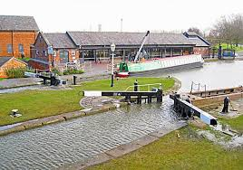
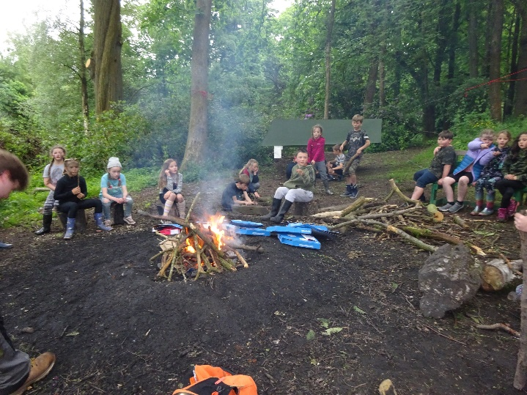
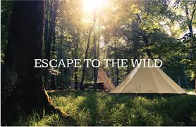
Year 3 Trips
Ellesmere Boat Museum
30th September 2026
Residential to Kibblestone (Living off the land theme) Thursday 10th - Friday 11th June 2027
website
Kibblestone Campsite | Join our Adventure

