Slide 1

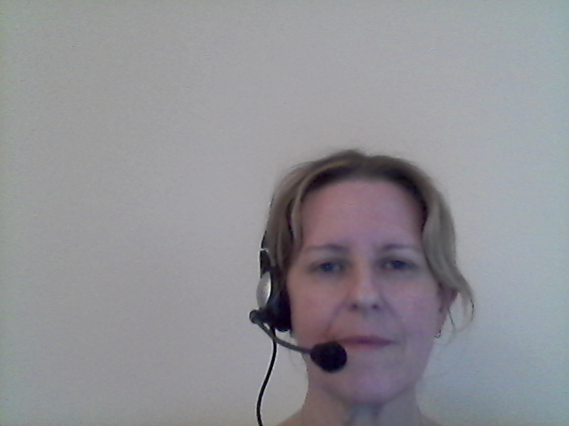
Reception Curriculum Evening 24th September 2025 Mrs Adams & Mrs Barnett

Slide 2
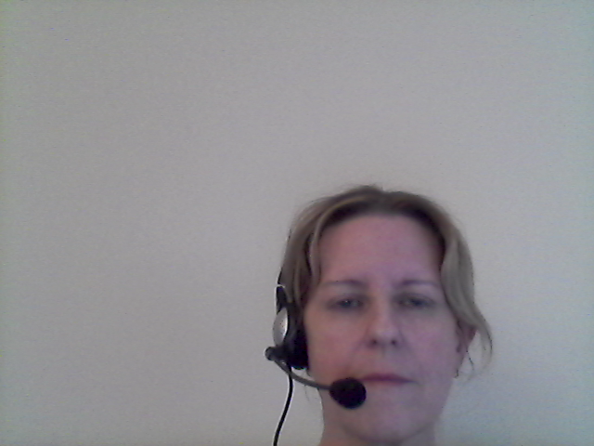
EYFS Curriculum
Communication
& Language
Personal
Social &
Emotional
Physical
Literacy
Expressive
Arts &
Design
Understanding
The
World
Mathematics

Slide 3
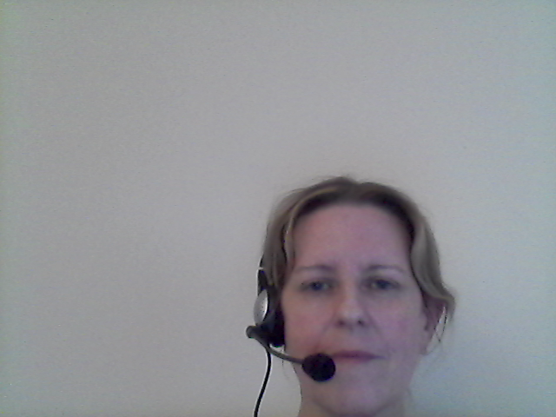
The Prime Areas
Communication
& Language
Personal
Social &
Emotional
Physical
Listening, Attention & Understanding
Speaking
Self Regulation
Managing Self
Building Relationships
Gross Motor Skills
Fine Motor Skills

Slide 4

The Specific Areas
Literacy
Understanding
The
World
Expressive
Arts &
Design
Mathematics
Past & Present
People, Culture & Communities
The Natural World
Computing
Comprehension
Word Reading
Writing
Creating with Materials
Being Imaginative & Expressive
Number
Numerical Patterns

Slide 5

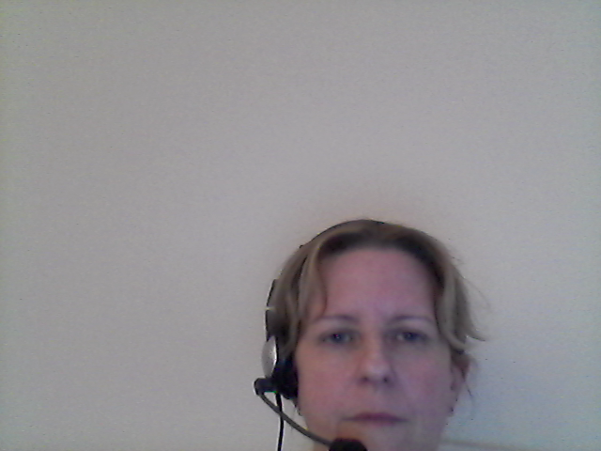
Comprehension
Literacy
By the end of Reception:
Demonstrate understanding of what has been read to them by retelling stories and narratives using their own words and recently introduced vocabulary.
Anticipate (where appropriate) key events in stories.
Use and understand recently introduced vocabulary during discussions about stories, non-fiction, rhymes and poems and during role play.

Slide 6

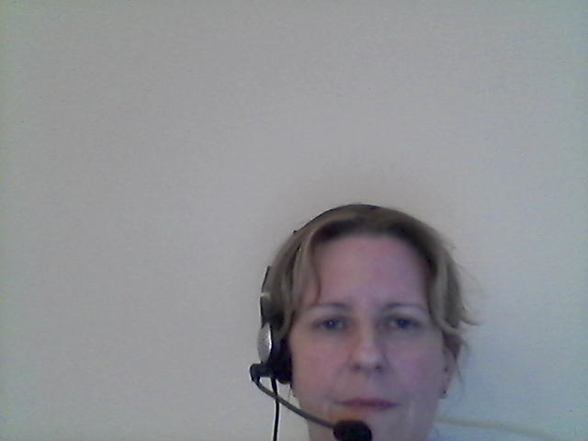
Word Reading
Literacy
By the end of Reception:
Say a sound for each letter in the alphabet and at least 10 digraphs.
Read words consistent with their phonic knowledge by sound-blending.
Read aloud simple sentences and books that are consistent with their phonic knowledge, including some common exception (tricky) words.

Slide 7
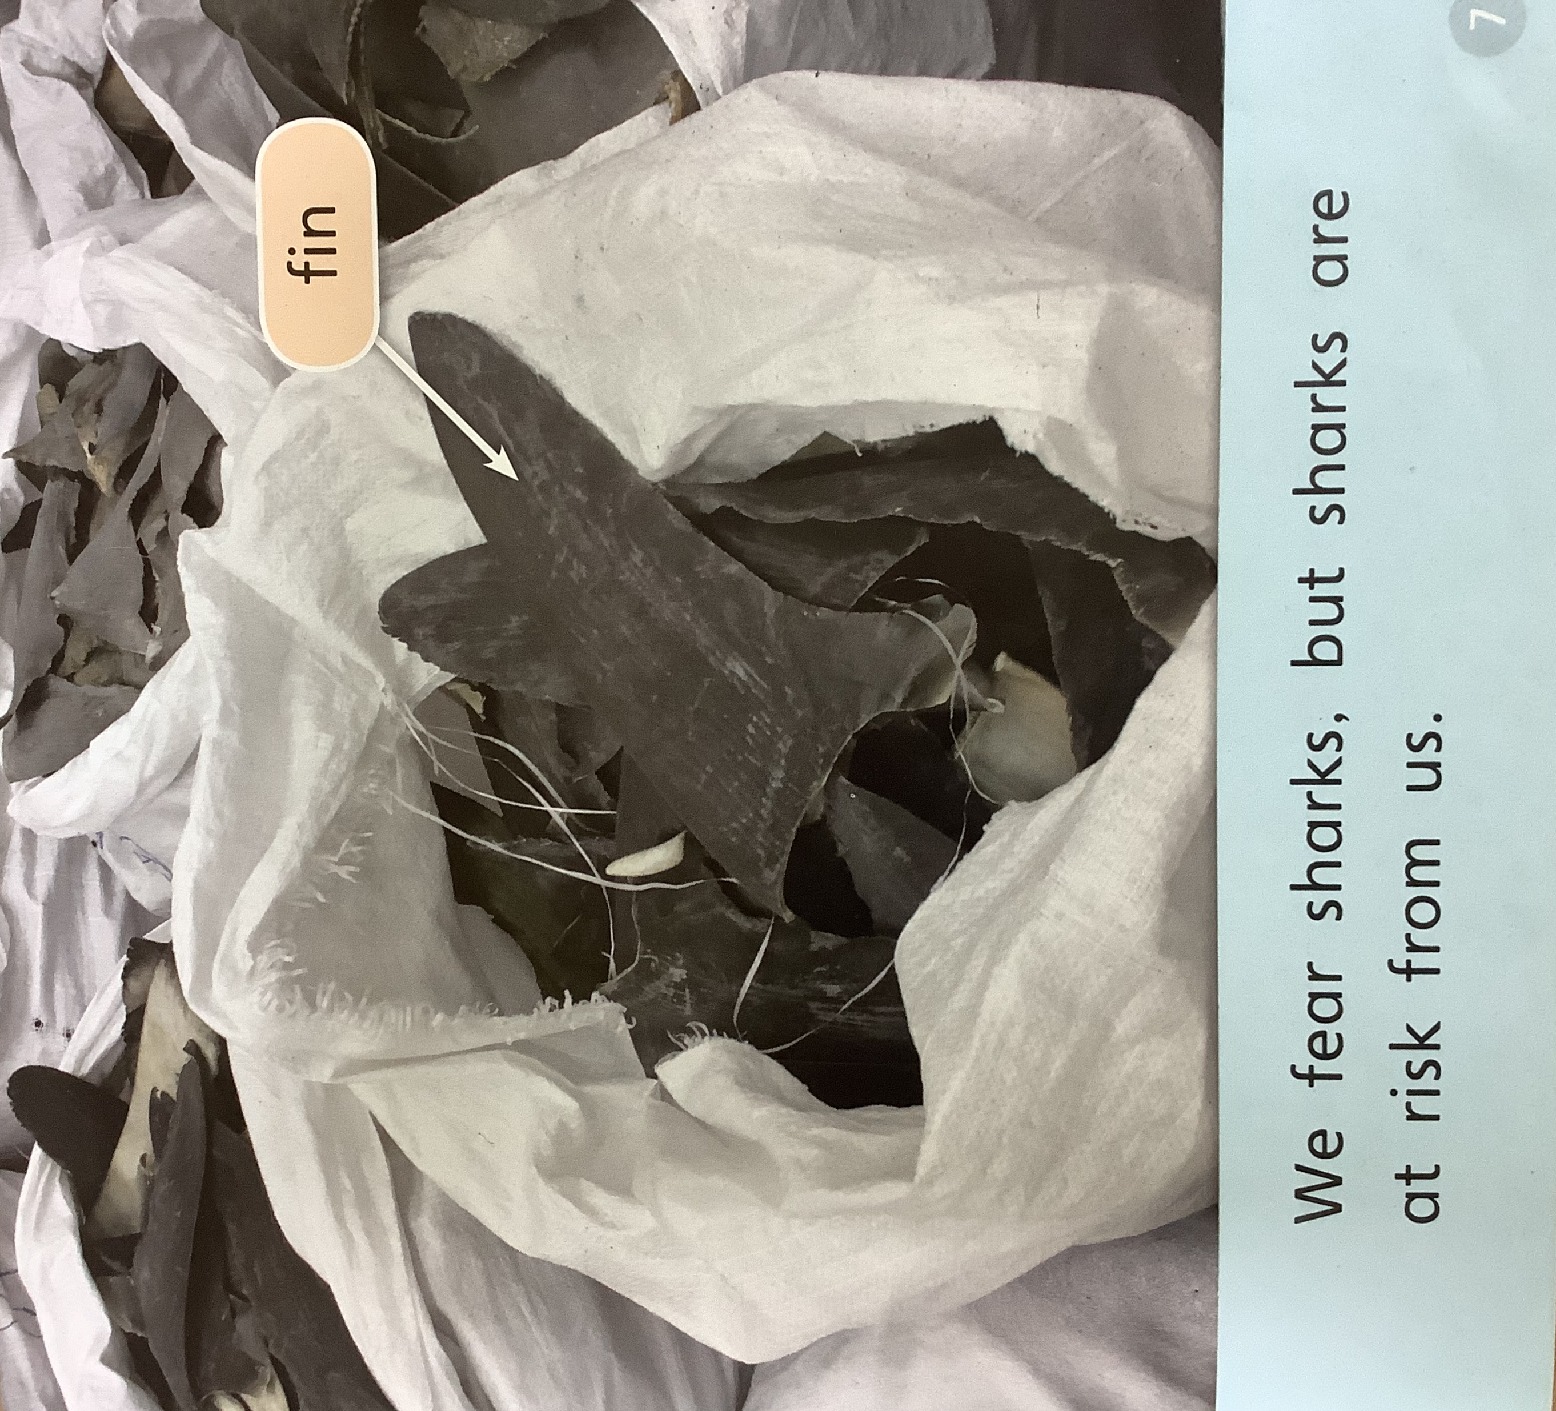
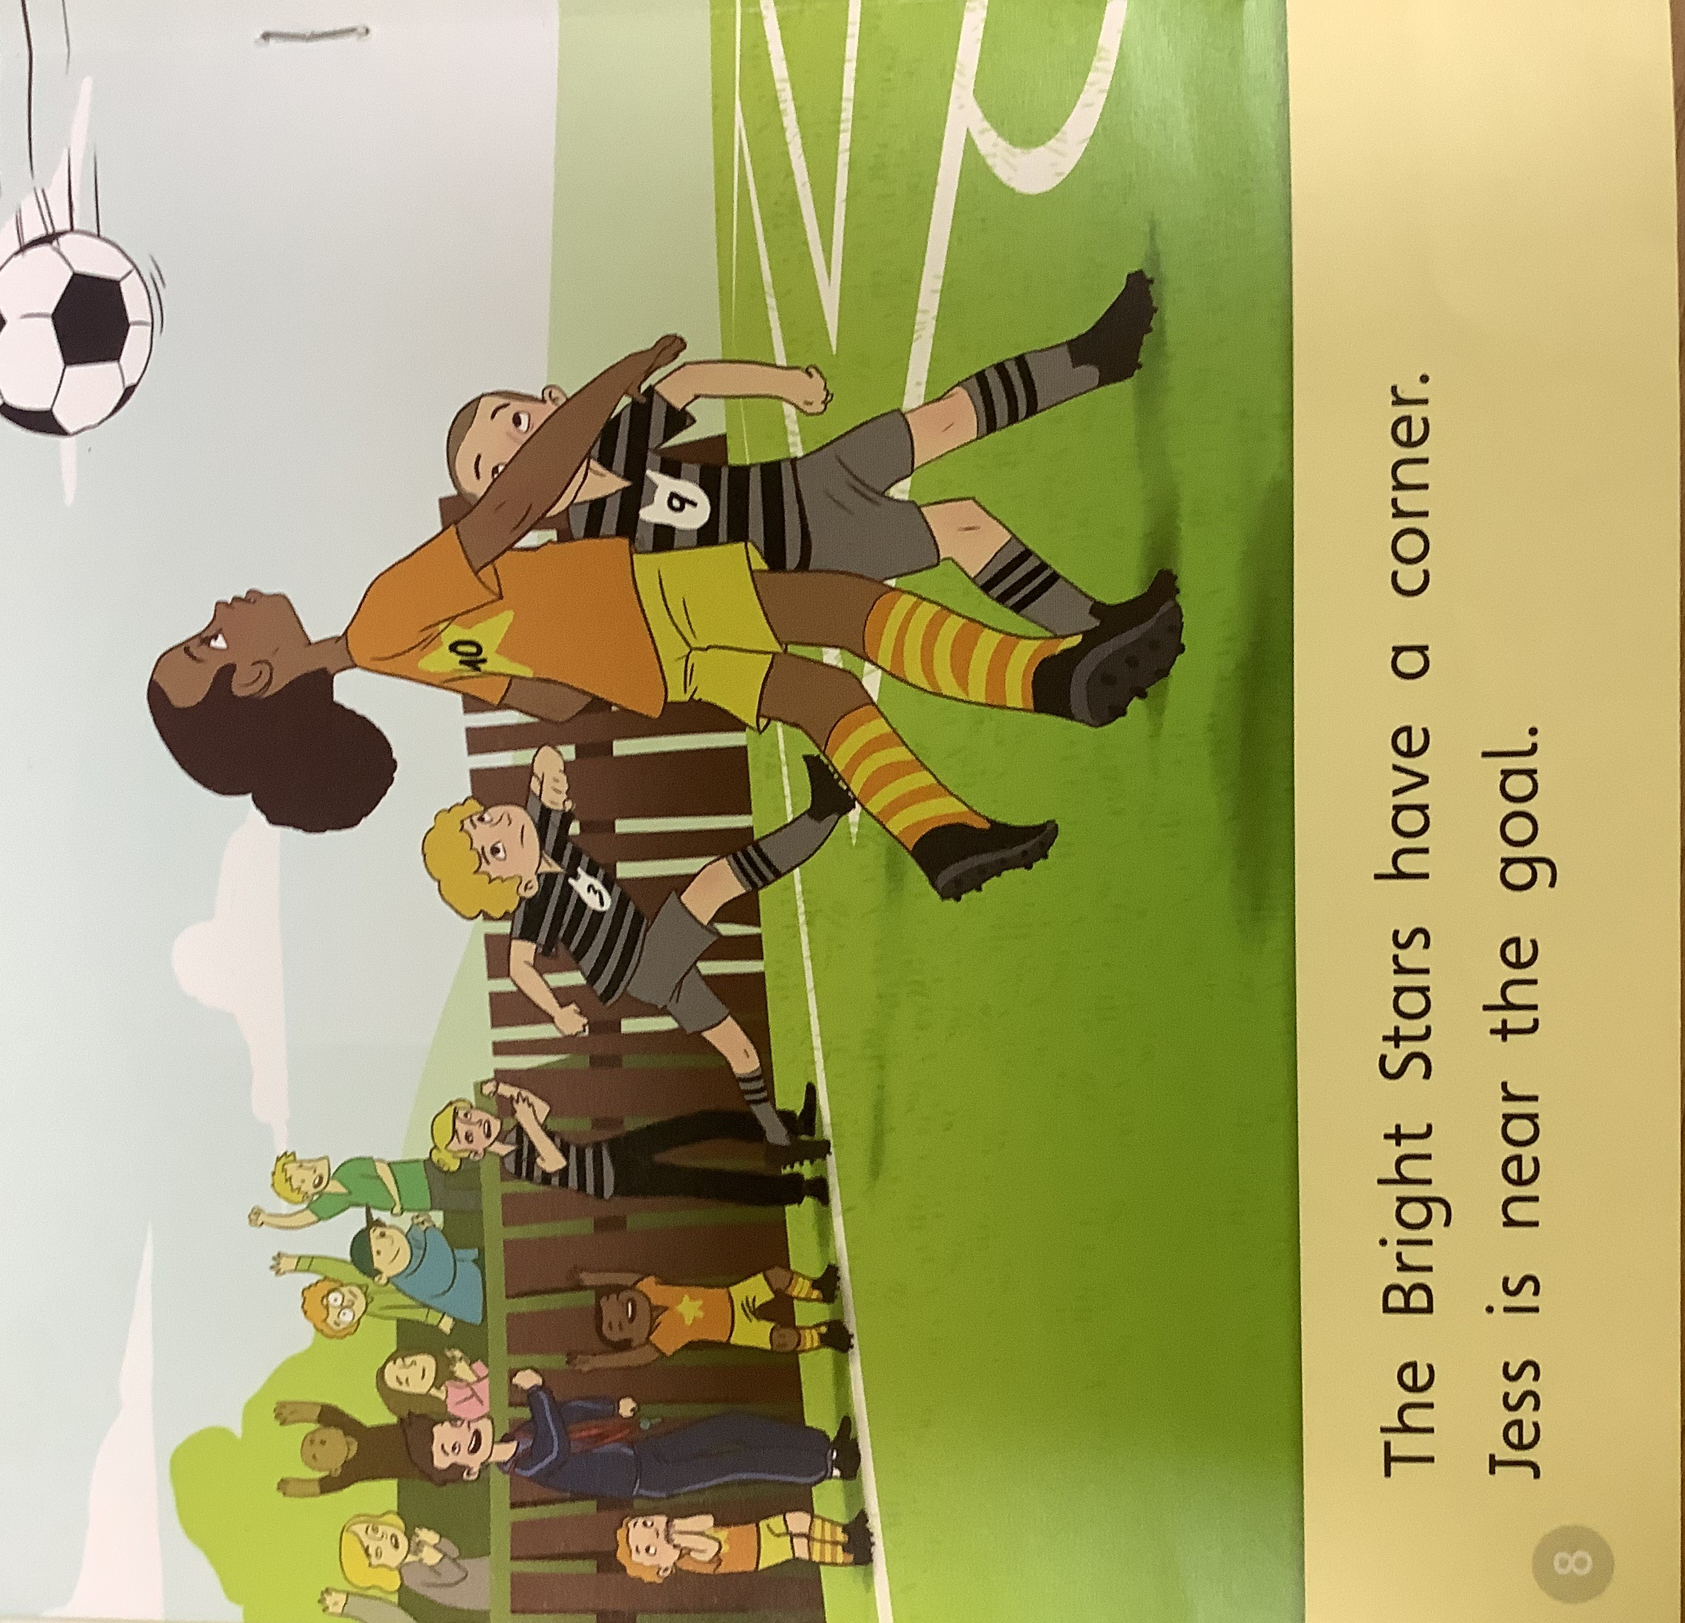

Word Reading
Literacy

Slide 8


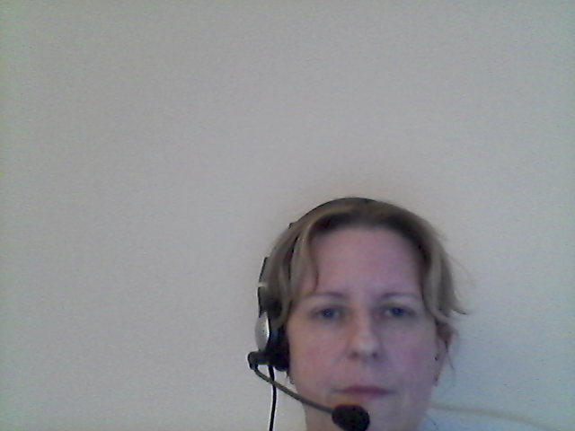
How can you help?
Literacy
Listen to your child read at least 4 times a week
5 – 10 minutes per session maximum.
Keep it positive
Record reading in the diary.
Use pure sounds when helping your child.
Read to your child.
Be a reading role-model

Slide 9

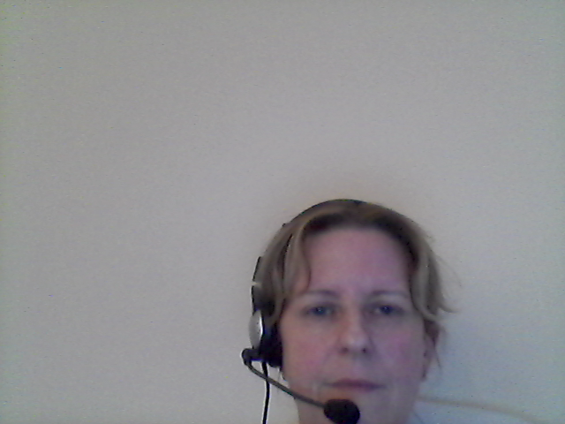
Writing in Reception
Literacy
By the end of Reception:
Write recognisable letters, most of which are correctly formed.
Spell words by identifying sounds in them and representing the sounds with a letter or letters.
Write simple phrases and sentences that can be read by others.

Slide 10
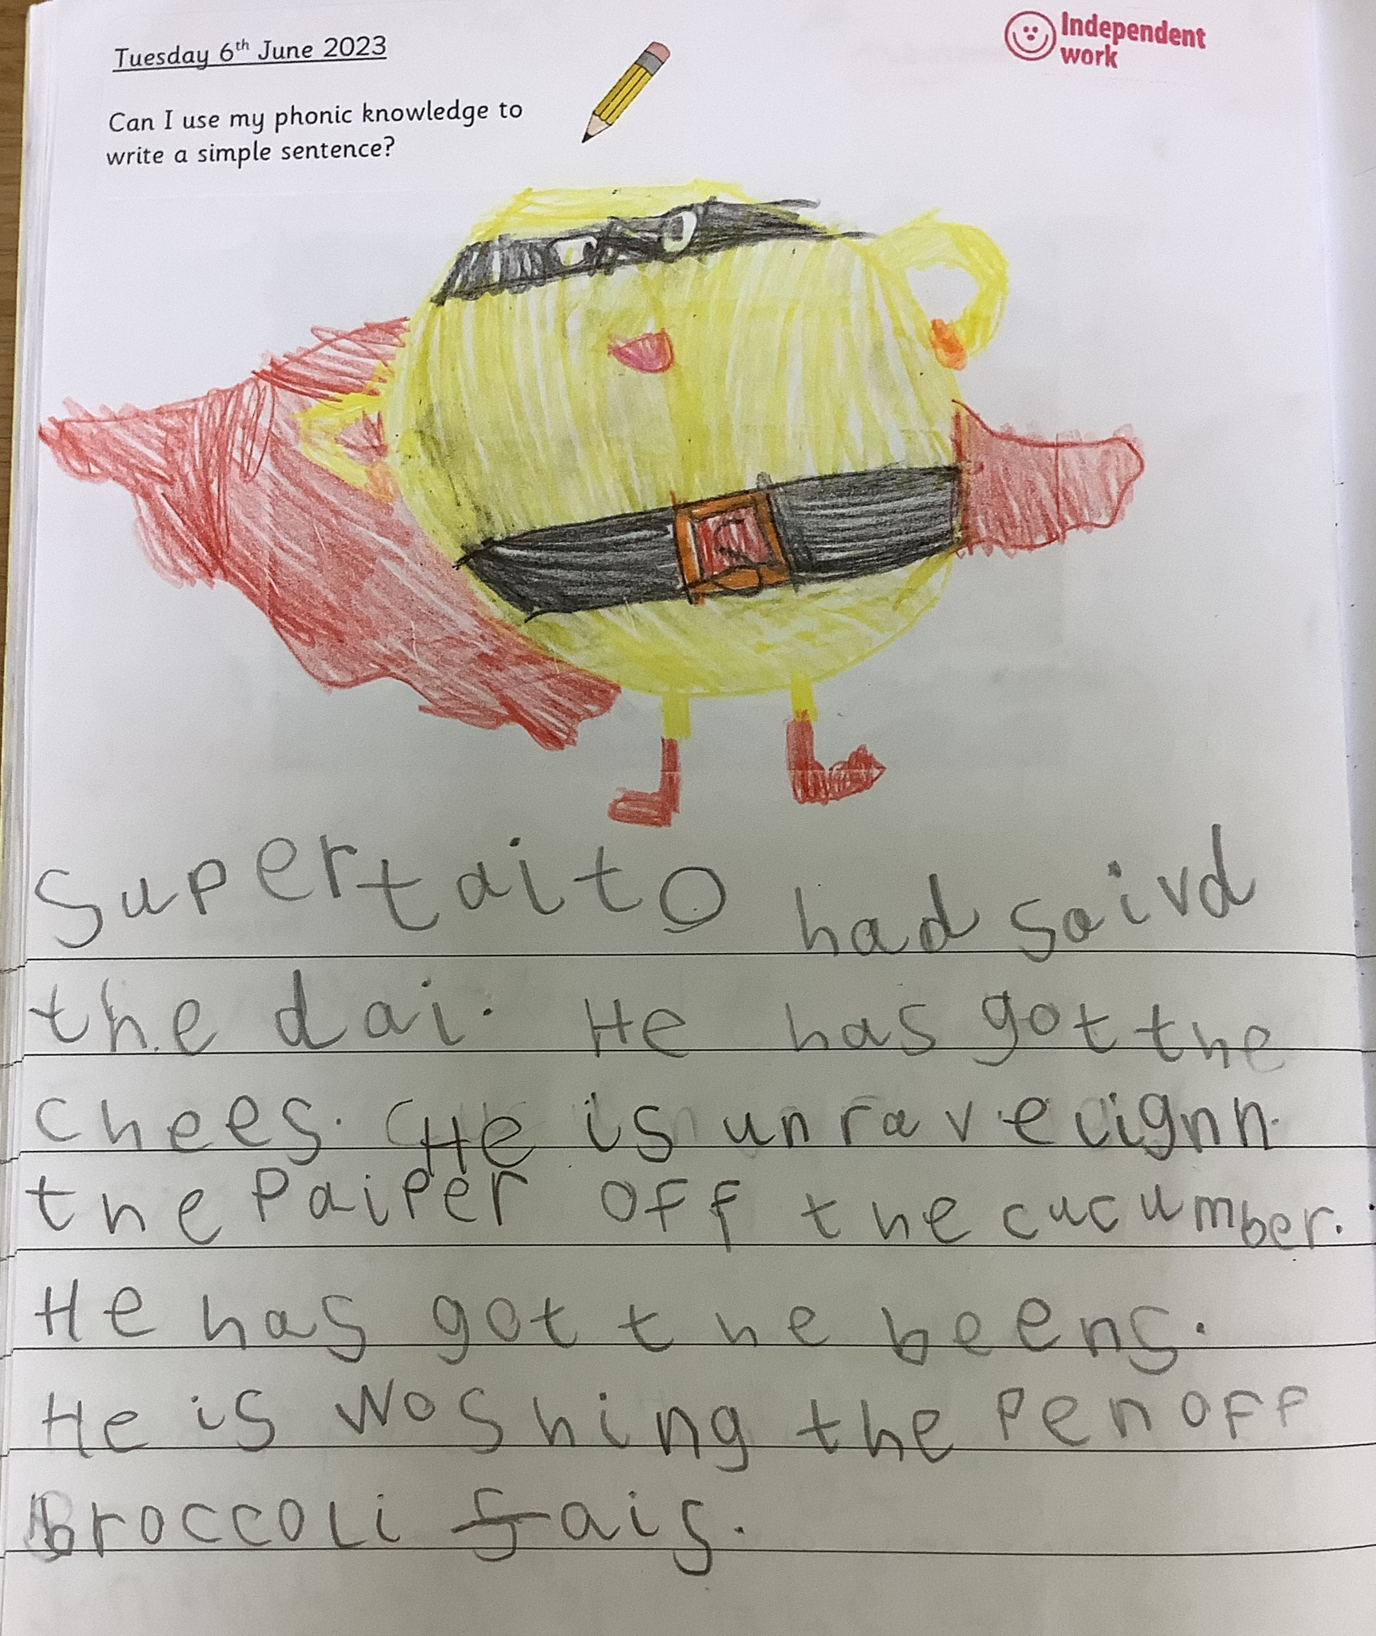
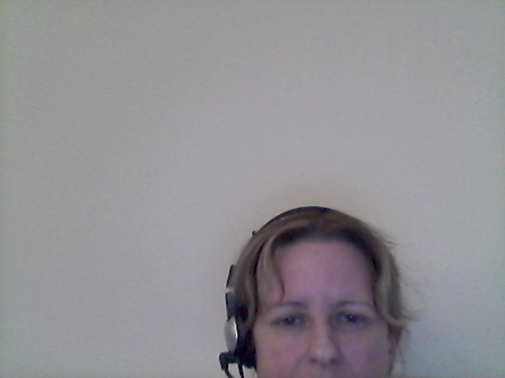
Writing in Reception
Literacy

Slide 11
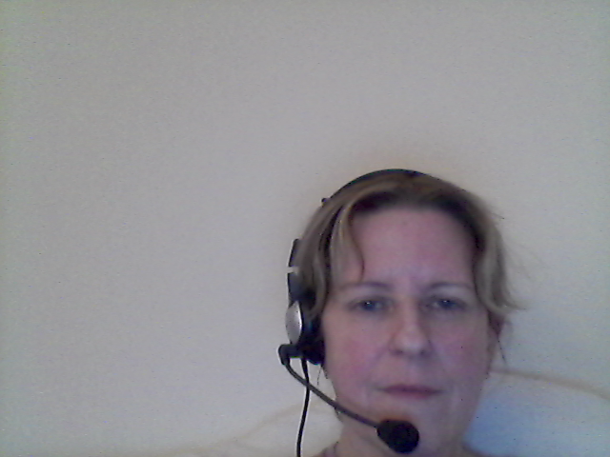
How can you help?
Literacy
Help your child with home learning tasks
Support your child to develop an effective pencil grip
Practise segmenting words for writing
Focus on correct letter formation

Slide 12
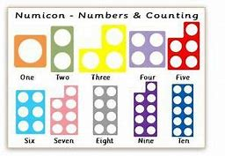
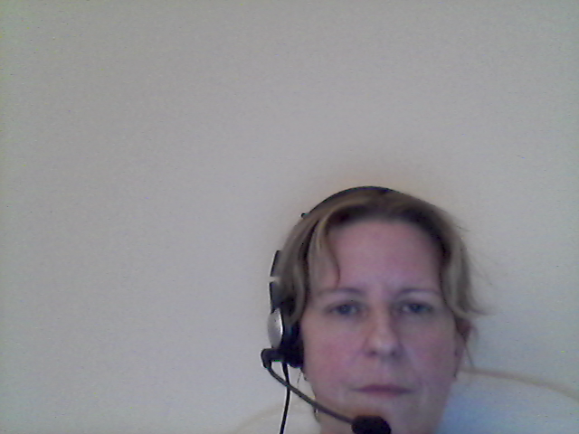
Maths in Reception
Mathematics
Number emphasis
Depth of understanding
Number facts
Counting
Comparing
Pattern recognition

Slide 13
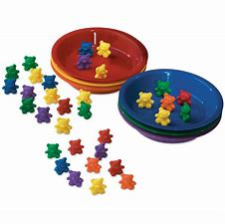
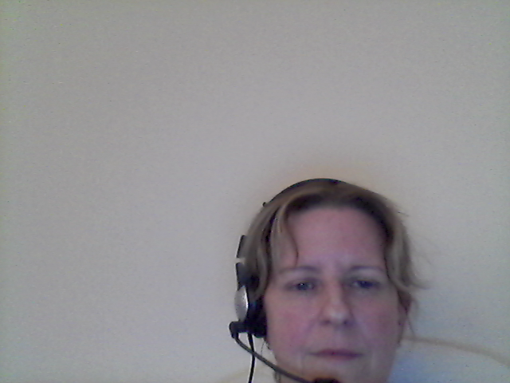
How can you help?
Mathematics
Help your child to count groups of objects accurately (to 20 or more by the end of the year)
Help your child to understand mathematical language (one more/one less, big, bigger, biggest/short, shorter, shortest)
Help your child to recognise that maths is everywhere!!
Please spend time visiting the website:
The Reception class page
The Maths web page

Slide 14







Reminders:
Changed on MONDAY
PE is on THURSDAY
Issued on FRIDAY.
Complete by WEDNESDAY
Class page is updated weekly – please check for news, reminders and updates.
Logins from Pre-School are still valid. Share learning in class and at home.

Slide 15


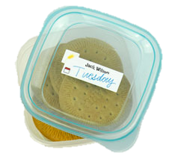



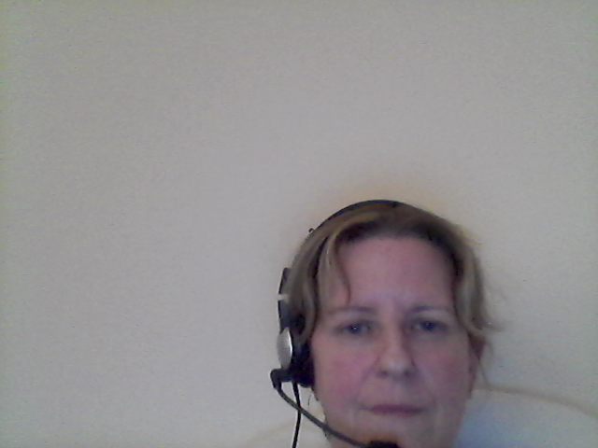
Every day…

Slide 16
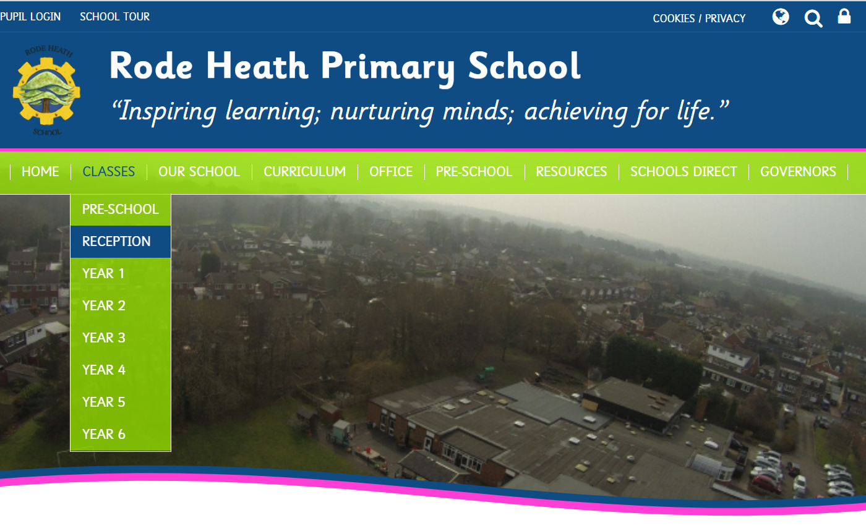


Keeping in Touch…
www.rodeheath.cheshire.sch.uk
admin@rodeheath.cheshire.sch.uk
(01270) 314414

Slide 17
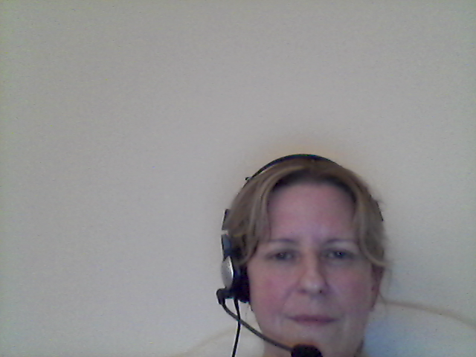
Any Questions?
Our door is always open
Don’t worry about things at home – get in touch!

