Slide 1

Welcome to Year 5
Miss Watson

Slide 2
General Routines
Water bottles should be labelled.
All clothing named.
Phones to go into the basket in my cupboard at the start of a day and not to be used until outside the school premises.
PE kits to be worn on Thursdays and Fridays for the entire day. Dress accordingly to seasonal changes. This is for the autumn term.
Children can bring in trainers to wear for the Daily Mile.
Children are responsible for their own belongings.
All children must abide by the class rules or face a consequence in accordance with the school behaviour policy.
Healthy nut free snacks please.
Pencil cases small enough to fit in tray.
Reading records brought in daily and signed.
Raincoat.

Slide 3
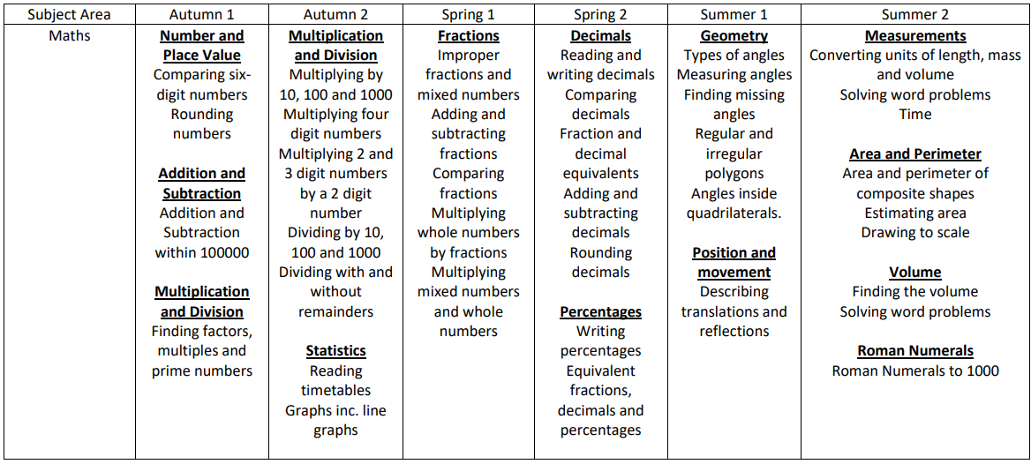
What will your children learn this year?

Slide 4
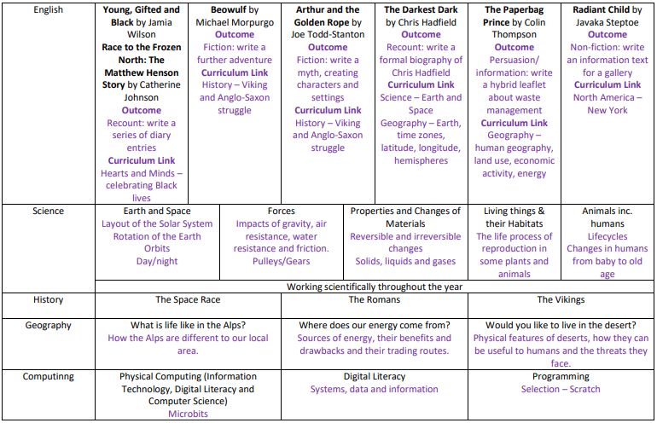

Slide 5
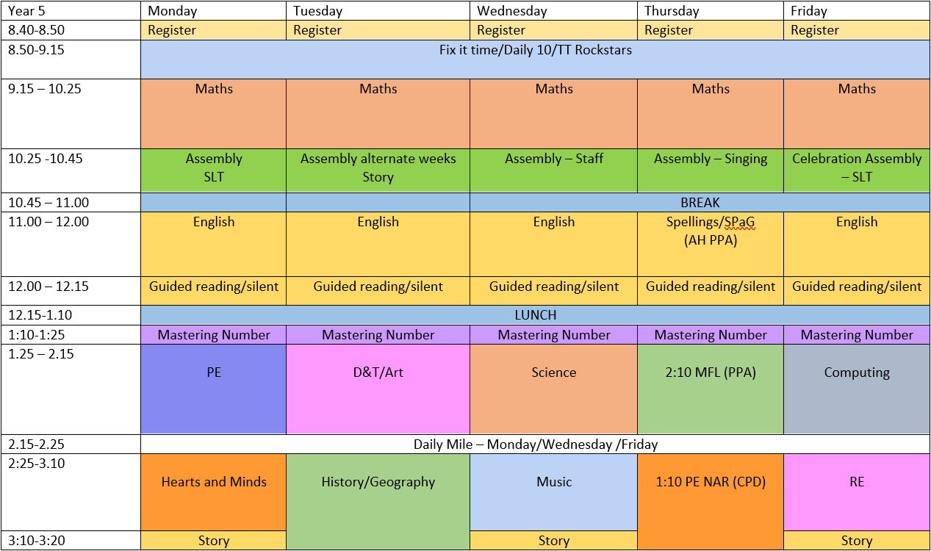

Slide 6
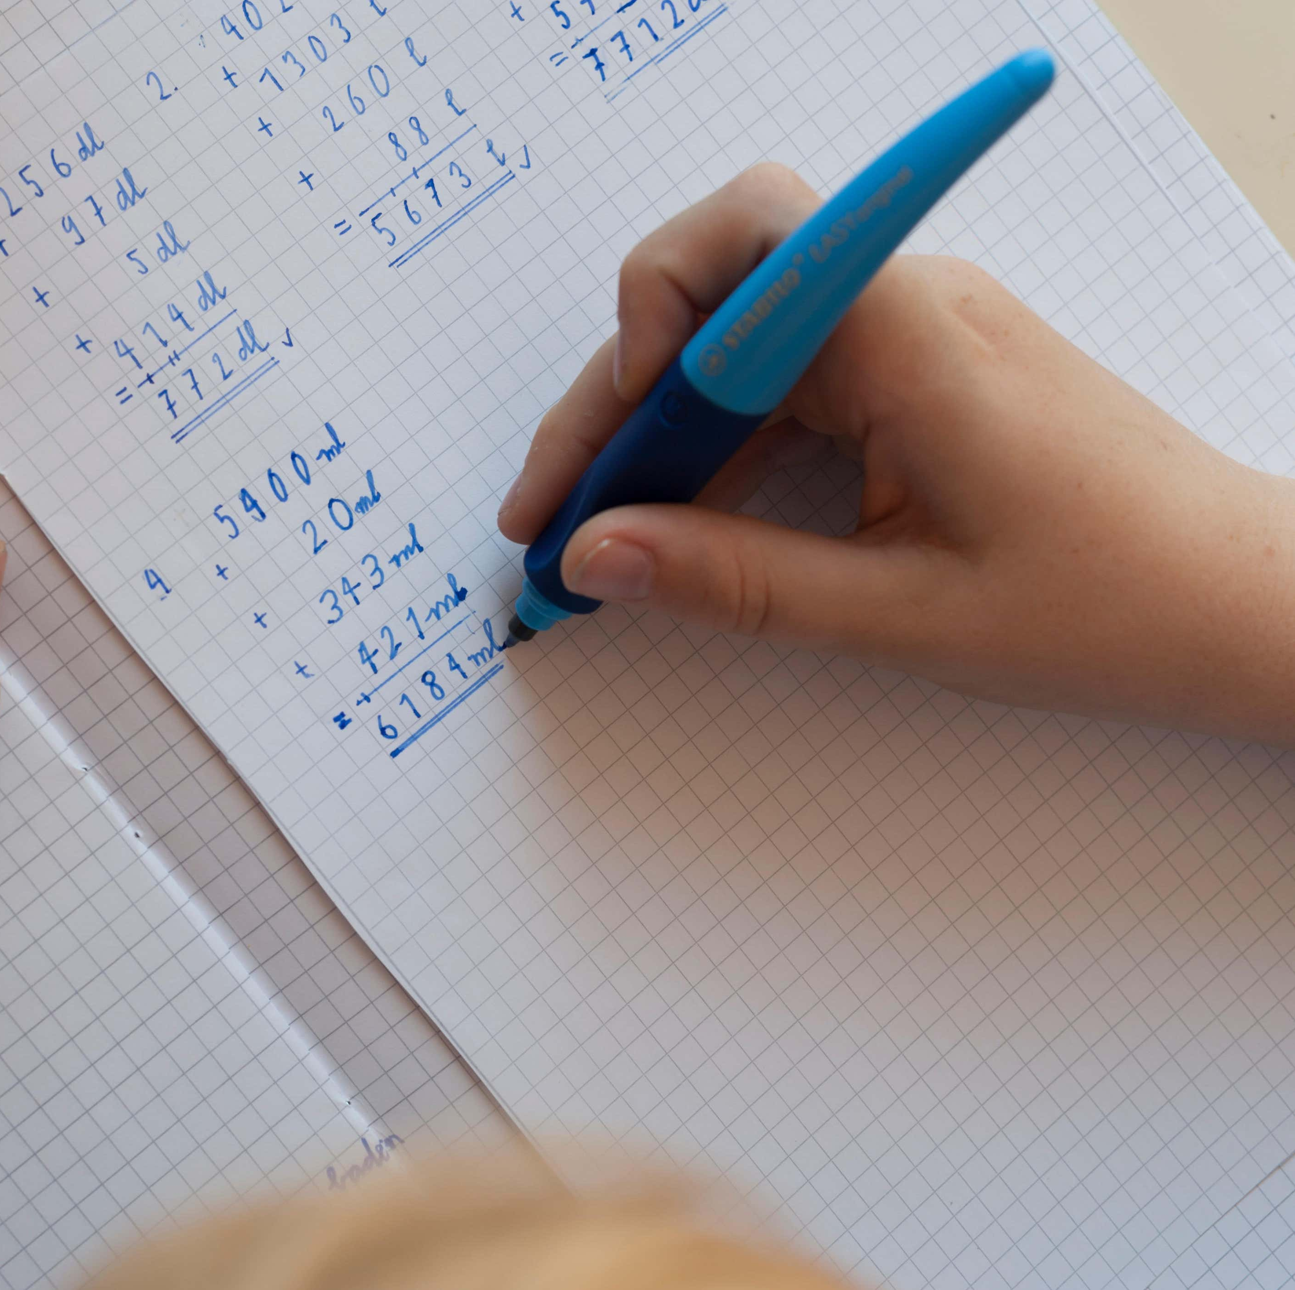
In Class Support
Miss Watson and Mrs Cosgrove
Work will be set at an appropriate level of challenge for the children and they will be expected to work hard and keep up to date

Slide 7
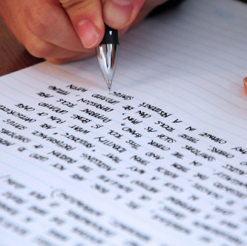
English
SPaG lessons – Spelling, punctuation and grammar with Mrs Harrop.
Individual and guided group reading.
Guided groups during lessons.
Support on teacher table.
Informative and creative writing.

Slide 8
Reading
School
  Weekly guided reading session – comprehension tasks to be completed in school the next day.
  Star reading scores (ZPDs) are updated each half-term.
  Renaissance quizzes to be included in their diaries.
  Checking on quizzes every two/three weeks.
Home
  Reading diaries to be completed in the right-hand column. Reading to be done at home for at least 4 nights, including the weekend (10 pages minimum). Page numbers please.
  There is a weekend section for reading.
  There is also a vocabulary section for new and exciting words.
  Please sign the diaries as we regularly check them.
  The diary is a good tool for communication between home and school as well.
  Read with your child at least a couple of times a week and ask questions about what they have read to check understanding.

Slide 9
Maths
We teach Maths every morning using the Maths No Problem scheme
Fluency skills are taught daily and build on prior knowledge and skills
Children explore the use of manipulatives and real life mathematics.
Please check the website weekly to keep up to date.
Class page has the weekly learning objectives and videos to help aid your child’s understanding.

Slide 10

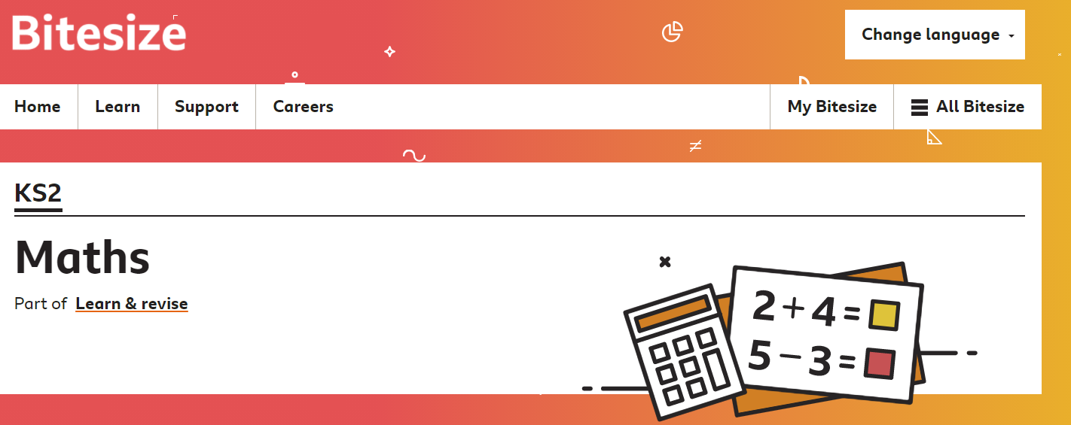
Maths Resources
TT Rockstars
BBC Bitesize Maths

Slide 11
Homework
Atom Learning: Maths and PAG homework will be set online on a Thursday for the following Thursday.
Spellings – look, say, cover, write and three sentences for Thursday test and SPaG lesson
Our expectation is that everyone will complete their home learning each week as per the school’s policy.
If there is something we haven’t covered yet, please don’t worry. Your child could look it up independently and/or ask the teacher for help. Feel free to communicate through reading diaries or speak to a staff member at drop off/pick up.
Atom learning videos and hints help a lot!

Slide 12
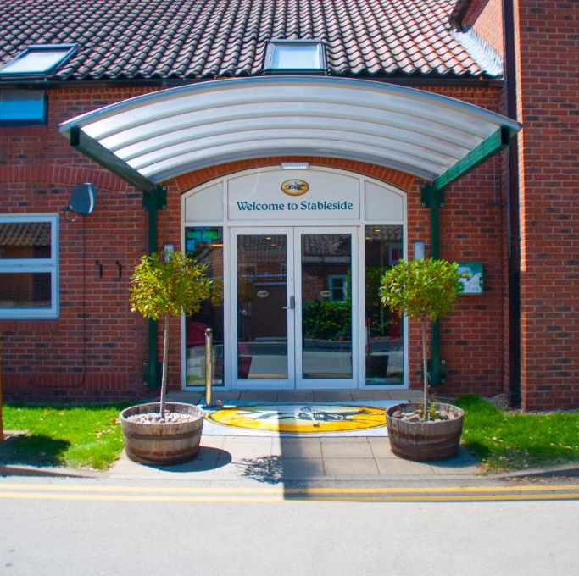
Residential
York Residential – York Racecourse
25th – 27th March 2026
More details to follow

Slide 13
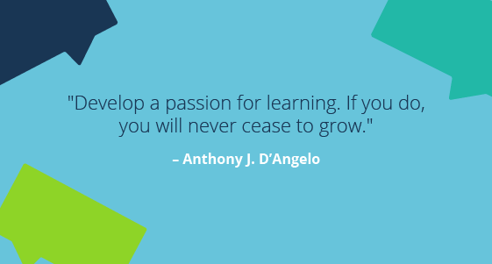
Year 5 mindset
Learning is fun and enjoyable, but the children are expected to work hard in upper Key Stage 2
Encourage independence and resilience
Promote a love of learning

Slide 14

Any Questions?

