Slide 1
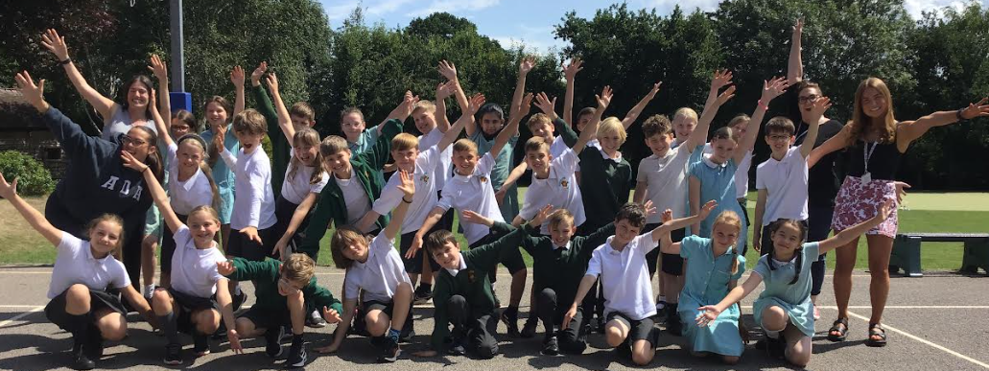
Year 6 – Chestnut
‘Our Wonderful World’
Curiosity
Broadmindedness
Creativity
Responsibility
Enjoying Life
Sense of Belonging
Miss Evans
Hopefully I will have given all of the information but I will answer any questions at the end if not!

Slide 2
Key dates
Autumn | Spring | Summer
Trip to Stockport Air raid shelters Thursday 16th October Parents’ Evening Wednesday 5th Nov Thursday 6th Nov | SATs Meeting - Feb Spring Break – SATS Revision Packs will go out | SATs Week Monday 11th May – Thursday 14th May 2026 Residential June – date tbc

Slide 3
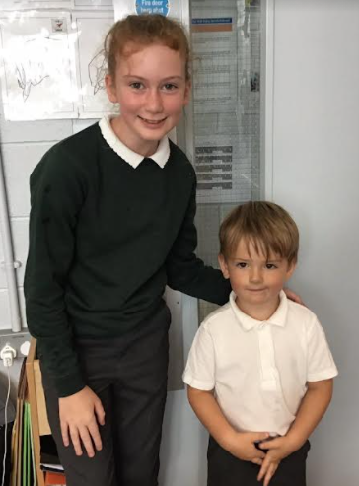
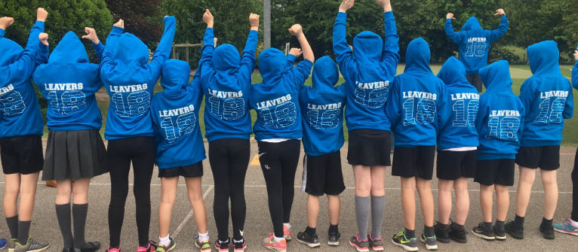
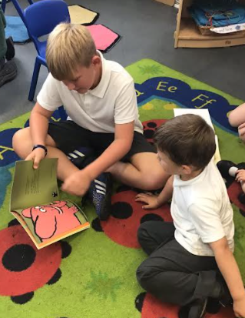
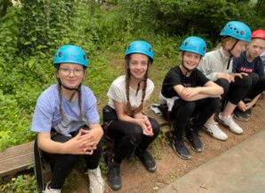
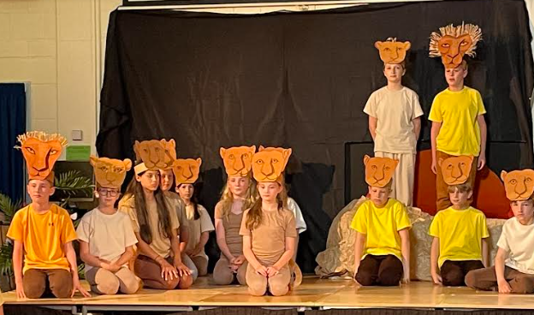
Highlights of Year 6

Slide 4
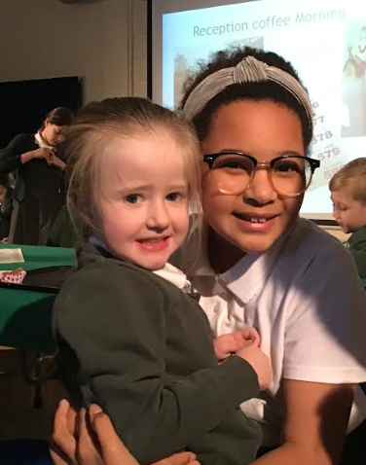
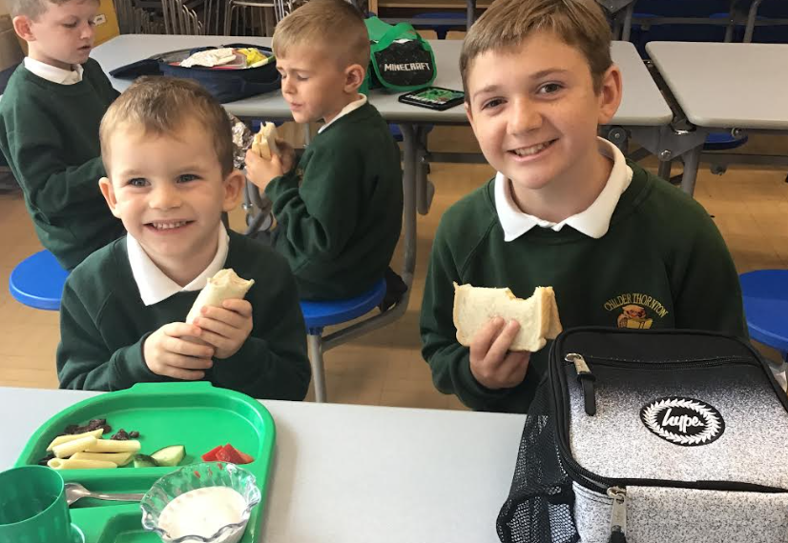
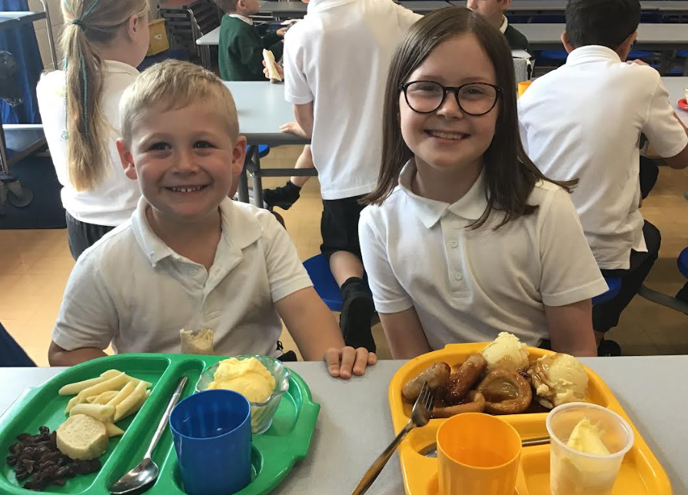
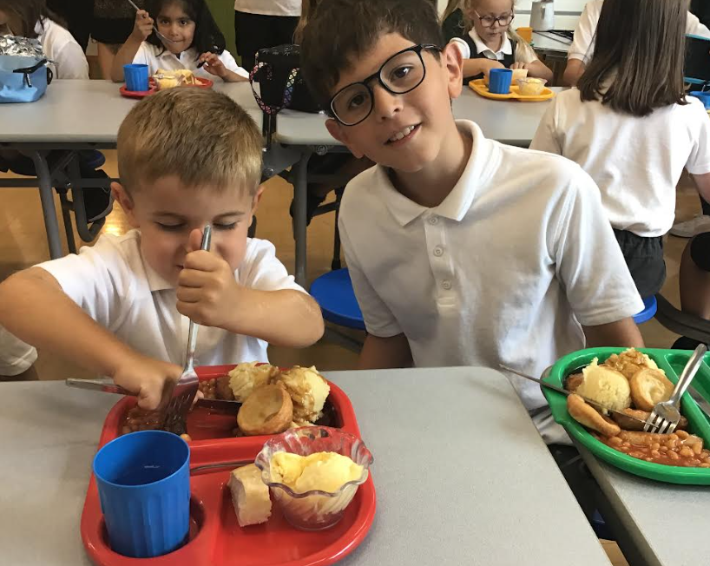
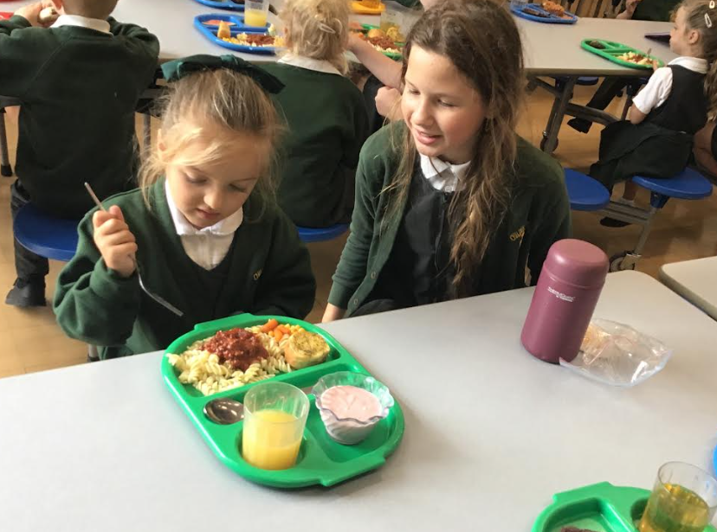
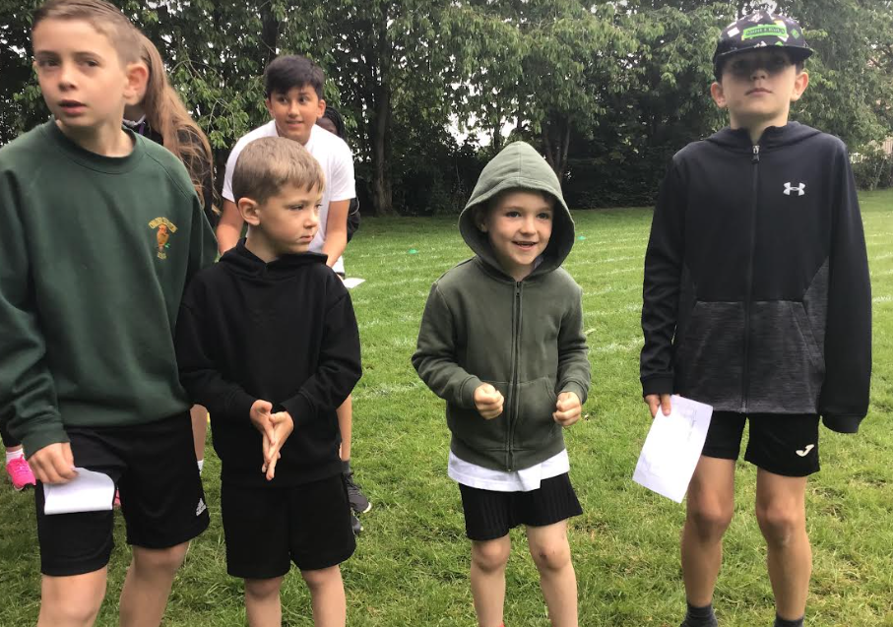
Buddies

Slide 5
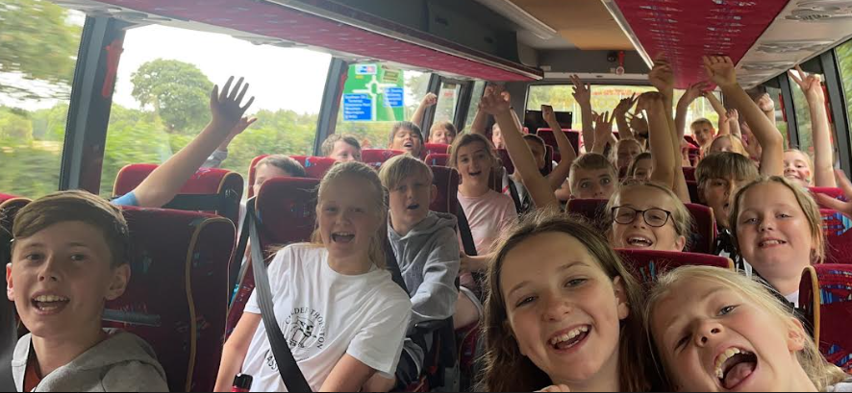
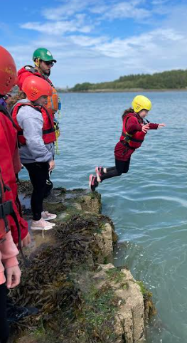
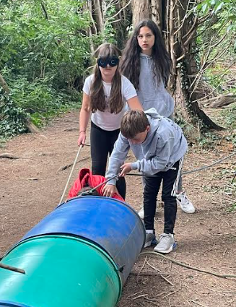
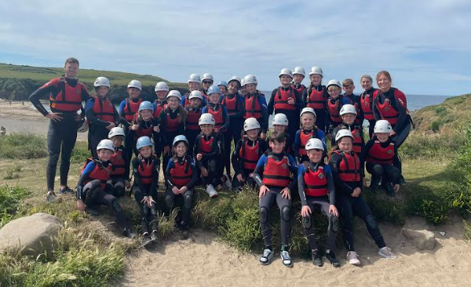
Conway

Slide 6
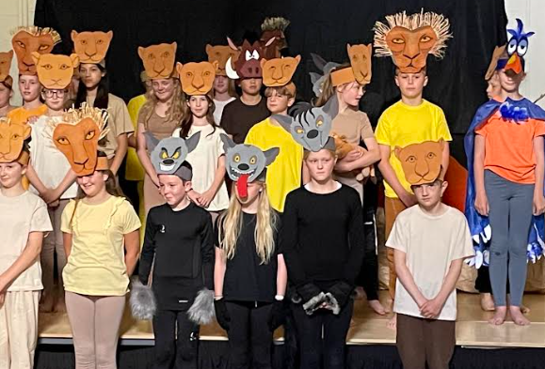
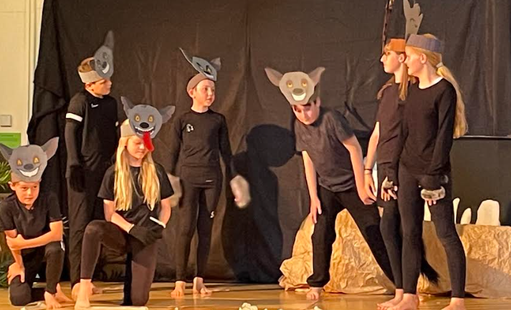
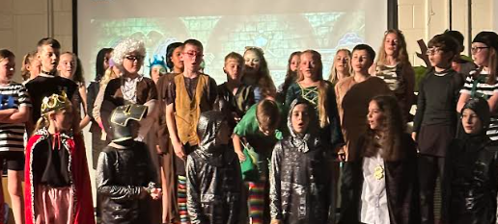
End of Year Production

Slide 7
Timetable
 | Monday | Tuesday | Wednesday | Thursday | Friday
AM |  |  |  |  | Reading diaries
PM |  | PE | New spellings – every week. Practise the words little and often!
 | SPAG.com - HW | Music | Spanish – every other week
PE - kits to be brought in at the beginning of the week and taken home at the end.
Forest Schools – old clothes and spare change as we approach the winter months.
Music – brought to and from school on a Tuesday

Slide 8
Uniform
Jewellery – studded earrings
Make up
Sorry !!!

Slide 9
SATS – only a fraction of Y6!
Maths
Arithmetic Paper – 30 minutes
2x Reasoning Paper – 40 minutes
Reading
Reading Paper - 1 hour
SPAG
Spelling Paper
Grammar Paper – 45 minutes
More information at the SATs meeting – February.
Relaxed
Prepared
Ready!

Slide 10
Curriculum

Slide 11
History and Geography
Autumn | Spring | Summer
World at War WW2 Why it started Significant events / people Propaganda | Time for change? Climate change project linked to protecting our planet – the world the children will be living in. More information – beginning of Spring Term | INVADERS Anglo-Saxons and Vikings Who were they? Impacts on the way we live today. More information – beginning of Summer Term
Knowledge Organisers
Using the vocabulary confidently
Recognising key dates and plotting on a timeline
Recalling facts on important historical moments

Slide 12
Maths
Autumn | Spring | Summer
Place Value Four Operations Fractions Geometry – Position and Direction | Decimals Percentages Algebra Imperial and Metric Measures Perimeter, Area and Volume Ratio and Proportion | Shape Problem Solving Statistics SATs

Slide 13
English - writing
Autumn | Spring | Summer
History / Geography unit: World at War Second World War Aut 1 Star of Fear Star of Hope Aut 2 Windrush Generation | History / Geography unit: Time for change? Climate Change Sp 1 Kong Sp 2 Plastic Planet | History / Geography unit: INVADERS Anglo-Saxons and Vikings Sum 1 Jeremy Button Sum 2 Sky Chasers

Slide 14

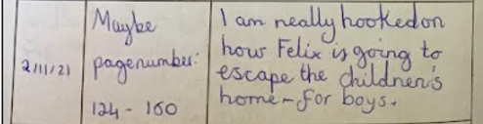
English - reading
Class page – website
It is important that your child is reading frequently to support their writing – building vocabulary, recognising spelling patterns.
Reading regularly will improve their reading speed – supporting them when it comes to the reading paper.
T will check recorded in their reading records – by an adult or child.

Slide 15
English - reading
Reading with your child and questions you might want to ask.
Retrieval – literally pulling it from the text
Who went to fetch the eggs from the shop?
Why did Tom move his tractor?
Prediction
What may happen next?
Who is going to do something?
Inference – inferring something using evidence in the text to prove this
Point evidence, point evidence
What impression did you get of Billy? (Point and why)
Why might Bob think Bill is …..?

Slide 16
English - SPAG
Spellings:
New sp in log books every Wednesday.
Spag.com:
Monday (login - back of diary)
Follow up from the sessions in school on particular spelling rules.

Slide 17
Science
Autumn | Spring | Summer
Animals including Humans Electricity | Living things and their habitats Light | Evolution SRE – you will receive info before this unit.

Slide 18
Homework – planners!!
1. Reading – ‘strive for 5’
2. TTRS
3. Spellings – Wednesday
4. SPAG.com – Monday
Occasionally, SATs follow up work or corrections to do at home.
Independent – it is their responsibility to complete this otherwise they will have to catch up during break times.
Thanks so much in advance for your support!!

Slide 19

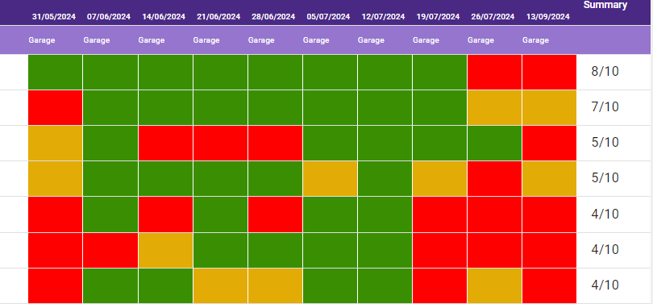
15 minutes per week minimum for homework.
Gig once a month in school will determine which times tables will be set.
5 minutes - Garage
10 minutes Studio
We will track how often it is completed.

Slide 20
Information
Website – Chestnut class page
Twitter
Letters / emails / text

Slide 21
Thank you in advance for your support!
We are really looking forward to working with your children this year!
If you have any questions, please don’t hesitate to ask!

